Slide 1
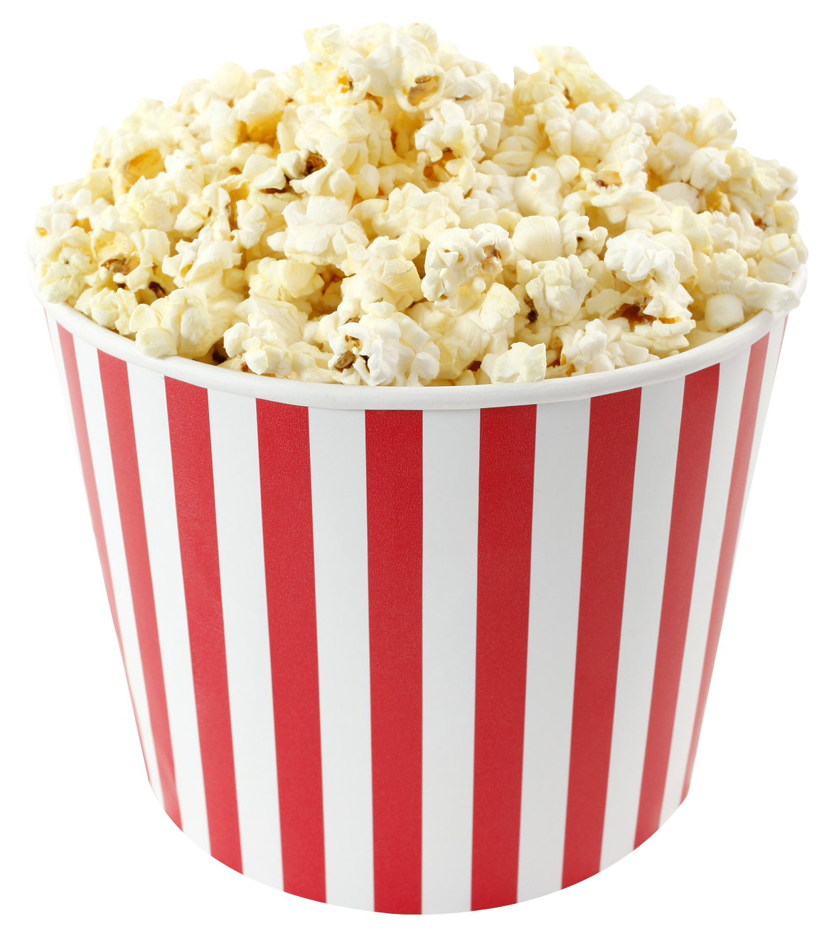
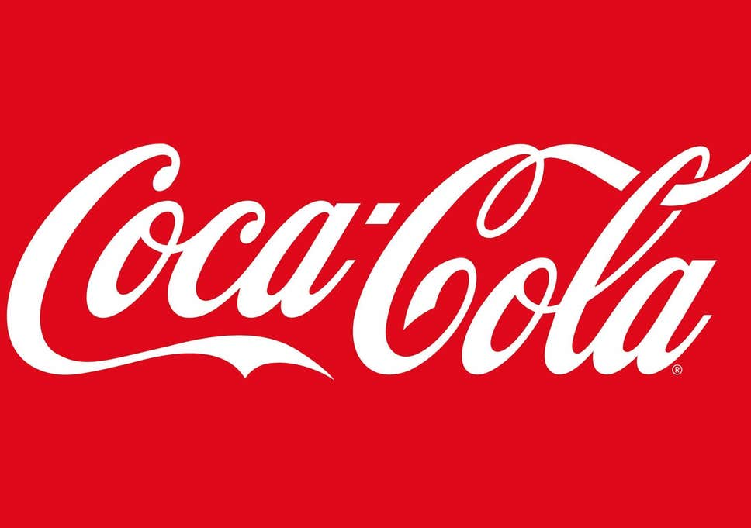
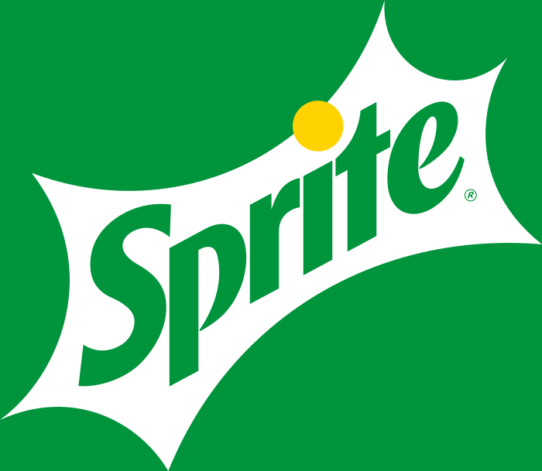
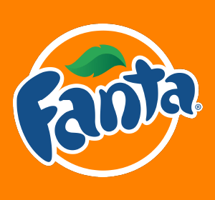
The Salty Sweet Caramel Popcorn
Giant
$ 6.5
Large
$ 4.5
Standard
$ 2.5
Drinks
0.5 l
0.4 l
0.3 l
$ 3.0
$ 2.5
$ 2.0

