Slide 1
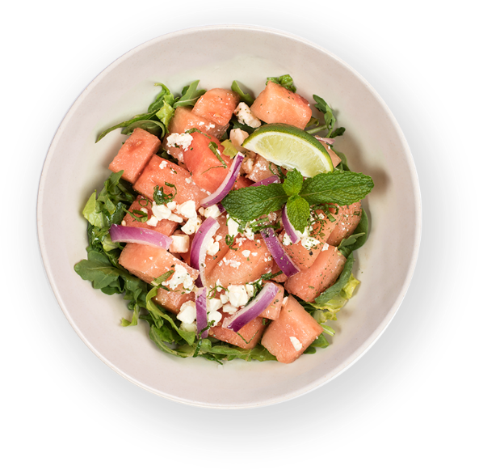
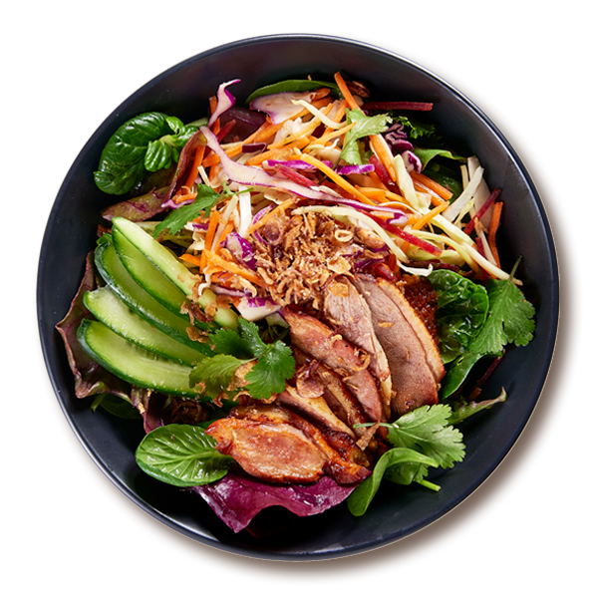
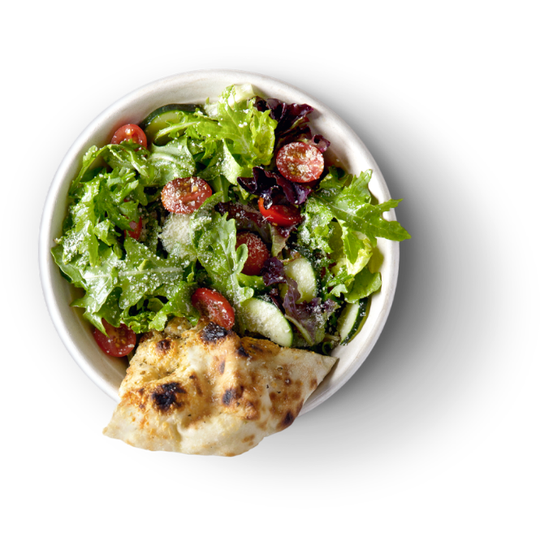
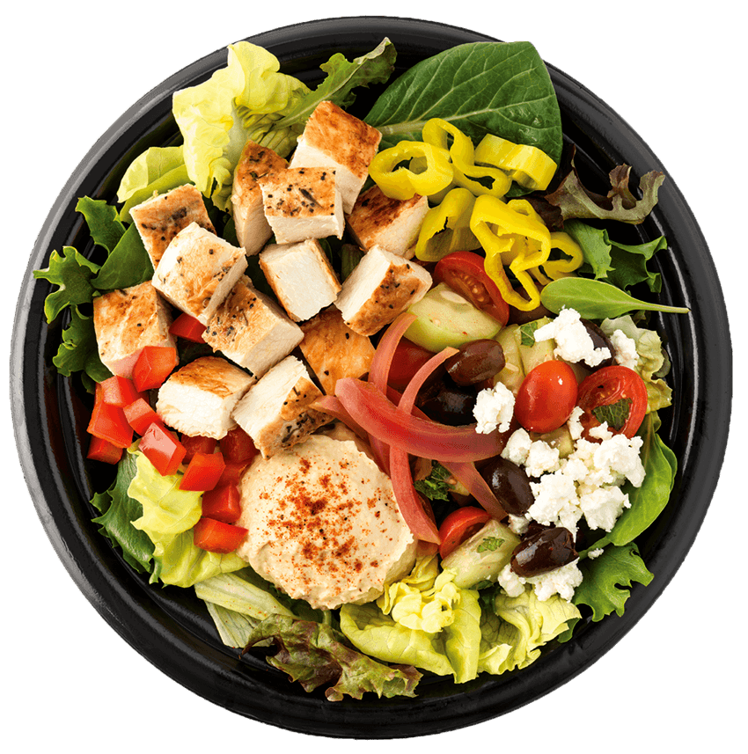
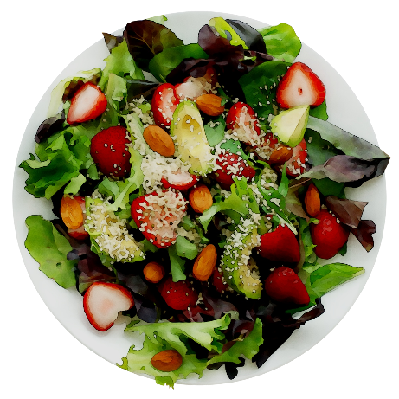
RESTAURANT
www.restaurant.com

Slide 2
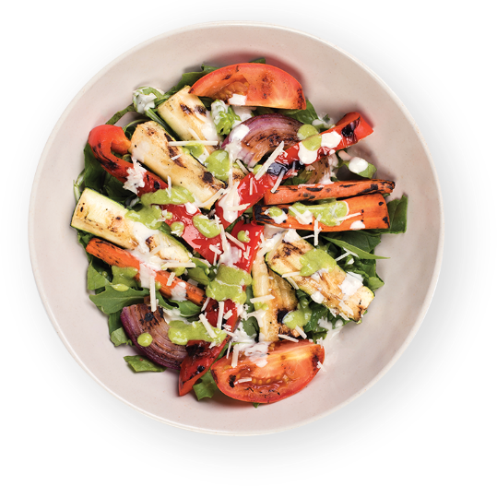
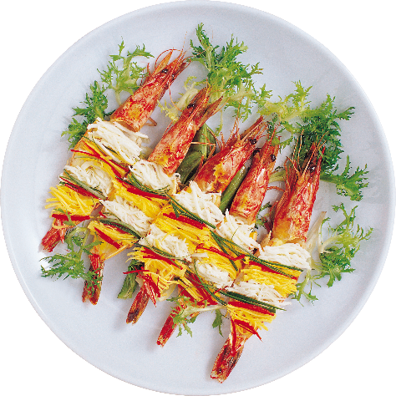
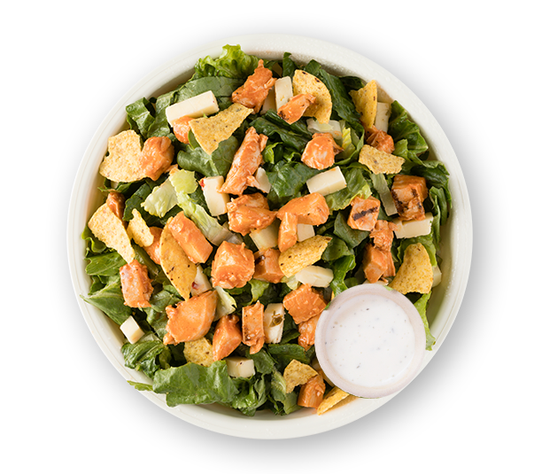
RESTAURANT
www.restaurant.com
Barbeque
Meal
$6.00

Slide 3
RESTAURANT
www.restaurant.com
Dose Juice
Flower
$3.00

Slide 4
RESTAURANT
www.restaurant.com
Chicken
Chop
Salad
$5.00

Slide 5
RESTAURANT
www.restaurant.com
Fish with
curry
$7.25

Slide 6
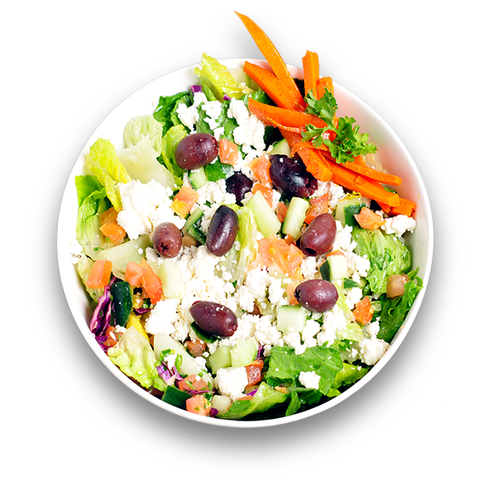
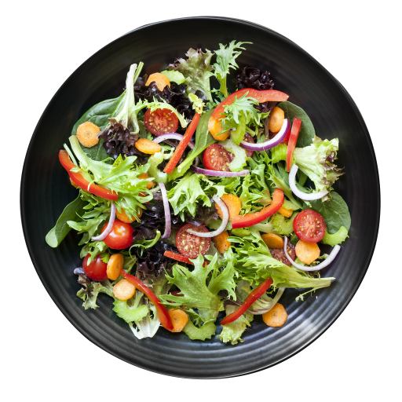
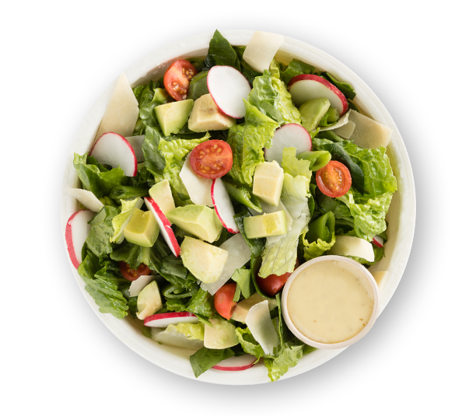
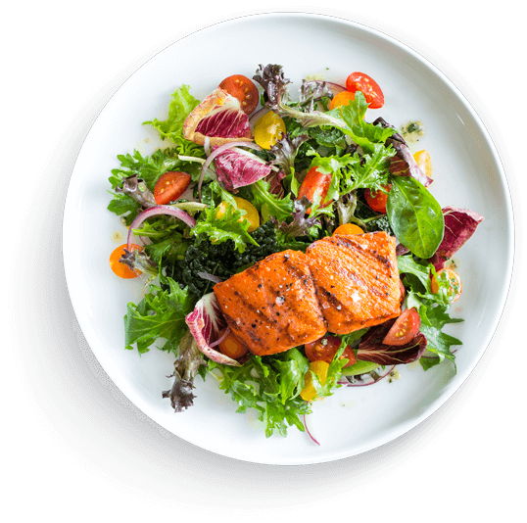
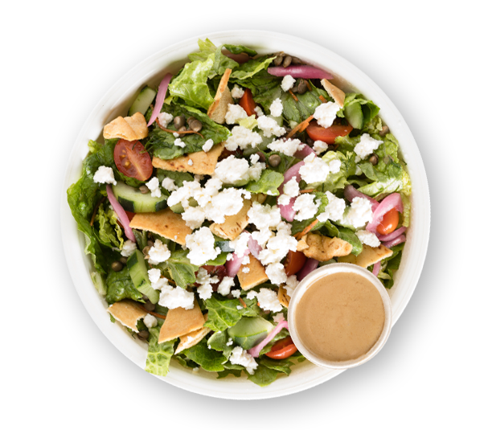
c
RESTAURANT
www.restaurant.com

Slide 7
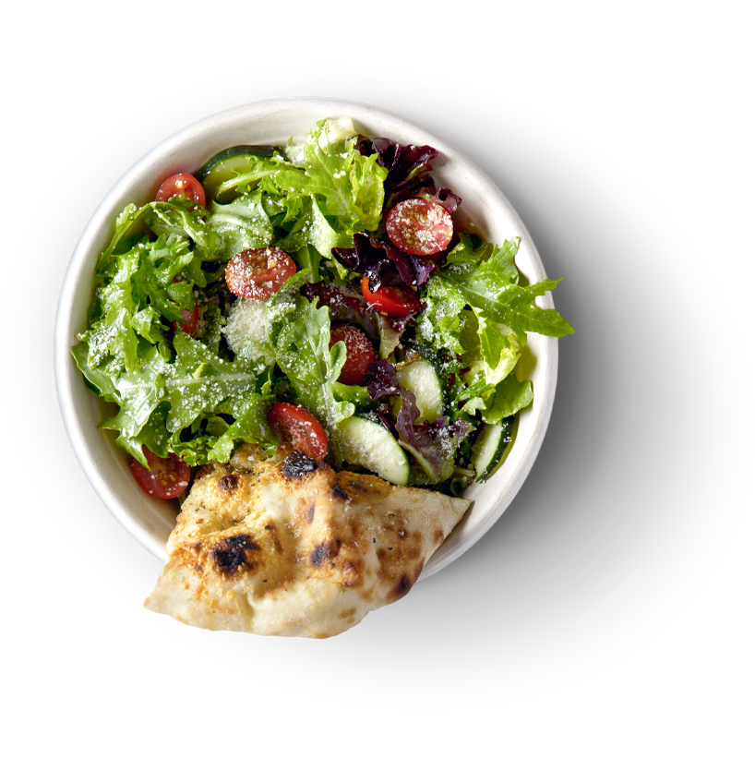
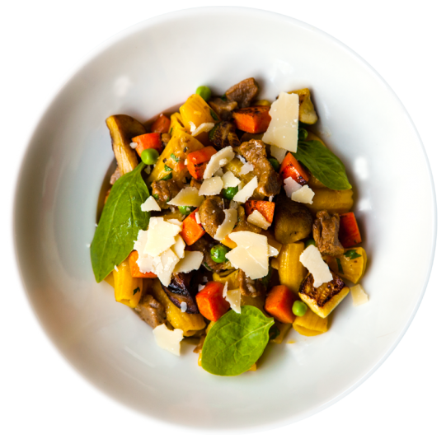
Mixed
Fruit
Salad
$7.00
RESTAURANT
www.restaurant.com

Slide 8
Creamy
Fruit
Salad
$6.50
RESTAURANT
www.restaurant.com

Slide 9
Veggie
Delight
$12.25
RESTAURANT
www.restaurant.com

Slide 10
Beef
Cucumber
Mix
$18.00
RESTAURANT
www.restaurant.com

Slide 11
RESTAURANT

