Slide 1
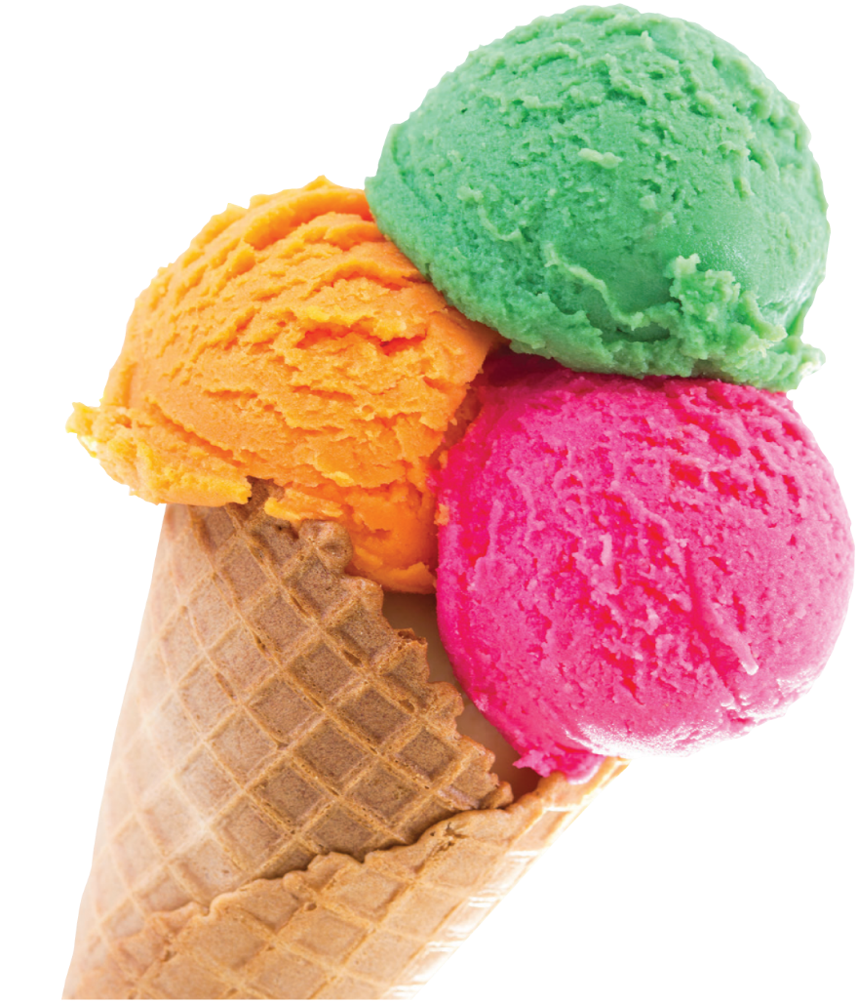
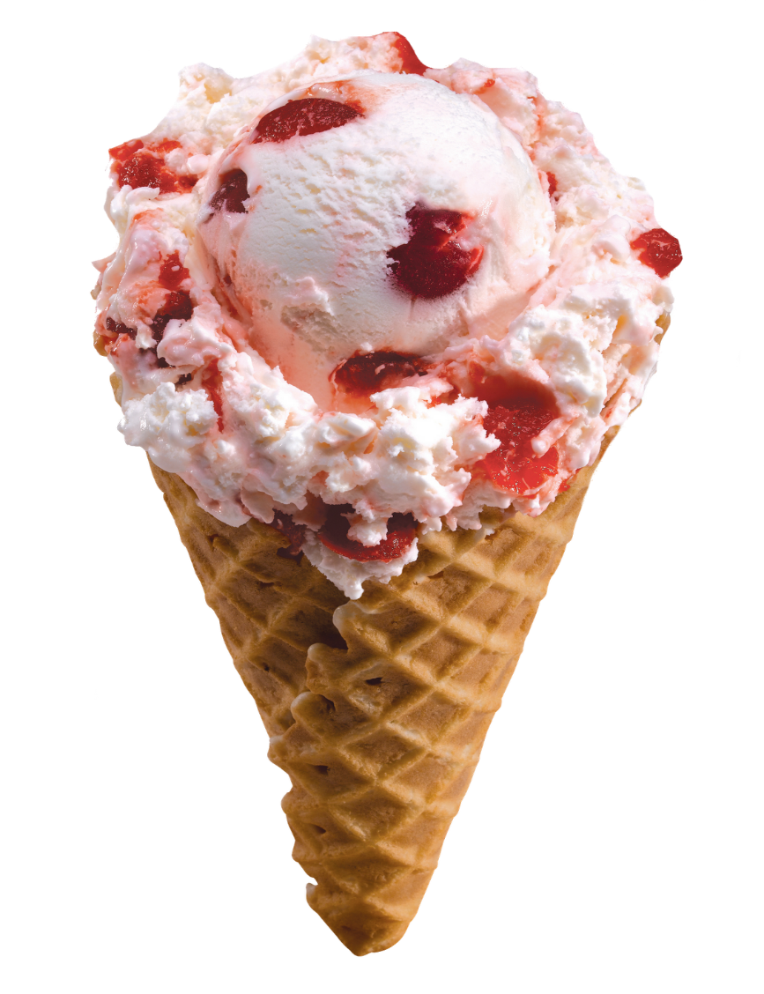
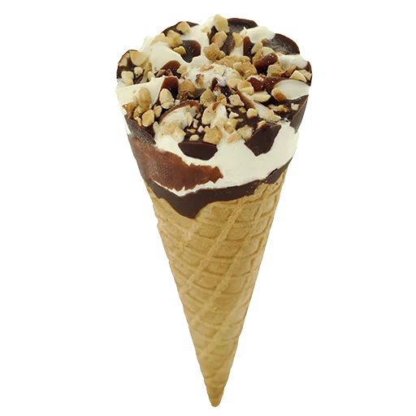
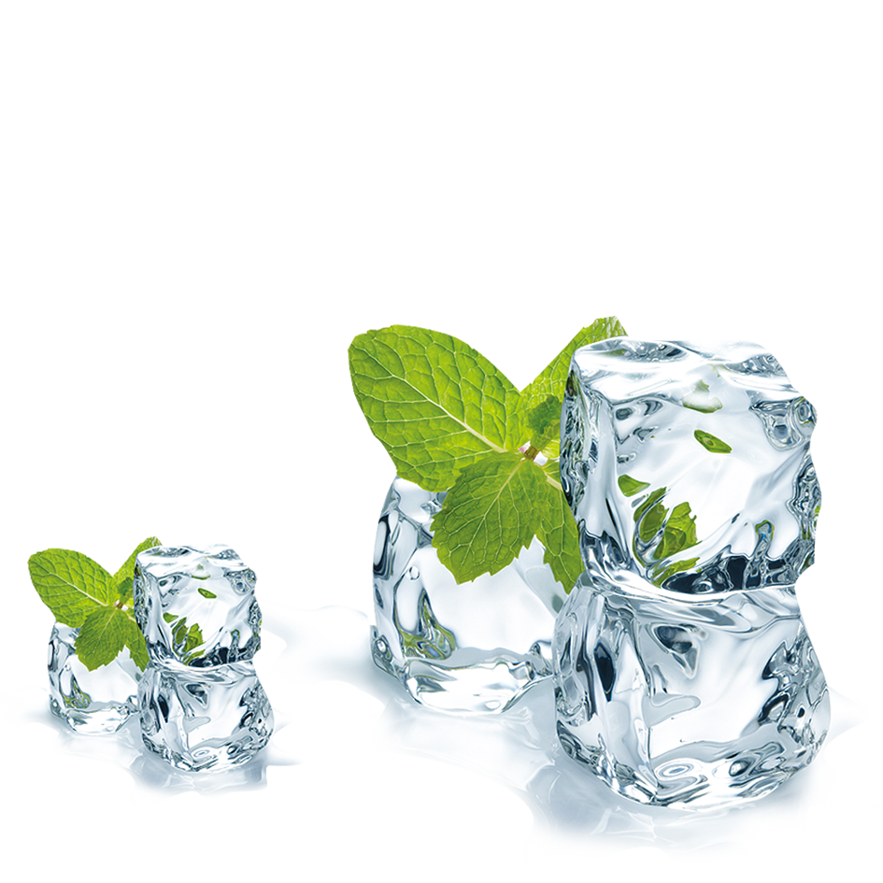
ICE CREAM
MENU
Have a sweet day!
Notes:
https://www.wynnummanlyleagues.com.au/wp-content/uploads/2016/06/Manly-Wynnum-Corporate-Business-Venue-Hire.jpg

Slide 2
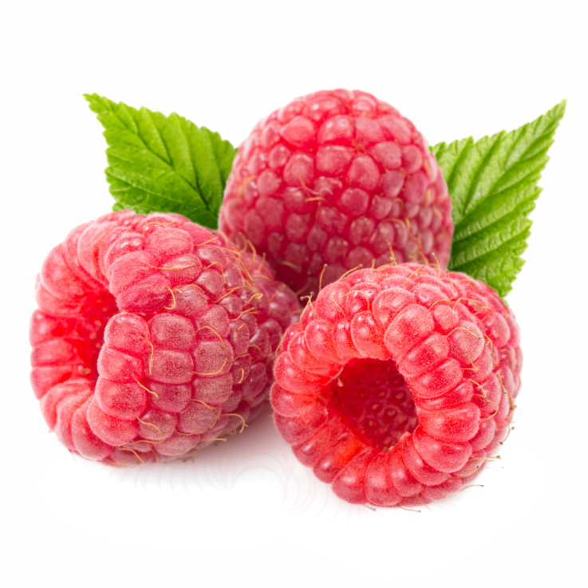
NEW
2$
Price
Vanilla Berry Ice Cream
Dip into the cloud of paradise pleasure. Try the refreshing taste of the new season. Juicy berries and vanilla will not show you indifference. Buy yourself and share with a friend!
Notes:
https://www.wynnummanlyleagues.com.au/wp-content/uploads/2016/06/Manly-Wynnum-Corporate-Business-Venue-Hire.jpg

Slide 3
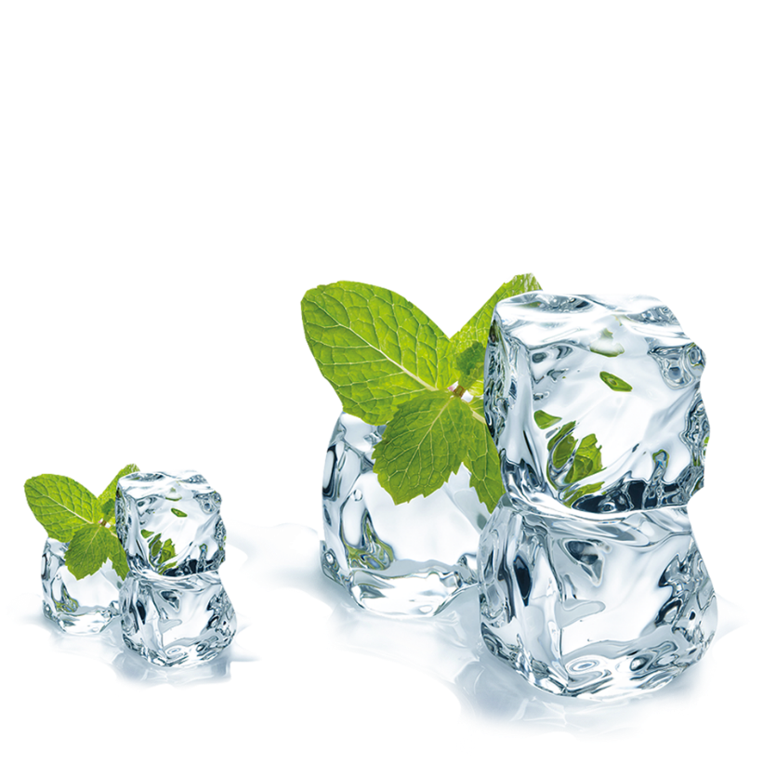
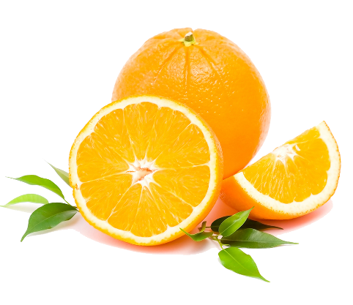
100%
NATURAL
3$
Price
Orange-Melon Ice Cream
The excellent taste of fresh orange in combination with ripe melon will give you an unforgettable taste and citrus coolness in this hot summer. Served with melon slices and orange peeling!

Slide 4
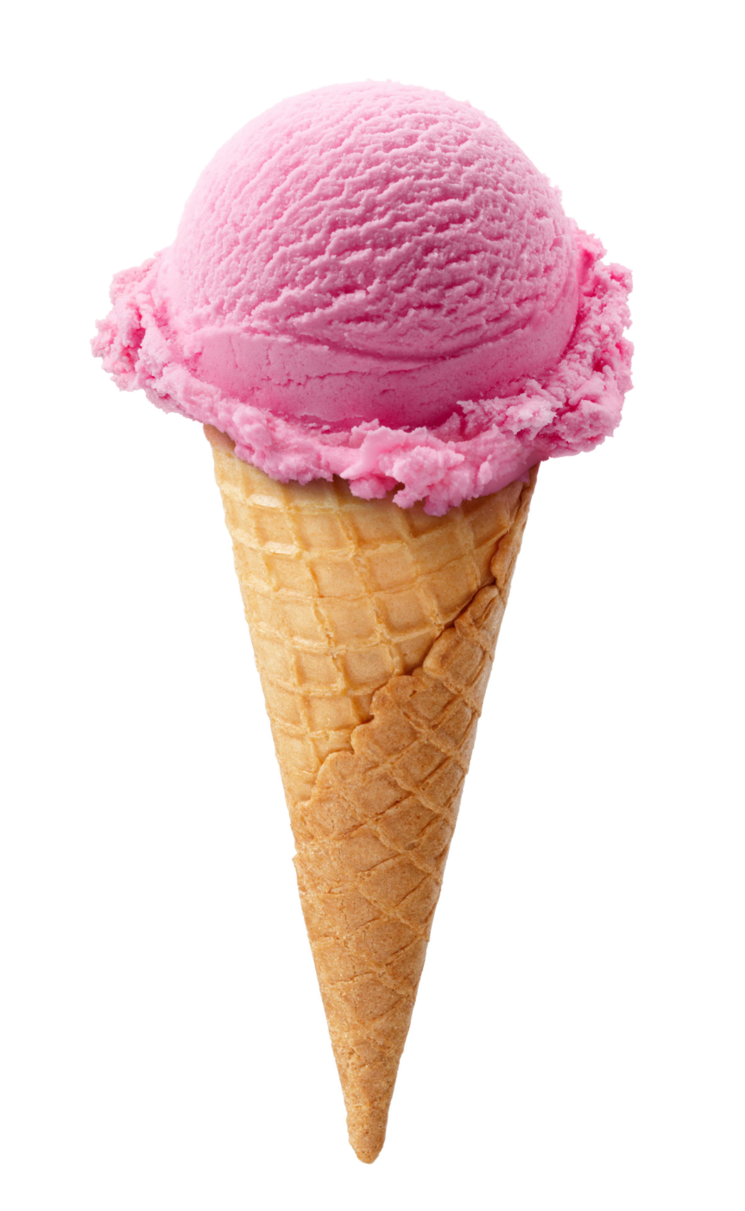
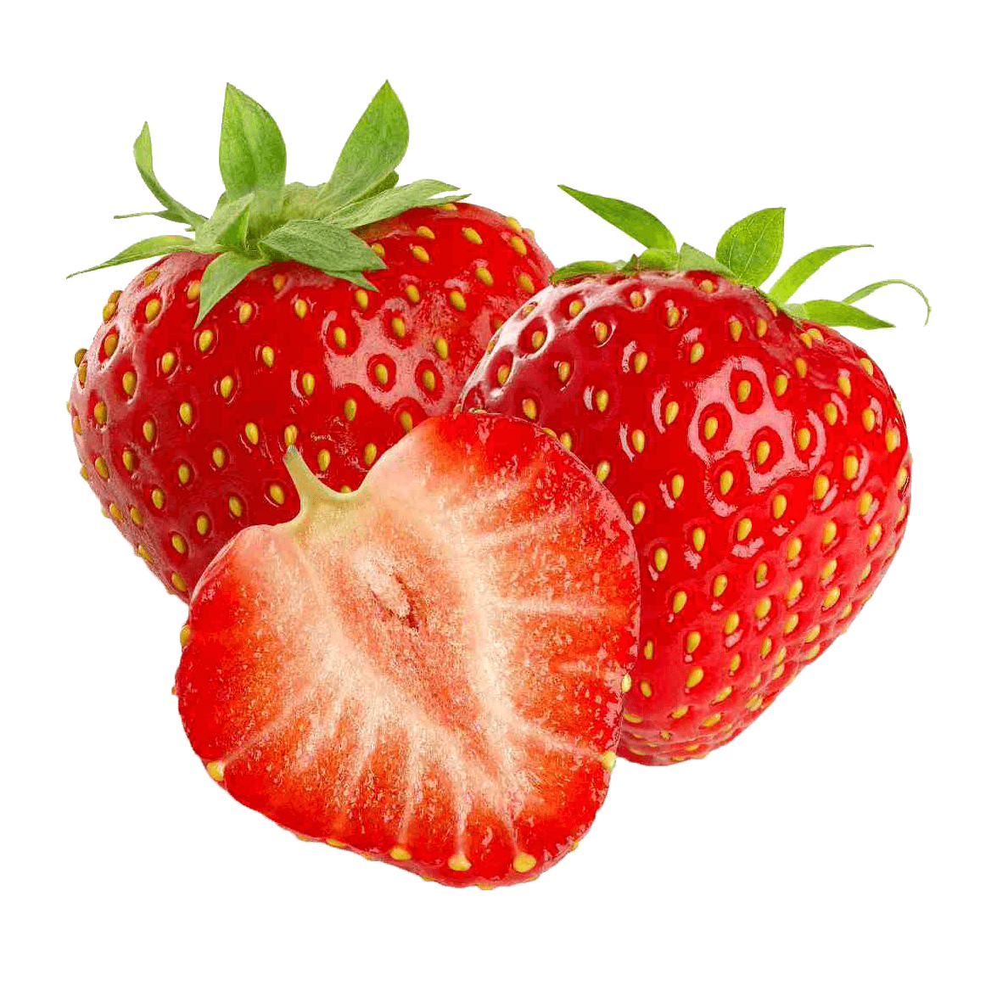
MEGA
HIT
2$
Price
Strawberry Ice Cream
Incredibly stunning taste of ripe strawberries carefully collected from the fields in New Zealand in a new ice cream. Served with mint leaves and ice cubes.

Slide 5
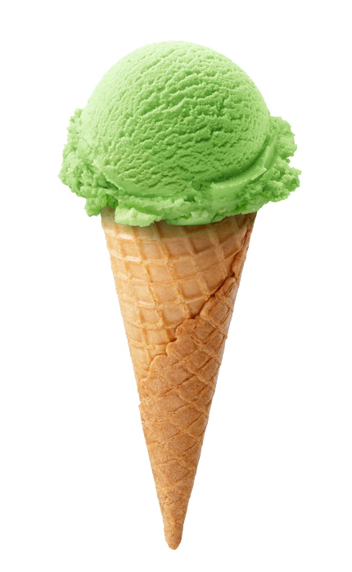
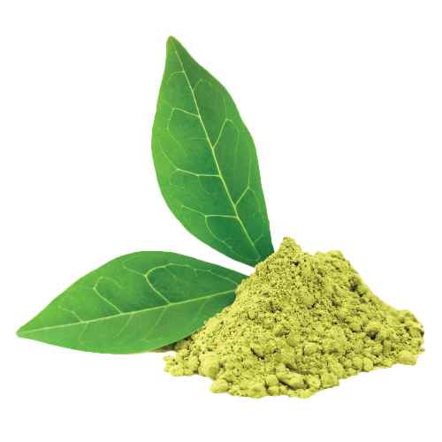
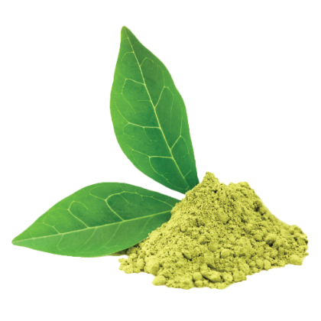
MEGA
HIT
4$
Price
Pistachio Ice Cream
Delicate ice cream with pistachios and hazelnut is an excellent choice for the natural products. Made from limited products. Do not keep the preservatives of taste enhancers.

Slide 6
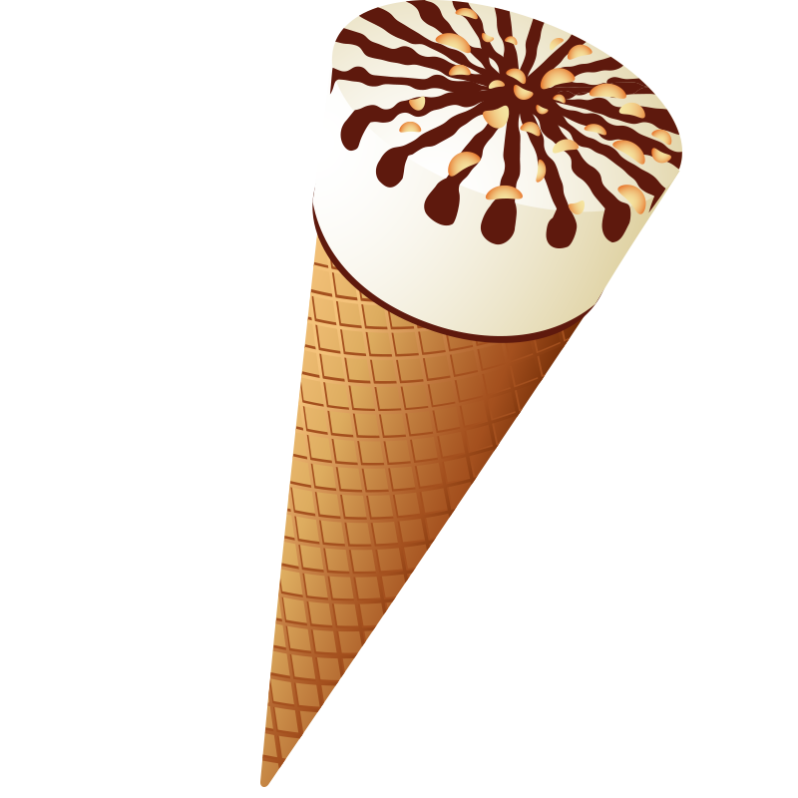
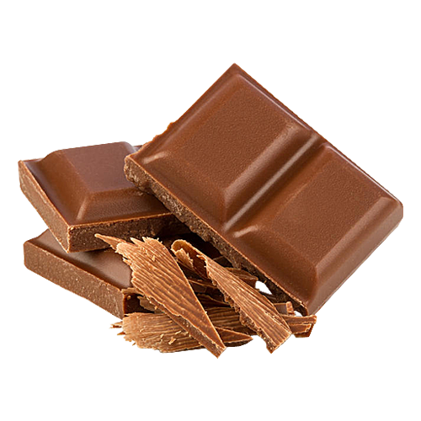
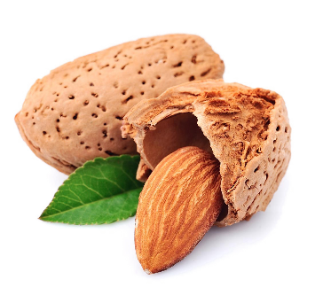
50%
SALE
3$
Price
Chocolate Ice Cream
Delicious chocolate ice cream with slices of almonds will not leave anyone indifferent. A terrific dessert for you and your family. It is made from 100% coco without flavor enhancers.

Slide 7
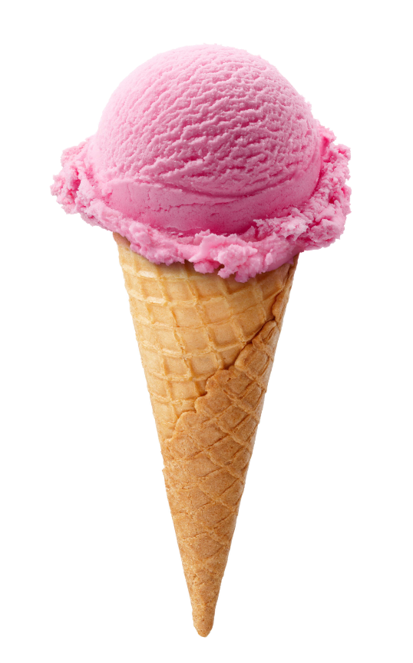
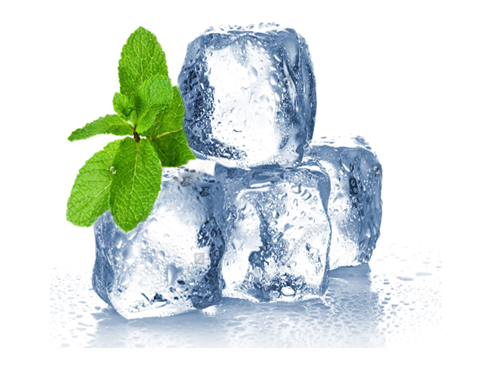
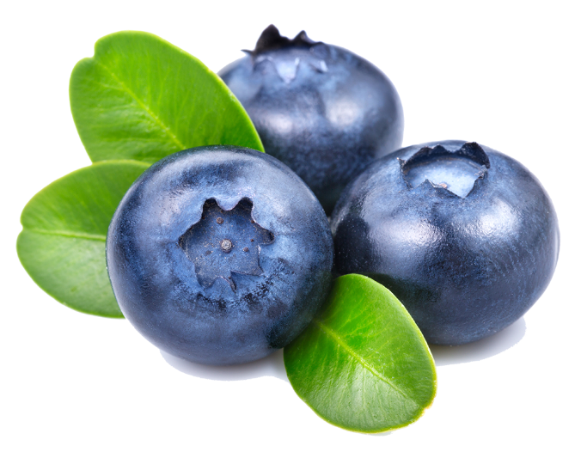
NEW
2$
Price
Blueberry Ice Cream
Ripe blueberries collected on the European plains are the richest berries in the content of vitamin C. This ice cream is not only delicious but also very useful. Share this excellent dessert with second half.

Slide 8
100%
NATURAL
3$
Price
Vanilla Ice Cream
Delicate vanilla ice cream is prepared from the limited products without the addition of dried milk and preservatives will perfectly refresh in hot weather and bring a delightful delight to gourmets and children.

Slide 9
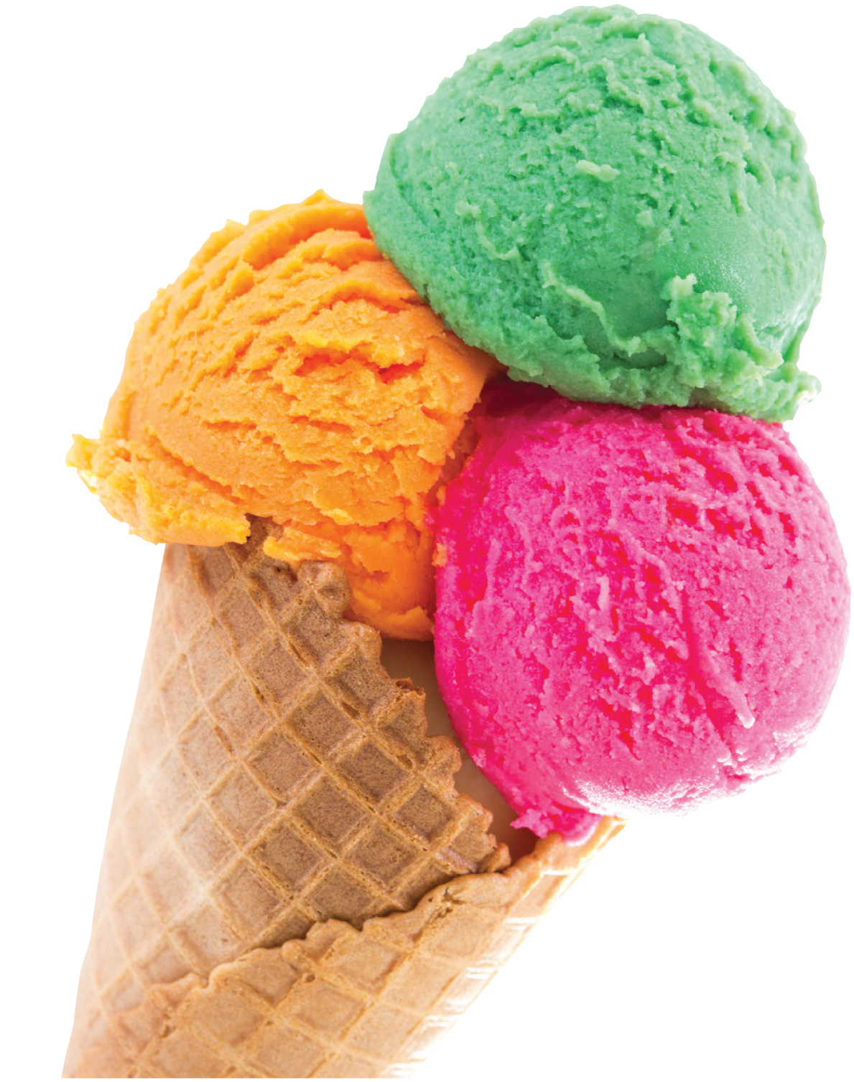
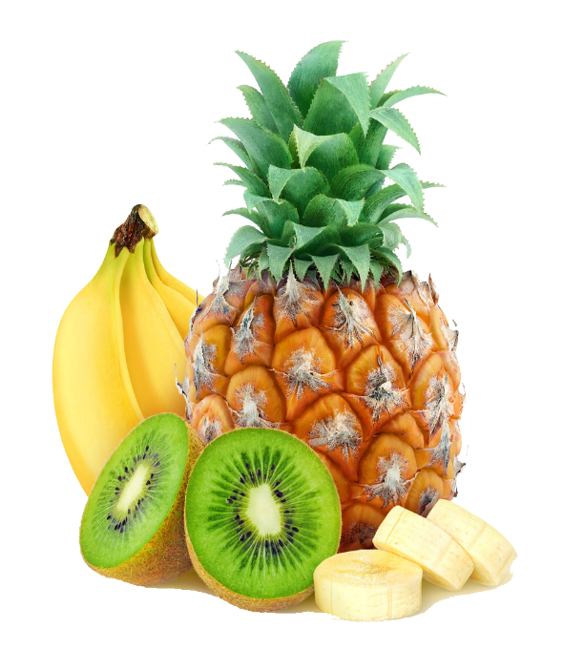
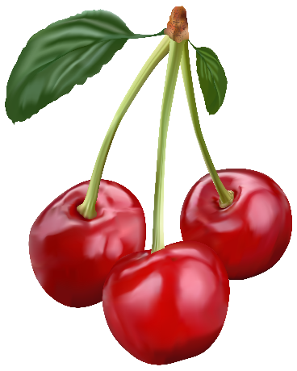
50%
SALE
4$
Price
Tropical Ice Cream
Ice cream is made from ripe fruit from the fields. It is a 100% natural product. Delicious taste of fruit will give you freshness and cheerfulness.

Slide 10
ICE CREAM
MENU
Have a sweet day!
Notes:
https://www.wynnummanlyleagues.com.au/wp-content/uploads/2016/06/Manly-Wynnum-Corporate-Business-Venue-Hire.jpg

