Slide 1
SIGNAGE
TUBE
PRESENTS

Slide 2
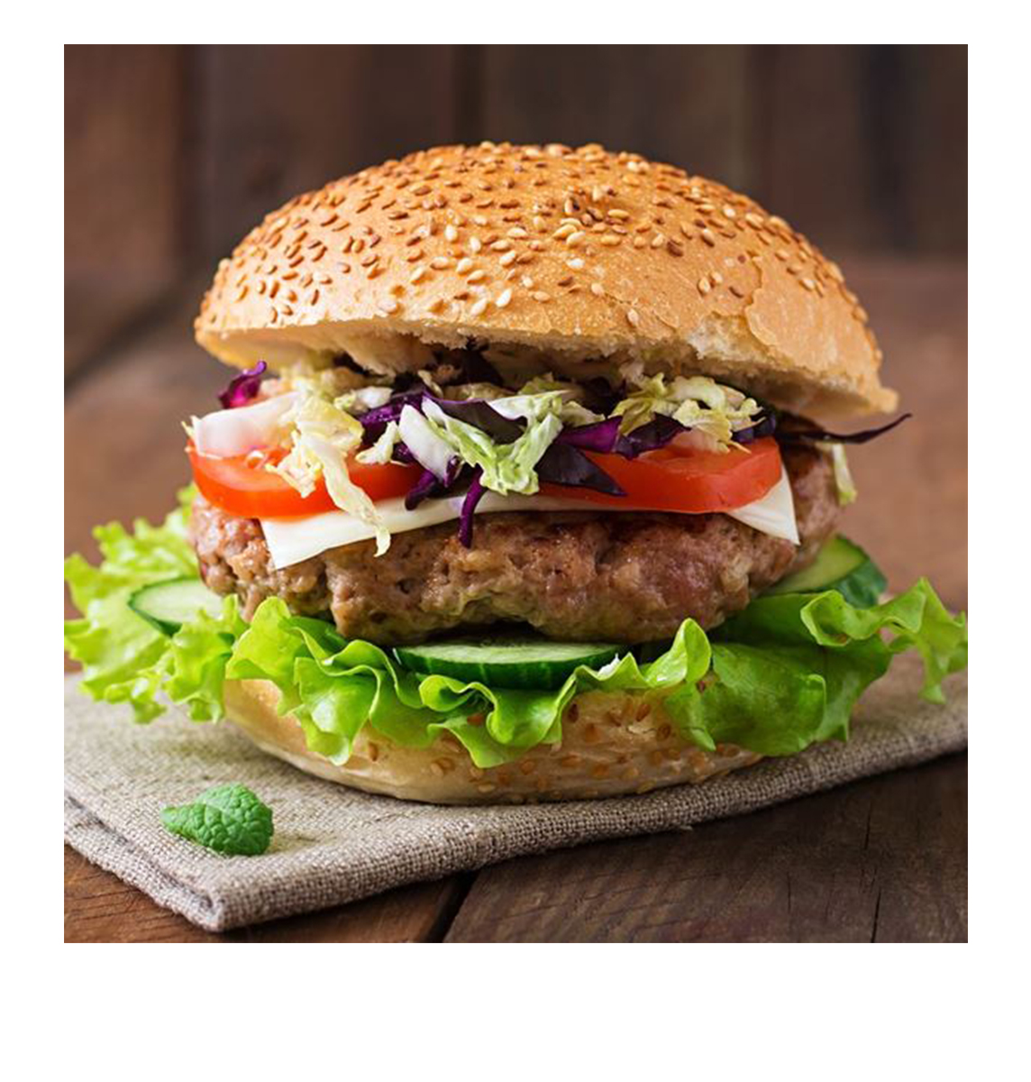
CHEESE
BURGER
Onion rings, HBC sauce, peppered pastrami, Swiss cheese, mayo, lettuce, tomato & red onion, served with a gherkin
ONLY
7
90
$
Notes:
https://encrypted-tbn3.gstatic.com/images?q=tbn:ANd9GcRchtniX0Rxgk4w7mfr0TPwRMUB4Se3fSor_BSotaLDVQwtHnY0cWVe

Slide 3
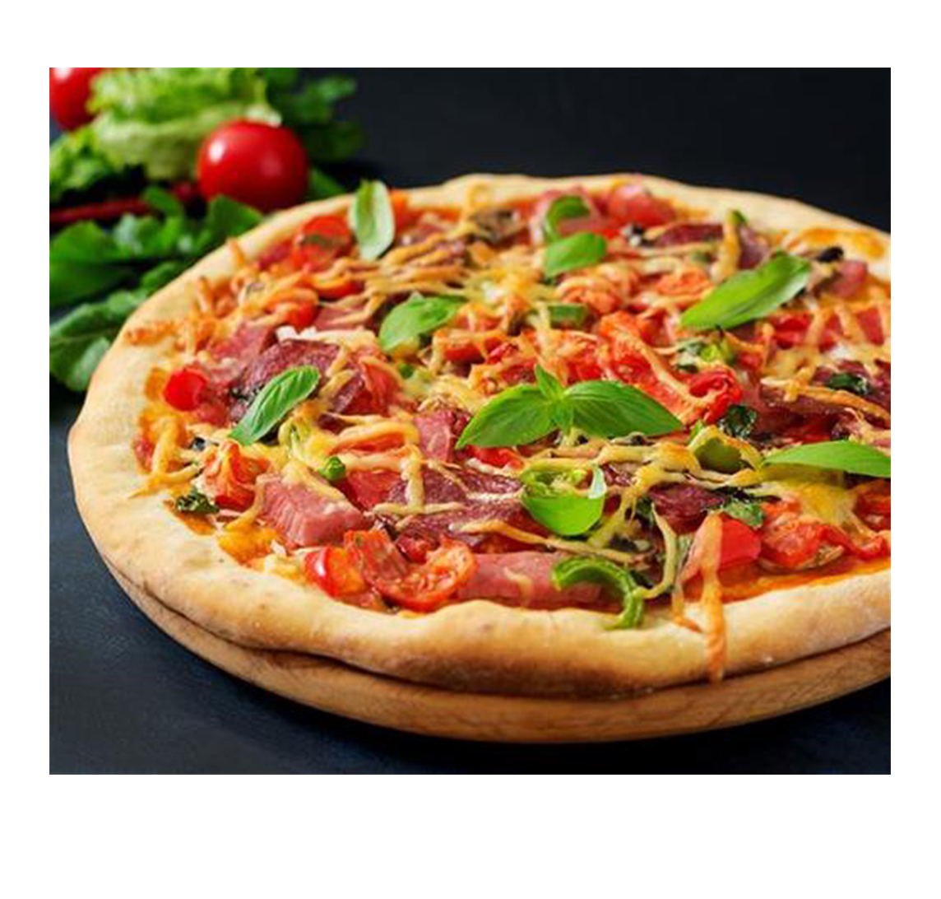
MUSHROOM
PIZZA
Mushrooms, Black Olives, Ground Beef, Freshly Sliced Tomatoes, Canadian Bacon, Pepperoni, Green Bell Peppers
ONLY
9
50
$
Notes:
https://encrypted-tbn2.gstatic.com/images?q=tbn:ANd9GcS7KGlJOgfJ3VylYWeSAneHcFLvBvSxNUbyfgZgxaPUrvk7NQpSEYjI

Slide 4
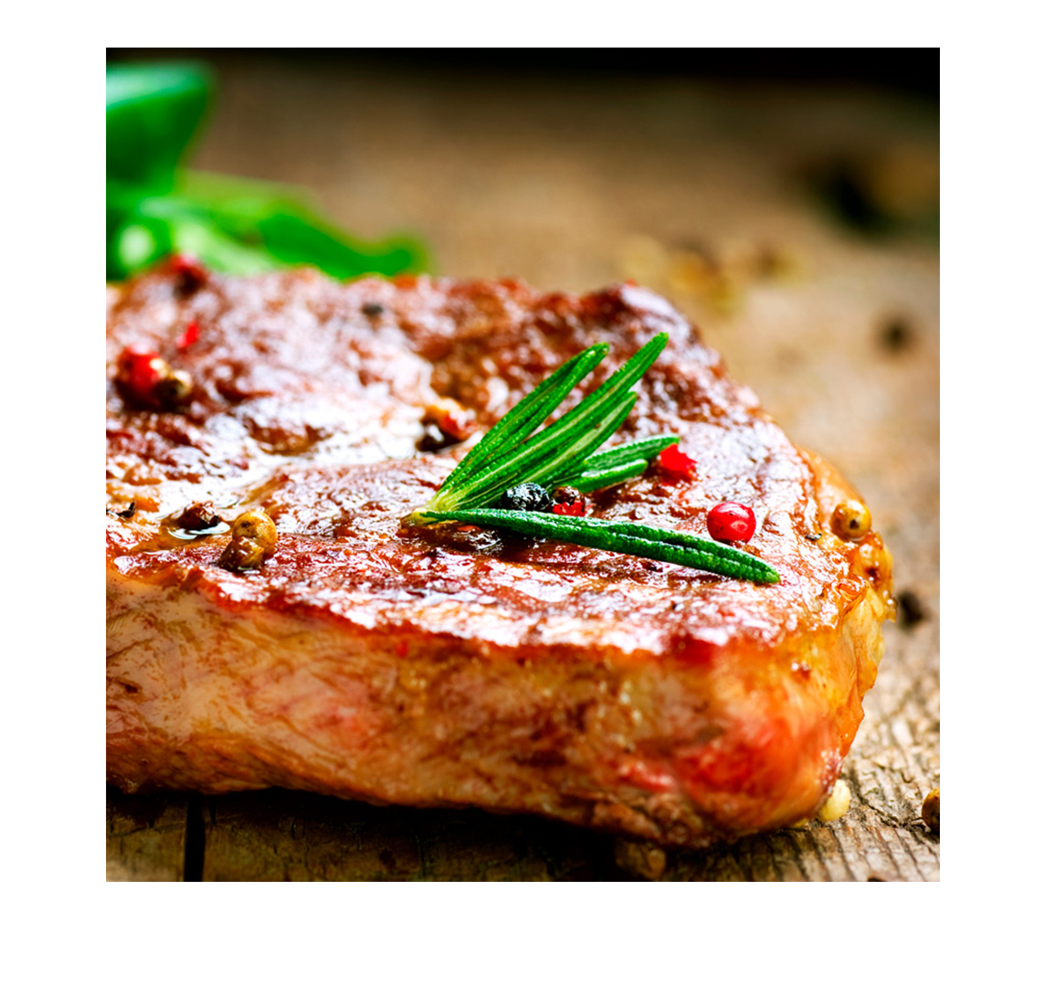
GRILLED
BEEF
Sliced thin GRILL beef brisket alongside of our homemade cornbread, coleslaw and beer battered fries
offer
23
00
$
Notes:
http://www.bervini.com/images/ilmegliodalmondo/usa/carne-usa-01.jpg

Slide 5
Complete Menu
UP TO 10 CATEGORIES

Slide 6
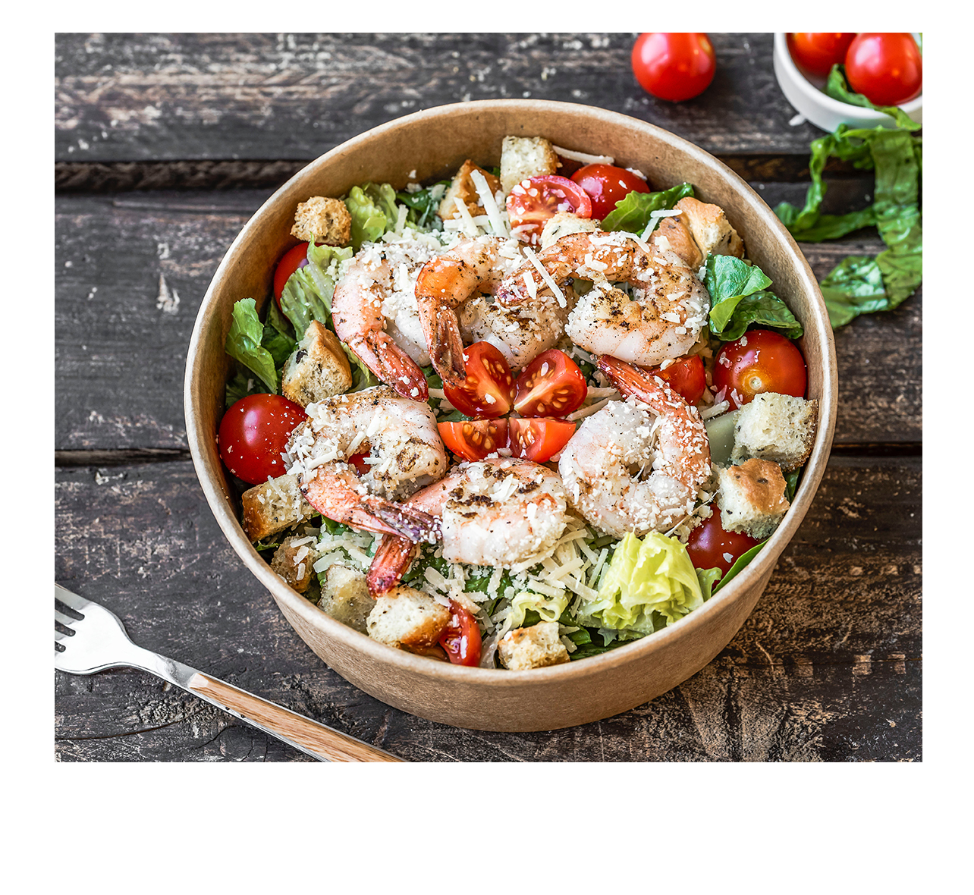
DELICIOUS
STARTERS
12
Salmon Salad
$
50
Mozzarella Sticks
5
$
00
9
Meat Balls
$
00
3
French Fries
$
50
Mini Hamburgers
8
$
00
Fish and Chips
7
$
90
Notes:
https://unsplash.com/photos/AiHJiRCwB3w
https://unsplash.com/photos/w_z0RJCSBiE
https://unsplash.com/photos/hfK401V_NXk

Slide 7
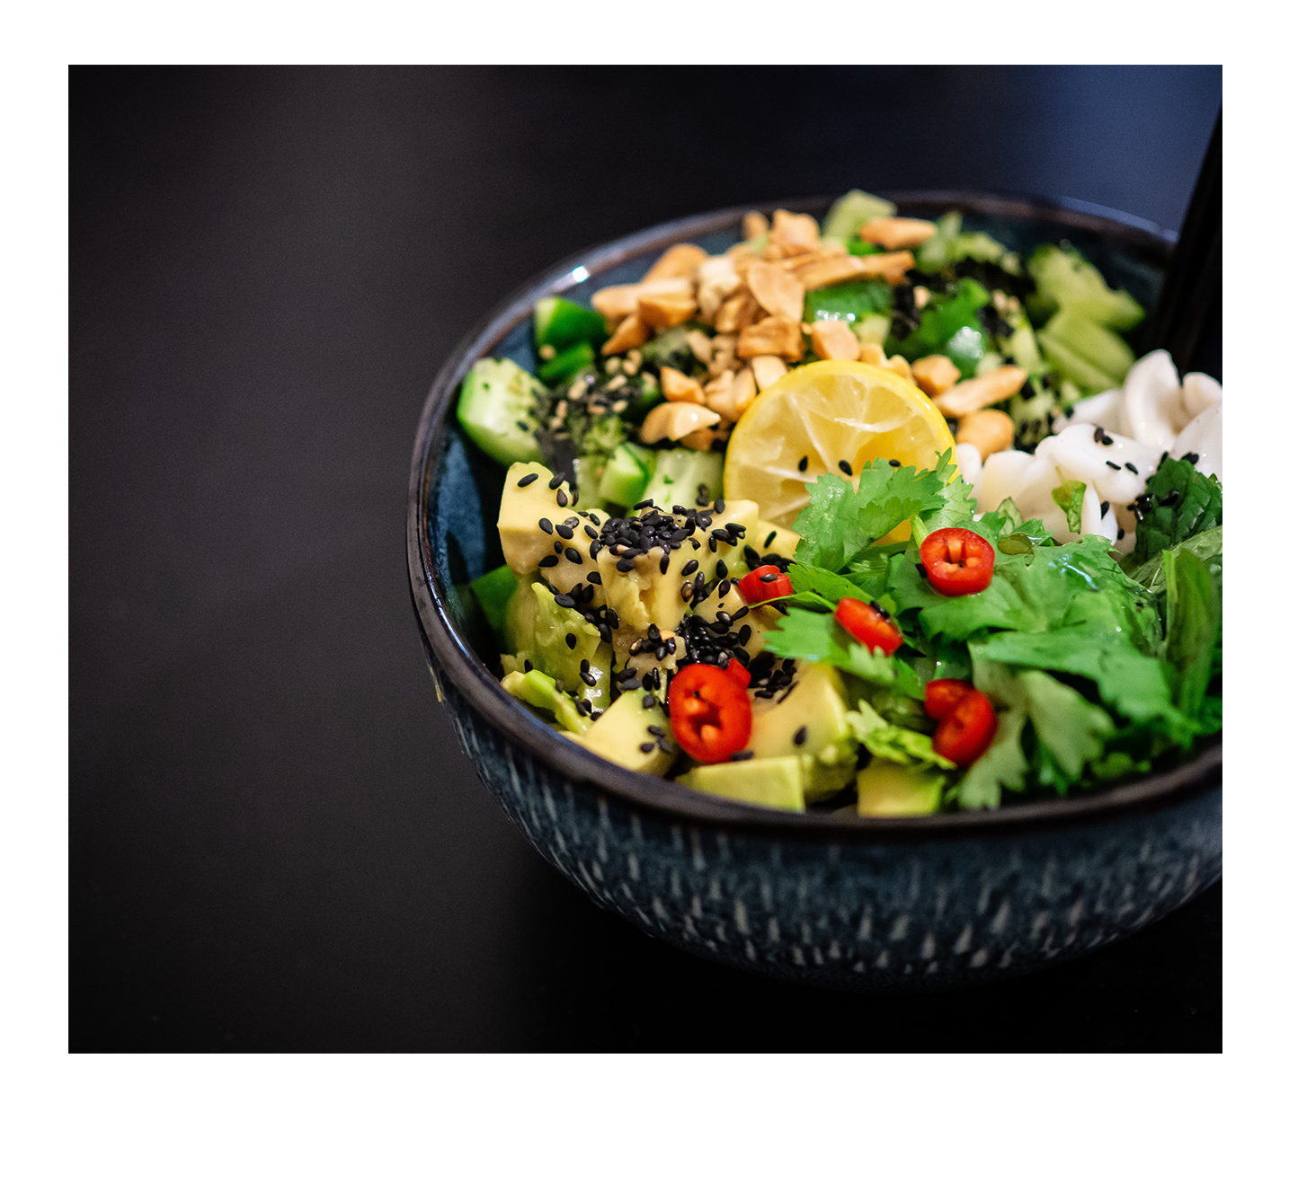
DELICIOUS
STARTERS
Another Meal
12
$
50
Delicious Food
5
$
00
Yummy!
9
$
00
3
French Fries
$
50
Mini Hamburgers
8
$
00
Fish and Chips
7
$
90

Slide 8
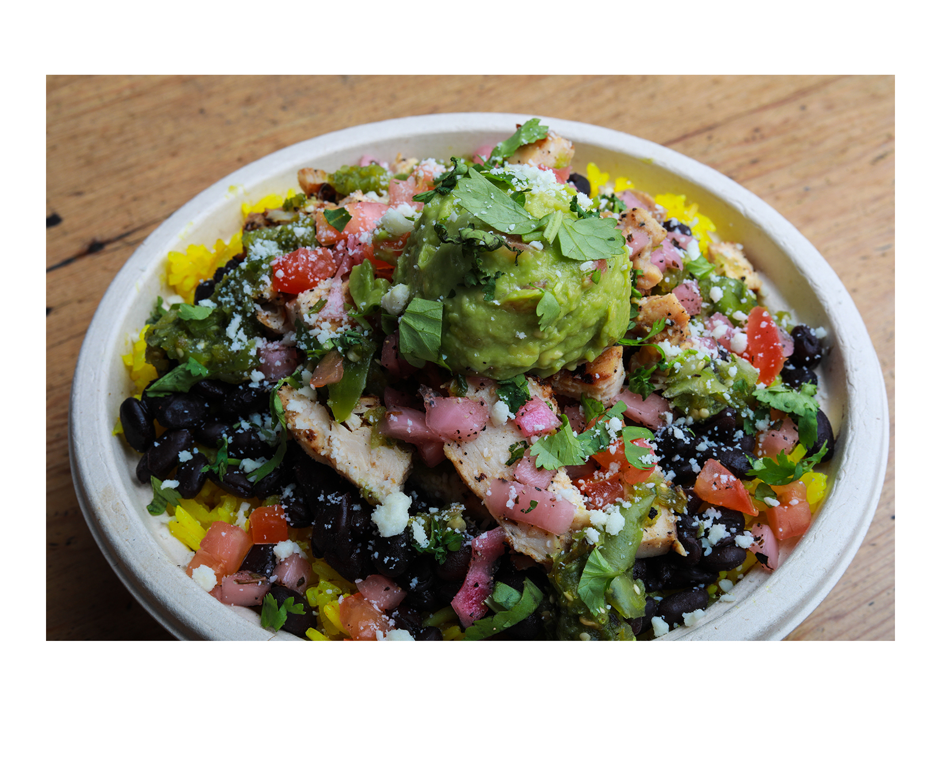
FRESH
SALADS!
Salmon Salad
12
$
50
Caesar Salad
5
$
00
Avocado Salad
9
$
00
Greek Salad
3
$
50
Grilled Chicken Salad
8
$
00
Smoked Shrimp Salad
7
$
90
Notes:
https://unsplash.com/photos/9sHHPiqrJso
https://unsplash.com/photos/12eHC6FxPyg
https://unsplash.com/photos/PY_dHgdrcno

Slide 9
THANK YOU
ENJOY YOUR MEAL

