Slide 1
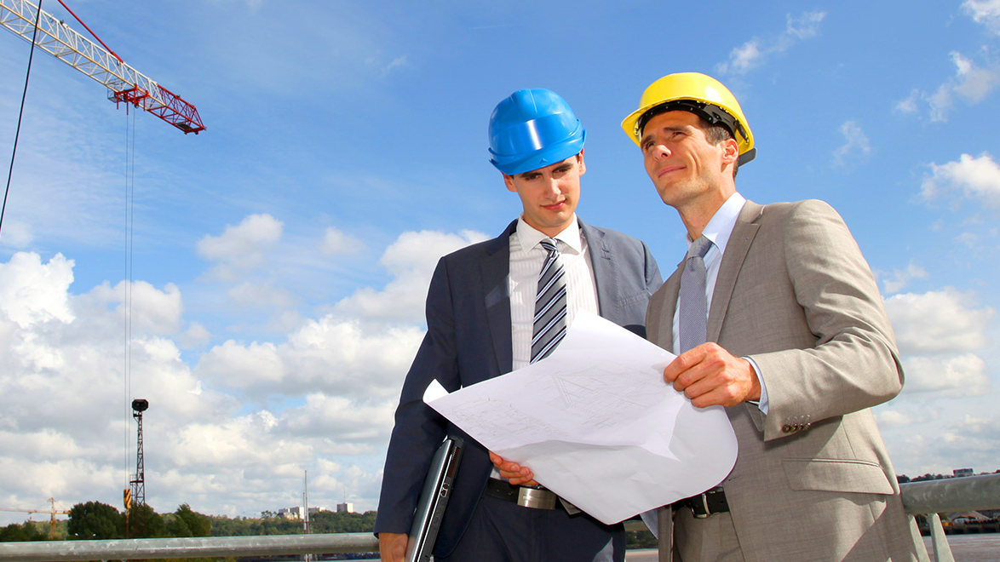
Construction
Company Promo
Your presentation as construction company
Start here
Notes:
https://www.pngkit.com/view/u2q8r5e6i1e6u2i1_safeteyline-lone-worker-warehouse-worker-png/

Slide 2
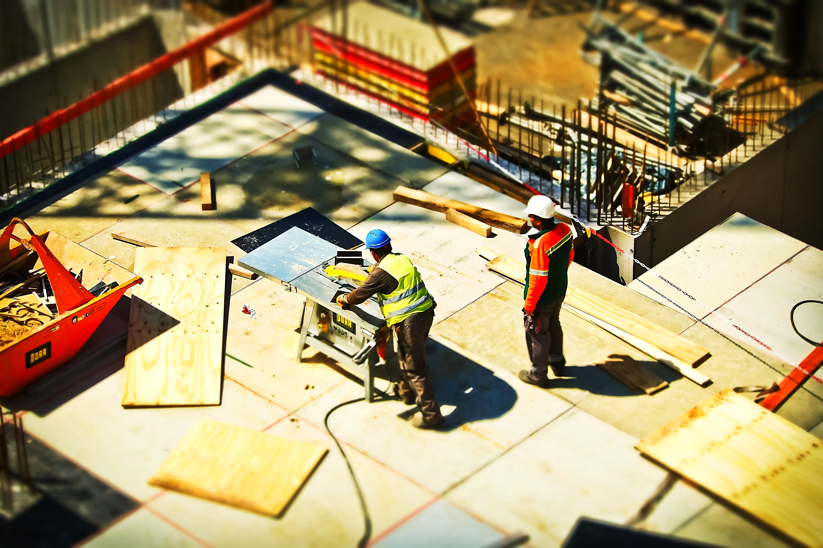
Construction
Company Skills
Bricks and stones
51 %
Steel
73 %
Wood
95 %
Notes:
2.http://nccsltd.com/images/slider2.jpg
3.https://www.pexels.com/photo/2-man-on-construction-site-during-daytime-159306/

Slide 3
Create with the heart,
build with the mind.
Bob
Head of steel
Notes:
4.http://www.downtowniq.com/Mundra/img/cont/cont2.jpg
5.https://www.sccpre.cat/maxp/JobbJJ/

Slide 4
1.618
Proportion is the heart of beauty
Notes:
https://assets.mobilereach.com/wp-content/uploads/2018/03/field_worker_tablet-375848-edited.jpg

Slide 5
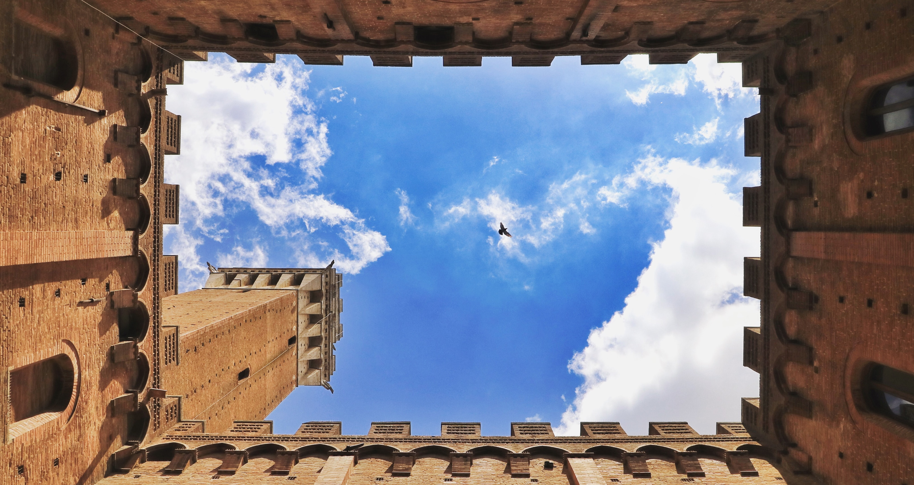
Beautiful buildings
Notes:
https://www.devprojournal.com/wp-content/uploads/2018/12/field-technician-696x464.jpg
unsplash.com/photos/DUecWjq04hQ

Slide 6
We All Know Our Goals In Life And We
Must Attain Them No Matter What Obstacles We Face
Tim
Head of wood
Notes:
10.https://stock.adobe.com/images/picture-of-construction-engineer-working-on-building-site/
11.https://www.sccpre.cat/show/JooRTi_for-business-continuity-managers/

Slide 7
Juan
Expert in bricks
Eric
Expert in wood
Daisy
Expert in steel
Notes:
https://pixabay.com/photos/building-professional-employee-2762319/

Slide 8
John
Expert in stones
Jessica
Architect on site
Betty
Architect on site
Notes:
https://pixabay.com/photos/building-professional-employee-2762319/

Slide 9
The shortest distance between two points is under construction
Learn more
Notes:
3.https://www.pexels.com/photo/2-man-on-construction-site-during-daytime-159306/
13.https://www.crconstruction-inc.com/wp-content/uploads/2017/09/team3.png

Slide 10
The road to success
is always under construction
Bricks and stones
51 %
Steel
73 %
Wood
95 %
Notes:
https://fieldtasks.com/blog/wp-content/uploads/2018/01/Field-Service-technician2.png

Slide 11
Architect
Notes:
15.https://nma.org/wp-content/uploads/2013/08/GettyImages-599706162.jpg
16.https://i.dlpng.com/static/png/3996916-architectural-engineering-construction-worker-laborer-builder-builder-png-900_940_preview.png
17.https://unsplash.com/photos/HtBlQdxfG9k

Slide 12
WWW
Visit our website
www.construction.com
Notes:
https://unsplash.com/photos/tZw3fcjUIpM

