Slide 1
YLI INSURANCE PRESENTATION

Slide 2
Insurance With a Global Reputation
YLI Company
Although human life is priceless, we always act as something had an even greater price than life.
_{Antoine de Saint-Exupery.}
Tailoring insurance coverage around your needs is easier than you think. We’re here to help you learn more about all your opinions and provide answers to common questions.
Notes:
https://www.pexels.com/photo/man-carrying-her-daughter-smiling-1157395/

Slide 3
Insurance With a Global Reputation
YLI Company
LIFE
HEALTH
DISABILITY
A life insurance policy is an insurance for your medical and your health.
Save up to 50% when you buy online. Ready to take next step?
A life insurance policy is an insurance for your medical and surgical expenses.
Save up to 50% when you buy online. Ready to take next step?
A life insurance policy is an insurance that provides income for disabled person.
Save up to 90% when you buy online. Ready to take next step?
Insure Your Life
Notes:
https://www.ashotels.it/wp-content/uploads/2016/06/Banner_ashotels_10.jpg

Slide 4
Insurance With a Global Reputation
YLI Company
Life Insurance
Health Insurance
Home & Property
Auto Insurance
Sports & Leisure
Save up to 50% when
you buy online.
Save up to 50% when
you buy online.
Save up to 20% when
you buy online.
Save up to 20% when
you buy online.
Save up to 230% when
you buy online.
Tailoring insurance coverage around your needs is easier than you think. We’re here to help you learn more about all your opinions and provide answers to common questions.
Notes:
https://www.pexels.com/photo/person-raising-hands-mid-air-sidewards-while-standing-on-gray-steel-railings-680257/

Slide 5
Protect Your Family’s Future
YLI Company
With us, all your insurance needs will be met with family guiding you every step of the way.
>
With us, all your insurance needs will be met with your health needs you every step of the way.
>
With us, all your insurance needs will be met with your home needs every step of the way.
>
With us, all your insurance needs will be met with your family traveling every step of the way.
>
With us, all your insurance needs will be met with your car insurance every step of the way.
>
Notes:
https://www.pexels.com/photo/standing-family-near-fireplace-1648387/

Slide 6
Insurance With a Global Reputation
YLI Company
Founded Since 1917
Protect You
Family’s Future
A life insurance policy is an insurance contract. In exchange for regular premiums, the contract offers to an agreed lump sum of money if one of the lives covered dies during the term of the policy.
Notes:
https://www.pexels.com/photo/smiling-man-holding-woman-s-left-shoulder-1586481/
https://www.pexels.com/photo/smiling-man-carrying-baby-on-his-neck-2274162/

Slide 7
Insure Your Business!
>
Business Owners
>
General Liability
>
Professional Liability
Business
Owner
Liability
Risk management, hadging, development
Risk management, hadging, development
Risk management, hadging, development
Notes:
https://www.kisspng.com/png-businessperson-blade-pc-management-professional-wo-1363279/preview.html

Slide 8
Insure Your Health!
YLI Company
Medical
Health policy
Save up to 50% when you buy online
Save up to 50% when you buy online
Medicare
Claims
Save up to 50% when you buy online
Save up to 50% when you buy online
Notes:
https://www.pngfly.com/png-lpox0e/

Slide 9
Insure Your Health!
YLI Company
Find The Right Plan For You And Your Family
With us, all of your insurance needs will be met with your health wellness every step of the way. Your insurance agent.
>
With us, all of your insurance needs will be met with your health as a senior citizen every step of the way. Your insurance agent.
>
With us, all of your insurance needs will be met with your health first aid every step of the way. Your insurance agent.
>
19
37
89
Countries
Clinics
Agents
Notes:
https://www.pexels.com/photo/adult-biology-chemical-chemist-356040/

Slide 10
INSURANCE AGENTS
YLI Company
Notes:
https://www.pexels.com/photo/man-and-woman-shaking-hands-1249158/

Slide 11
Life
Health
Home
Auto
Protect your family’s
dream
Protect your family’s
dream
Protect your family’s
dream
Sacred duty
to manifest the
true unity
Notes:
https://www.pexels.com/photo/computer-desk-electronics-indoors-374074/

Slide 12
Insure Your Life!
YLI Company
1
2
3
4
5
Life
Health
Home
Auto
`Travel
Save up to 50% when you
buy online
Save up to 50% when you
buy online
Save up to 50% when you
buy online
Save up to 50% when you
buy online
Save up to 50% when you
buy online

Slide 13
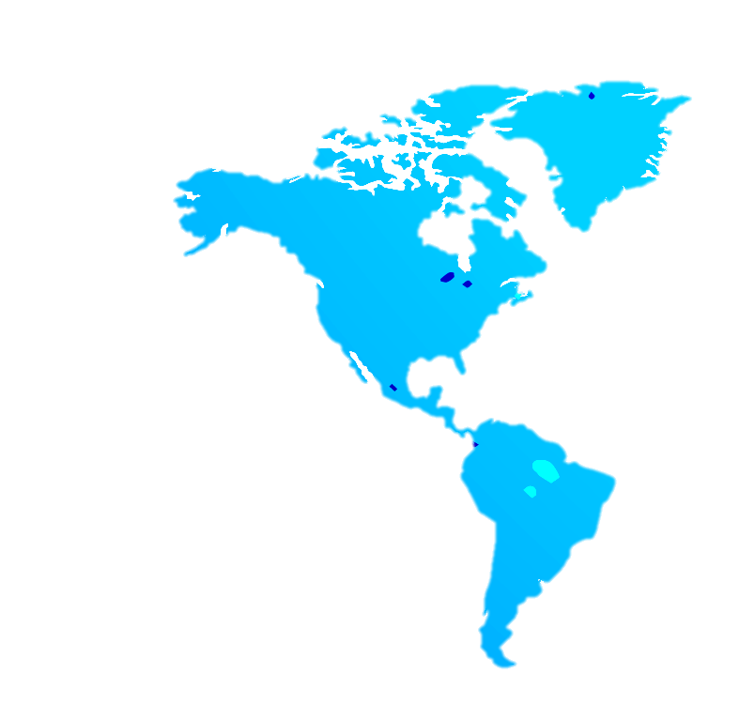
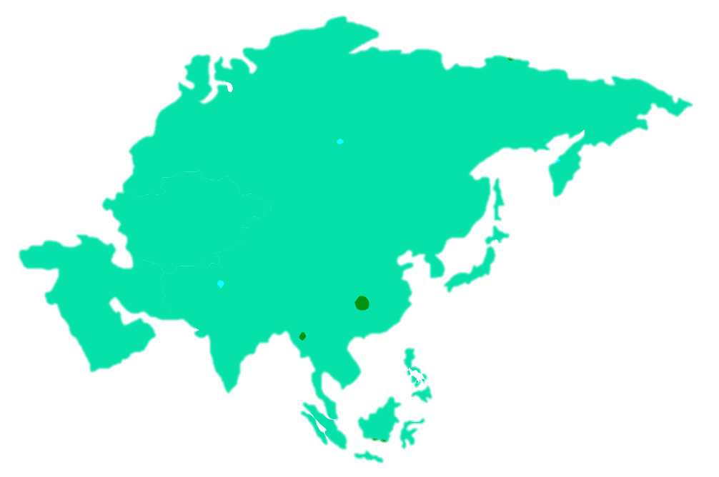
AGENTS
WORLD MAP
YLI COMPANY
MAIN OFFICE
1
USA, 498 MAYFIELD AVE, NEW YORK, IL 85321
1
2
MAIN OFFICE
978 UNIVERSITY ST. ROSELLE, IL 60172
4
3
MAIN OFFICE
2
714 BOWMAN ST. NORTH MIAMI BEACH, FL 33160
4
MAIN OFFICE
323 FIFTH AVE. CANANDAIGUA, NY 14424
3

Slide 14
AGENTS
IN AFRICA
YLI COMAPANY
MAIN OFFICE
1
4 S. CHAPEL ST. OSWEGO, NY 13126
5
2
MAIN OFFICE
82 CLINTON STREET. SUN PRAIRIE, AFRICA 53590
3
2
3
MAIN OFFICE
12 BRANCH DR. WOODSIDE, AFRICA 11377
4
4
MAIN OFFICE
5 BLACKSMITH WAY. SAUGUS, AFRICA
1

Slide 15
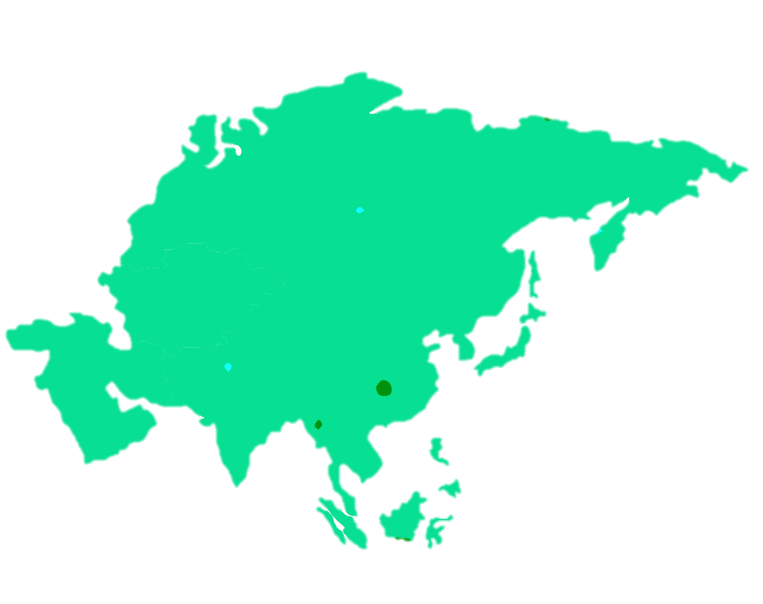
AGENTS
IN AFRICA
YLI COMPANY
2
1
1
MAIN OFFICE
115 UNIVERSITY ST. JOHN AFRICA 60172
5
2
MAIN OFFICE
3
205 BOWMAN STREET NORTH AFRICA 33160
4
3
MAIN OFFICE
USA, 498 MAYFIELD AVE, NEW YORK, IL 85321
4
MAIN OFFICE
323 FIFTH AVE. CANANDAIGUA, NY 14424

Slide 16
Insure Your Life!
YOUR PERSONAL INSURANCE AGENT
CALL US TOLL-FREE AT : +1-800-123-4567
Insurance With Global Reputation
When there is danger from external forces, people want to be secure and sure. Insurance provides a financial security to protect their important possessions – auto, property, business, health and life. CALL 24/7 us toll-free at +123456789 Your insurance agent.
Notes:
https://www.pexels.com/photo/person-wearing-silver-headset-smiling-41280/

