Slide 1
INSURE YOUR FUTURE
Notes:
https://freedesignfile.com/272380-happy-children-in-a-circle-hd-picture/

Slide 2
INSURE YOUR LIFE
GOODLIFE INSURANCE COMPANY
LIFE
HEALTH
HOUSE
TRAVEL
SAVE UP TO 30%
WHEN YOU BUY ONLINE.
SAVE UP TO 50%
WHEN YOU BUY ONLINE.
SAVE UP TO 10%
WHEN YOU BUY ONLINE.
SAVE UP TO 50%
WHEN YOU BUY ONLINE.
A life insurance policy is an insurance contract
A health insurance policy covers the cost of medical expenses.
A house insurance policy covers house damages.
A travel insurance policy covers an expected events.
Notes:
https://picswe.net/pics/elderly-people-dating-03.html

Slide 3
INSURANCE SERVICES
GOODLIFE INSURANCE COMPANY
LIFE INSURANCE
HEALTH INSURANCE
HOME & PROPERTY
A life insurance policy is an insurance contract.
A health insurance policy covers the cost of medical expenses.
A house insurance policy covers house damages.
Notes:
https://unsplash.com/photos/UH-xs-FizTk
https://www.pexels.com/photo/person-giving-keys-on-man-1288482/
https://pxhere.com/en/photo/1446749

Slide 4
STORE INSURANCE SERVICES
GOODLIFE INSURANCE COMPANY
LIFE
HEALTH
HOME & PROPERTY
Save up to 30% when you buy online. Get ready
Save up to 50% when you buy online. Get ready
Save up to 10% when you buy online. Get ready
MEDICAL
AUTO POLICY
SPORT & LEISURE
Save up to 50% when you buy online. Get ready
Save up to 20% when you buy online. Get ready
Save up to 25% when you buy online. Get ready

Slide 5
INSURANCE AGENTS
GOODLIFE INSURANCE COMPANY
ELIZABETH FRATKIN
JOHN MCCONNOCHIE
DANIEL DORSEY
HELEN SHETTY
INSURANCE AGENT
INSURANCE AGENT
INSURANCE AGENT
INSURANCE AGENT
+1-800-123-4567
+1-800-123-4567
+1-800-123-4567
+1-800-123-4567
With us, all your insurance needs will be met with family guiding you every step of the way. Your insurance agent.
With us, all your insurance needs will be met with family guiding you every step of the way. Your insurance agent.
With us, all your insurance needs will be met with family guiding you every step of the way. Your insurance agent.
With us, all your insurance needs will be met with family guiding you every step of the way. Your insurance agent.
Notes:
https://www.rawpixel.com/image/385584/premium-photo-image-face-woman-smile
https://www.rawpixel.com/image/388399/free-photo-image-portrait-person-face
https://www.rawpixel.com/image/379636/premium-photo-image-portrait-white-afternoon
https://www.pexels.com/photo/woman-wearing-coat-762020/

Slide 6
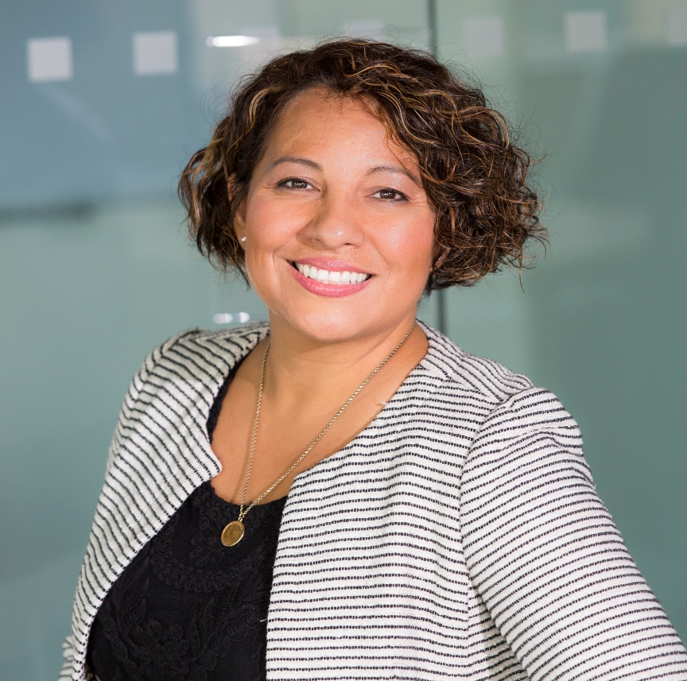
Helen Arden
FOUNDER AND PRESIDENT
GOODLIFE INSURANCE SERVICES
Tailoring insurance coverage around your needs is easier than you think. We’re here to help you learn more about all your options and provide answers to common questions. Ready to take the next step?
Notes:
https://www.pexels.com/photo/woman-smiling-at-the-camera-1181686/

Slide 7
MR. JOHN ELLIOT
DIRECTOR OF FYL
GOODLIFE INSURANCE SERVICES
With us, all of your insurance needs will be met with family guiding you every step of the way. Your insurance agent
Notes:
https://www.shutterstock.com/image-photo/business-people-shaking-hands-finishing-meeting-63361036
https://www.pexels.com/photo/selective-focus-photograph-of-man-wearing-gray-suit-jacket-1138903/

Slide 8
1 250 000 HAPPY CLIENTS
GOODLIFE INSURANCE COMPANY
Notes:
https://www.shutterstock.com/image-photo/real-estate-agent-offer-house-property-563308033

Slide 9
PROTECT YOUR FAMILY’S FUTURE
GOODLIFE INSURANCE COMPANY
Notes:
https://www.pexels.com/photo/person-giving-keys-on-man-1288482/
https://www.pexels.com/photo/standing-family-near-fireplace-1648387/
https://pxhere.com/en/photo/1446759
https://www.pexels.com/photo/computer-desk-electronics-indoors-374074/
https://www.pexels.com/photo/red-car-2343508/
https://images.pexels.com/photos/2371721/pexels-photo-2371721.jpeg?cs=srgb&dl=beach-bridge-clouds-2371721.jpg&fm=jpg
https://www.pexels.com/photo/smiling-man-holding-woman-s-left-shoulder-1586481/
https://www.pexels.com/photo/man-and-woman-shaking-hands-1249158/

Slide 10
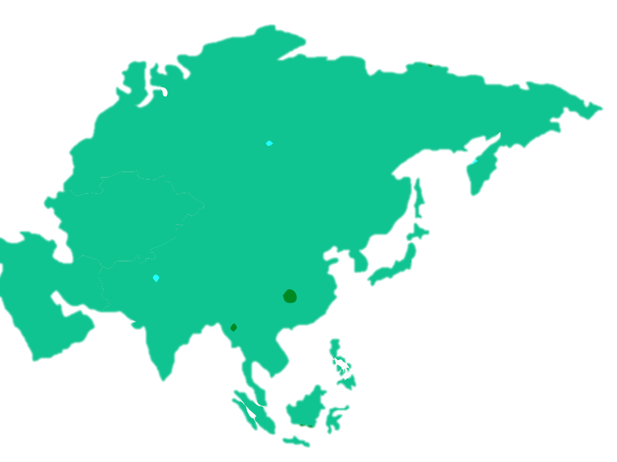
YOUR AGENTS
WORLD MAP
1
MAIN OFFICE
USA, 498 MAYFIELD AVE, NEW YORK, IL 85321
MAIN OFFICE
1
2
978 UNIVERSITY ST. ROSELLE, IL 60172
3
5
5
MAIN OFFICE
2
3
714 BOWMAN ST. NORTH MIAMI BEACH, FL 33160
4
4
MAIN OFFICE
323 FIFTH AVE. CANANDAIGUA, NY 14424
5
MAIN OFFICE
4 S. CHAPEL ST. OSWEGO, NY 13126
Notes:
BY PEXEL

Slide 11
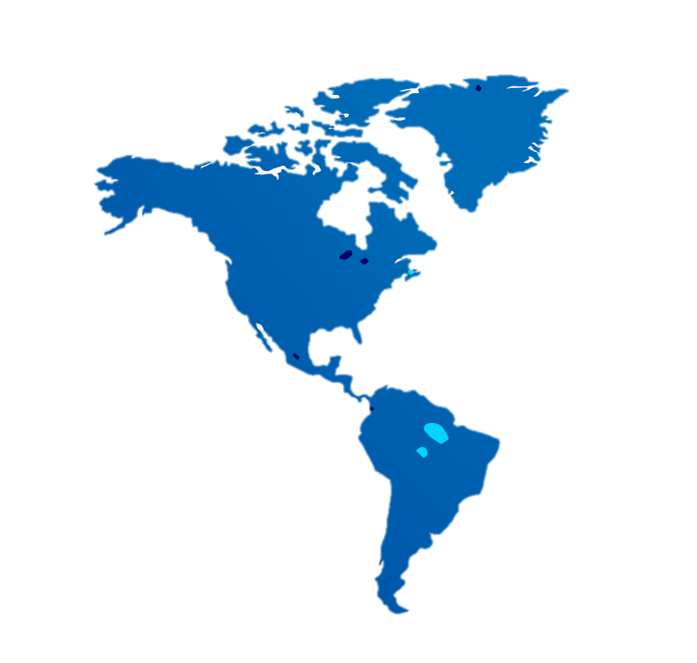
Travel AGENTS
IN AFRICA
4
5
2
MAIN OFFICE
1
82 CLINTON STREET. SUN PRAIRIE, AFRICA 53590
1
MAIN OFFICE
2
12 BRANCH DR. WOODSIDE, AFRICA 11377
MAIN OFFICE
3
5 BLACKSMITH WAY. SAUGUS, AFRICA
3
MAIN OFFICE
4
115 UNIVERSITY ST. JOHN AFRICA 60172
5
MAIN OFFICE
205 BOWMAN STREET NORTH AFRICA 33160
Notes:
BY PEXEL

Slide 12
PURCHASE
AND ENJOY
INSURE YOUR FUTURE
THANKS FOR WATCHING

