Slide 1
BEAUTY AND SPA
joygaelbeautyspa.com

Slide 2
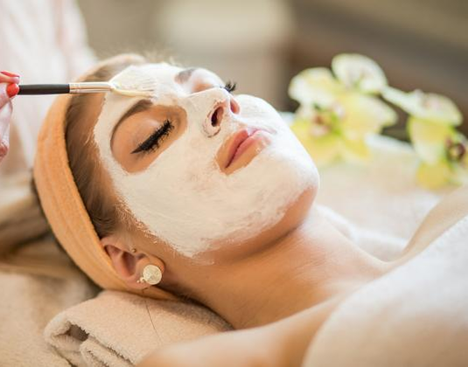
SPA
MASKING
AND TINTING
Notes:
http://nb-storage-public-bucket.s3.amazonaws.com/57ea0d954cedfd000d03122d.jpg

Slide 3
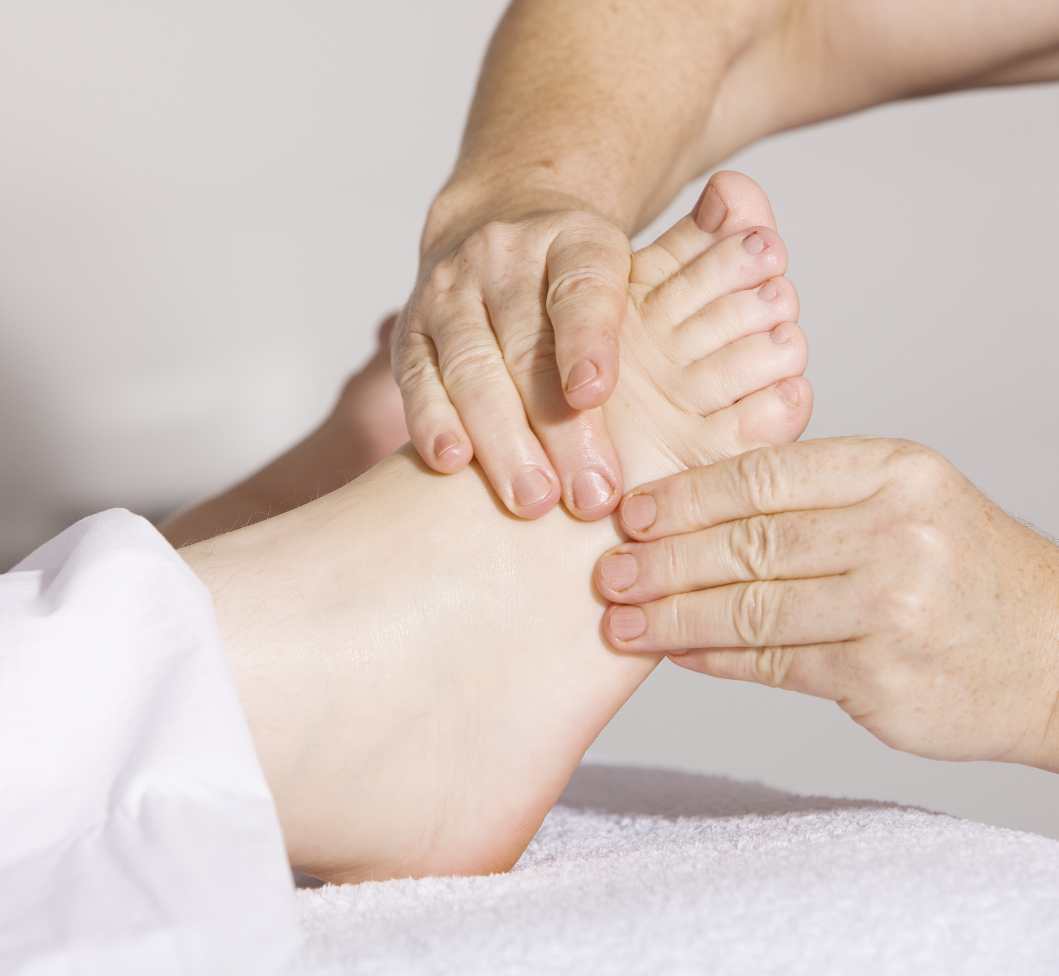
SPA
BODY AND
LEGS
MASSAGE
Notes:
https://www.pexels.com/photo/adult-alternative-medicine-care-comfort-356053/

Slide 4
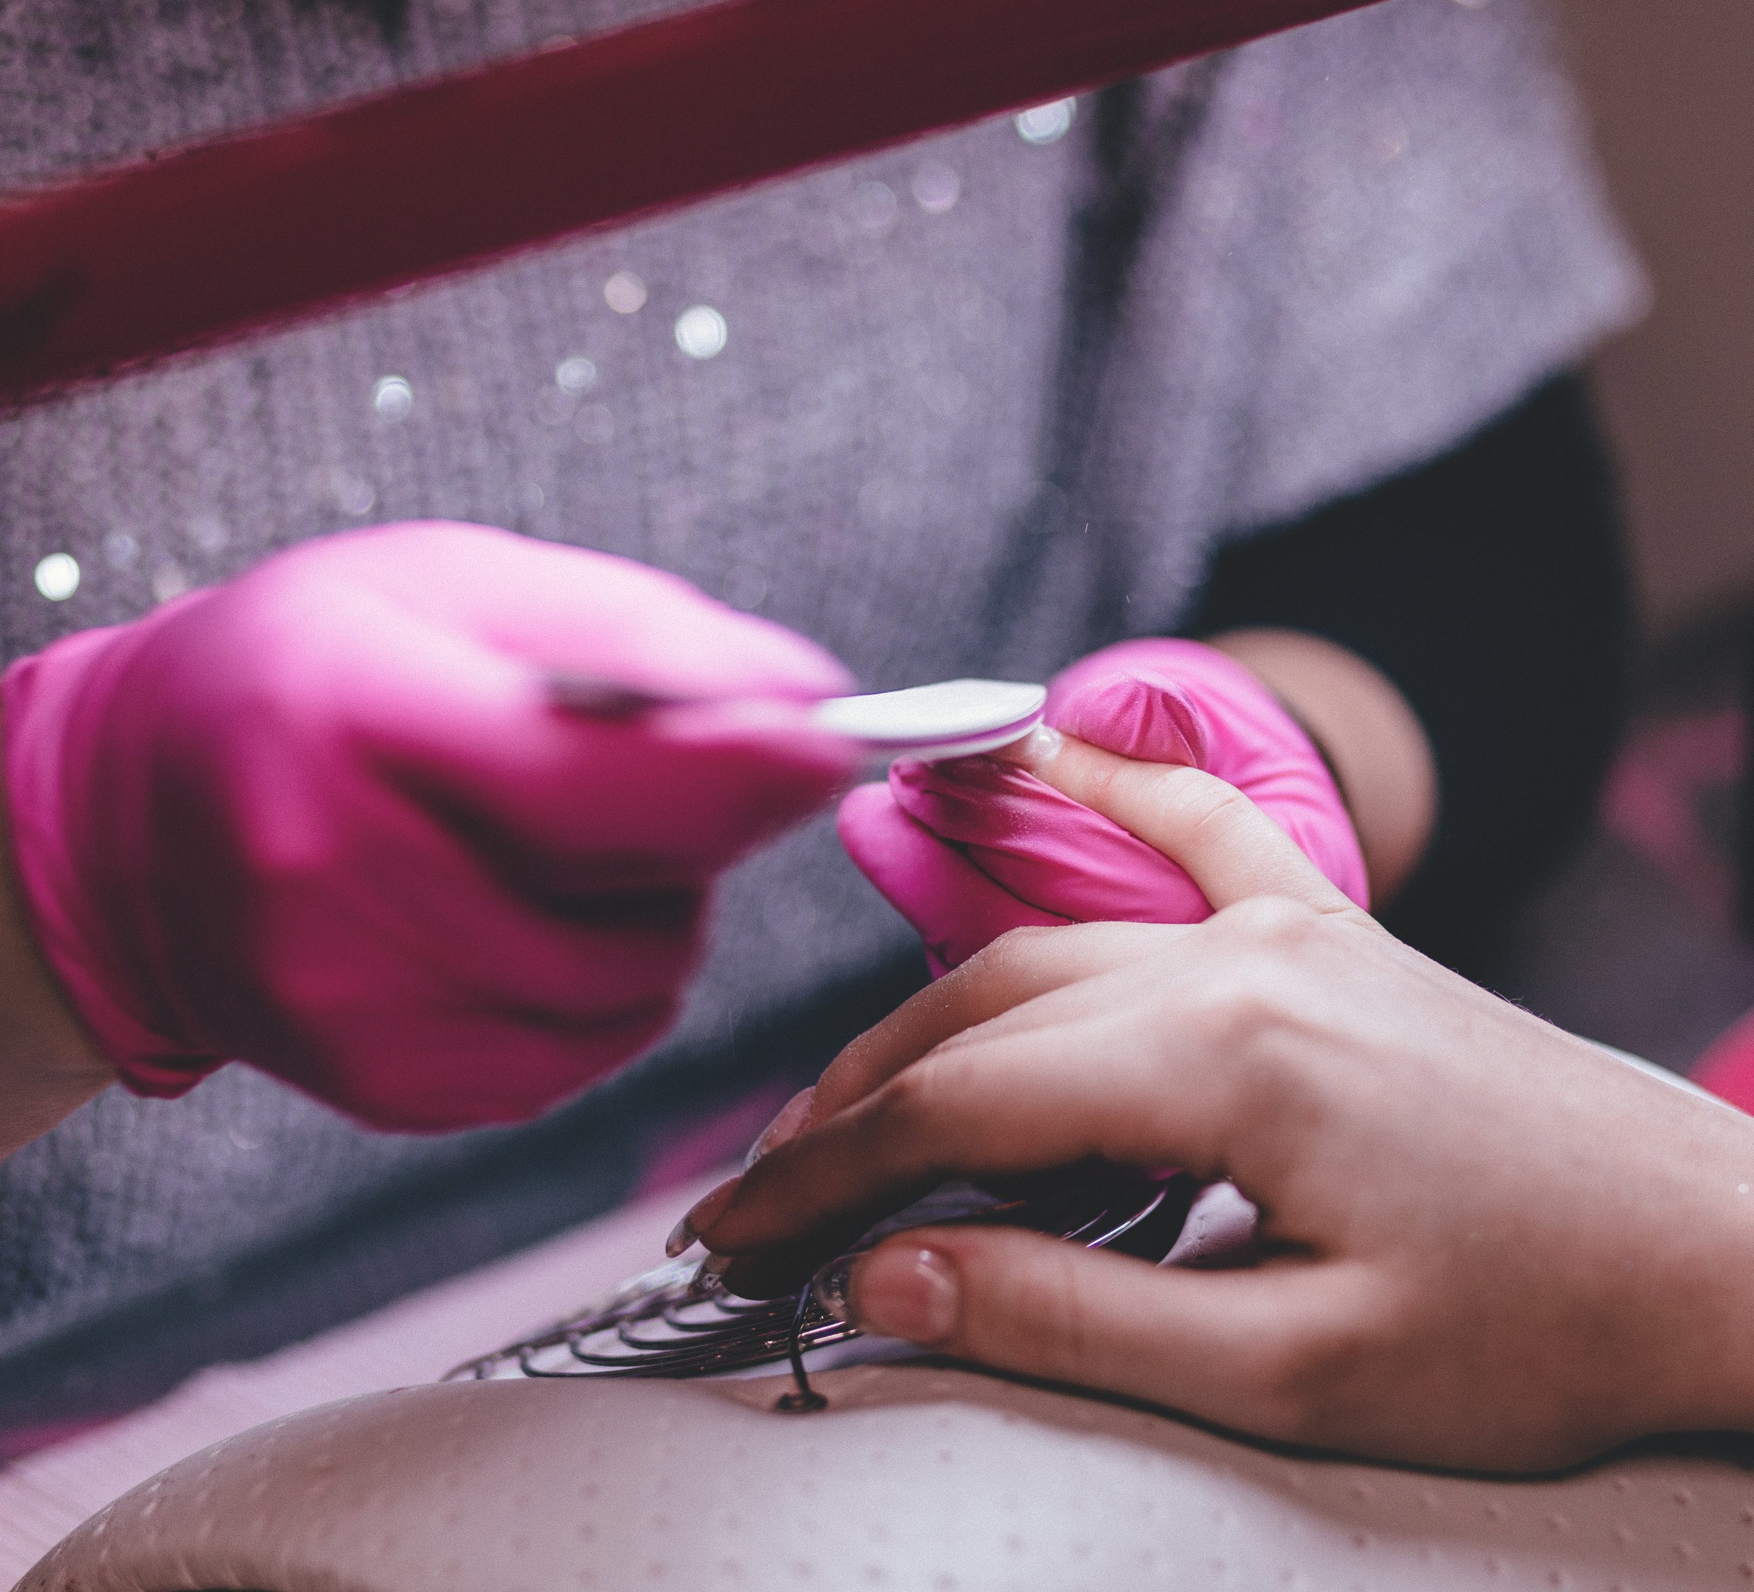
SPA
NAIL CARE & NAIL COLOR
Notes:
https://www.pexels.com/photo/close-up-of-woman-having-manicure-332046/4.

Slide 5
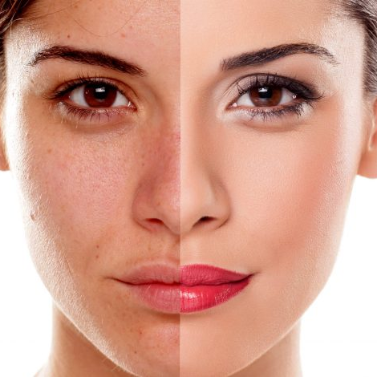
OUR RESULTS
Notes:
http://eubeautyhouse.com/wp-content/uploads/2015/11/shutterstock_232561066-800x470.jpg
https://www.shutterstock.com/es/image-photo/comparison-portrait-woman-without-makeup-232561069?src=vYaseZUjYXS0dhTBe7GTFQ-1-34

Slide 6
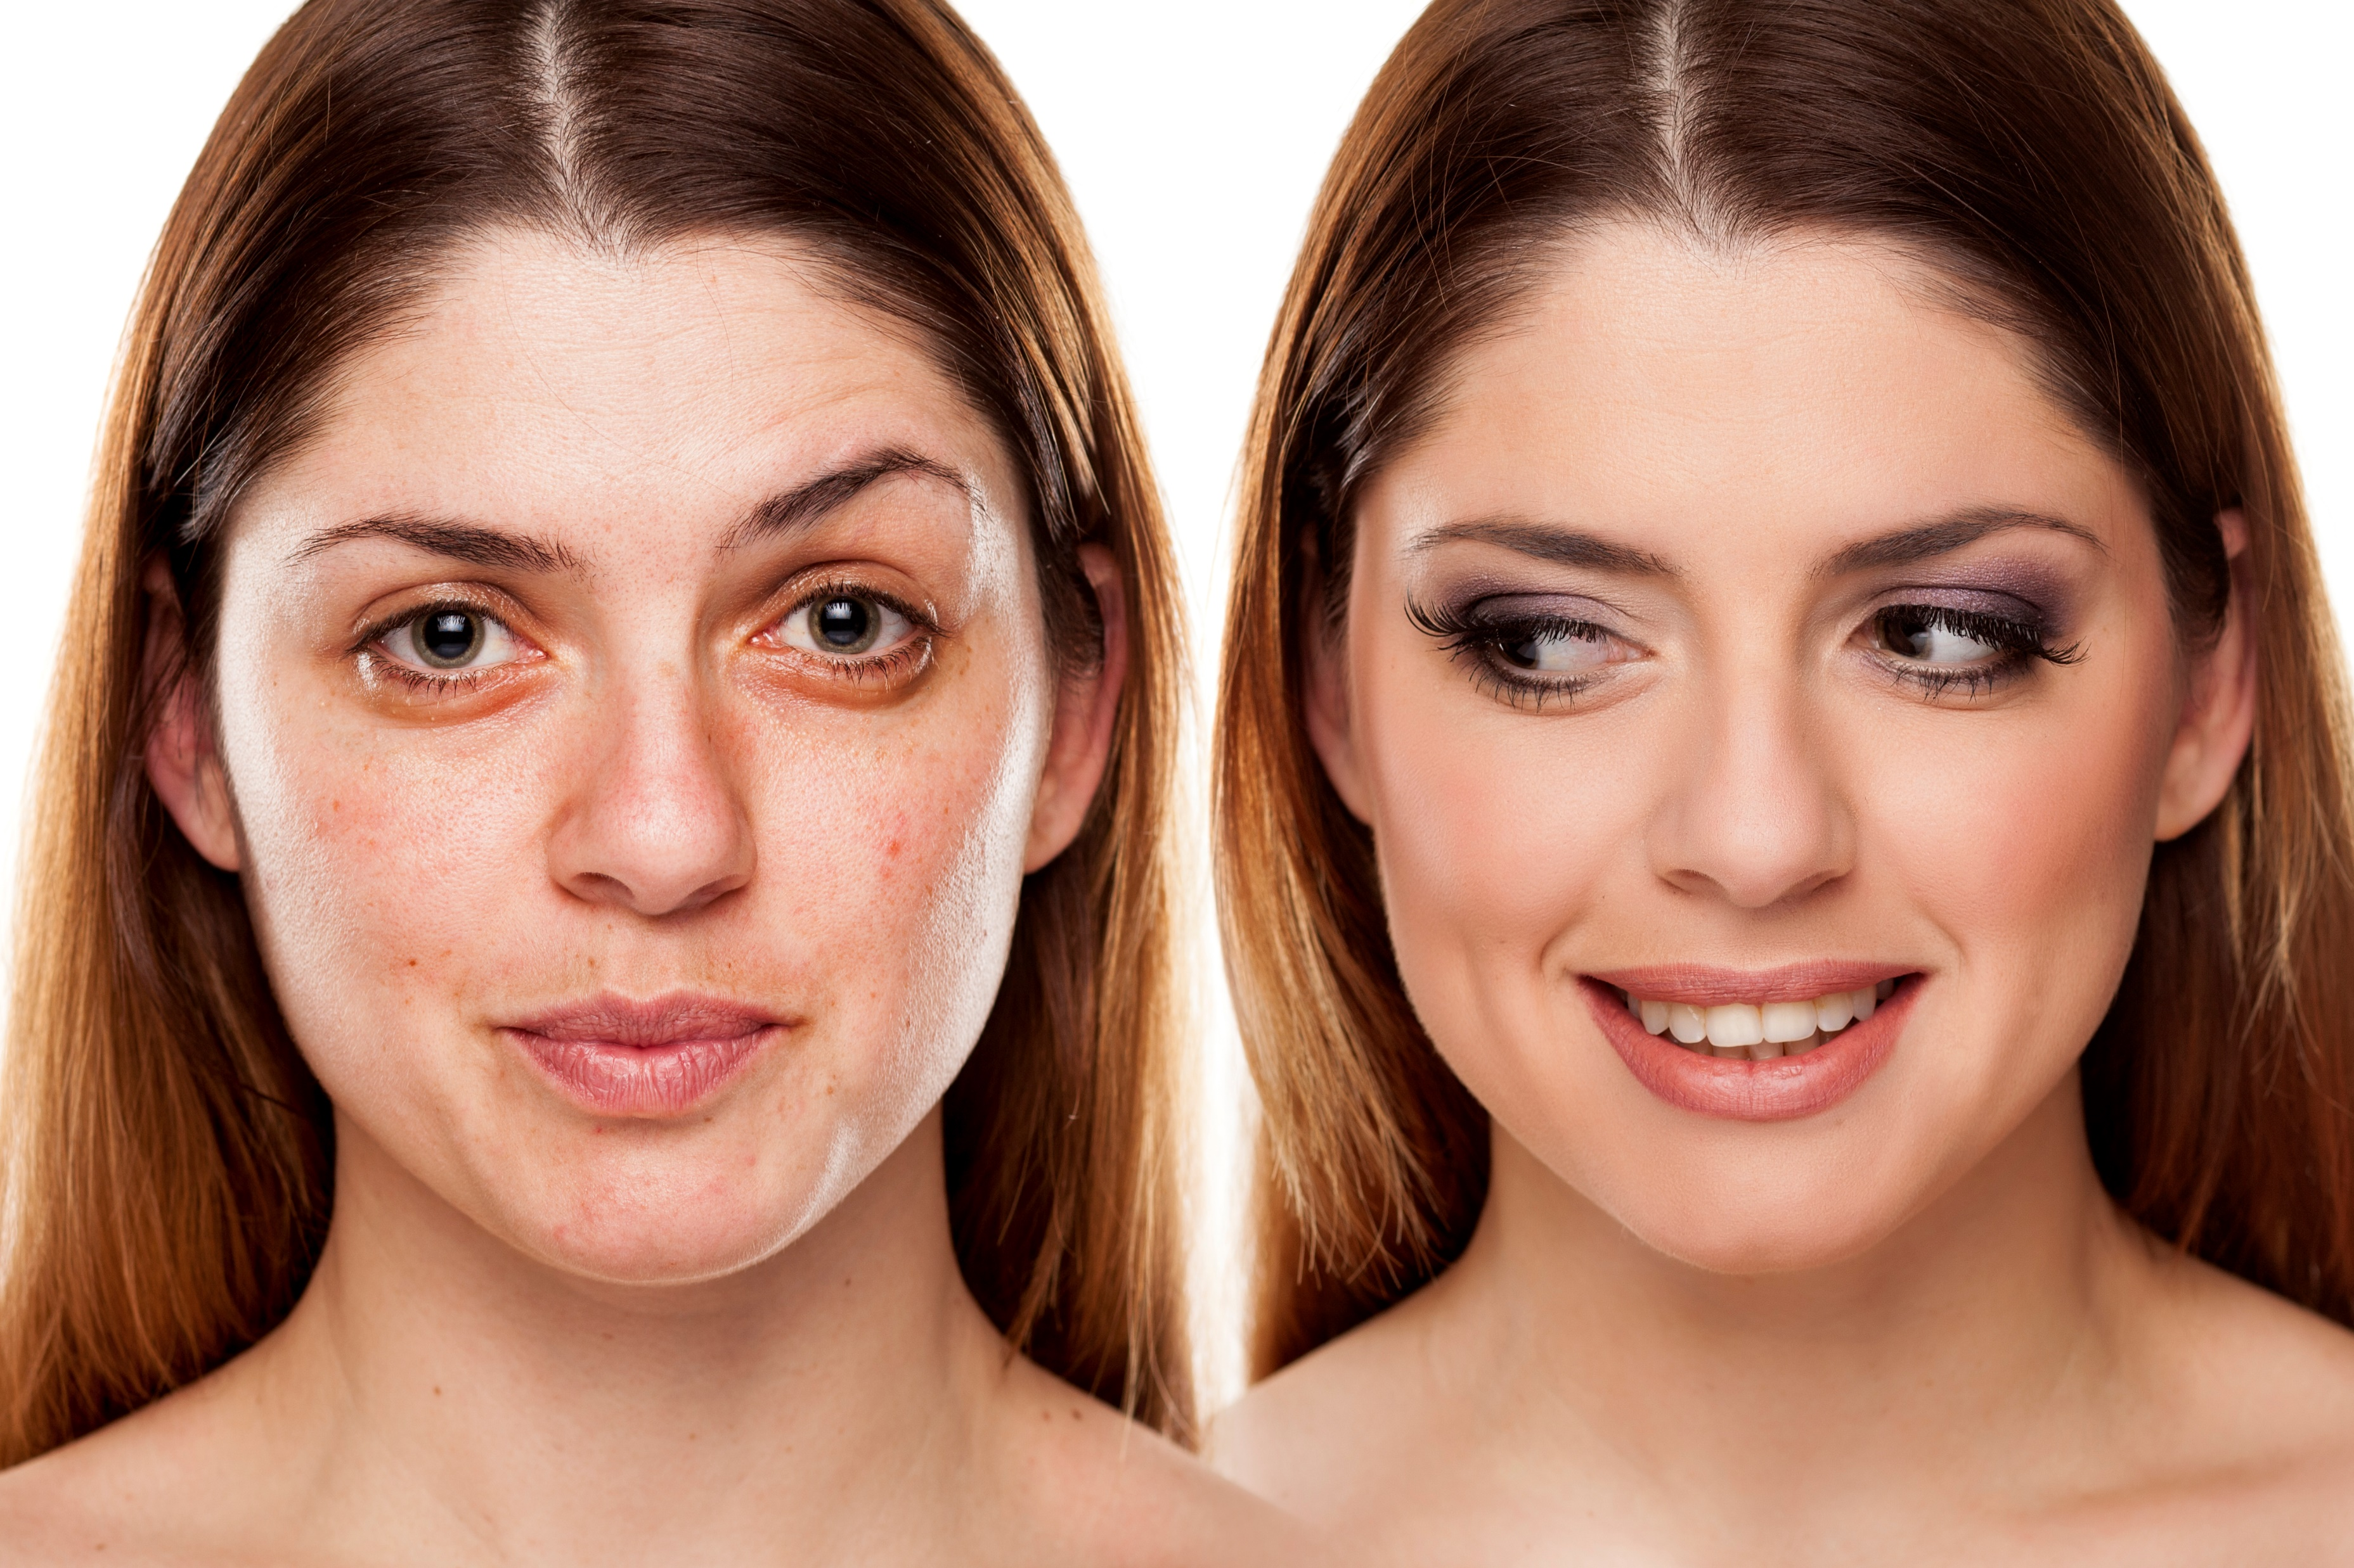
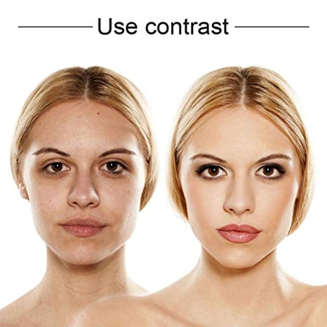
BEFOR & AFTER
Notes:
https://www.shutterstock.com/image-photo/comparison-portrait-woman-without-makeup-249119563?src=89-bcDqnVrSrKCj6J6WU5w-1-13
https://www.shutterstock.com/image-photo/comparative-portrait-female-face-without-makeup-311958881

Slide 7
CALL US NOW
GET 50% OFF FOR THE FIRST PROCEDURE
Notes:
www.flowerstoreinabox.com.au

Slide 8
Dreams Comes True
joygaelbeautyspa.com
+1-800-123-4567
1234 NY

Slide 9
BEAUTY AND SPA
joygaelbeautyspa.com

Slide 10
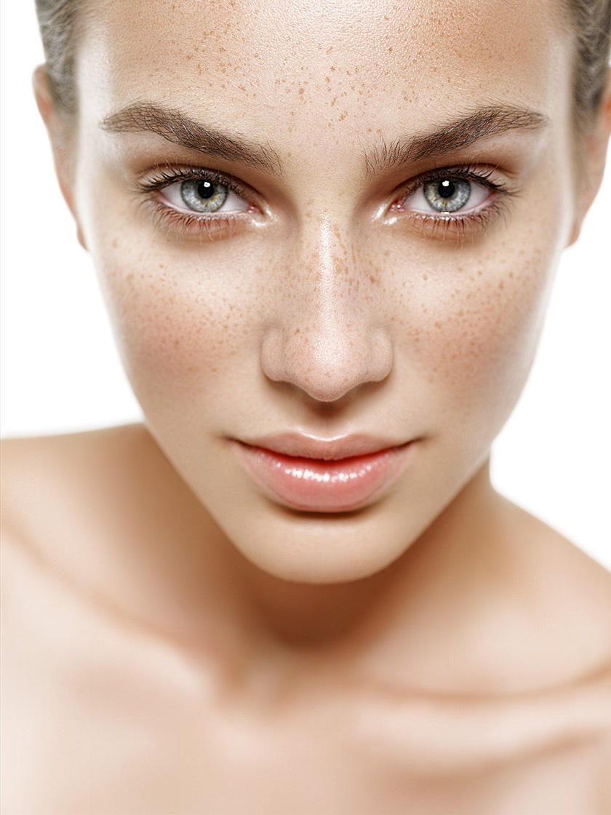
FACE CONTROL
Minimize
Your Wrinkles
GET FIRST BOTOX FOR FREE
Notes:
https://fstoppers.com/photo/31274

Slide 11
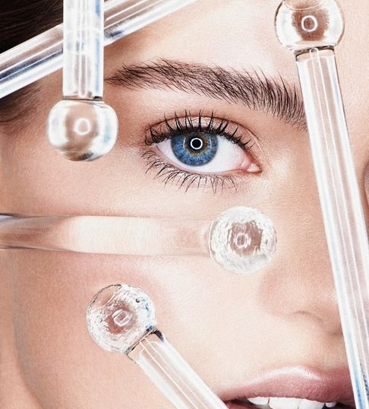
FACE CONTROL
MINIMIZE
YOUR
WRINKES
GET FIRST BOTOX FOR FREE
Notes:
https://www.gosee.de/FlorianSommet

Slide 12
FACE CONTROL
MINIMIZE
YOUR
WRINKES
GET FIRST BOTOX FOR FREE
Notes:
https://cdn.shopify.com/s/files/1/2711/2864/files/ellespain-2-1433858750_large.jpg?v=1539461131

Slide 13
CLIENTS TESTIMONIAL
MY SKINS LOOKS
GREAT AND VERY
SMOOTH AS 10 YEARS
AGO! THANKS!

Slide 14
CLIENTS TESTIMONIAL
I Feel Young And Beautiful Again!
Thank You. You Are Awesome!
Notes:
https://www.pexels.com/photo/closeup-photo-of-smiling-woman-wearing-blue-denim-jacket-1130626/

Slide 15
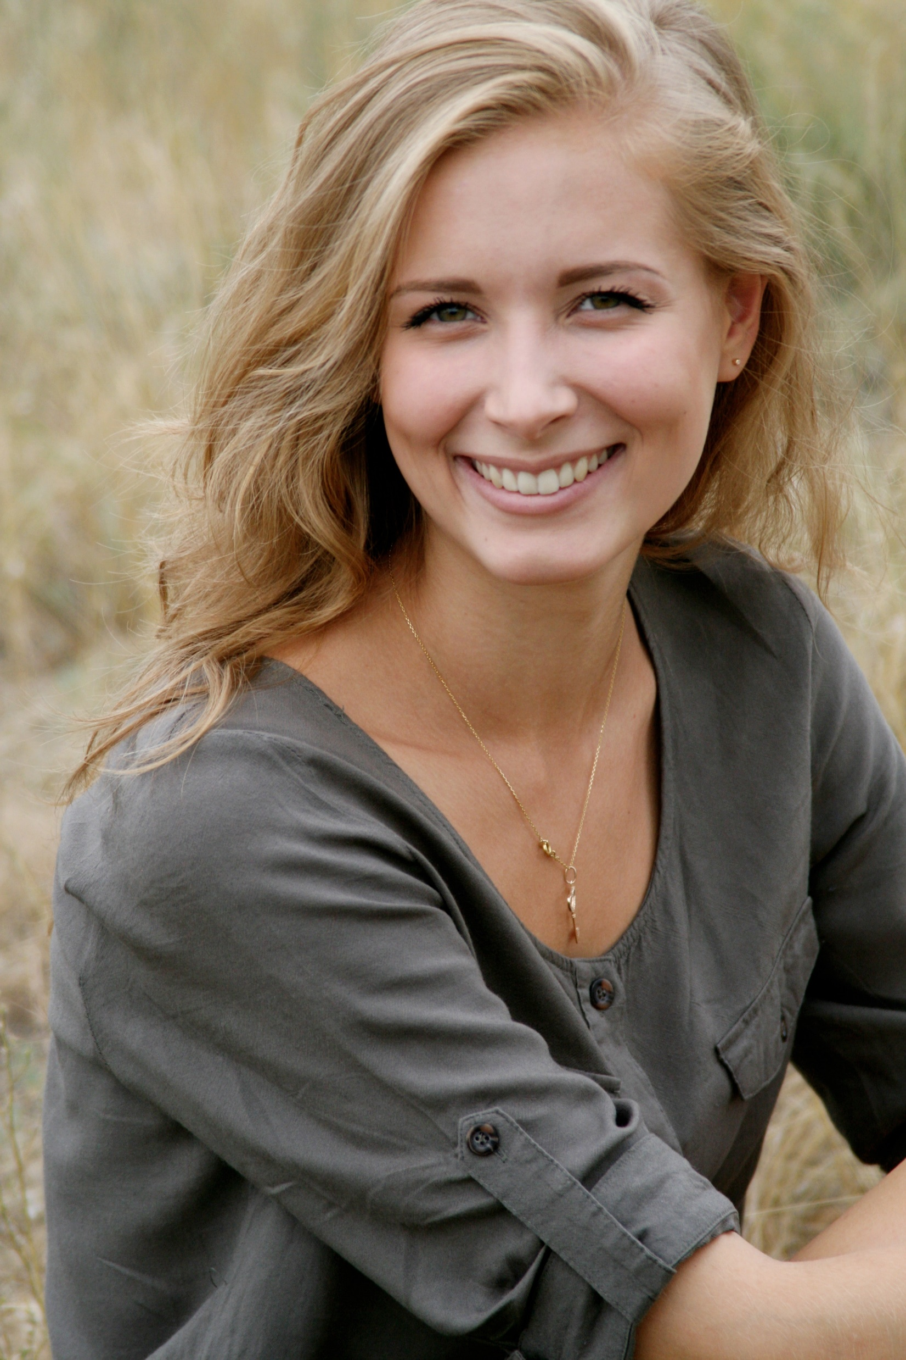
CLIENTS TESTIMONIAL
STAFF ARE REAL
PROFESSIONALS AND FRIENDLY. WILL COME AGAIN. THANKS
Notes:
https://www.pexels.com/photo/woman-in-black-scoop-neck-shirt-smiling-38554/

Slide 16
HURRY UP!
LIMITED
OFFER-
ONLY TILL END
OF MAY

Slide 17
Dreams Comes True
joygaelbeautyspa.com
+1-800-123-4567
1234 NY

