Slide 1
ARCHITECTURE
PRESENTATION
Notes:
https://pixnio.com/furniture/wood-furniture-chair-indoors-seat-desk-office-workplace#

Slide 2
Alice Samuelson
TOPIC: Architectural Design
Notes:
https://www.pexels.com/photo/woman-wearing-white-shirt-1181690/

Slide 3
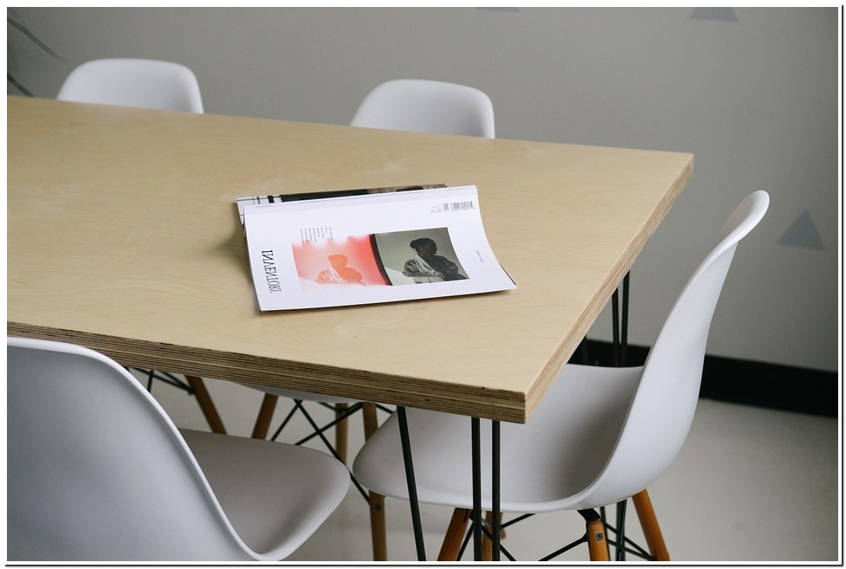
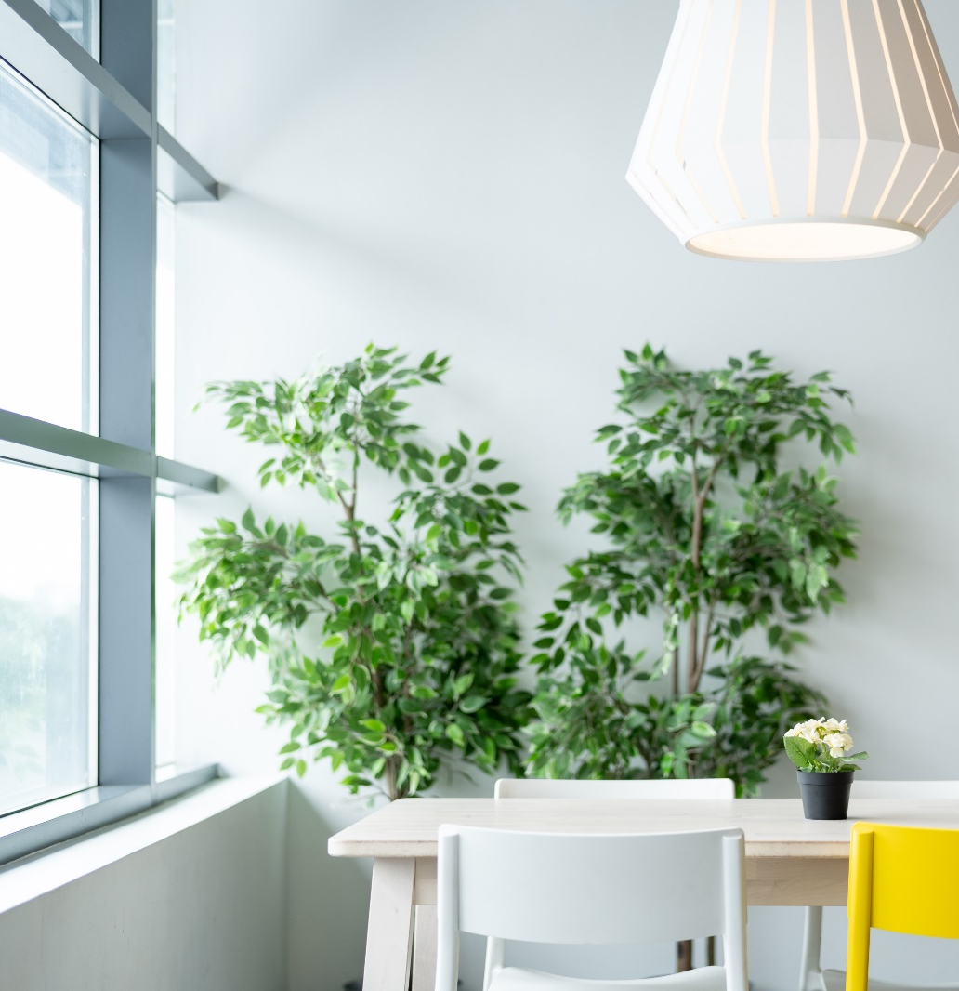
ARCHITECTURE
GALLERY SLIDE
ARCHITECTURAL DESIGN
THIS IS A PROCESS OF DESIGN FOR BUILDING AND LANDSCAPES.
Notes:
https://4.bp.blogspot.com/-y6On89Tvmhs/WMANZH2xVfI/AAAAAAAAAPo/BVwLAog9bVsW_u4XQVPloboISULB3RJqQCLcB/s1600/Bella%2BCobble%2BPatio%2BStones%2BIdeas.jpg
https://unsplash.com/photos/HgPAUR1ALJQ
https://pixabay.com/photos/pillows-bed-bedding-bedroom-white-1031079/
https://pixabay.com/photos/ikea-table-dining-chair-lamp-4048225/

Slide 4
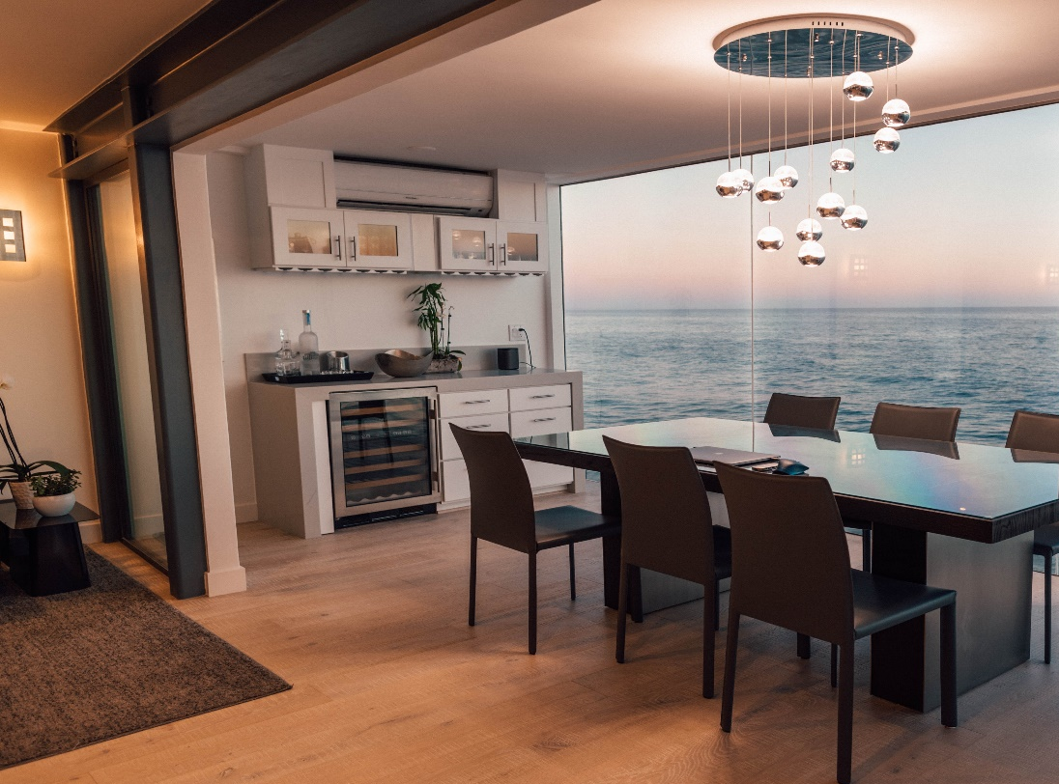
ARCHITECTURE & DESIGNS
TEAM SLIDE
Web design
Project Management
We design web pages for your business.
We have a very talented project management to create the stunning designs.
Interior app design
Interior app design
We design homes.
We use apps for your house interior designs.
Notes:
https://www.pexels.com/photo/brown-wooden-center-table-584399/
http://homedesignlatest.site/214022/interior-architectural-photography/
https://pixabay.com/photos/ikea-table-dining-chair-lamp-4048225/
https://unsplash.com/photos/tleCJiDOri0

Slide 5
Interior App Design
Architecture Magazine
Project Management
We will decorate your houses according to your mood.
We design architecture magazines for your business.
Our project management team will give you the best result for your house design.
Notes:
https://www.pexels.com/photo/brown-wooden-center-table-584399/
https://4.bp.blogspot.com/-y6On89Tvmhs/WMANZH2xVfI/AAAAAAAAAPo/BVwLAog9bVsW_u4XQVPloboISULB3RJqQCLcB/s1600/Bella%2BCobble%2BPatio%2BStones%2BIdeas.jpg
https://madplumcreative.com/wp-content/uploads/2016/01/20.jpg

Slide 6
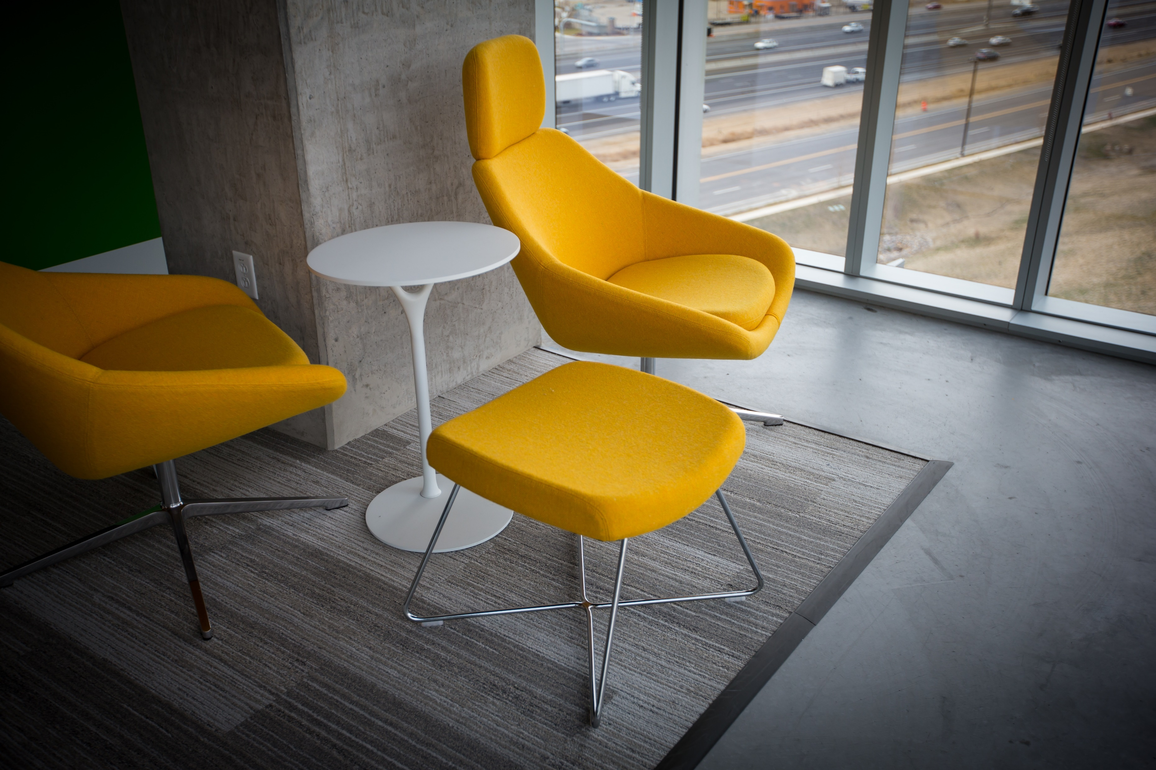
ARCHITECTURE PROMO
MULTIPURPOSE
Notes:
https://unsplash.com/photos/HgPAUR1ALJQ

Slide 7
ARCHITECTURE PROMO
ARCHITECTURE
INTERIOR
DESIGN
This is a product planning, design and building construction.
This is a design planning for buildings or homes.
This is a creating or designing an object or a system.
Notes:
https://pixnio.com/furniture/wood-furniture-chair-indoors-seat-desk-office-workplace#
https://www.behance.net/gallery/20957073/IKEA-Kitchen
http://hmba.me/wp-content/uploads/2019/03/simple-small-house-design-interior-0-inside-small-house-designs-house-interior-design-for-small-houses-interior-house-designs-for-small-simple-interior-design-ideas-for-small-house.jpg

Slide 8
DESIGN AGENCY
OUR MANAGER
Project Manager manages designers, environment and the team for the project.
Notes:
https://www.pexels.com/photo/two-orange-armchairs-and-assorted-color-heart-wall-decors-2079293/

Slide 9
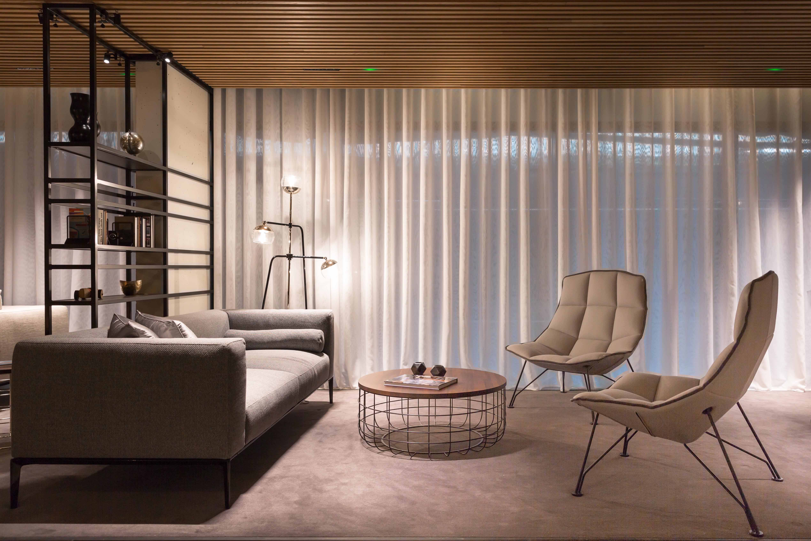
CREATIVE SLIDE
ARCHITECTURE
BANNER SLIDE
ARCHITECT
INNOVATE
UNIQUELY SIMPLIFIED
We innovate / create new methods for architecture designs.
We create unique and simplified designs.
ENVISIONED
AUTHORITATIVE
Our envision is to create new unique architecture designs.
“Reference Architecture is an authoritative source of information about a specific subject.
Notes:
http://clipgoo.com/daut/as/f/w/welcome-to-wish-london-interior-architecture-design-and_interior-archetect_interior-design_interior-designer-designs-home-design-living-room-blog-contemporary-american-society-of-designers-free-softwa.jpg

Slide 10
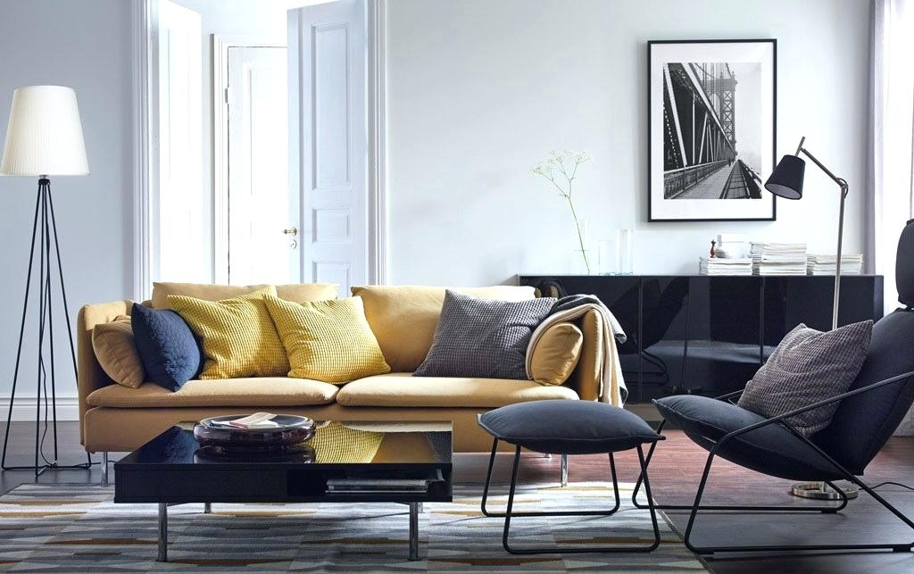
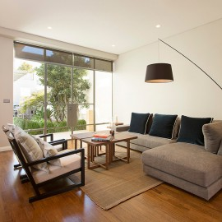
DESIGN GALLERY SLIDE
TEAM SLIDE
We use light colors, very clean and modern designs.
Portfolio slide
Notes:
https://4.bp.blogspot.com/-y6On89Tvmhs/WMANZH2xVfI/AAAAAAAAAPo/BVwLAog9bVsW_u4XQVPloboISULB3RJqQCLcB/s1600/Bella%2BCobble%2BPatio%2BStones%2BIdeas.jpg
http://kerdi.info/wp-content/uploads/2018/10/living-room-sets-ikea-inspiring-living-room-furniture-sets-and-living-room-astounding-living-room-sets-furniture-ikea-living-room-sets-uk.jpg
https://www.pexels.com/photo/white-and-gray-mattress-1864901/
http://homedesignlatest.site/214022/interior-architectural-photography/

Slide 11
MULTI CUBE
GALLERY SLIDE
MULTI CUBE DESIGN
We provide multi – level system specification and modeling framework.
Notes:
https://pixnio.com/furniture/wood-furniture-chair-indoors-seat-desk-office-workplace#
https://madplumcreative.com/wp-content/uploads/2016/01/20.jpg
https://www.pexels.com/photo/white-and-gray-mattress-1864901/
https://pixabay.com/photos/pillows-bed-bedding-bedroom-white-1031079/

Slide 12
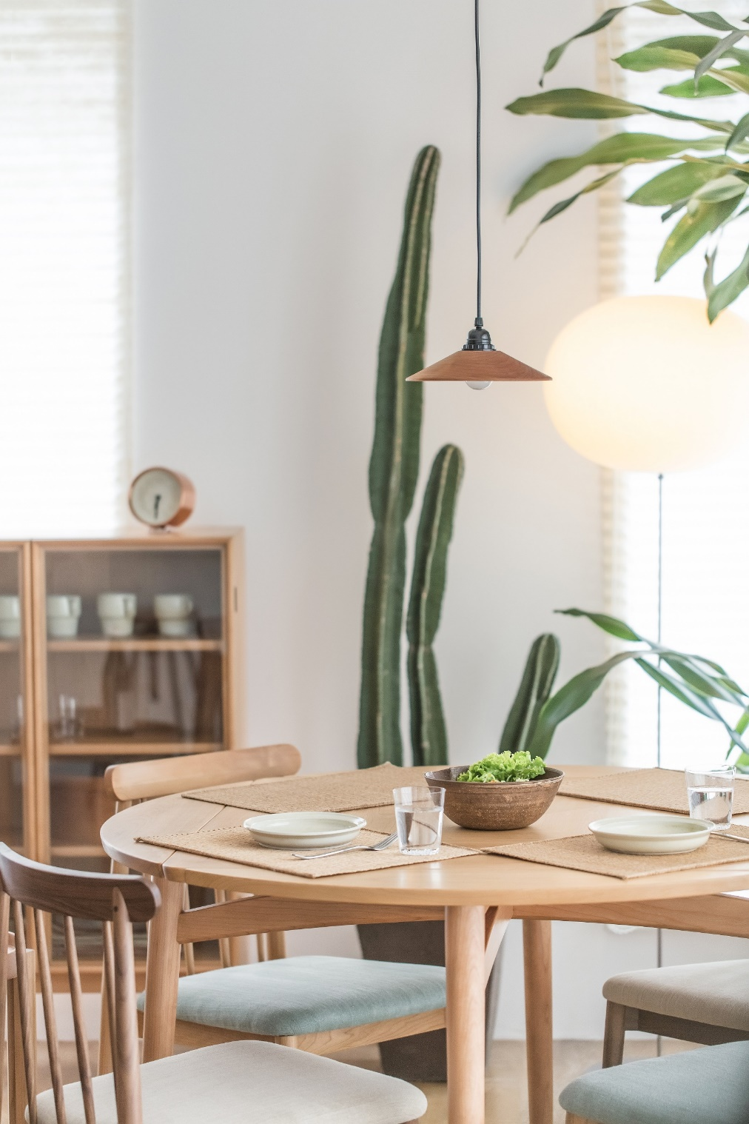
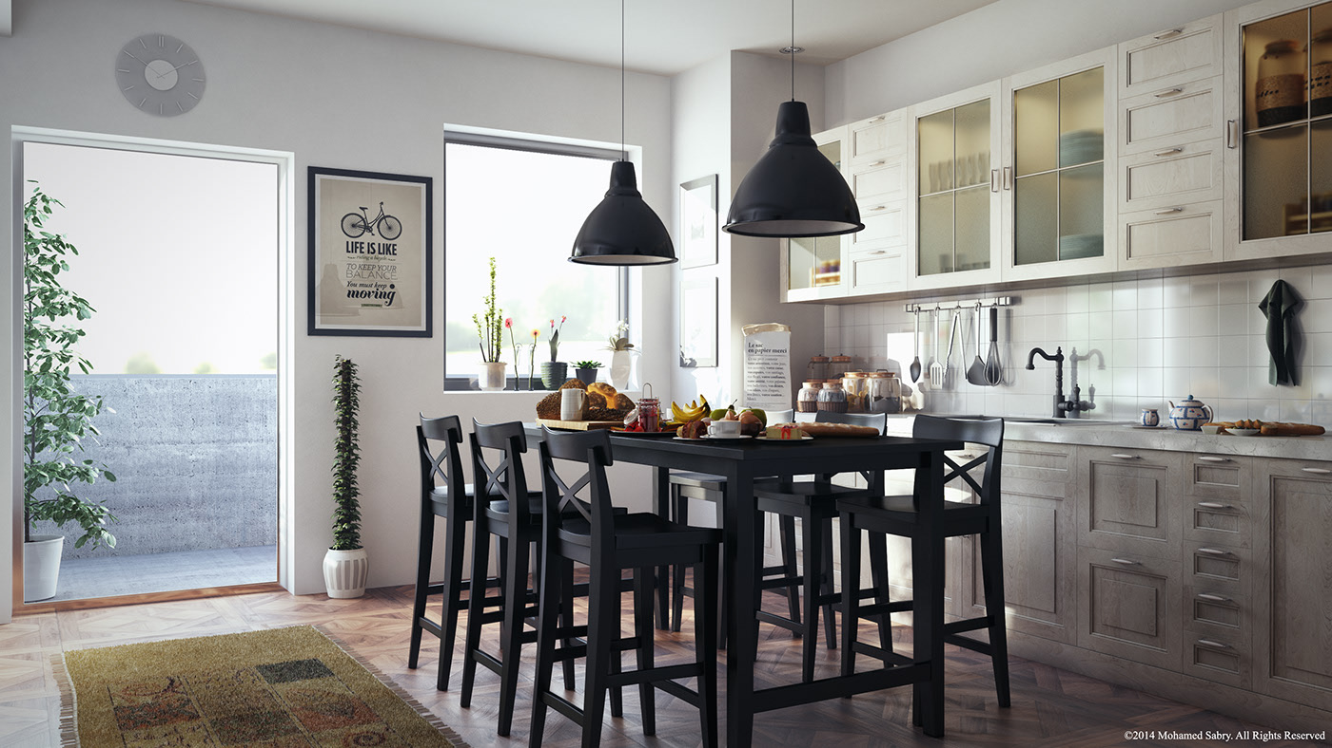
Notes:
http://clipgoo.com/daut/as/f/w/welcome-to-wish-london-interior-architecture-design-and_interior-archetect_interior-design_interior-designer-designs-home-design-living-room-blog-contemporary-american-society-of-designers-free-softwa.jpg
http://kerdi.info/wp-content/uploads/2018/10/living-room-sets-ikea-inspiring-living-room-furniture-sets-and-living-room-astounding-living-room-sets-furniture-ikea-living-room-sets-uk.jpg
https://www.pexels.com/photo/brown-wooden-center-table-584399/
https://www.behance.net/gallery/20957073/IKEA-Kitchen
http://homedesignlatest.site/214022/interior-architectural-photography/
https://www.pexels.com/photo/green-cactus-plant-near-to-white-ceramic-plate-on-brown-wooden-table-154161/

Slide 13
INTERIOR & DESIGN
GALLERY SLIDE
Interior Design
We will plan, research, coordinates and manage your building and houses and design.
Notes:
http://kerdi.info/wp-content/uploads/2018/10/living-room-sets-ikea-inspiring-living-room-furniture-sets-and-living-room-astounding-living-room-sets-furniture-ikea-living-room-sets-uk.jpg
http://ikimasuyo.info/wp-content/uploads/2018/07/den-office-design-ideas-small-home-office-den-decorating-ideas.jpg
https://encrypted-tbn0.gstatic.com/images?q=tbn:ANd9GcRkoJIgWNYf6v0wzn30O8dGq8HSTDBjH2yuBh0BE7XcGo8rh2b8

Slide 14
ARCHITECTURE SERVICES
OUR
DESIGN
INTERIOR
AGENCY
ARCHITECTURE AGENCY
We are looking for an Architect
Responsibilities:
Controls project to start to finish to ensure high quality, innovative and functional design.
Develop architecture according clients needs.
We design and re-design interiors of environmental design in an active manner.
INTERIOR AND DESIGN
I want to surprise paris apple
fans challenged cezanne in his book
of the spiritual art Kandinsky wrote:
From the cup of tea he did inspired creature
Notes:
https://www.pngfly.com/png-vs4z16

Slide 15
Interior app design
This is a design planning for buildings or homes.
Mobile app design
This is a design planning for mobile app designs.
Project management
INTERIOR
DESIGN
SLIDE
Our project management team will give you the best result for your house design.
Architecture
This is a product planning, design and building construction.
Notes:
http://homedesignlatest.site/214022/interior-architectural-photography/

Slide 16
ARCHITECTURE
PRESENTATION
Notes:
https://pixnio.com/furniture/wood-furniture-chair-indoors-seat-desk-office-workplace#

