Slide 1
Your luxury TRAVEL
Forevermore Travel AGENCY
Notes:
https://i.pinimg.com/originals/57/27/46/572746c4a9f07aa5bec6c1f697d001df.jpg

Slide 2
LUXURY RESORT AND SPA 5*
Standard Room
DBL, BB
Sea View
Outdoor Pool
Air Conditioning
Gym & Spa
FAMILY ROOM, $300
BEST SELLER IN THE LAST WEEK
Notes:
https://www.yelp.com/biz_photos/the-tash-team-la-jolla-22?select=PN7ShdQuwdaReySOpF_oLg
https://s3-media3.fl.yelpcdn.com/bphoto/PN7ShdQuwdaReySOpF_oLg/o.jpg

Slide 3
LUXURY RESORT AND SPA 5*
Standard Room
DBL, BB
Sea View
Outdoor Pool
Air Conditioning
Gym & Spa
DBL, $200
BEST SELLER IN THE LAST WEEK
Notes:
https://www.yelp.com/biz_photos/the-tash-team-la-jolla-22?select=PN7ShdQuwdaReySOpF_oLg
https://s3-media3.fl.yelpcdn.com/bphoto/PN7ShdQuwdaReySOpF_oLg/o.jpg

Slide 4
LUXURY RESORT AND SPA 5*
Bungalow
DBL, BB
Sea View
Outdoor Pool
Air Conditioning
Gym & Spa
BUNGALOW, $500
BEST SELLER IN THE LAST WEEK
Notes:
https://www.yelp.com/biz_photos/the-tash-team-la-jolla-22?select=PN7ShdQuwdaReySOpF_oLg
https://s3-media3.fl.yelpcdn.com/bphoto/PN7ShdQuwdaReySOpF_oLg/o.jpg

Slide 5
LUXURY RESORT AND SPA 5*
Bungalow
DBL, BB
Sea View
Outdoor Pool
Air Conditioning
Gym & Spa
BUNGALOW, $500
BEST SELLER IN THE LAST WEEK
Notes:
https://www.yelp.com/biz_photos/the-tash-team-la-jolla-22?select=PN7ShdQuwdaReySOpF_oLg
https://s3-media3.fl.yelpcdn.com/bphoto/PN7ShdQuwdaReySOpF_oLg/o.jpg

Slide 6
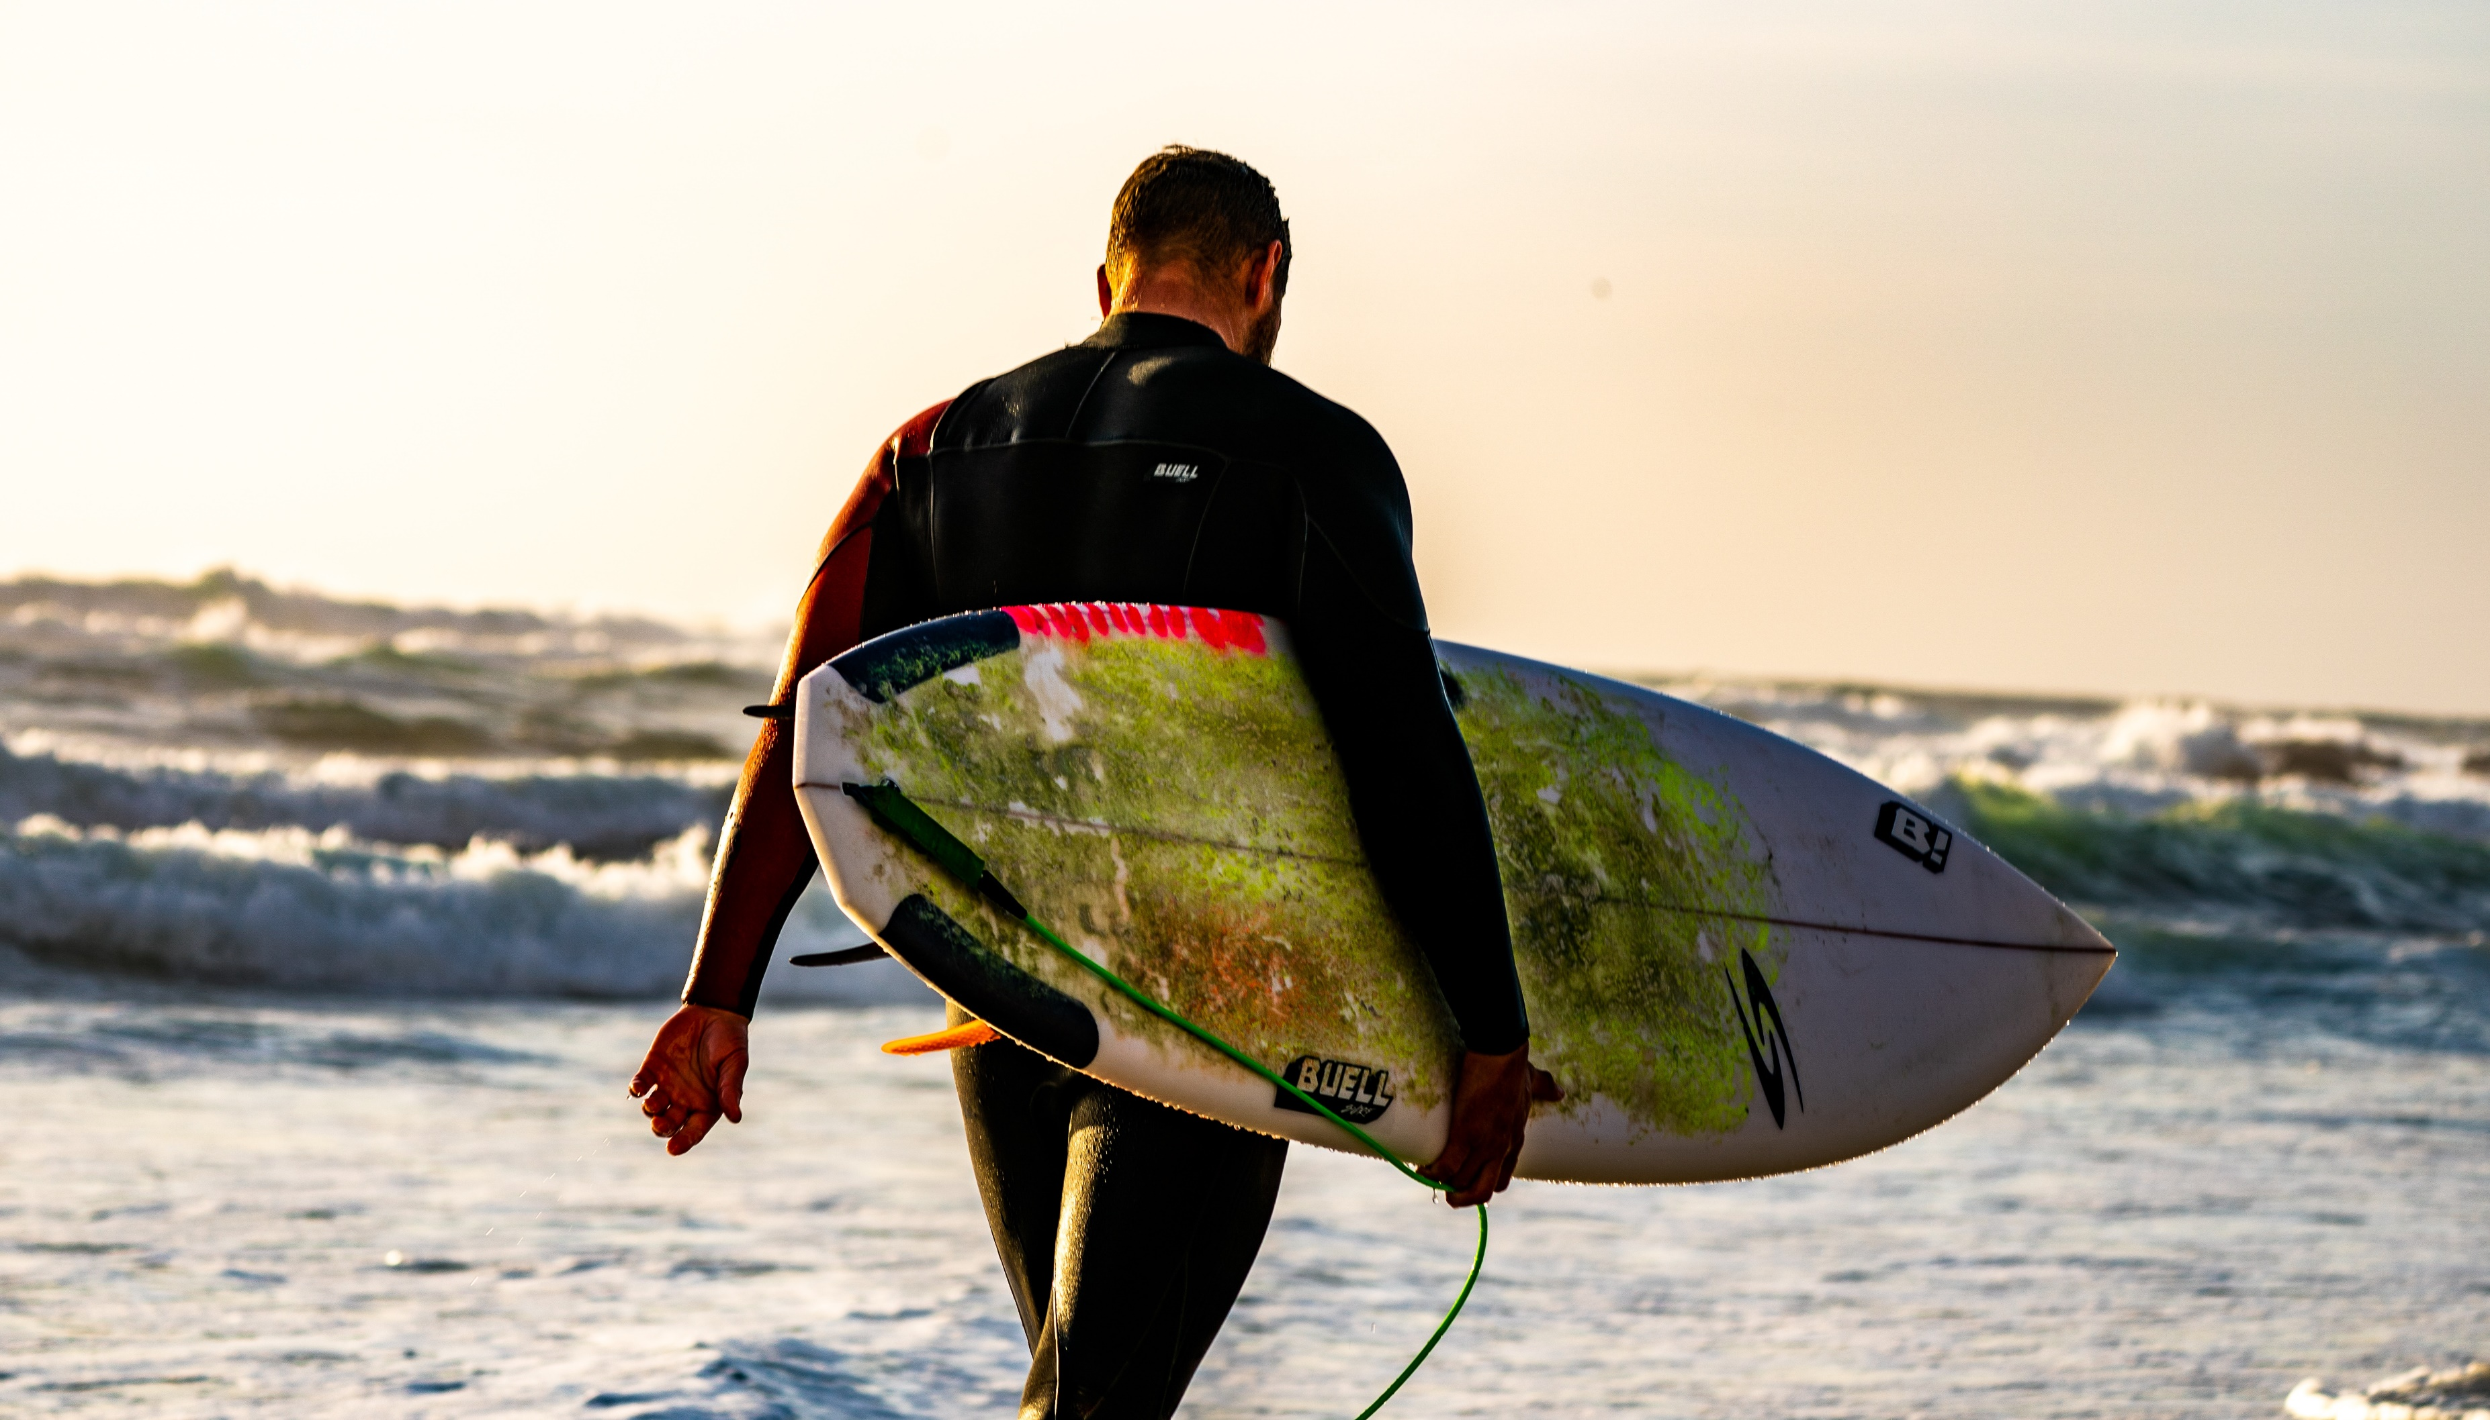
Your luxury TRAVEL
1,500,000
HAPPY CLIENTS
Notes:
https://unsplash.com/photos/1_gjTbx4o-E

Slide 7
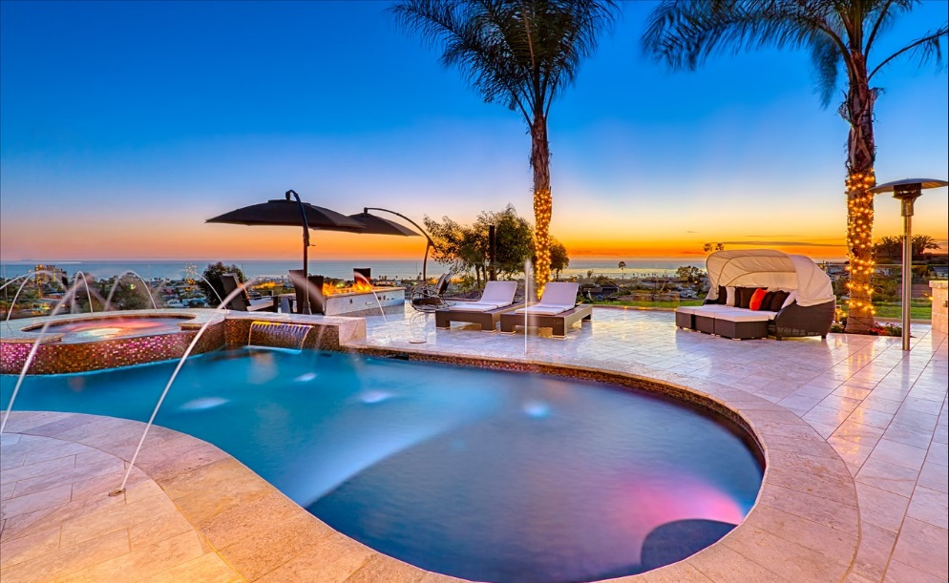
Start Your Adventure Now
Notes:
https://unsplash.com/photos/mPqo7JYGPI0 cycles
https://unsplash.com/photos/g2BWlyejtqg manhatan newyork
https://www.pexels.com/photo/landscape-sky-man-people-34511/ Norway mountains
https://www.facebook.com/JacquelinesDaySpa/photos/a.318606841532588/1357721280954467/?type=1&theater spa stones

Slide 8
Why Book With Company
PRICE
FLEXIBILITY
EXCLUSIVE DEALS
WHEREVER YOU ARE IN THE WORLD,
FTA WILL GIVE YOU PRICES THAT IS FIT WITH YOUR BUDGET,
WHEREVER YOU ARE IN THE WORLD,
FTA IS ON HAND TO HELP.
FTA OFFERS YOU GREAT EXCLUSIVE DEALS. WE WANT OUR CLIENT TO BE SATISFIED AND HAPPY.
MORE OPTIONS
SUPPORT
GLOBETROTTERS
FTA IS ALWAYS CONSISTENT.
WHEREVER YOU ARE IN THE WORLD,
FTA IS ON HAND TO HELP
WHEREVER YOU ARE IN THE WORLD,
FTA IS ON HAND TO HELP YOUR TRAVEL EXPENSES.

Slide 9
Your luxury TRAVEL
Travel
YOUR DREAM
Notes:
https://www.pexels.com/photo/group-of-person-walking-in-mountain-1365425/

Slide 10
Travel
YOUR DREAM
PRICE
FLIGHTS
TOURS
WORLD TRIP
SAVE UPTO 30%
WHEN YOU BUY ONLINE
SAVE UPTO 20%
WHEN YOU BUY ONLINE
SAVE UPTO 15%
WHEN YOU BUY ONLINE
SAVE UPTO 50%
WHEN YOU BUY ONLINE
Wherever you are in the world,
FTA will give you prices that is fit with your budget.
Wherever you are in the world,
FTA is on hand to help your flights expenses.
Wherever you are in the world,
FTA is on hand to help your tours expenses.
Wherever you are in the world,
FTA is on hand to help your world trip expenses.
Notes:
https://unsplash.com/photos/gSVFQvRKfq8

Slide 11
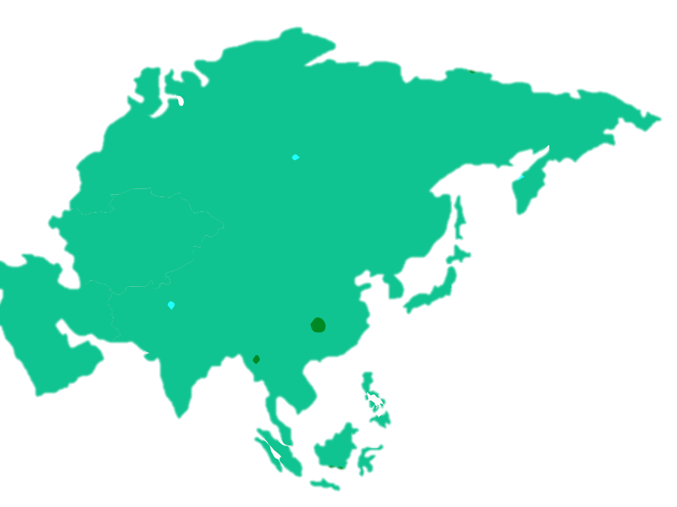
Travel AGENTS
WORLD MAP
1
MAIN OFFICE
978 UNIVERSITY ST. ROSELLE, IL 60172
MAIN OFFICE
1
2
714 BOWMAN STREET. NORTH MIAMI BEACH, FL 33160
3
5
MAIN OFFICE
2
3
323 FIFTH AVE. CANANDAIGUA, NY 14424
4
4
MAIN OFFICE
4 S. CHAPEL ST. OSWEGO, NY 13126
5
MAIN OFFICE
82 CLINTON STREET. SUN PRAIRIE, WI 53590
Notes:
BY PEXEL

Slide 12
Travel AGENTS
IN AFRICA
4
5
2
MAIN OFFICE
1
12 BRANCH DR. WOODSIDE, NY 11377
1
MAIN OFFICE
2
5 BLACKSMITH WAY. SAUGUS, MASSACHUSETTS(MA)
MAIN OFFICE
3
26 BOWMAN STREET. NORTH MIAMI BEACH, FL 3345
3
MAIN OFFICE
4
USA, 498 MAYFIELD AVE, NEW YORK, IL 85321
5
MAIN OFFICE
323 FIFTH AVE. CANANDAIGUA, NY 14424
Notes:
BY PEXEL

Slide 13
Enjoy
YOUR TRAVEL
Your luxury TRAVEL

