Slide 1
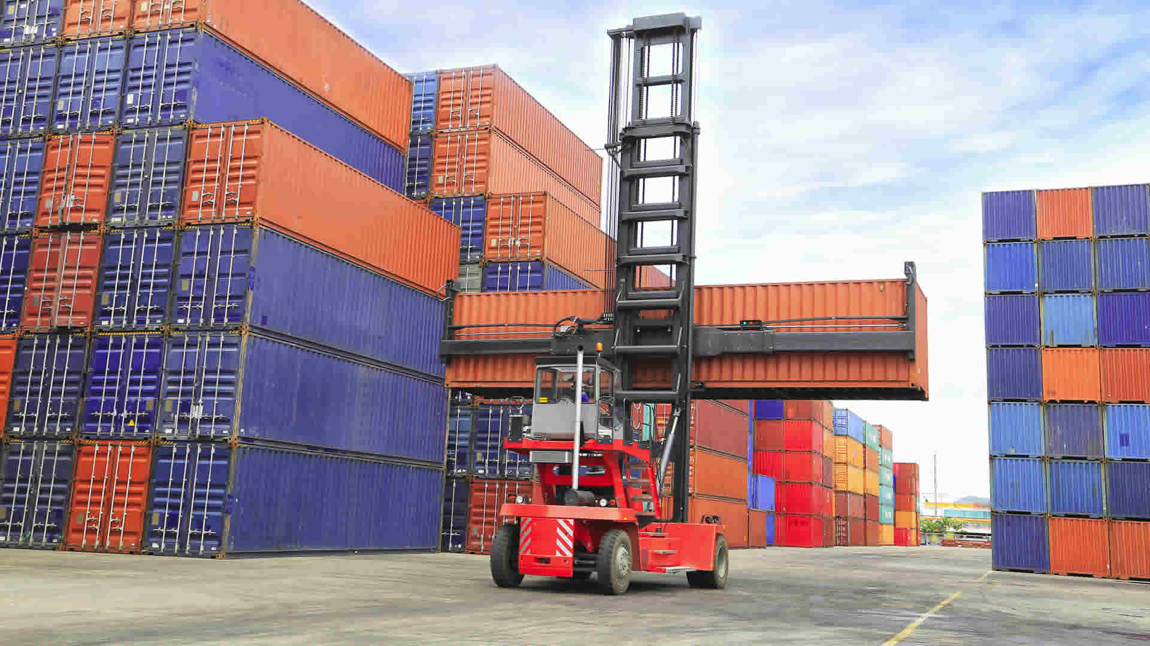
ST LOGISTIC COMPANY
PRESENTATION
Notes:
https://agrotranssur.com.ar/images/header-image/header-bg6.jpg

Slide 2
About Us
ST Logistics
“
Most businesses think that product is most the important thing, but without great leadership won’t make a company successful
-Robert Kiyosaki
”
Our company is a global logistics company, which serves leading businesses, governments, non-governmental organizations, not-for-profit.
We help customers to make long-term improvements of their performance and realize their most important goals.
Notes:
https://agrotranssur.com.ar/images/header-image/header-bg6.jpg

Slide 3
Ship
Train
Truck
Aircraft
Exclusively for the purpose of aiding teammates.
Transportation of trailers containing goods, raw materials or waste,
Improve management systems in order to enhance trucking operation.
Ensures right-in-time delivery
Notes:
https://www.shutterstock.com/image-photo/white-truck-on-asphalt-rural-road-62238007

Slide 4
DELIVERY UNLIMITED
COURIER SERVICES | CARGO SERVICES | WAREHOUSING SERVICES
Delivery Of Goods Of Different Weights In Your Region At Reasonable Price
Report
Delivery
Consultation
Borderless logistic
unlimited
Fastest Delivery
Borderless logistic
unlimited
Notes:
https://agrotranssur.com.ar/images/header-image/header-bg6.jpg

Slide 5
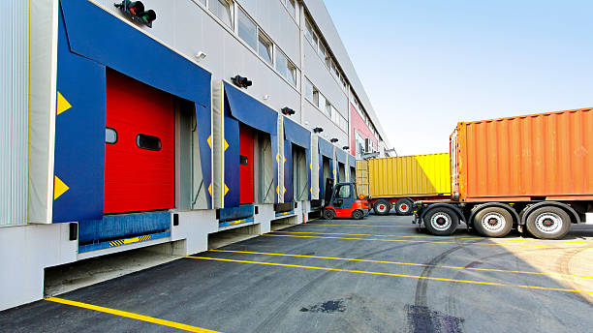
Logistic Management
together with passion
Tracking
Storage
Overseas
Turn over
Delivery
Use for tracking resources.
Order preparation, just in time distribution systems, flawless.
Provides overseas logistics tracking.
Provides logistics turn over.
Fastest pick-up and delivery.
Our firm is owned by 1400 plus partners, spread across Europe, the Americas, Asia Pacific, the Middle East and Africa.
Notes:
https://www.shutterstock.com/image-photo/forklift-trucks-cargo-dock-warehouse-63625063

Slide 6
App future
Fastest Delivery
Pay Bills and Money Send
Send Documents and Mail
Quickly
Simple
Available
Deliver your application
Schedule A Pick-Up
Branch Locator

Slide 7
What We Do?
Number One best services in America, Asia and Middle East
LOGISTIC
DELIVERY
SHOPPING
Our work with clients has always been at the intersection of deep industry expertise and extensive functional capabilities
This continues today across 22 sectors and 12 business areas
Our work with clients has always been at the good reputation. We ensure that the trust that they gave us never fails.
Our work with clients has always been at the smooth operation of a shopping center.
We are business
Notes:
https://www.kisspng.com/png-paper-cardboard-box-corrugated-fiberboard-packagin-2061913/

Slide 8
Our logisticians
Great company!
Searching
Saving
Go beyond analyzation and coordinate organizations supply chain.
Create savings by using the space between the sleeves for product increasing payload up to 10%.
Secure
Social
Go beyond logistic
make the world go round and secure business.
Management information and other resources including energy and people.
Notes:
https://www.shutterstock.com/image-photo/happy-postal-delivery-courier-van-delivering-56892856
https://www.pngfly.com/png-r1cij1

Slide 9
People, Partnership, Performance
JOHN BROWN
ST Logistics Expert
Hi Everyone, We Are Business
For Every Management, We Assemble A Team With Most Appropriate Experience And Expertise. No Matter The Challenge , We Focus On Delivering Practical And Enduring Results. And Equipping Our Clients To Grow And Lead. We Partner With Clients To Put Recommendations Into Practice.
Notes:
https://www.pngfly.com/png-bfuevt

Slide 10
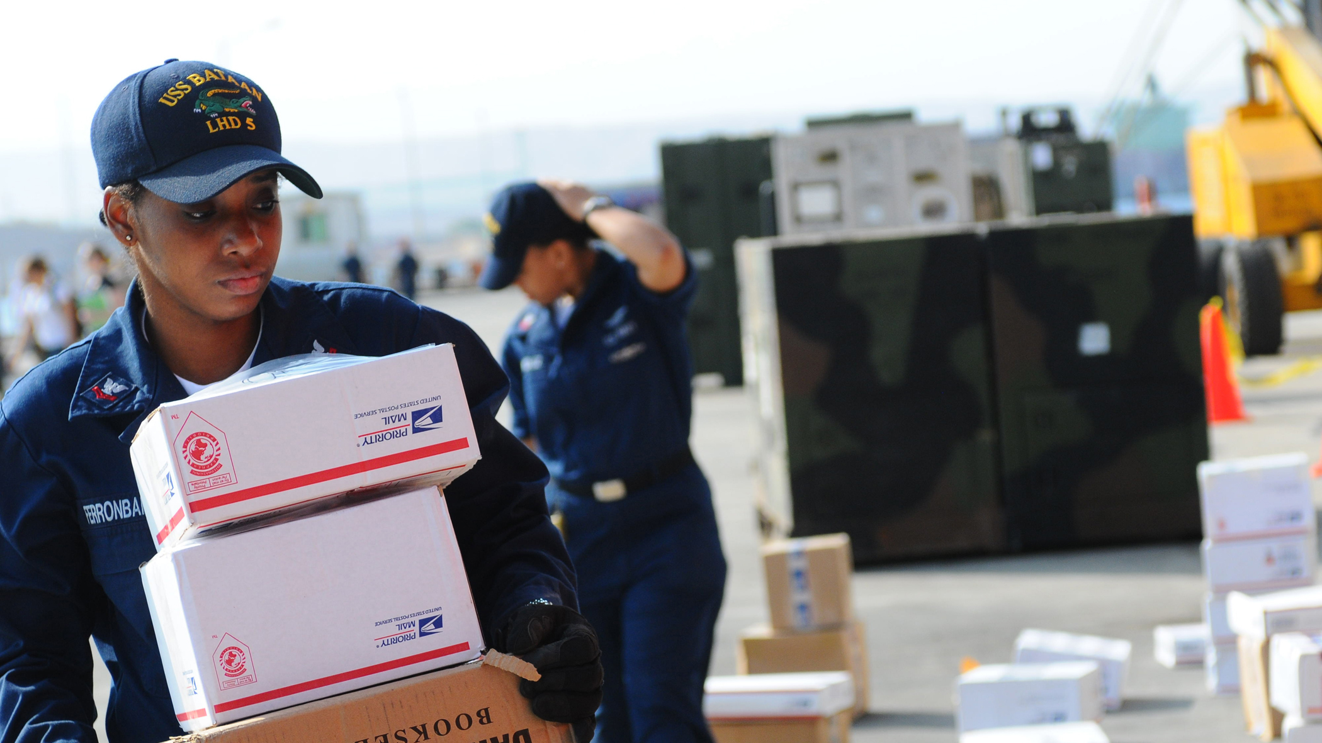
4 Goals
Objectives
Put client interests ahead of the firm’s fast shipping.
Increased efficiency.
Increased Sales.
Improved customer services.
Notes:
https://upload.wikimedia.org/wikipedia/commons/f/f3/US_Navy_091022-N-7508R-002_Logistics_Specialist_2nd_Class_Bridgette_FerronBarnes_sorts_mail_for_amphibious_assault_ship_USS_Bataan_%28LHD_5%29_while_in_port_Aqaba%2C_Jordan.jpg

Slide 11
Why Choose Our Company
Go beyond logistics make the world go round
We Deliver All
Over The World
We serve clients at every level of their organization, in whatever capacity we can be most useful, whether as a trusted advisor to top management as a hands-on-coach for front-line employees.
For every management, we assemble a team with the most appropriate experience and expertise.
Notes:
http://www.epowerfirst.com/manage/images/201810181944659.jpg

Slide 12
Our Happy Customers
We will make you satisfied always!
Solving Problems And Keeping Clients Happy
Great place to work! Great and talented people to work around! It was a productive and fun to work with all of my co-workers and team leads.
Great Company! Collaborative and Cooperative environment.
Very nice company! They help each other to maintain the Good Rating of the Group.
34
75
97
Awards Win
Fun Likes
Life Awards
Notes:
https://www.kisspng.com/png-paper-cardboard-box-corrugated-fiberboard-packagin-2061913/
https://www.sallogistics.com/pcat-gifs/products-small/door-to-door-delivery.jpg

Slide 13
YOUR PARCELS
are in safe hands
Notes:
https://www.shutterstock.com/image-photo/happy-postal-delivery-courier-van-delivering-56892856

Slide 14
LOGISTIC 1
LOGISTIC 2
Intelligent selection of people.
Sensitive to the needs with the needs of clients.
LOGISTIC 3
LOGISTIC 4
LOGISTIC 5
Work life balance.
Good Management.
Amazing Company!
Future delivery
All your delivery is in good hands!

Slide 15
Thank You
Our mission is to help our clients make distinctive, lasting and substantial improvements in their performance and to build a great firm that attracts, develops, excites and retains exceptional people.
Solving the hardest problems requires the best people.
Notes:
https://www.sallogistics.com/pcat-gifs/products-small/door-to-door-delivery.jpg

