Slide 1
AB ASIA MEDICAL
HEALTHCARE PRESENTATION

Slide 2
MEDICAL
CENTRE
PROMO
HEALTH
MEDICINE
FOR YOU
FREE PREGNANCY CHECKUP EVERY MONTH
FREE ALZHEIMER’S DISEASE ASSISTANCE EVERY MONTH
FREE MEDICINES FOR PATIENTS W/ TUBERCULOSIS
Notes:
https://www.pexels.com/photo/adult-doctor-girl-healthcare-355934/

Slide 3
TOP MEDICAL
SERVICE
MEDICAL
COMPANY
CLINICAL SERVICES OFFERS TO ALL AGE GROUPS (CHILDREN, ADOLESCENTS, ADULTS AND THE ELDERLY)
100%
100%
TRAINING OF MEDICAL CLERKS AND PODT-GRADUATE INTERNS
PATIENTS ARE CLOSELY MONITORED PRIOR, DUTING OR AFTER THE PROCEDURE.

Slide 4
WE ARE MEDICAL
TEAM
AMBULANCE PERSONNEL
DOCTORS
NURSE PRACTITIONERS
FIRST-AIDERS
HCA’S

Slide 5
BASED IN DEDICATED OUTPATIENT TRAINING CENTERS IN WHICH RESIDENTS WORKS
TRAINESS REQUIRED ATLEAST 6 MONTHS OF INPATIENT HOSPITAL EXPERIENCE
FAMILY
MEDICINE
Notes:
https://pxhere.com/en/photo/1446759

Slide 6
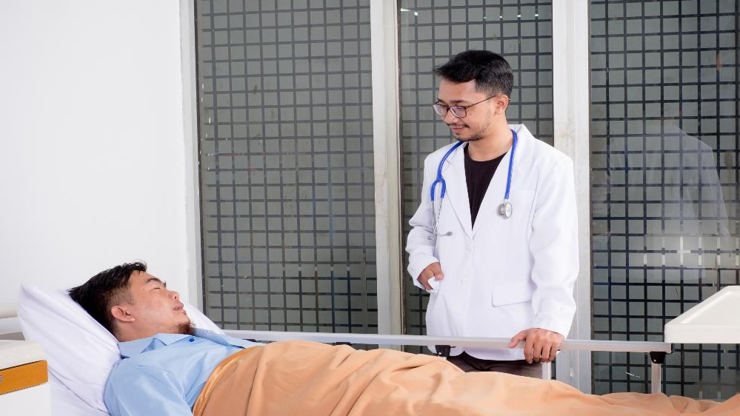
MEDICAL
CLINIC
TEST
MEDICAL EXAMINATION FEE
THIS MEDICAL FEE INCLUDES
PHYSICAL EXAMINATION & DOCUMENT FEE - $100
CHEST X-RAY - $100
ROUTINE URINALYSIS - $100
Notes:
https://unsplash.com/photos/YGkEFQqgI94
https://www.pexels.com/photo/man-wearing-gray-collared-top-1323867/

Slide 7
YOUR
TITLE HERE
WE ARE MEDICAL TEAM
FIRST-AIDERS
HCA’S
AMBULANCE PERSONNEL
DOCTORS
NURSE PRACTITIONERS

Slide 8
MEDICAL REAGENT TEST
AMNIOCENTESIS
BLOOD ANALYSIS
BLOOD COUNT
BLOOD TYPING
BONE MARROW ASPIRATION
ENZYME ANALYSIS
MEDICAL
ANALYLSIS

Slide 9
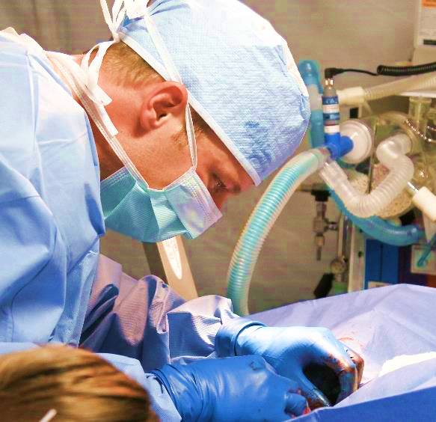
HEALTH SERVICE
CONSIST OF
MEDICAL PROFESSIONALS
ORGANIZATIONS
ANCILLARY HEALTH CARE WORKERS PROVIDES MEDICAL CARE TO THOSE IN NEED. HEALTH SERVICES SERVE PATIENTS, FAMILIES, COMMUNITIES, AND POPULATIONS.

Slide 10
OUR TEAM
DR. ALADDIN B. SEAN
DR. NITISHA M. YADAV
DR. AYN A. HEZI

Slide 11
THERAPY DOCTORS
THERAPY DOCTORS HELP PATIENTS MAKE DECISIONS AND CLARIFY PATIENTS FEELINGS IN ORDER TO SOLVE THEIR PROBLEMS.

Slide 12
HEALTH CENTER
SERVICES
PROVIDES HEALTH SERVICES CONSISTS OF
DERMATOHHOLOGY
UROLOGY
PSYCHIATRY
CARDIOLOGY
NEPHROLOGY

Slide 13
MEDICAL METHODOLOGY
SYSTEMATIC REVIEW AND METHODS FOR CLINICAL RESEARCH, META ANALYSIS / SYSTEMATIC REVIEW.
Notes:
https://www.pexels.com/photo/adult-ambulance-care-clinic-263210/

Slide 14
MEDICAL THERAPY
A COMBINATION OF NUTRITIOUS DIET, EXERCISES AND NO SMOKING.
79%
Notes:
https://pxhere.com/en/photo/1446749
https://pxhere.com/en/photo/1446759

Slide 15
YOUR
MEDICINE
79%
LEARN ABOUT MEDICATION SAFETY AND PRACTICAL TIPS.

Slide 16
DENTAL
CENTER
FREE DENTAL CHECK UP.
REMOVAL OF WISDOM TEETH
BADLY BROKEN TEETH
FREE DENTAL CHECKUP
PASTA
VENEER

Slide 17
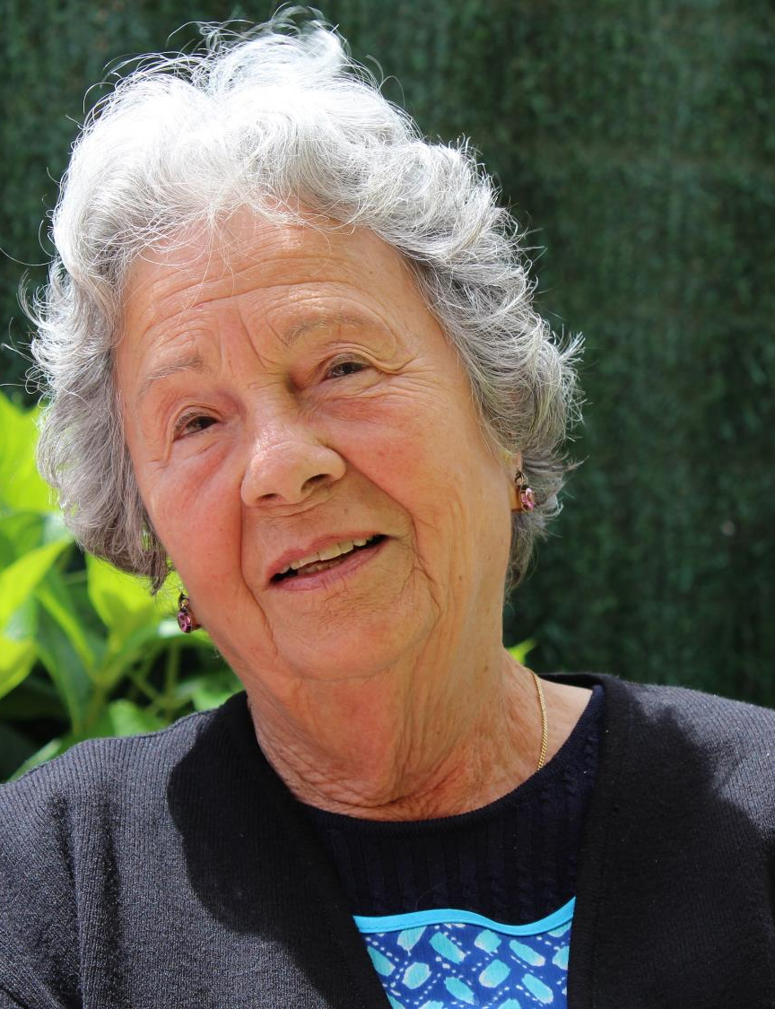
MEDICAL
SERVICES
FOR YOU
MEDICAL
CARE
79%
MAINTENANCE AND IMPROVEMENT OF HEALTH VIA DIAGNOSIS AND TREATMENT OF DISEASE.

Slide 18
THANKS
ENJOY AND BE HEALTHY

