Slide 1
MYNUMBERONESHOP
OUR SPECIAL OFFERS!
Notes:
https://www.kisspng.com/png-shopping-cart-clip-art-online-shopping-shopping-ba-6713387/download-png.html

Slide 2
MYNAMBAWANSHOP
TELEVISION 22”
High dynamic range. Amazing quality.
00
500
SAVE
30%
(1200.00)
Notes:
https://zhf1943ap1t4f26r11i05c7l-wpengine.netdna-ssl.com/wp-content/uploads/2018/02/samsung-android-smart-tv-640x640.png

Slide 3
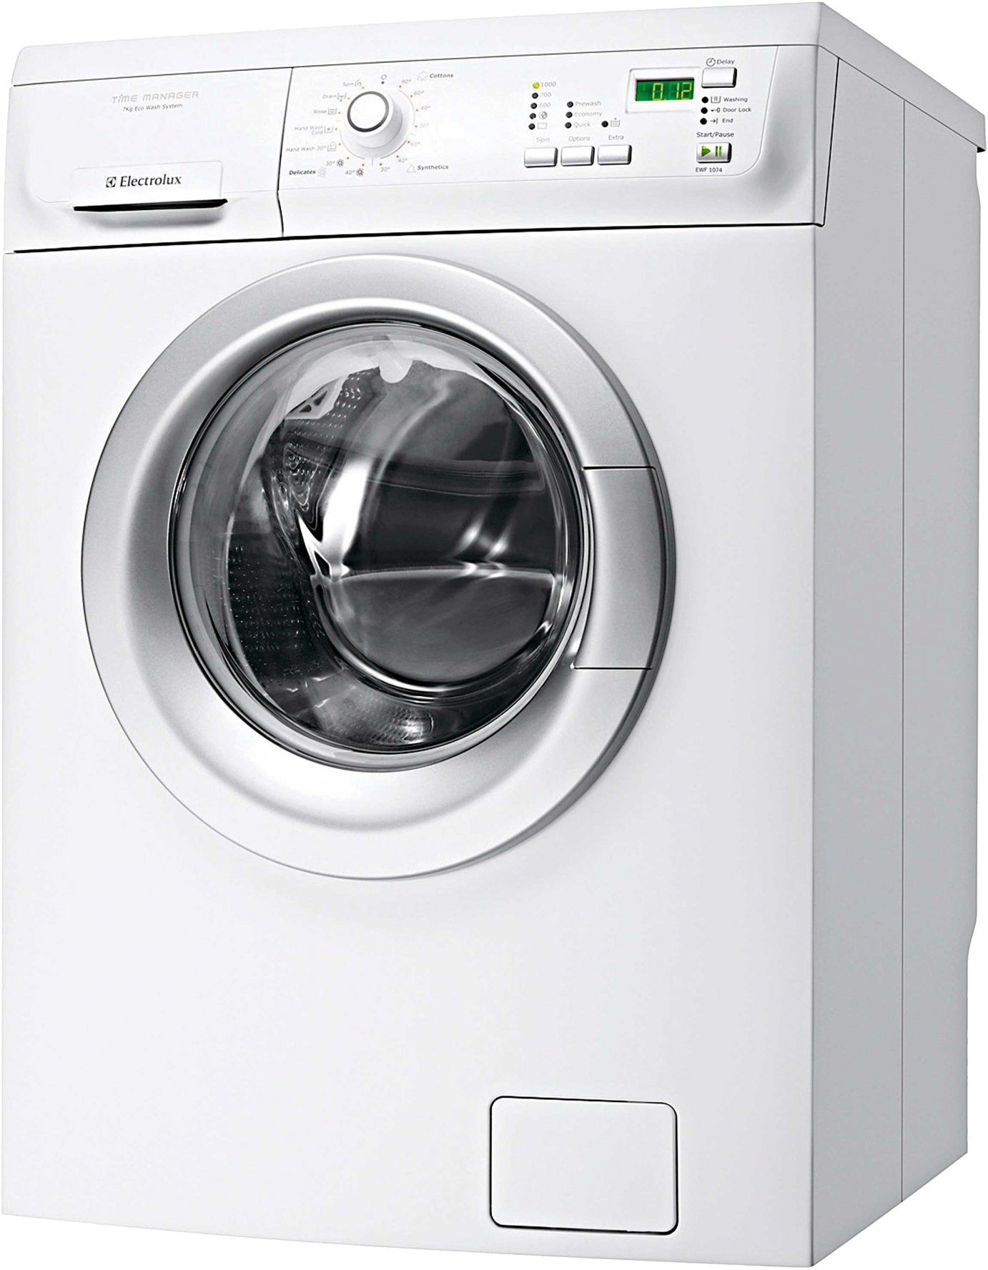
MYNAMBAWANSHOP
WASHING MACHINE
Spins like no other. Cleans everything, Saves water and electricity.
00
1000
(600.00)
-50%
SPECIAL OFFER!
DETERGENTS FOR HALF PRICE!
Notes:
https://www.snipstock.com/image/png-images-washing-machine-9-png-23017

Slide 4
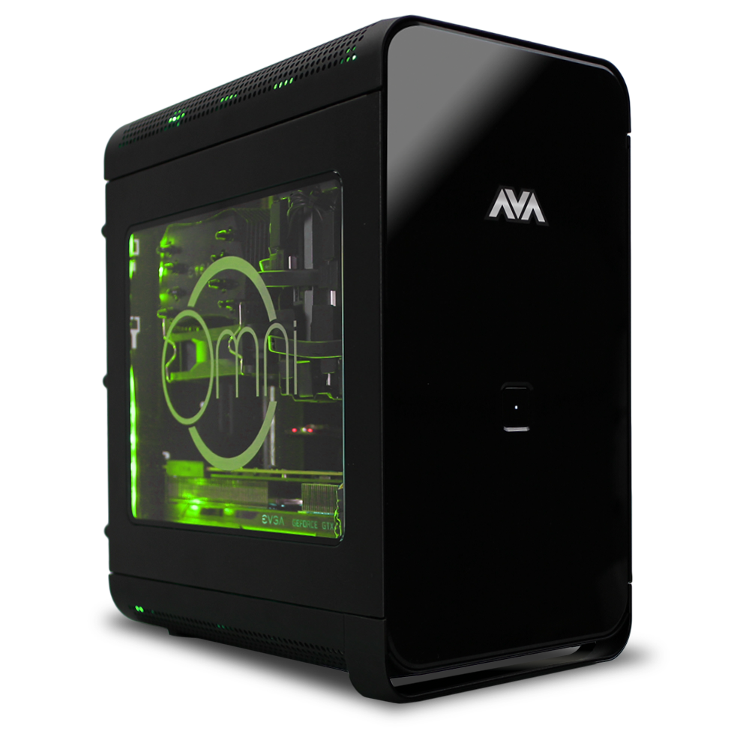
MYNAMBAWANSHOP
AMAZING
SALE!
-33%
DESKTOP COMPUTER
3.6 GHz, 16 GB DDR4 RAM, GFX 900, 8 GB GDDR5 VRAM
400
00
(1100.00)
Notes:
https://www.pngfly.com/png-jlibzn/

Slide 5
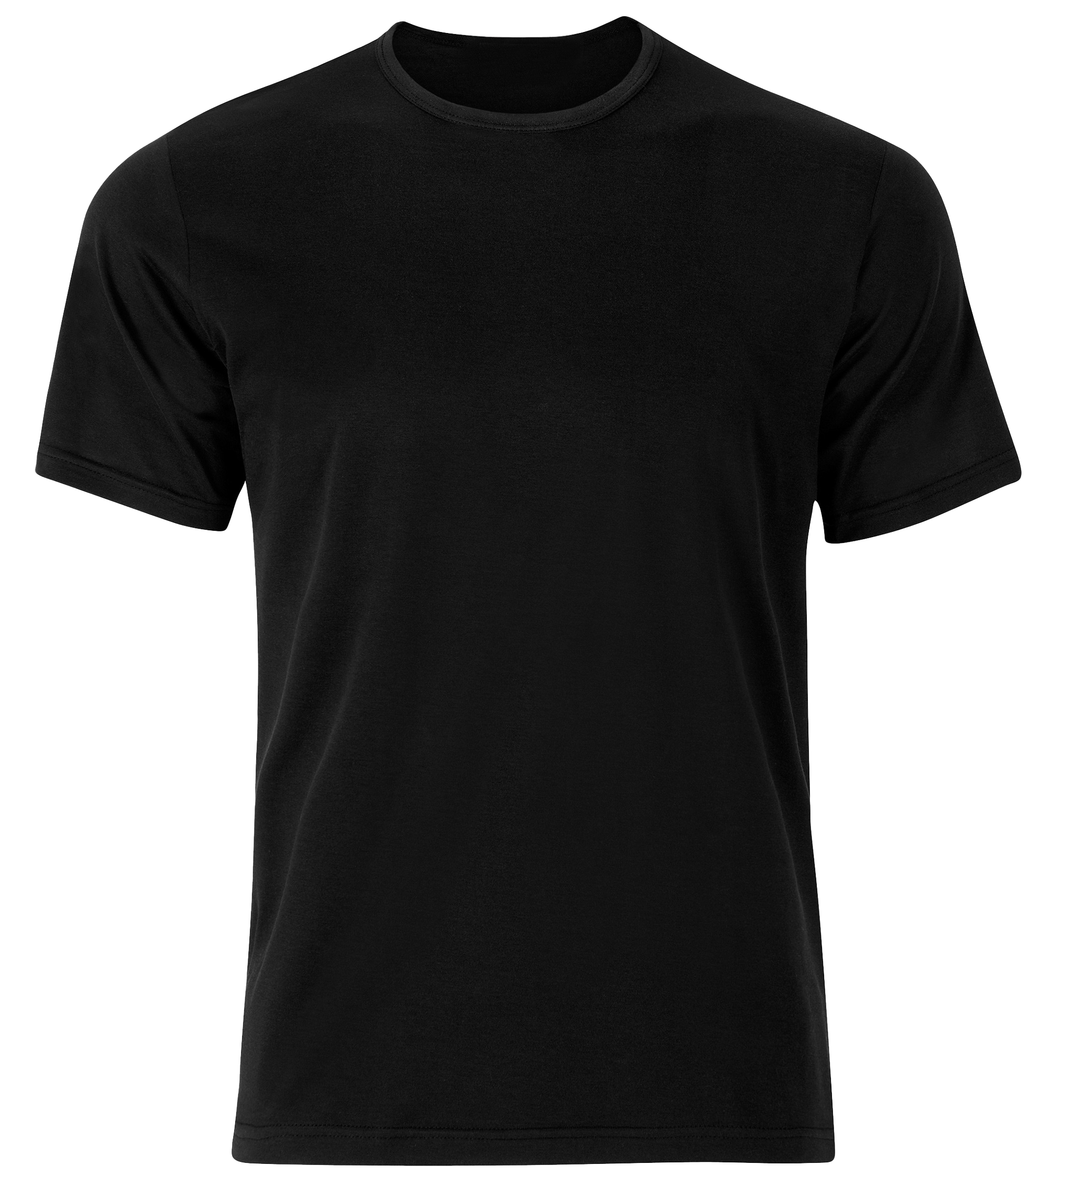
MYNAMBAWANSHOP
BRANDED T-SHIRT
Cool t-shirt with an amazing brand! All sizes, various colors.
20
00
(20.00)
-50%
SPECIAL OFFER!
BUY TWO GET ONE FREE!
Notes:
https://www.kisspng.com/png-t-shirt-polo-shirt-clothing-sleeve-black-t-shirt-83688/

Slide 6
MYNUMBERONESHOP
VISIT WWW.M1SHOP.COM
FOR MORE SPECIAL PRICES!
Notes:
https://www.kisspng.com/png-shopping-cart-clip-art-online-shopping-shopping-ba-6713387/download-png.html

Slide 7
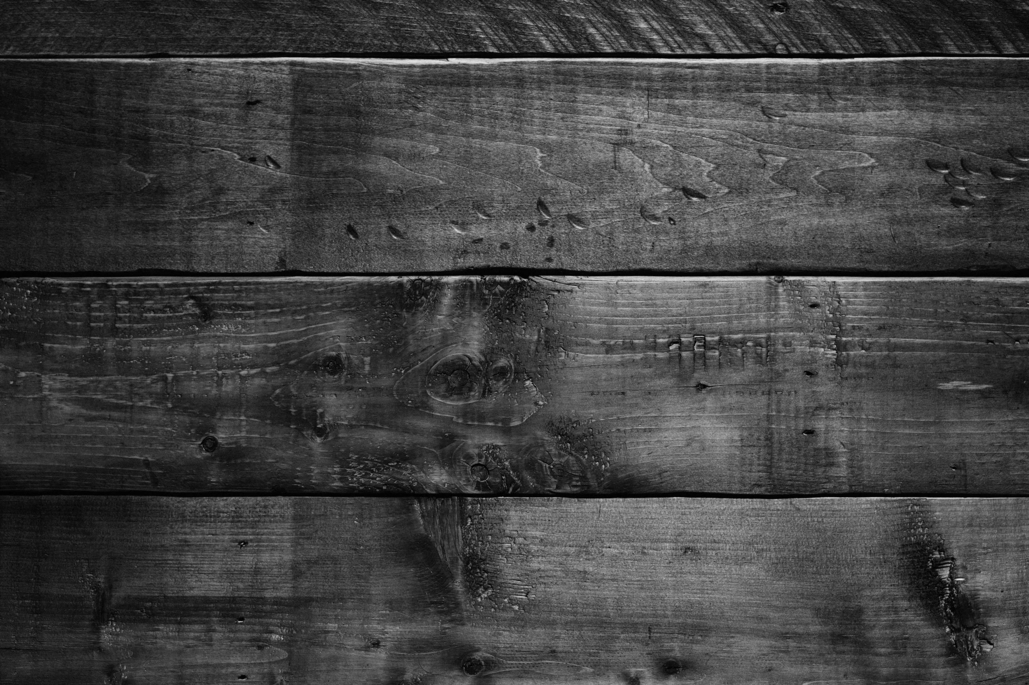
THIS WEEK’S OFFER
Notes:
https://www.pngfly.com/png-yk6o02/
https://unsplash.com/photos/xVKEZ9wVIYM

Slide 8
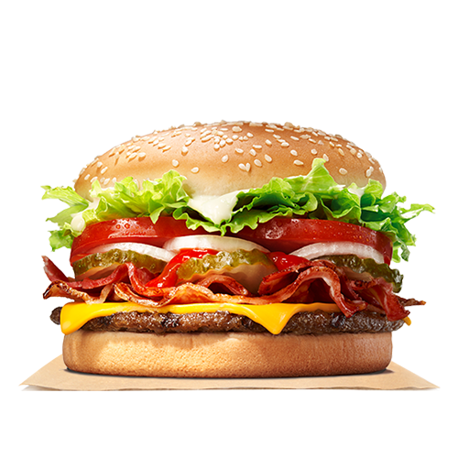
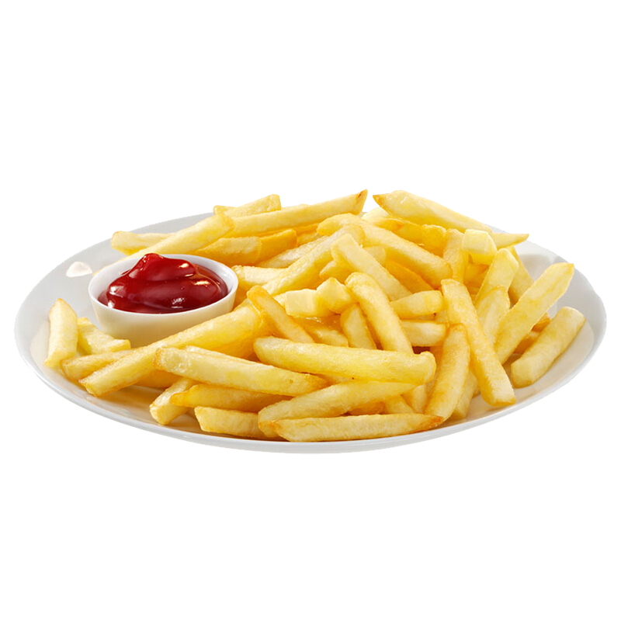
CHEESEBURGER MEAL
Delicious cheeseburger with coke and
French fries. Choose your Mayo!
00
¹⁰
BIG SIZE!
12OZ
Notes:
https://unsplash.com/photos/xVKEZ9wVIYM

Slide 9
HAPPY HOUR!
All cocktails between 4 pm and 6 pm.
Buy 2 get 1 for free
00
¹⁵
Notes:
https://www.pngfly.com/png-h36bs9/

Slide 10
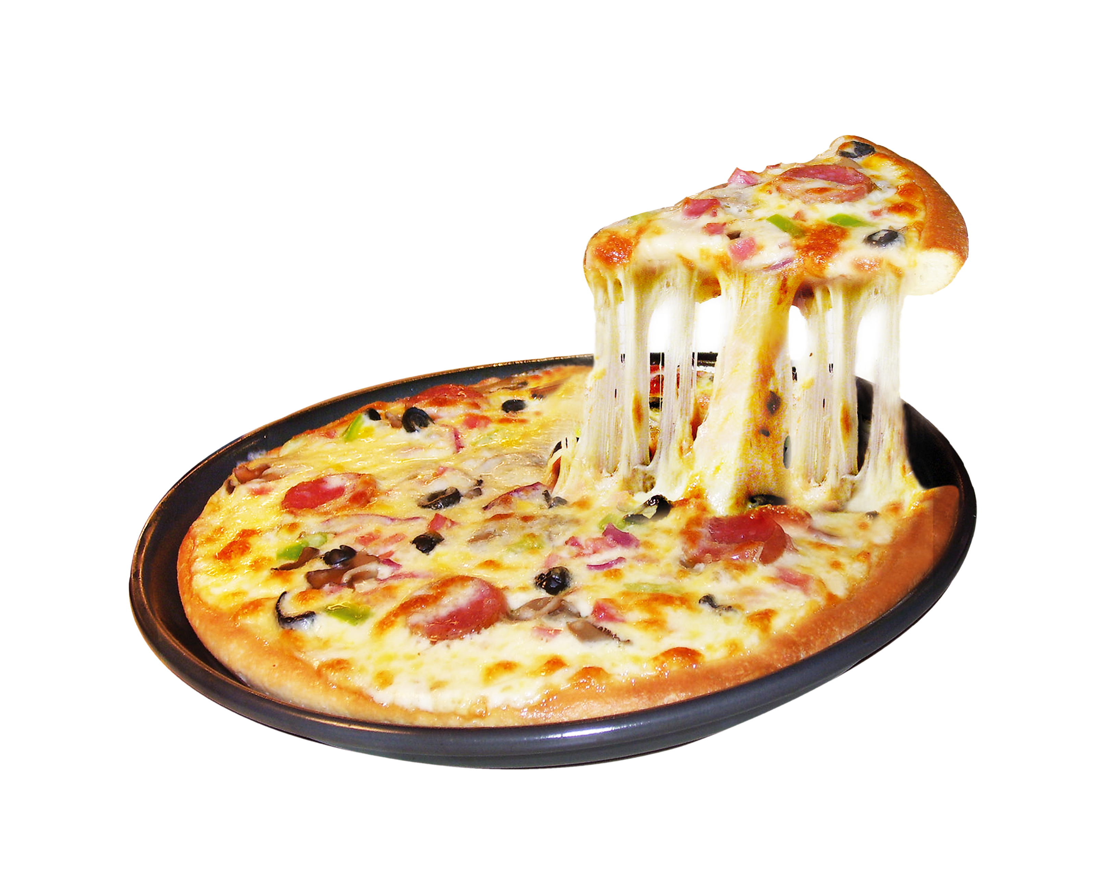
WEEKLY SPECIAL PIZZA
One topping pizza and 4 medium sodas
Or a 2-liter bottle of soda.
00
²⁰
FAMILY SIZE
HUGE
Notes:
https://www.pngfly.com/png-y9ddlg

Slide 11
VISIT WWW.UNLIFILIBBQRESTAURANT.COM
FOR MORE SPECIAL PRICES!
Notes:
https://www.pngfly.com/png-yk6o02/
https://unsplash.com/photos/xVKEZ9wVIYM

Slide 12
ADD PRICETAGS & CONFETTI!
SALE
SALE
SAVE
BIG SAVE!
SALE
50%
-33%
-30%
UPPER ROW
LOWER ROW
UPPER ROW
LOWER ROW
-15%
-20%
Promo Runs until December 2020
SPECIAL OFFER!
BUY ONE GET ONE FOR FREE!
50%

