Slide 1
SALE PROMO
WWW.SALENATHIS.COM

Slide 2
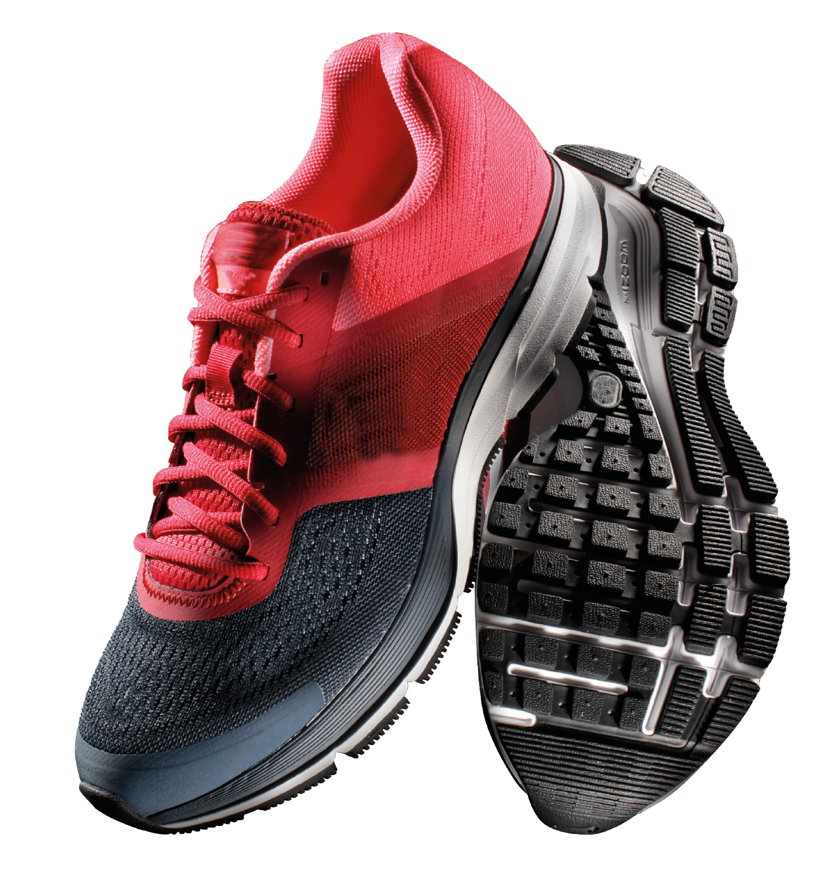
SUPPORTS RUBBER
Men shoes size: 39-44
Shoe Color: Black | Red | White
$200
BUY NOW
WWW.SALENATHIS.COM
Notes:
https://ya-webdesign.com/image/nike-shoes-png/782472.html

Slide 3
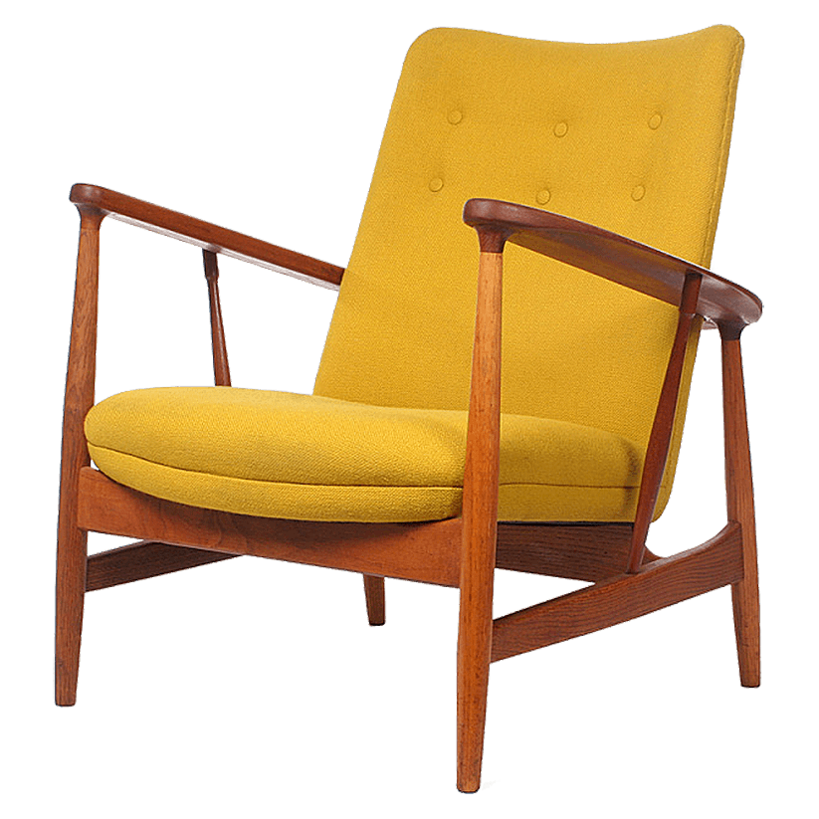
MODERN DESIGN
Size: Width: 140cm
Color: Yellow | Red | Black
Brand new
$100
BUY NOW
WWW.SALENATHIS.COM
Notes:
https://www.freepngs.com/chair-pngs

Slide 4
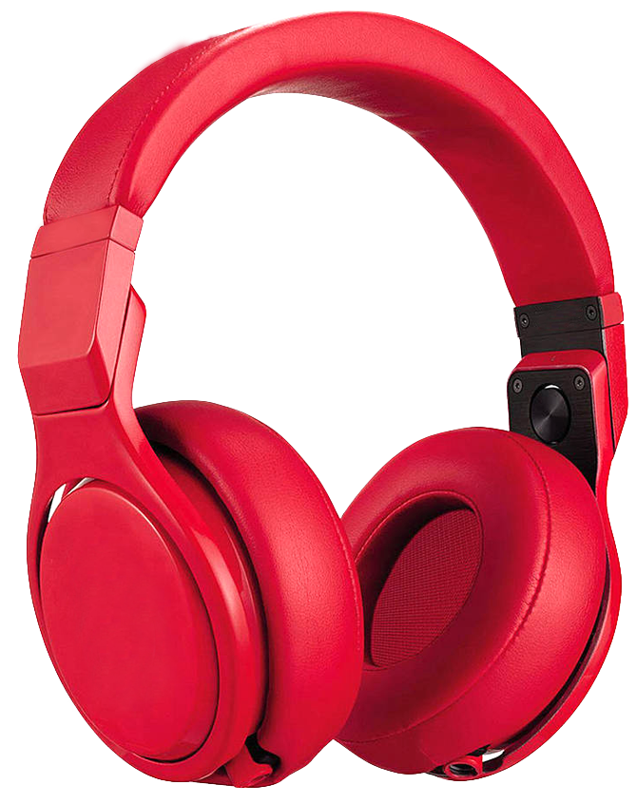
SONY HEADPHONE
Sensitivity : 102dB/mW
Frequency response: 5Hz-22,000Hz
w/ Noise Cancellation
$100
BUY NOW
WWW.SALENATHIS.COM
Notes:
https://www.kisspng.com/png-headphones-beats-electronics-microphone-sound-disc-90672/download-png.html

Slide 5
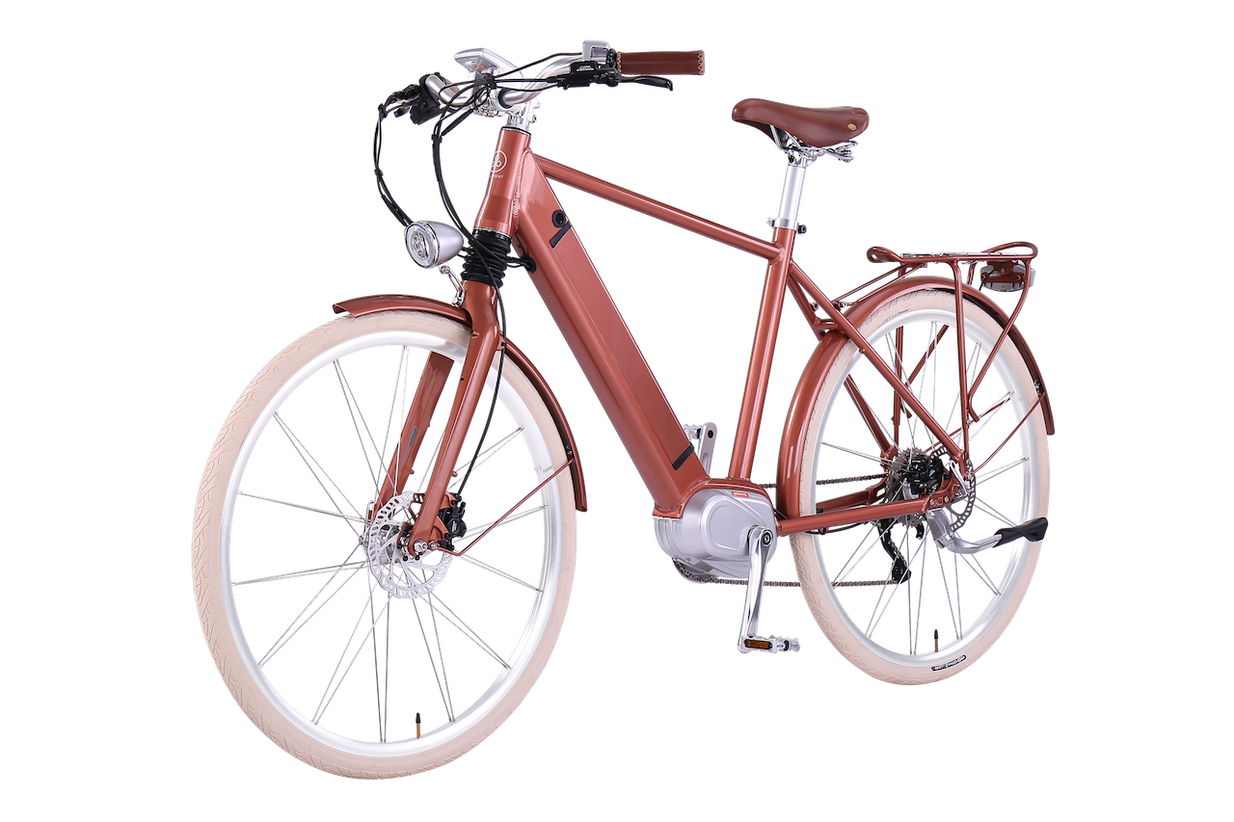
CUSTOMIZE BIKE
Gold seat post lock
33 spokes / radius
Leather brown seat
Red bar tape
Free medium helmet, bike lock and pump
$500
BUY NOW
WWW.SALENATHIS.COM
Notes:
https://www.pngfly.com/png-wpscyi/

Slide 6
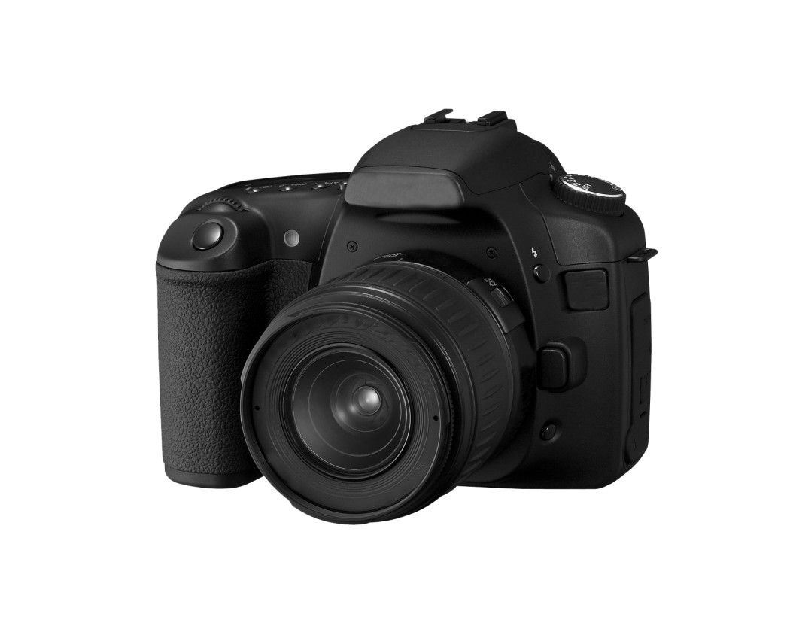
CANON SX50HS
Camera Bag
Camera Strap
Charger
4 batteries
Charger
2 pcs. CD’s (Manual/Driver)
$1800
BUY NOW
WWW.SALENATHIS.COM
Notes:
https://www.snipstock.com/image/png-images-camera-24-png-22255

Slide 7
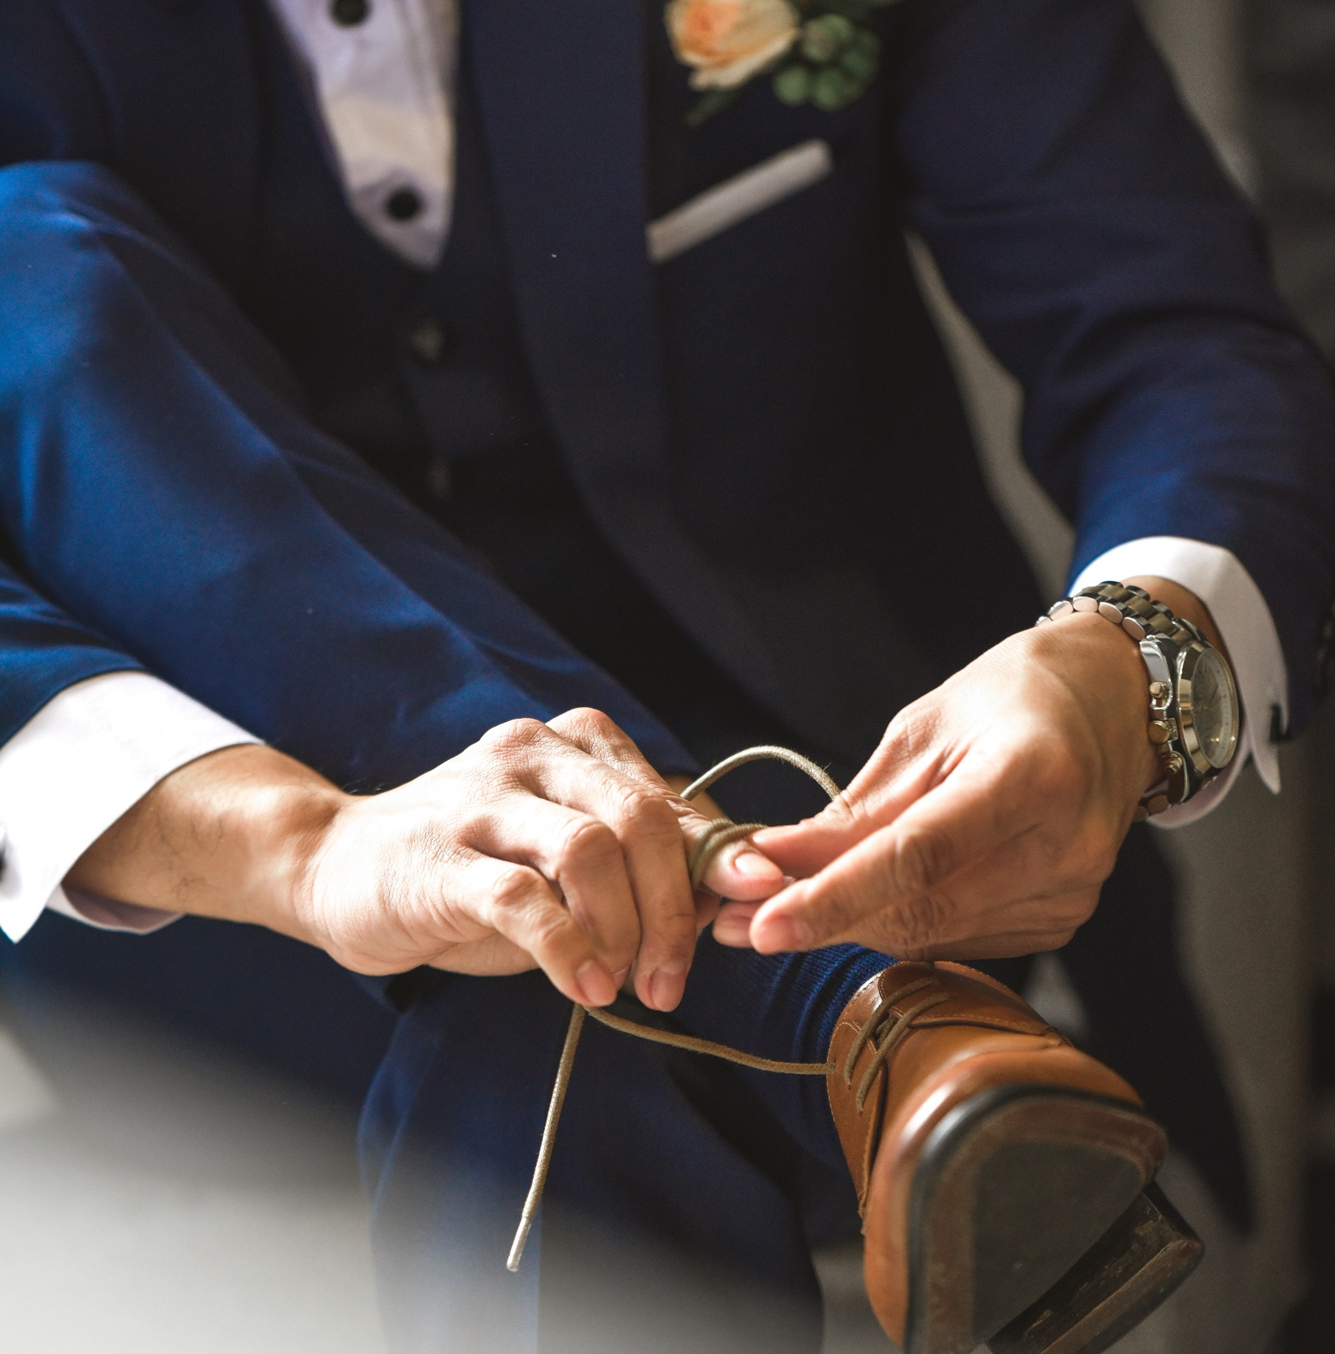
BROWN LEATHER SHOES
Synthetic Leather
$150
BUY NOW
WWW.SALENATHIS.COM
Notes:
https://unsplash.com/photos/p-ZVPT5tAzY

Slide 8
RED HEELS
Heel Height: 3"-4"
Material: Leather
Color: Red
Size: 8
$100
BUY NOW
WWW.SALENATHIS.COM
Notes:
http://www.barraques.cat/imgdirs/big/4/44294_shoe-wallpaper-iphone.jpg

Slide 9
HOMEMADE CUP CAKES
10 pcs. of sweet homemade cup cakes
$15
WWW.SALENATHIS.COM
Notes:
https://unsplash.com/photos/cKJ8ZxQ2bC8

Slide 10
SALE PROMO
WWW.SALENATHIS.COM

