Slide 1
Find…

Slide 2
Best Bag packs under $200

Slide 3
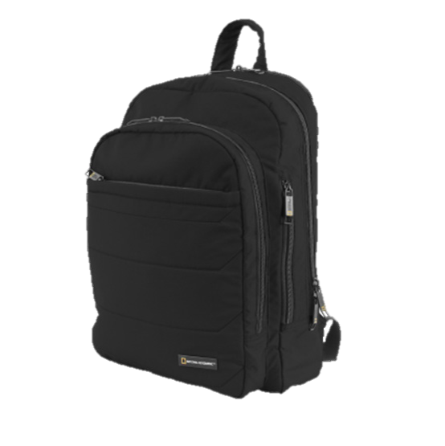
New York, USA
BAGGYBEST
1-800-123-4567
AMERICAN
TOURISTER
$139
XS S M XL
50% WOOL
30% COTTON
20% POLYESTER
Notes:
https://www.pexels.com/photo/blank-cement-concrete-corner-984541/
https://4bag.gr/wp-content/uploads/2018/04/backpack-black-national-geografic-1.jpg

Slide 4
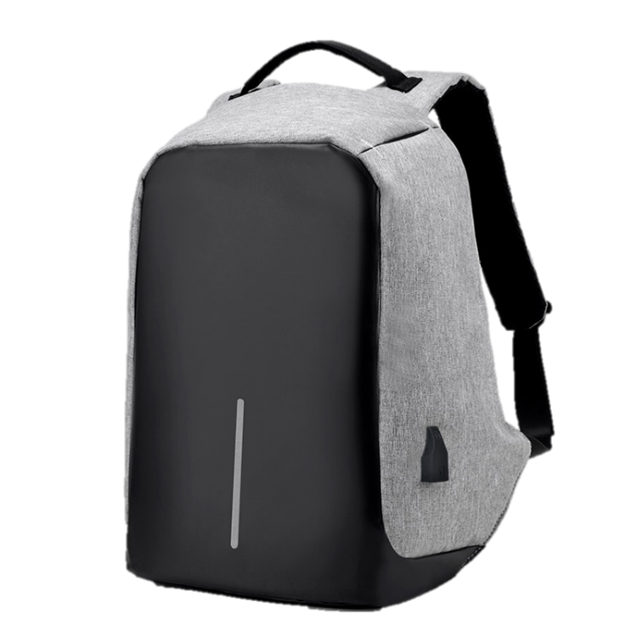
New York, USA
BAGGYBEST
1-800-123-4567
AWSOME
BACKPACK
$ 99
XS S M XL
50% WOOL
30% COTTON
20% POLYESTER
Notes:
https://oraclegadget.com/wp-content/uploads/2018/09/Third-Generation-USB-Charge-Anti-Theft-Backpack-Men-15inch-Laptop-Backpacks-Fashion-Travel-School-Bags-Bagpack-3.jpg

Slide 5
New York, USA
BAGGYBEST
1-800-123-4567
AMERICAN
TOURISTER
AWSOME
BACKPACK
AMERICAN
TOURISTER
$119
$99
$199
XS S M XL
XS S M XL
XS S M XL
50% WOOL
30% COTTON
20% POLYESTER
50% WOOL
30% COTTON
20% POLYESTER
50% WOOL
30% COTTON
20% POLYESTER
Notes:
https://www.pexels.com/photo/blank-cement-concrete-corner-984541/
https://4bag.gr/wp-content/uploads/2018/04/backpack-black-national-geografic-1.jpg
https://oraclegadget.com/wp-content/uploads/2018/09/Third-Generation-USB-Charge-Anti-Theft-Backpack-Men-15inch-Laptop-Backpacks-Fashion-Travel-School-Bags-Bagpack-3.jpg

Slide 6
New York, USA
BAGGYBEST
1-800-123-4567
AMERICAN
TOURISTER
MIKE SMITH
I LOVE THE SEPARATE COMPARTEMENTS OF THIS BAG
BECAUSE THEY KEEP EVERYTHING ORGANIZED, EXCELLENT BUY!
XS S M XL
JOHN SANT
50% WOOL
30% COTTON
20% POLYESTER
THIS BACKPACK LOOKS SMALL FROM THE OUTSIDE BUT IT EASILY FITS MY 15.6 ‘’ LAPTOP, IPAD, MOUSE, PENS,PENCILS AND STILL HAS SOME ROOM.
$299
Notes:
https://www.pexels.com/photo/blank-cement-concrete-corner-984541/
https://4bag.gr/wp-content/uploads/2018/04/backpack-black-national-geografic-1.jpg

Slide 7
New York, USA
BAGGYBEST
1-800-123-4567
AMERICAN
TOURISTER
ONE SEPARATE LAPTOP COMPARTMENT HOLD 15.6 INCH LAPTOP AS WELL AS 15 INCH, 14 INCH AND 13 INCH MACBOOK/LAPTOP.
A LUGGAGE STRAP ALLOWS BACKPACK FIT ON LUGGAGE/SUITCASE.
SLIDE OVER THE LUGGAGE UPRIGHT HANDLE TUBE FOR EASIER CARRYING.
XS S M XL
50% WOOL
30% COTTON
20% POLYESTER
$199
Notes:
https://www.pexels.com/photo/blank-cement-concrete-corner-984541/
https://4bag.gr/wp-content/uploads/2018/04/backpack-black-national-geografic-1.jpg

Slide 8
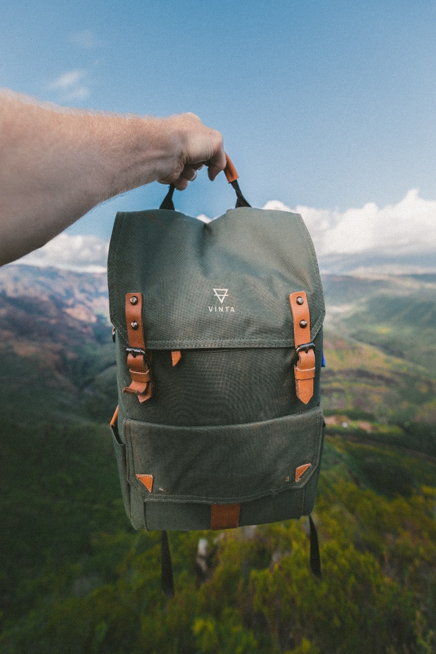
New York, USA
BAGGYBEST
1-800-123-4567
WHO ARE WE
ONE SEPARATE LAPTOP COMPARTMENT HOLD 15.6 INCH LAPTOP AS WELL AS 15 INCH, 14 INCH AND 13 INCH MACBOOK/LAPTOP.
A LUGGAGE STRAP ALLOWS BACKPACK FIT ON LUGGAGE/SUITCASE.
SLIDE OVER THE LUGGAGE UPRIGHT HANDLE TUBE FOR EASIER CARRYING.
Notes:
https://unsplash.com/photos/O_bhy3TnSYU
https://unsplash.com/photos/9nUAVoddLwM

Slide 9
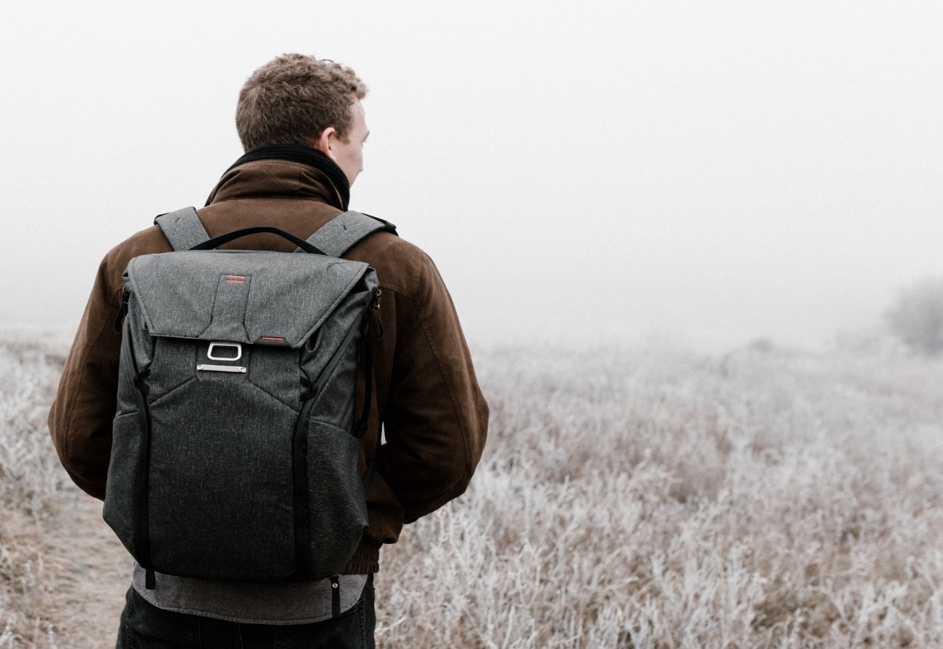
New York, USA
BAGGYBEST
1-800-123-4567
SOME DISCRIPTION
ONE SEPARATE LAPTOP COMPARTMENT HOLD 15.6 INCH LAPTOP AS WELL AS 15 INCH, 14 INCH AND 13 INCH MACBOOK/LAPTOP.
A LUGGAGE STRAP ALLOWS BACKPACK FIT ON LUGGAGE/SUITCASE.
SLIDE OVER THE LUGGAGE UPRIGHT HANDLE TUBE FOR EASIER CARRYING.
Notes:
https://unsplash.com/photos/O_bhy3TnSYU
https://unsplash.com/photos/9nUAVoddLwM

Slide 10
New York, USA
BAGGYBEST
1-800-123-4567
OUR CONTACT
OUR BENEFITS
ADDRESS: 1177 AV OF THE AMERICAS
WEBSITE: BEST_BACKPACKS.COM
INSTAGRAM: BEST_BACKPACKS
TEL: 1-800-123-4567
HIGH QUALITY
DURABLE MATERIALS
FREE DELIEVERY
MONEY BACK GUARANTEE
Notes:
https://unsplash.com/photos/O_bhy3TnSYU
https://unsplash.com/photos/9nUAVoddLwM

Slide 11
Find…
{
{

Slide 12
Best Drones under $1000
{
{

Slide 13
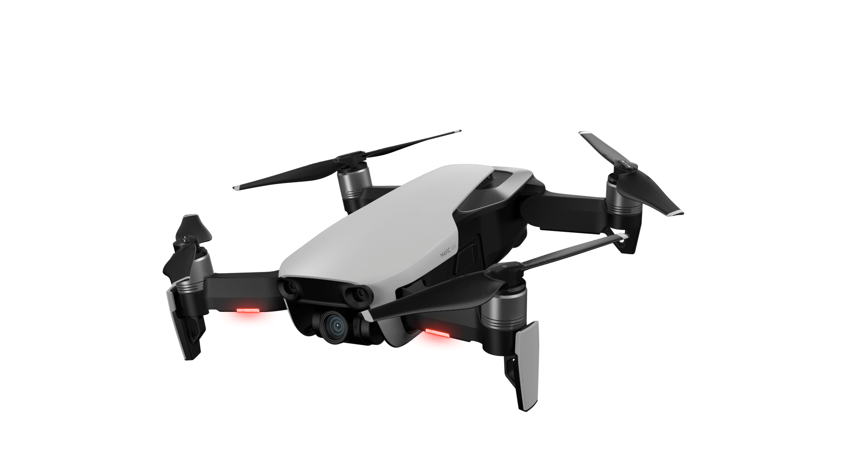
New York, USA
BAGGYBEST
1-800-123-4567
MAVIC
AIR
$599
XS S M XL
. Plug type USB cable
Product color white
Remote control distance 50-80 meters
Product size Open: 11*11*3.5 CM
Folding: 5.5*3.5*7.5CM
Lifetime 1 hour
{
{
Notes:
https://www.pexels.com/photo/blank-cement-concrete-corner-984541/
https://4bag.gr/wp-content/uploads/2018/04/backpack-black-national-geografic-1.jpg

Slide 14
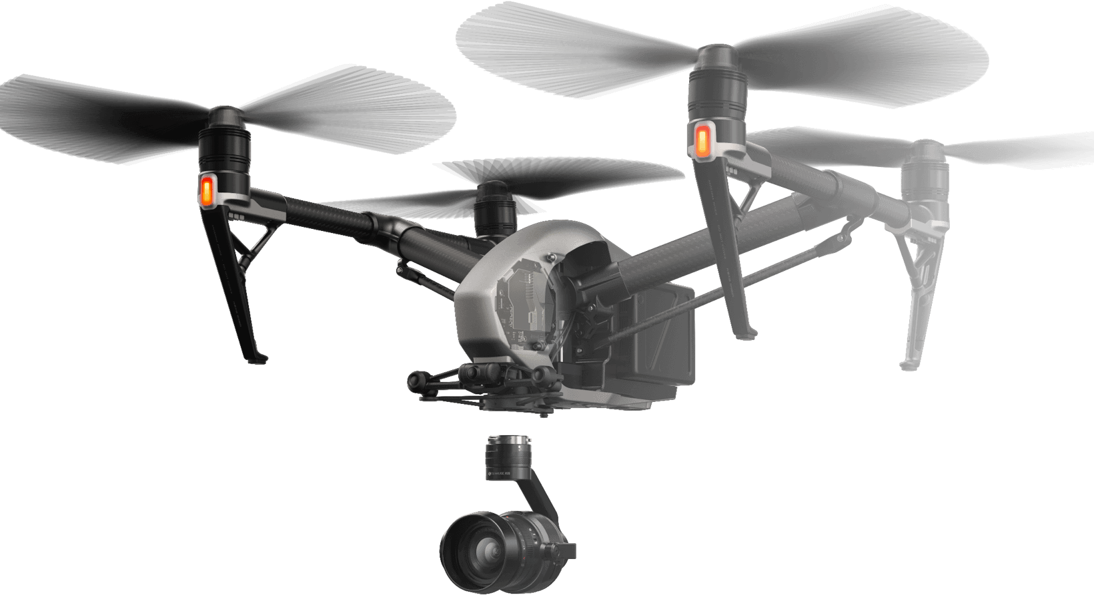
New York, USA
BAGGYBEST
1-800-123-4567
MAVIC
PRO OSMO
$799
XS S M XL
. Plug type USB cable
Product color black
Remote control distance 60-80 meters
Product size Open: 11*11*3.5 CM
Folding: 5.5*3.5*7.5CM
Lifetime 1 hour
{
{
Notes:
https://www1.djicdn.com/assets/images/products/zenmuse-x5s/v2/s4-p1-a8eda484604a5a41602c2b06fc3afe72.png

Slide 15
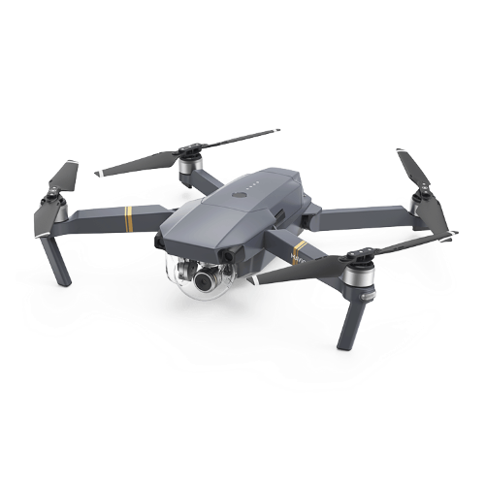
New York, USA
BAGGYBEST
1-800-123-4567
MAVIC
PRO 2
$499
XS S M XL
. Plug type USB cable
Product color grey
Remote control distance 50-90 meters
Product size Open: 12*11*3.5 CM
Folding: 5.5*3.5*7.5CM
Lifetime 1 hour
{
{
Notes:
https://www1.djicdn.com/assets/images/products/zenmuse-x5s/v2/s4-p1-a8eda484604a5a41602c2b06fc3afe72.png

Slide 16
New York, USA
BAGGYBEST
1-800-123-4567
MAVIC
PRO OSMO
MAVIC
AIR
MAVIC
PRO 2
$499
$399
$899
XS S M XL
XS S M XL
XS S M XL
. Plug type USB cable
Product color white black red
Remote control distance 50-80 meters
Product size Open: 11*11*3.5 CM
Folding: 5.5*3.5*7.5CM
Lifetime 1 hour
. Plug type USB cable
Product color white
Remote control distance 50-90 meters
Product size Open: 12*11*3.5 CM
Folding: 5.5*3.5*7.5CM
Lifetime 1 hour
. Plug type USB cable
Product color white
Remote control distance 50-60 meters
Product size Open: 12*11*3.5 CM
Folding: 5.5*3.5*7.5CM
Lifetime 1 hour
{
{
Notes:
https://www1.djicdn.com/assets/images/products/zenmuse-x5s/v2/s4-p1-a8eda484604a5a41602c2b06fc3afe72.png
https://www2.djicdn.com/assets/images/products/mavic-air/banner/drone-2aa05a6dc1fd6c94dfe80f6bd4a907ba.png?from=cdnMap
https://static.aeroflydrones.com/uploads/2018/12/DJI-Mavic-Pro-Drone-Transparent.png

Slide 17
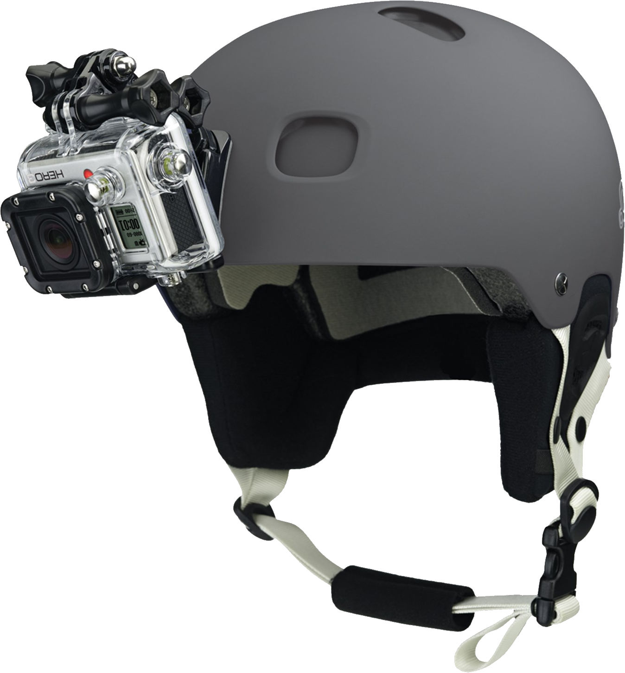
*WORKS GREAT IN ANY ORDER
New York, USA
BAGGYBEST
1-800-123-4567
AMAZING
HELMET
MIKE SMITH
I LOVE THIS COMPANY. BECAUSE THEY KEEP EVERYTHING ORGANIZED, EXCELLENT BUY!
XS S M XL
JOHN SANT
Black White Green
EXCELLENT! I’LL BUY AGAIN.
$99
{
{
Notes:
https://purepng.com/photo/24544/electronics-gopro-camera

Slide 18
*WORKS GREAT IN ANY ORDER
New York, USA
BAGGYBEST
1-800-123-4567
100 WHEY
PROTEIN +
Whey is the liquid remaining after milk has been curdled and strained. It is a byproduct of the manufacture of cheese or casein and has several commercial uses. Sweet whey is a byproduct produced during the manufacture of rennet types of hard cheese, like Cheddar or Swiss cheese.
XS S M XL
$19
{
{
Notes:
https://legionathletics.com/wp-content/uploads/2017/04/whey-dutch-chocolate-front.png

Slide 19
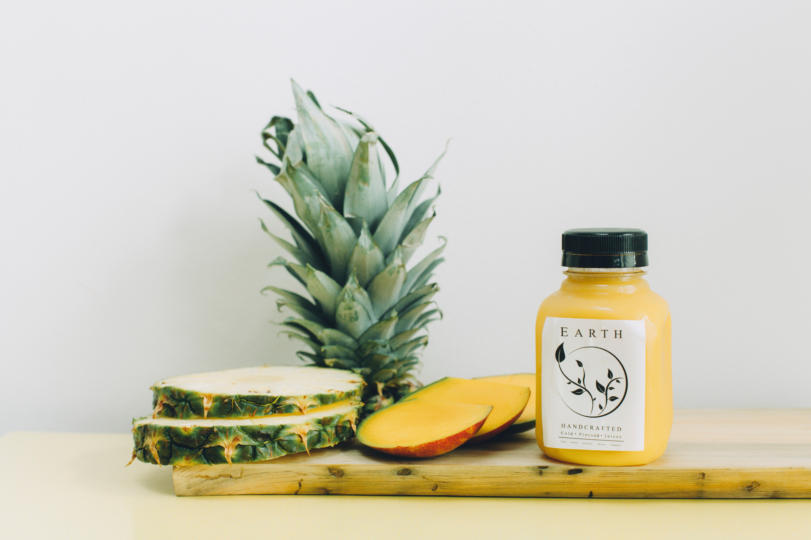
New York, USA
BAGGYBEST
1-800-123-4567
WHO ARE WE
WE ARE SELLING HIGH QUALITY PRODUCTS. WE GURANTEE YOU THE BEST SERVICE THAT YOU WANT. YOU CAN TRUST US!
{
{
Notes:
https://unsplash.com/photos/ArGvQkA7iOw

Slide 20
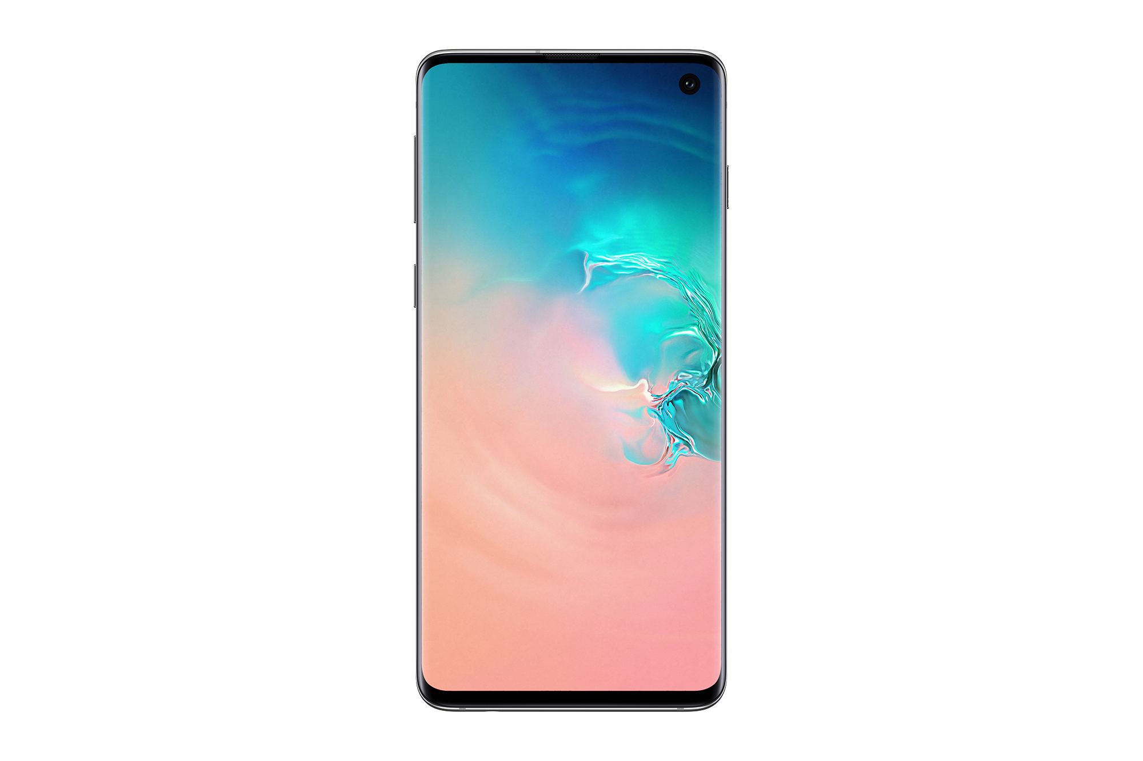
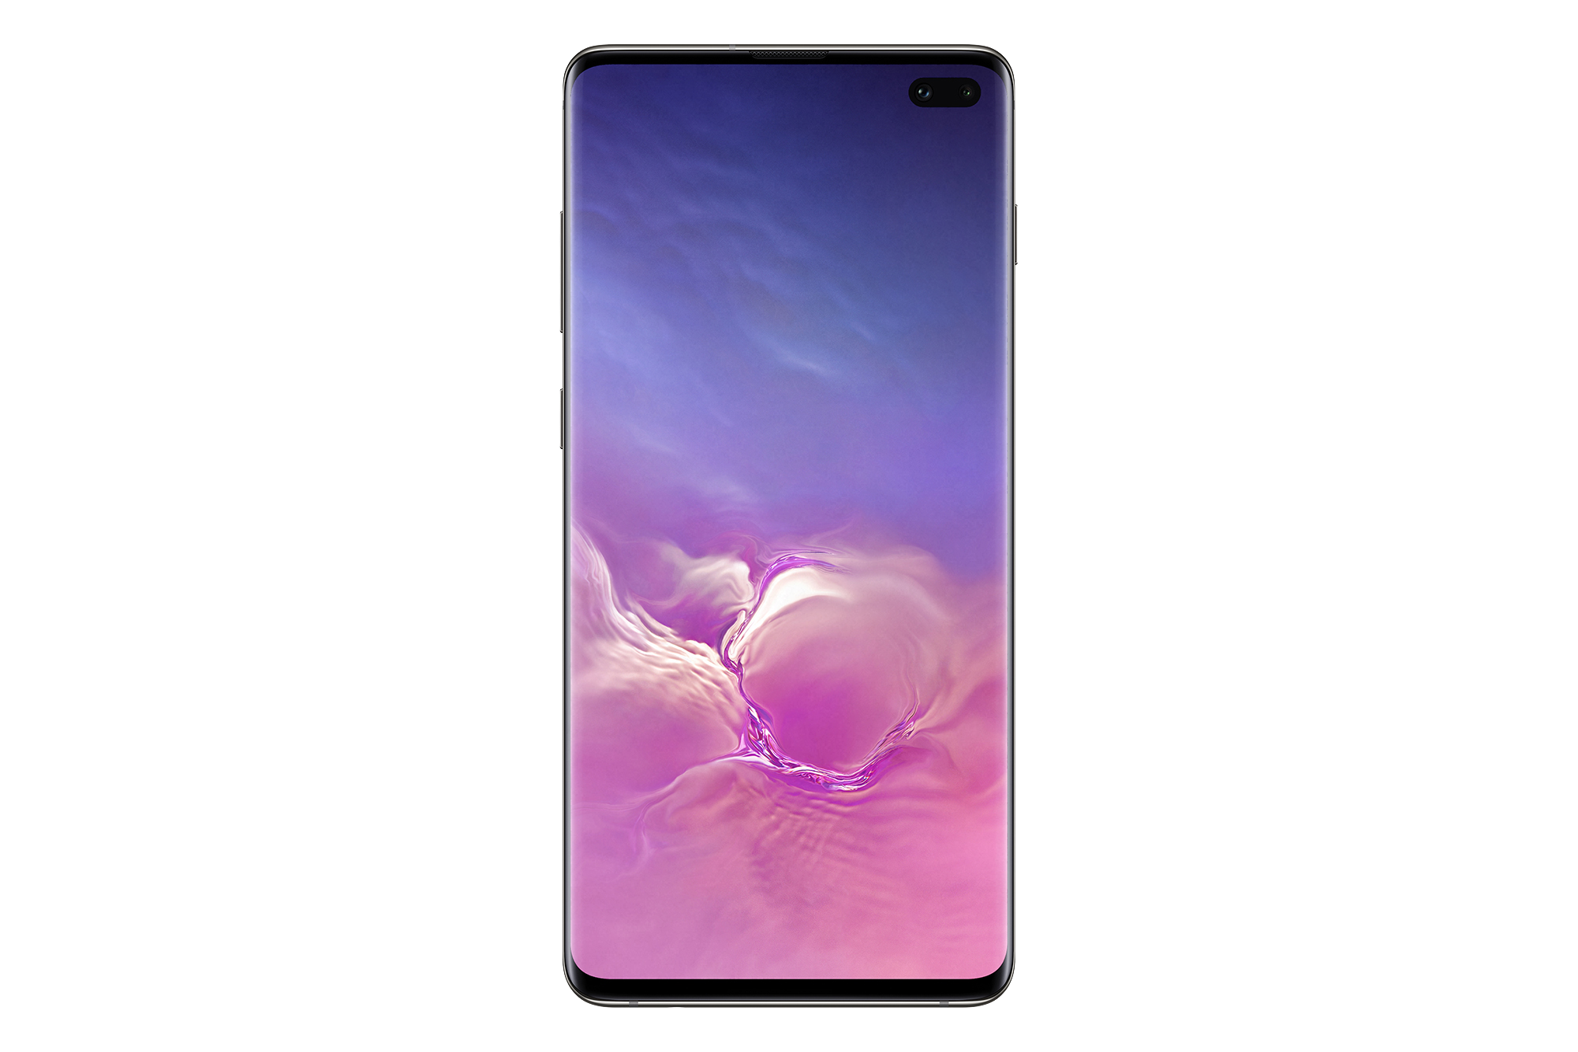
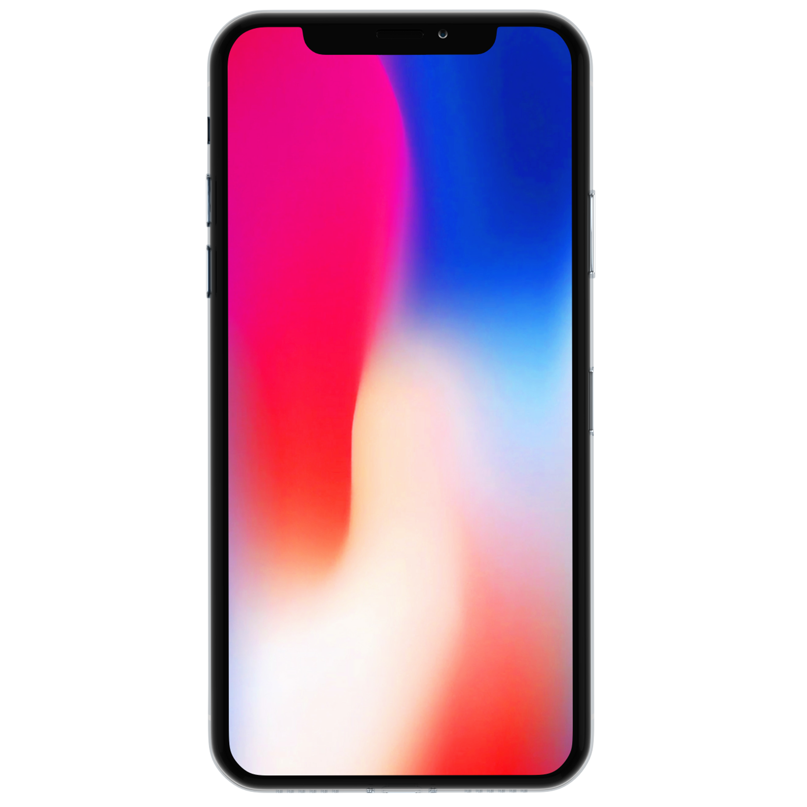
New York, USA
BAGGYBEST
1-800-123-4567
OUR CONTACT
OUR BENEFITS
ADDRESS: 1177 AV OF THE AMERICAS
WEBSITE: BEST_BACKPACKS.COM
INSTAGRAM: BEST_BACKPACKS
TEL: 1-800-123-4567
HIGH QUALITY
DURABLE MATERIALS
FREE DELIEVERY
MONEY BACK GUARANTEE
{
{
Notes:
https://purepng.com/photo/28226/electronics-apple-iphone-x
https://purepng.com/photo/30593/objects-samsung-galaxy-s10-prism-front
https://purepng.com/photo/30589/objects-samsung-galaxy-s10-ceramic-black-front

