Slide 1
Discounted Shoppy
www.discountedshoppy.com

Slide 2
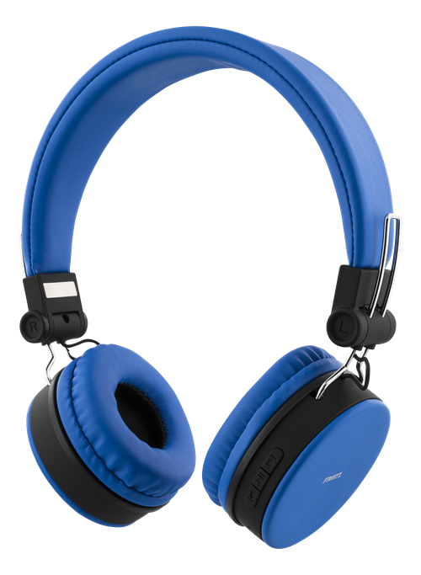
SMART HEADPHONE
$129.29
-30% Discount
.
Availability
In Stock
About Product
Driver unit 30mm
Dome type: CCAW Voice Coil
Power Handling capacity: 1,000mW(IEC)
Impedance 24 at 1KHZ
Sensitivity : 102dB
Frequency response: 5Hz-22,000Hz
w/ Noise Cancellation
DISCOUNTEDSHOPPY
Notes:
https://www.pngfly.com/png-wbe75m/

Slide 3
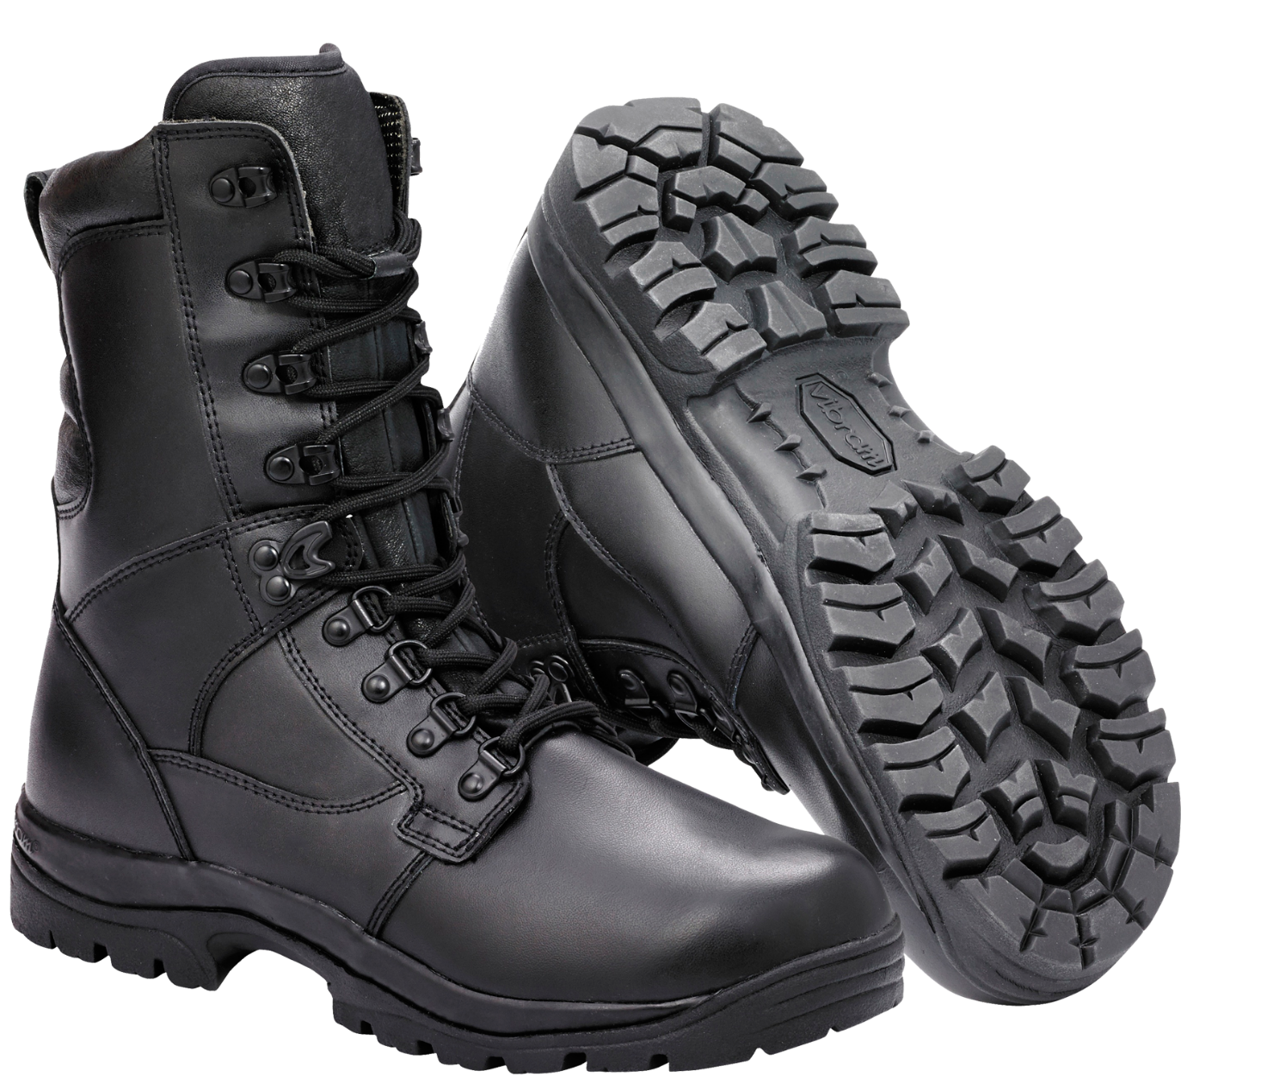
NEW SEASON
WINTER SHOE
$199
Soon
Lace-up
Man-made upper
Man-made lining
Man-made sole
Imported
Leather
DISCOUNTEDSHOPPY
Notes:
https://www.pngfly.com/png-lg7f05/

Slide 4
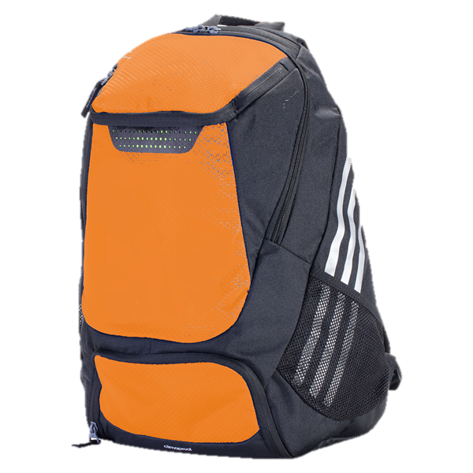
NEW SPORTS BAG
$59.9
-30% Discount
Availability
In Stock
About Product
20.5'' W x 13.4'' H x 7'' D
Polyester
Zip closure
Interior: two mesh pocket
Exterior: two zip pockets, one slip pocket, one yoga mat harness
Removable adjustable cross body strap
DISCOUNTEDSHOPPY
Notes:
https://www.kisspng.com/png-adidas-stadium-team-backpack-bag-shoe-soccer-adida-6015491/

Slide 5
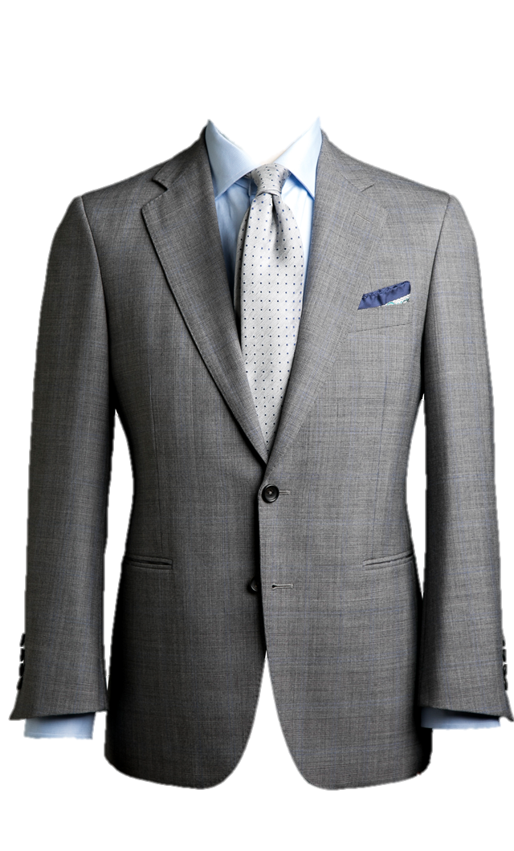
NEW SEASON
STYLISH SUIT
$299
Availability
In Stock
About Product
Stylish Body Fit Suit
Stretch to Comfort
height: 6'4”/193 cm
wearing: 40"/102 cm
DISCOUNTEDSHOPPY
Notes:
https://www.kissclipart.com/button-clipart-tuxedo-m-blazer-kaquyd/

Slide 6
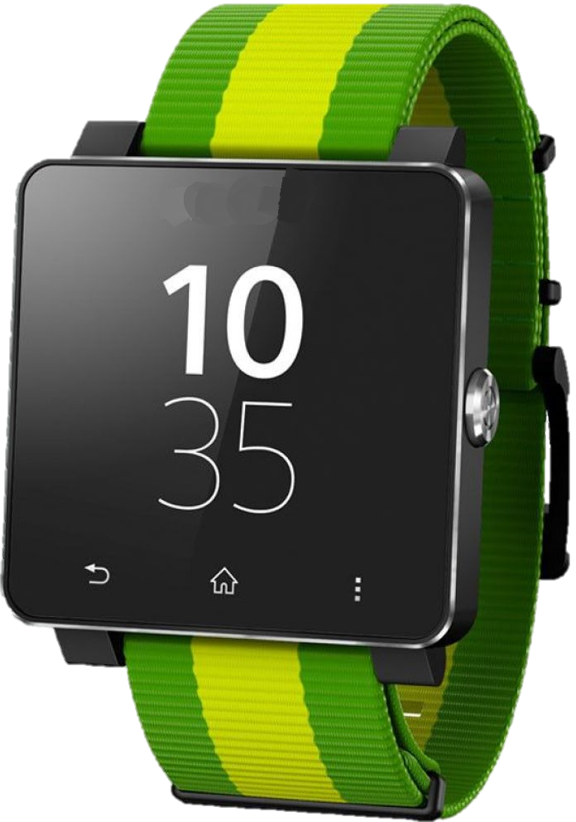
SMART WATCH
$599.5
NEW PRODUCT
Availability
Soon
About Product
Green Smart Watch for Android and iPhone
DISCOUNTEDSHOPPY
Notes:
https://www.pngfly.com/png-enfnf0/

Slide 7
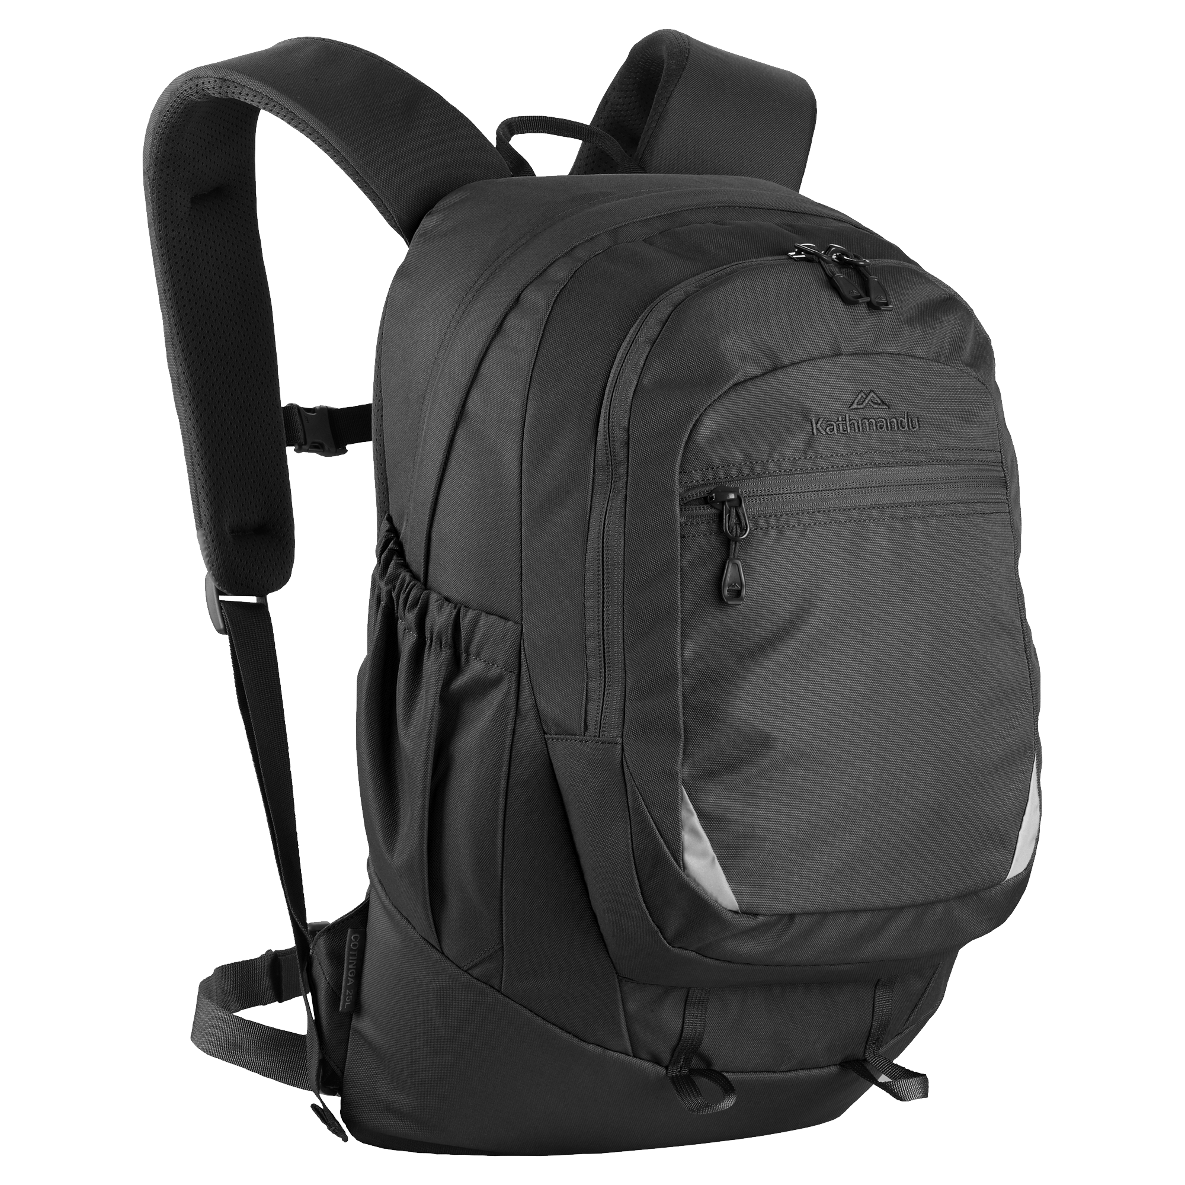
TRAVEL BAG
BEST SELLER
$109
Availability
In Stock
About Product
High Quality
w/ Laptop compartment
DISCOUNTEDSHOPPY
Notes:
https://www.pngfly.com/png-g8m2xp/

Slide 8
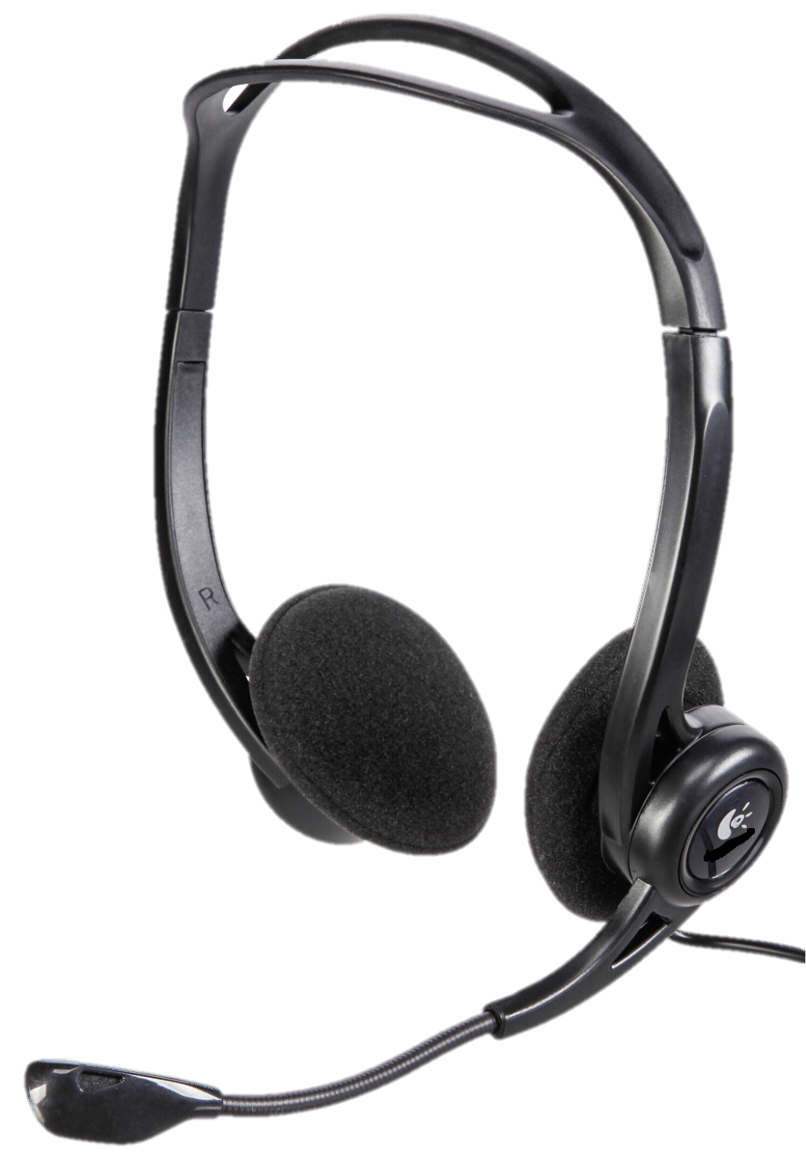
COMPUTER HEADSET
$89
Availability
In Stock
-30% Discount
About Product
Full-Size 7.1 Over-ear Gaming Headphones
Headphone LED RGB Illumination
Cable Length - 2.5m Nylon Braided cable
Weight 322g (435g with packing)
Freq. Range 20-20K Hz
Speaker Sensitivity 108+/-3dB
w/ Noise Cancellation
DISCOUNTEDSHOPPY
Notes:
https://www.pngfly.com/png-9plud6/

Slide 9
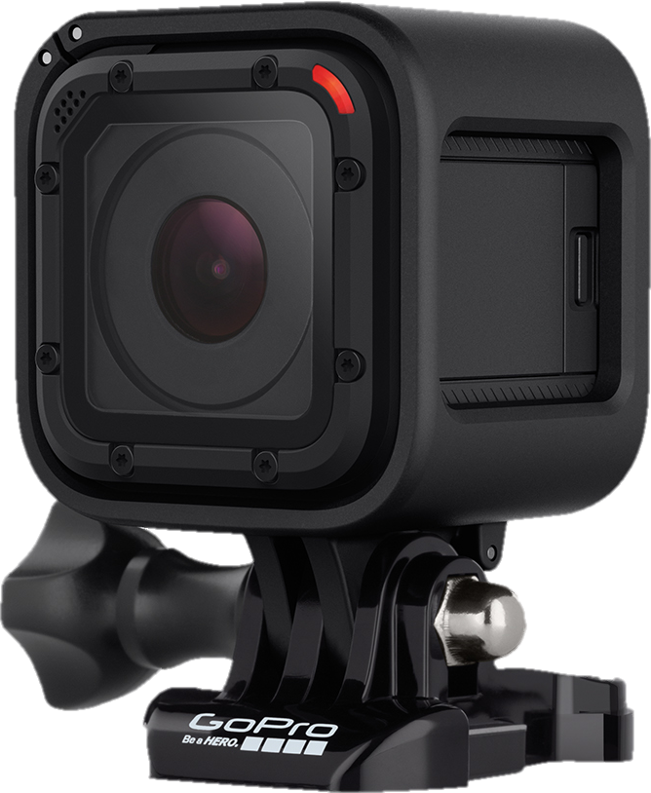
NEW PRODUCT
SMART CAMERA
$319
Availability
In Stock
About Product
100.6 degree wide angle
Built-in Memory Size: NO
Night Shot Function: Yes
WIFI Support: Yes
Battery Capacity: NO
Memory Card Support: 32G
Live Broadcast: Yes
DISCOUNTEDSHOPPY
Notes:
https://www.pngfly.com/png-whxpei/

Slide 10
Thanks For Watching
www.discountedshoppy.com

