Slide 1
ONLINE SUPER STORE
ONLINE SHOPPING STORE
Notes:
<a href="https://www.freepik.com/free-photos-vectors/background">Background vector created by 3ab2ou - www.freepik.com</a>

Slide 2
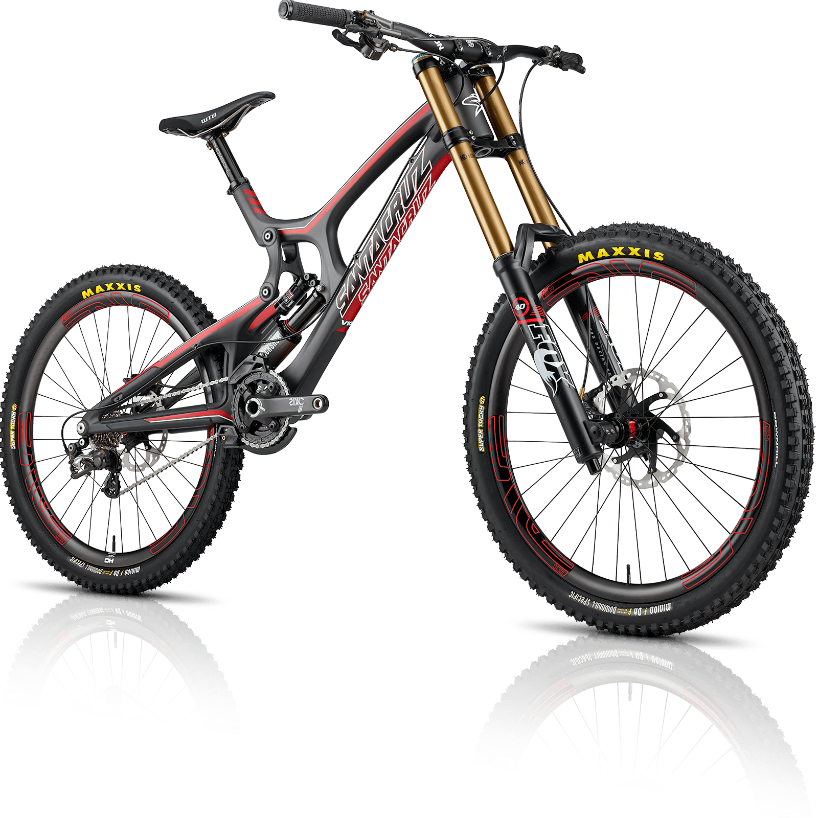
_{Brise 001}
$1000
Model: Lor-Em 1234
MOTO BISCLE
Mountain Bike 26’
Three color versions
Notes:
<a href="https://www.freepik.com/free-photos-vectors/background">Background vector created by 3ab2ou - www.freepik.com</a>

Slide 3
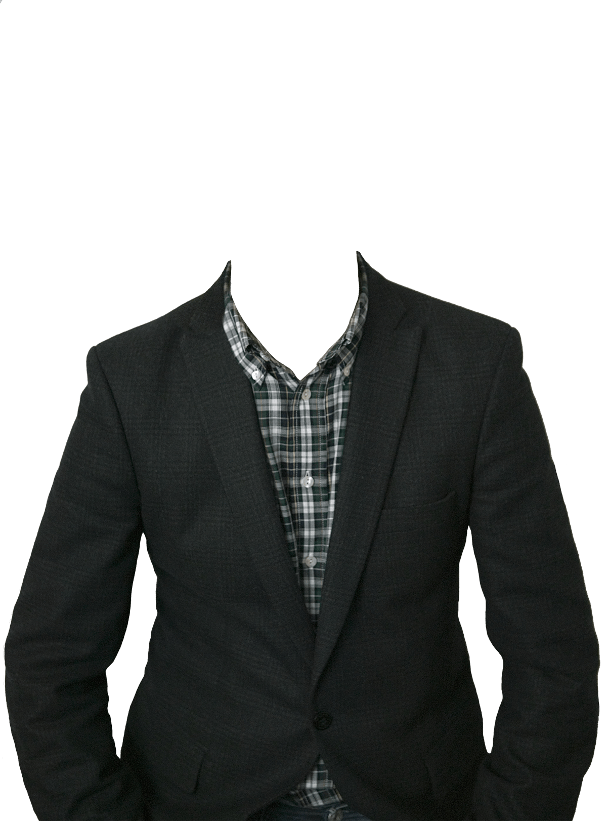
_{POLO RAV}
Model: Lor-Em 1234
$200
STYLISH SUIT
Men Fashion Slim Fit Formal One Button Suit Blazer
Three color versions
Notes:
<a href="https://www.freepik.com/free-photos-vectors/background">Background vector created by 3ab2ou - www.freepik.com</a>

Slide 4
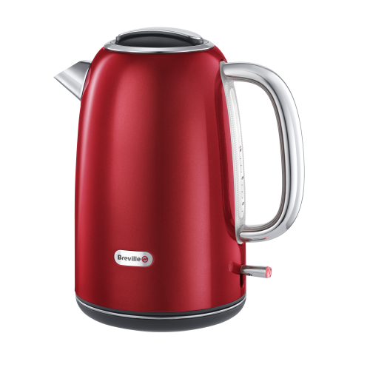
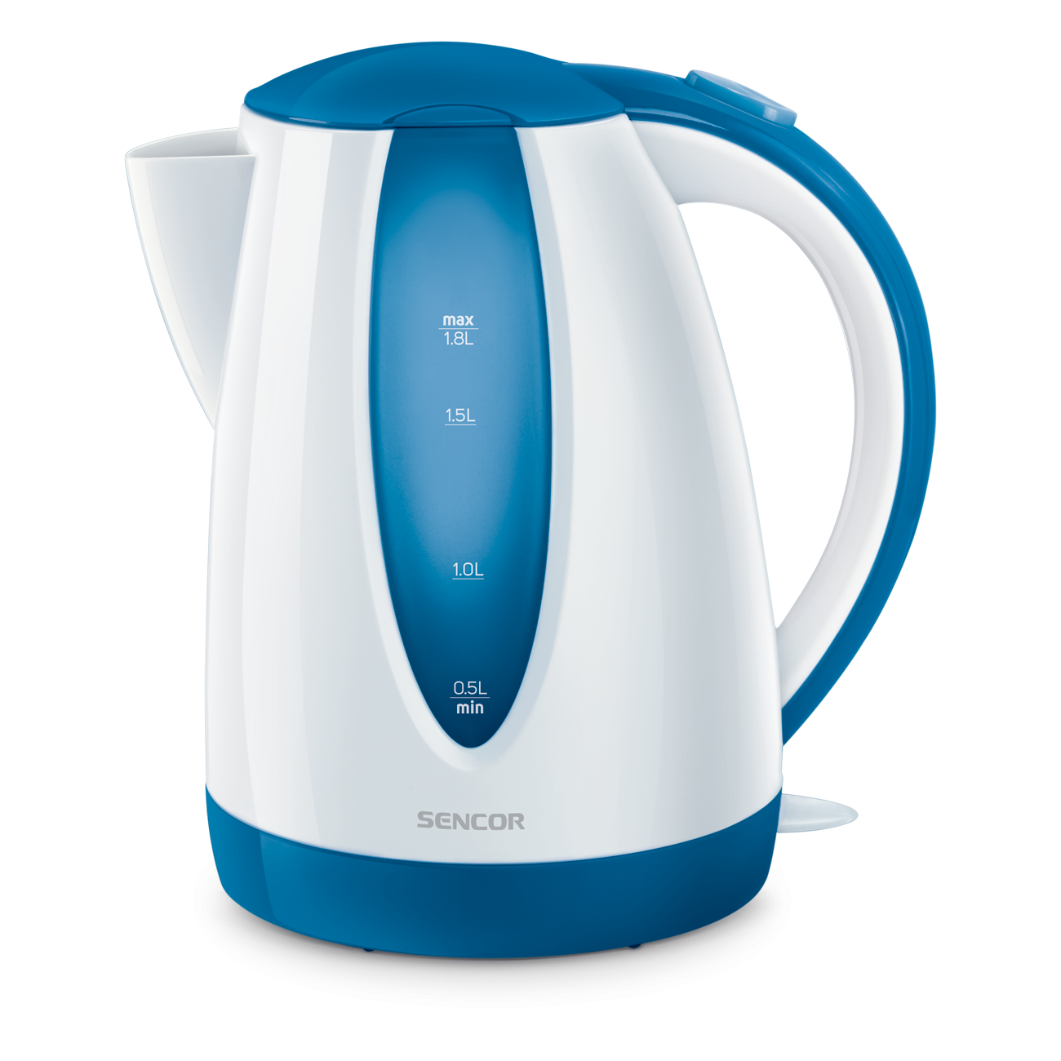
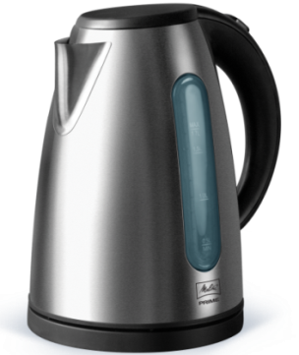
Automatic Kettle
Gray Kettle
Electric Kettle
Modern economical design Power supply
Automatic Power Off
Cordless Kettle
$60
$20
$15
Availability In Store
Availability In Store
Availability In Store
_{Iowa}
_{Eureka}
_{Mei}
Model: Lor-Em 1234
Model: Lor-Em 1234
Model: Lor-Em 1234
Notes:
<a href="https://www.freepik.com/free-photos-vectors/background">Background vector created by 3ab2ou - www.freepik.com</a>

Slide 5
TAKE
ADVANTAGE OF
DISCOUNT

Slide 6
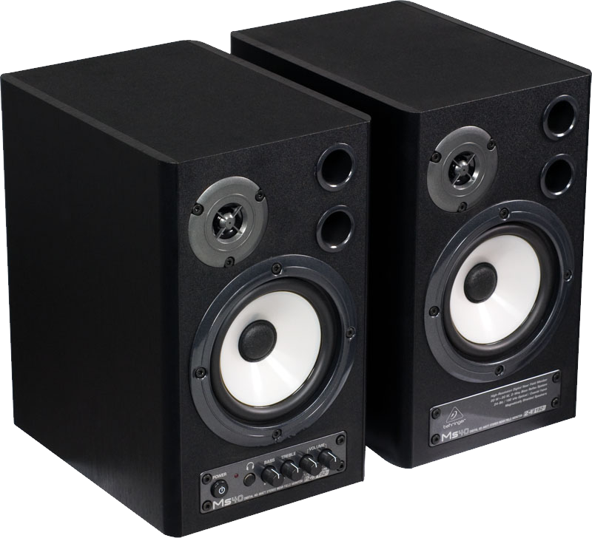
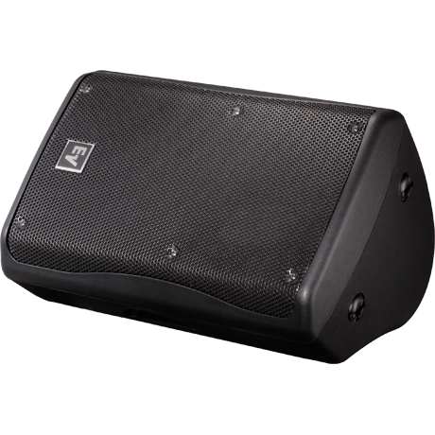
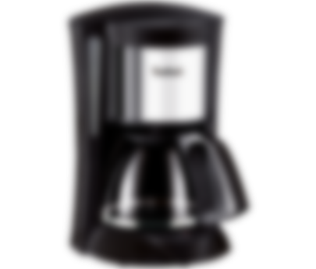
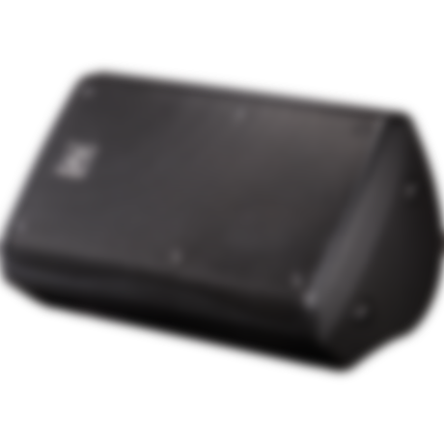
$199
OLD
PRICE
NOW $100
DYNAMIC SPEAKER
MODEL : Conzert
Premium audio brand Master & Dynamic possesses a deep passion
Notes:
<a href="https://www.freepik.com/free-photos-vectors/background">Background vector created by 3ab2ou - www.freepik.com</a>

Slide 7
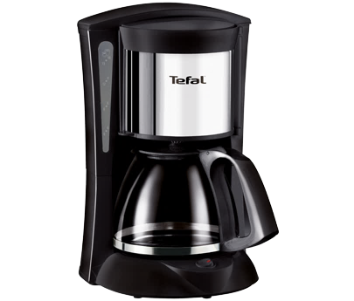
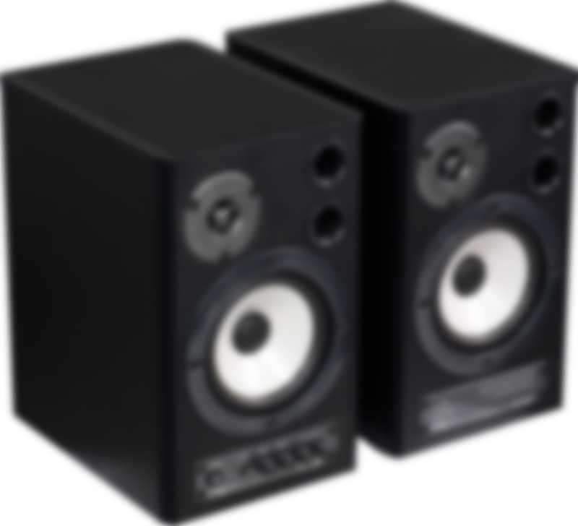
$199
$59
OLD
PRICE
OLD
PRICE
NOW $100
NOW $30
COFFEE MACHINE
MODEL : Eureka
Capture the freshness with beans to espresso in under a minute.
Notes:
<a href="https://www.freepik.com/free-photos-vectors/background">Background vector created by 3ab2ou - www.freepik.com</a>

Slide 8

$59
OLD
PRICE
$199
$219
OLD
PRICE
OLD PRICE
NOW $39
NOW $109
NOW $179
CONZERT SPEAKER
MODEL : Abc - 123
2-Way Karaoke Speaker Micro Component System with Bluetooth/FM/USB/MMC port (Black) Features: Mic Volume
Notes:
<a href="https://www.freepik.com/free-photos-vectors/background">Background vector created by 3ab2ou - www.freepik.com</a>

Slide 9
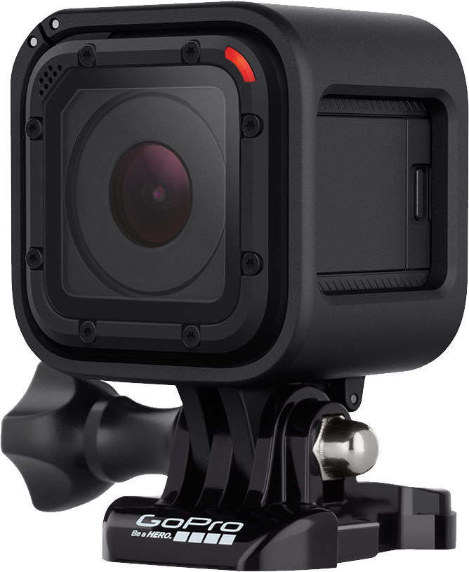
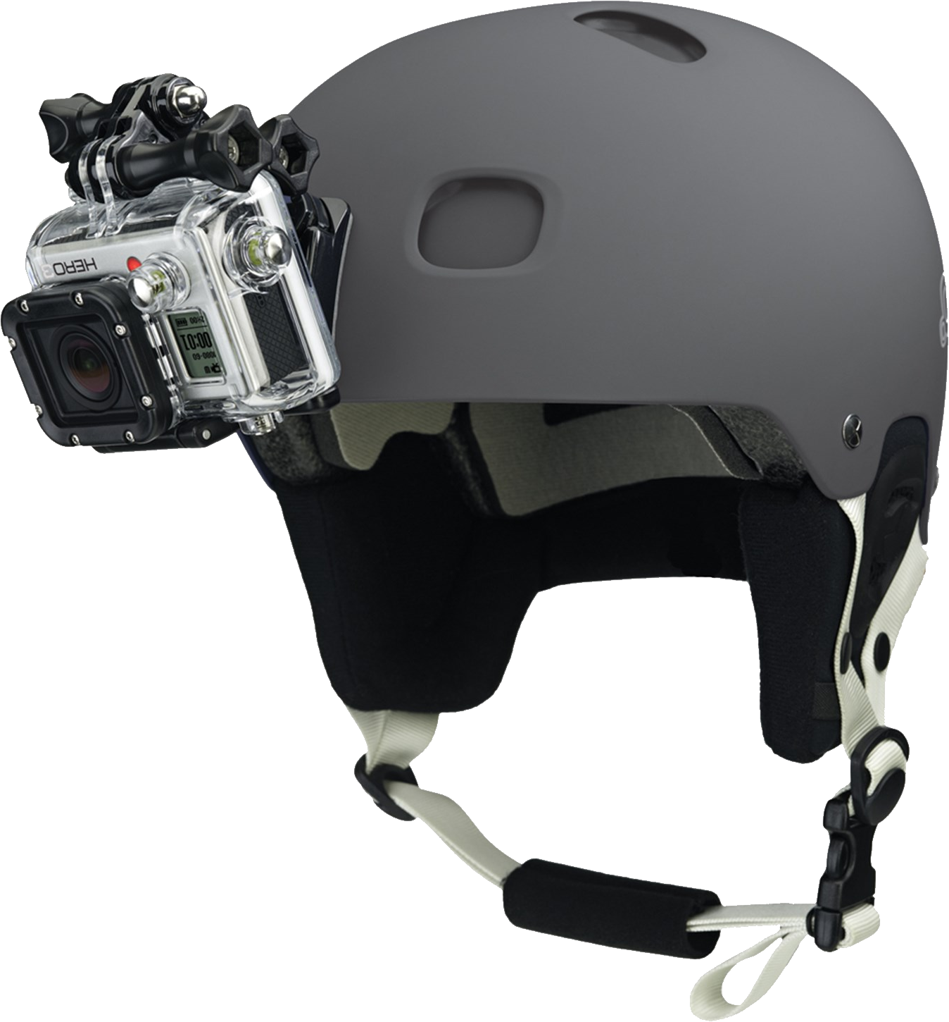
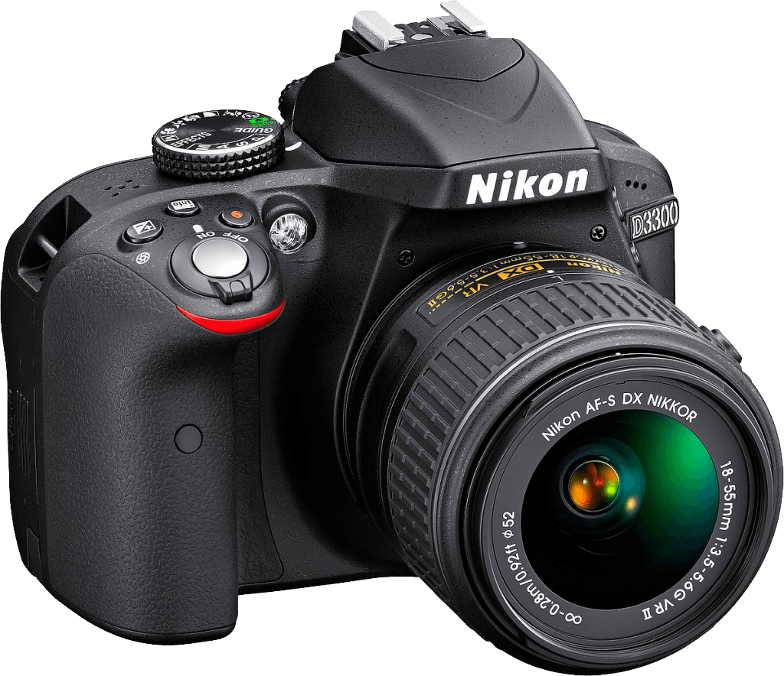
_{Canon DSLR}
_{Canon Web Cam}
_{Canon Go Pro}
Model: Lor-Em 1234
Model: Lor-Em 1234
Model: Lor-Em 1234
$269.9
$47.9
$124.9
DSLR CAMERA
WEB CAMERA
GOPRO HELMET
Features: 24Mp 3.0 TFT LCD 1080P FHD Digital Camera with UV Filter
18Mp 1080 Full HD
Motorcycle Full Face Helmet Chin Mount for All Go Pro
Availability In Stoke
Availability In Stoke
Availability In Stoke

Slide 10



THANKS FOR
WATCHING
ONLINE SUPERSTORE
osupstore
osupstore
osupstore
Notes:
<a href="https://www.freepik.com/free-photos-vectors/background">Background vector created by 3ab2ou - www.freepik.com</a>

