Slide 1
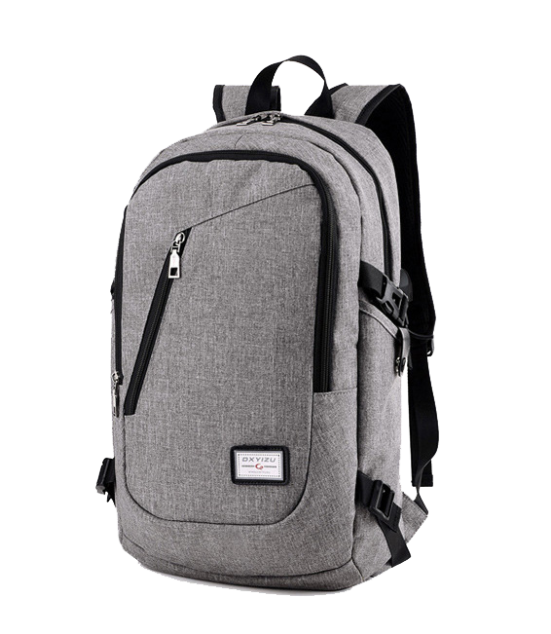
Smart
Bag
At checkpoint, unfolds to flat position keeping above and below the laptop sections clear. Adjustable padded laptop straps inside to fit different size laptops.
Discount 10%
{{{{
$60
OSMCOMPANY
Notes:
https://www.pngfly.com/png-yqx7mv/download.html

Slide 2
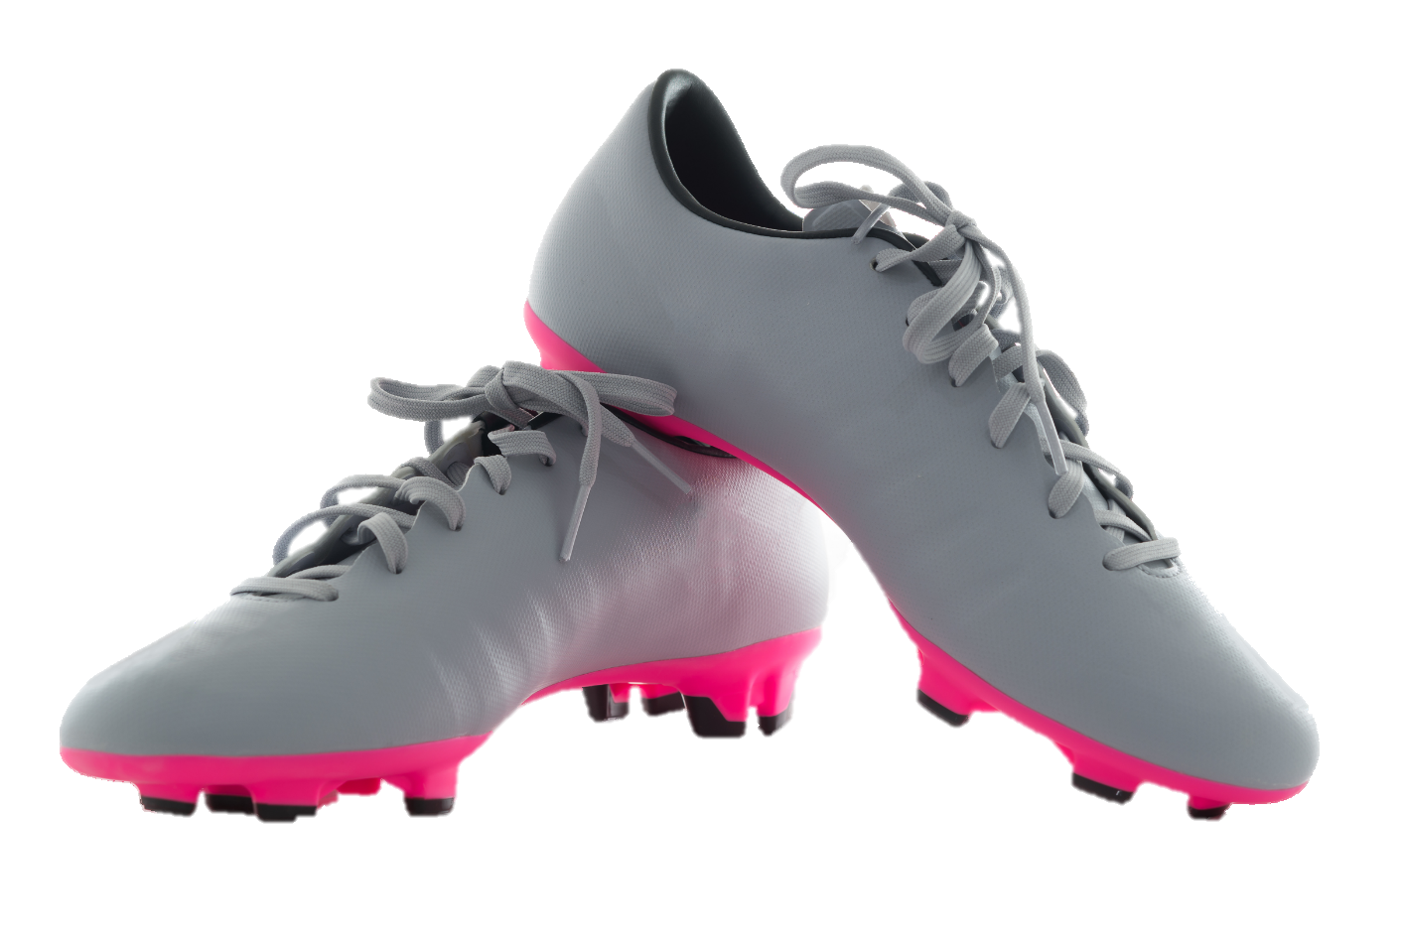
Sports
Shoes
You didn’t climb a rope 10 times to get better at climbing rope. You climb it because you want to be better you. Stay fearless and confident with new sandpaper-textured material built with Kevlar fiber and RopePro+ technology in our update.
The re-engineered anatomical shape
helps you get to that next level.
Discount 25%
{{{{
$80
OSMCOMPANY
Notes:
https://www.pngfly.com/png-zn6jjj/download.html

Slide 3
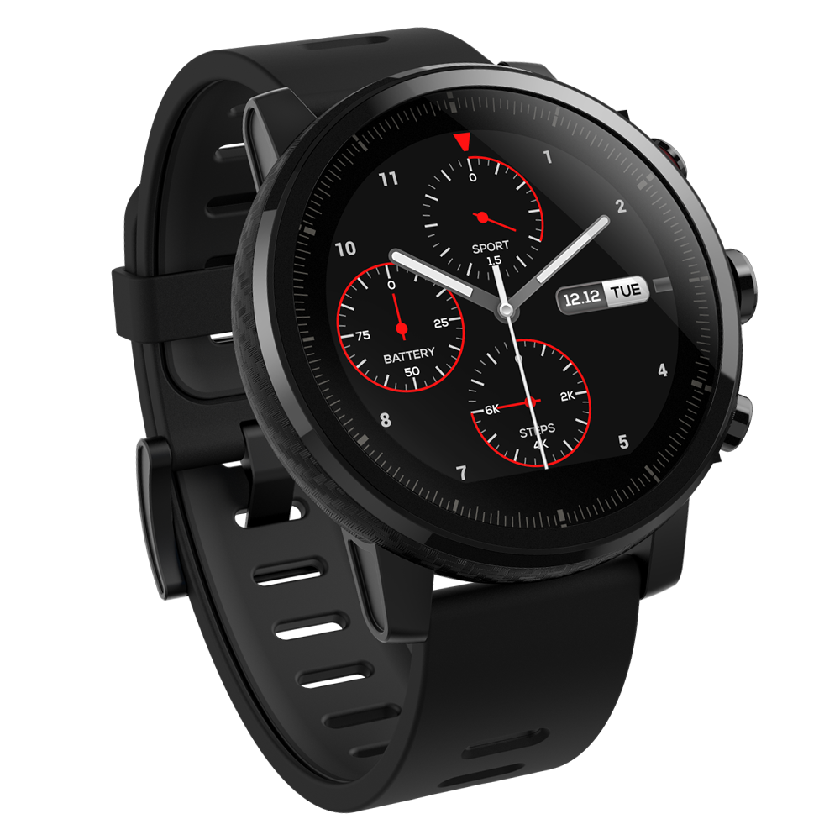
Smart
Watch
Phone calls reminding Ring, Two-way anti lost remind, Two-way search5. Pedometer, step motion meter, Calories calculation, Sports mileage records, Sedentary remind, Sleep monitoring, Remote photos, Alarm clock, Calendar, Notification remind, Time Synchronization
Discount 8%
{{{{
$200
OSMCOMPANY
Notes:
https://www.pngfly.com/png-gkcc31/download.html

Slide 4
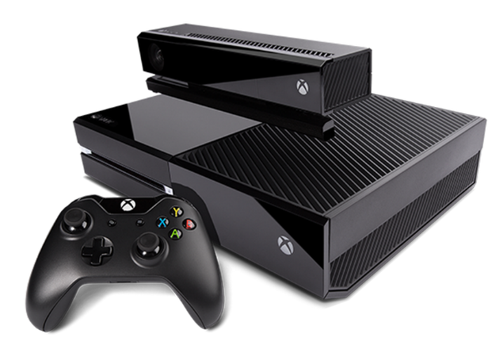
Sports
Shoes
A video game console is a specialized computer system designed for interactive video gameplay and display.
A video game console functions like a PC and is built with the same essential components, including a central processing unit (CPU), graphics processing unit (GPU) and random-access memory (RAM).
Discount 10%
{{{{
$500
OSMCOMPANY
Notes:
https://www.pngfly.com/png-27yh7d/download.html

Slide 5
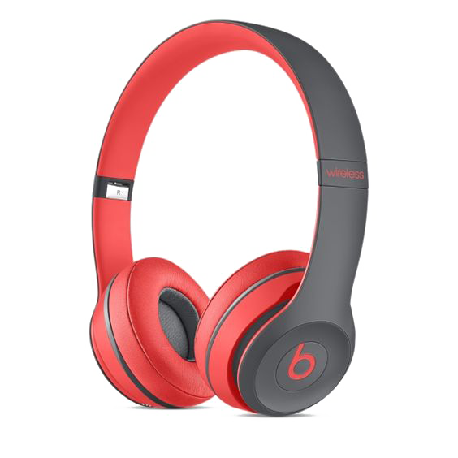
Stylish
Headphone
Are a pair of small loudspeaker drivers worn on or around the head over a user’s ears.
They are electroacoustic transducers, which convert an electric signal to a corresponding sound.
Discount 20%
{{{{
$100
OSMCOMPANY
Notes:
https://www.pngfly.com/png-5pb3b5/download.html

Slide 6
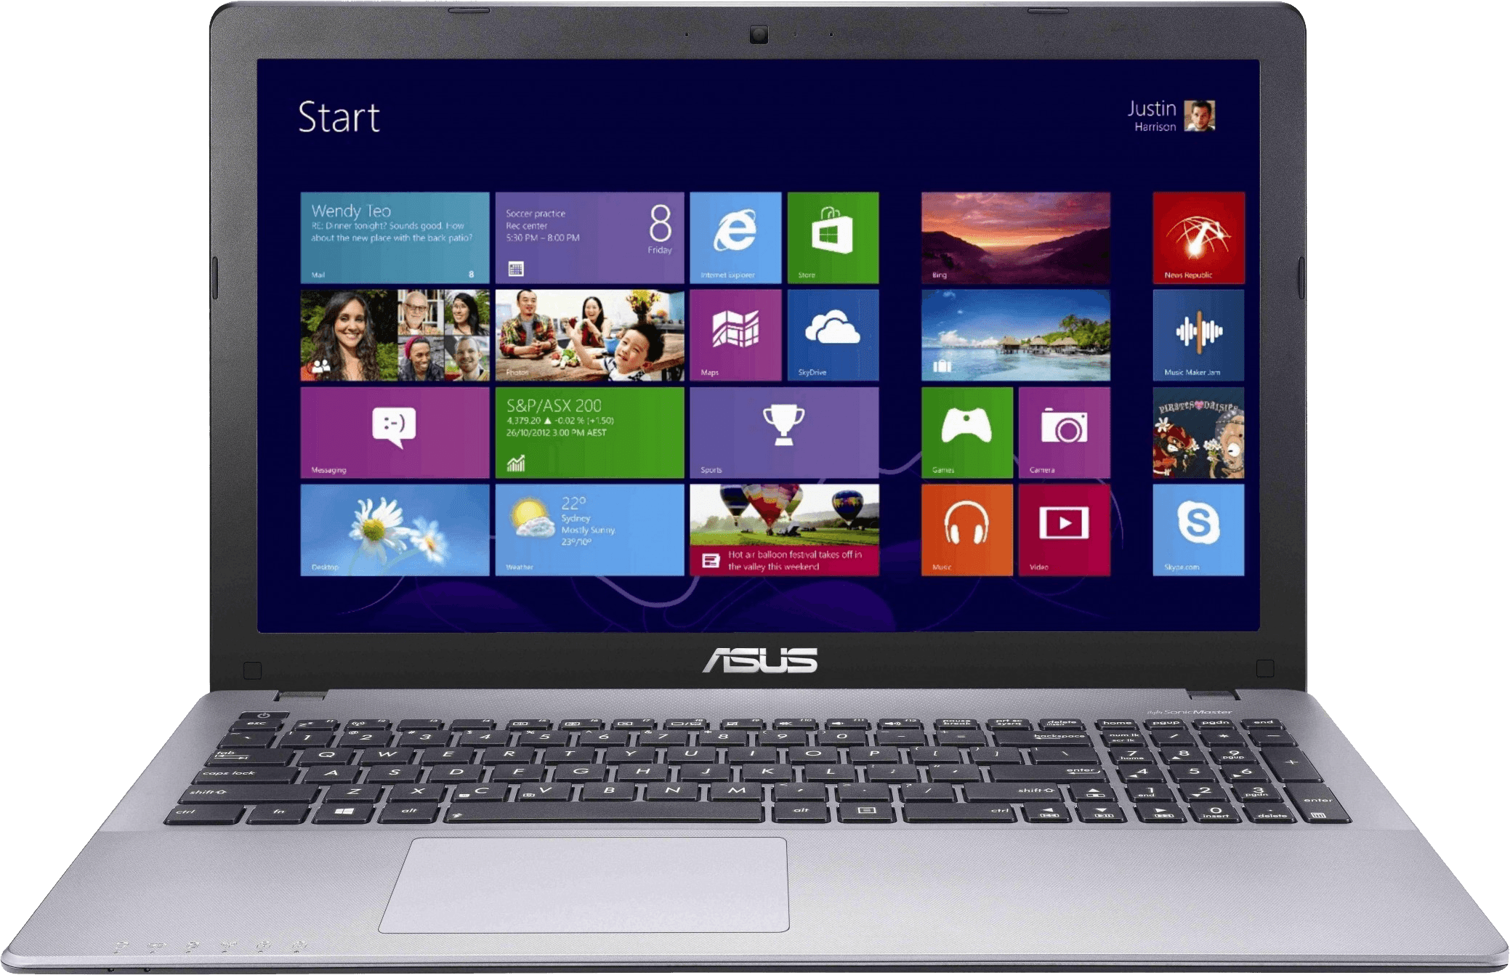
Laptop
A laptop, also called a notebook computer or simply a notebook, is a small, portable personal computer with a ‘clamshell’ from factor, having typically, a thin LCD or LED computer screen mounted on the inside of the upper lid of the ‘clamshell’ and an alphanumeric keyboard on the inside of lower lid.
Discount 10%
$1000
OSMCOMPANY
{{{{
Notes:
https://www.pngfly.com/png-xn3058/download.html

Slide 7
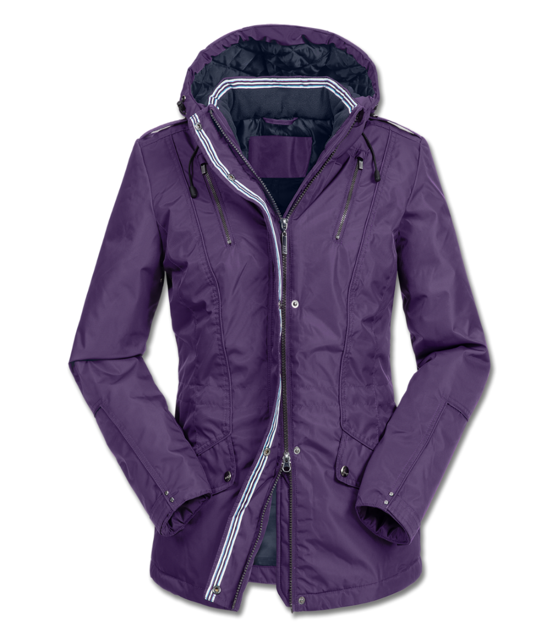
Winter Jacket
Are clothes used for protection against the particularly cold weather of winter. Often, they have a good water resistance, consist of multiple layers to protect and insulate against low temperatures.
Discount 50%
{{{{
$200
OSMCOMPANY
Notes:
https://www.pngfly.com/png-4zazx5/download.html

Slide 8
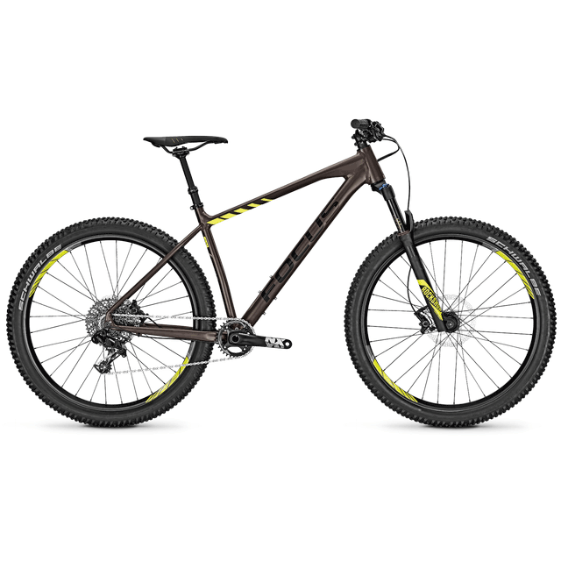
Mountain
Bike
A mountain bike or a mountain bicycle (abbreviated MTB) is a bicycle designed for off-road cycling.
Mountain bikes share similarities with other bicycles, but incorporate features designed to enhance durability and performance in rough terrain.
Discount 10%
{{{{
$2000
OSMCOMPANY
Notes:
https://www.pngfly.com/png-46he3u/download.html

Slide 9
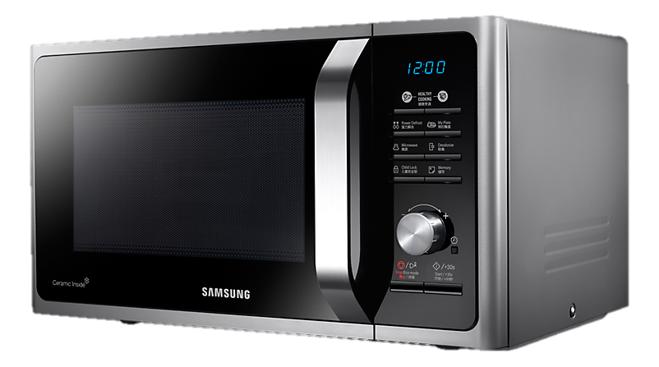
Microwave
Oven
Is an electric oven that heats food by exposing it to electromagnetic radiation in the microwave frequency range. This induces polar molecules in the food to rotate and produce thermal energy in a process known as dielectric heating.
Discount 20%
{{{{
$200
OSMCOMPANY
Notes:
https://www.pngfly.com/png-5pb3b5/download.html

Slide 10
Red
Dress
Is a garment consisting of a skirt with an attached bodice (or a matching bodice giving the effect of a one-piece garment).
It consists of a top piece that covers the torso and hangs down over the legs
Discount 10%
{{{{
OSMCOMPANY
$250
Notes:
https://www.pngfly.com/png-y6fqly/download.html

