Slide 1
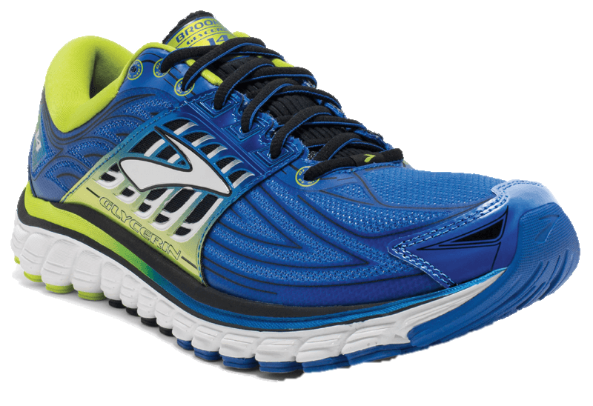
MODERN
SPORTS SNEAKERS
Sports Sneaker Style Men Rubber Shoes
Sizes: 35 – 39
Color: Blue
$90
Notes:
https://www.pngfly.com/png-yvl0lq/download.html

Slide 2
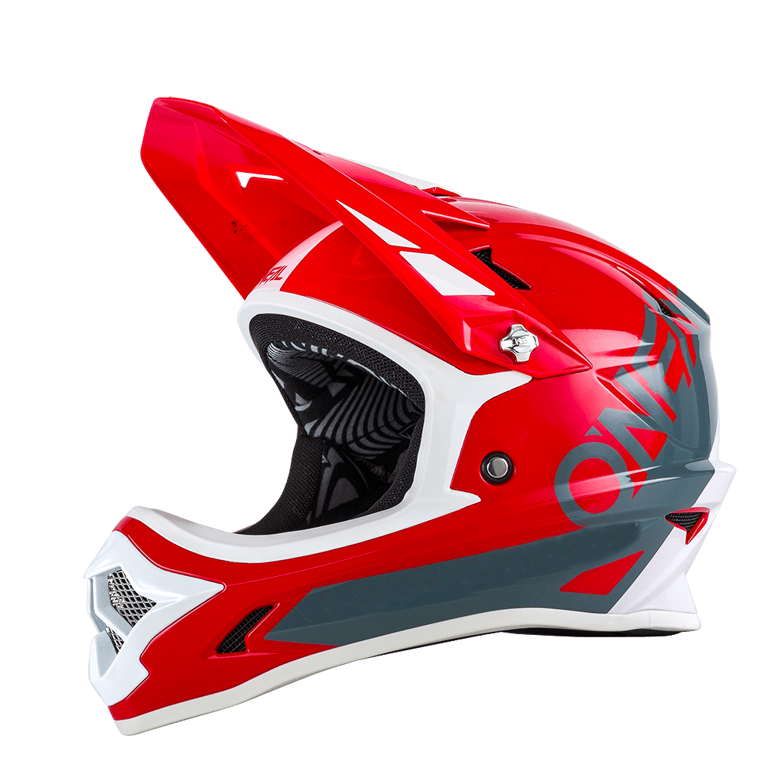
STYLISH
STEELBIRD AIR
Red Motorcycle Helmet
10% Discount for every purchase
$400
Notes:
https://www.pngfly.com/png-grz0sz/download.html

Slide 3
SPORTLY
SPORTS JACKET
Fitted Sports Jacket
Color: Black and White
Sizes: S, M, L, XL
$100
Notes:
https://www.pngfly.com/png-bp7aoc/download.html

Slide 4
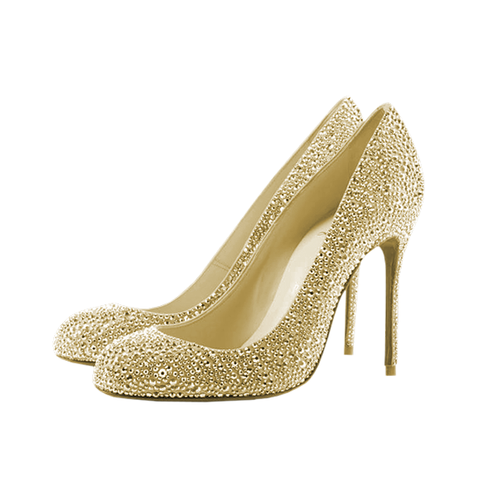
Stylish
LOUBOUTIN
Sizes: 35-40
Color: Gold, Pink
$100
Notes:
https://www.pngfly.com/png-pm3fw9/download.html

Slide 5
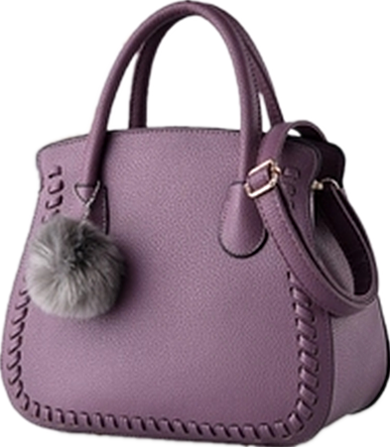
Women
HANDBAGS
Women’s Leather Bag
Color: Violet
$30
Notes:
https://www.pngfly.com/png-8mto2y/download.html

Slide 6
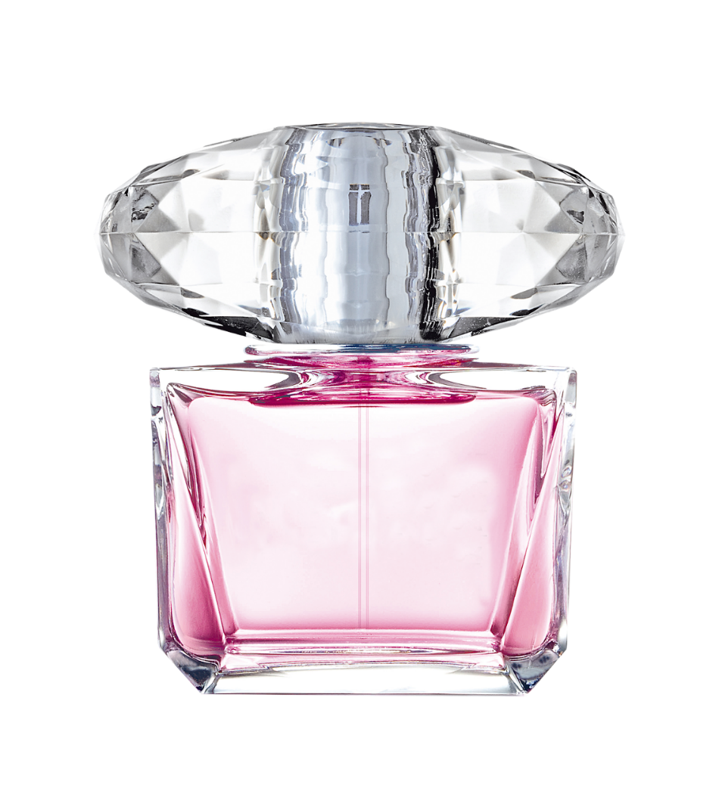
Perfume
FOR WOMEN
Gucci Perfume for Women
Medium Size
$100
Notes:
https://www.pngfly.com/png-gnlycx/download.html

Slide 7
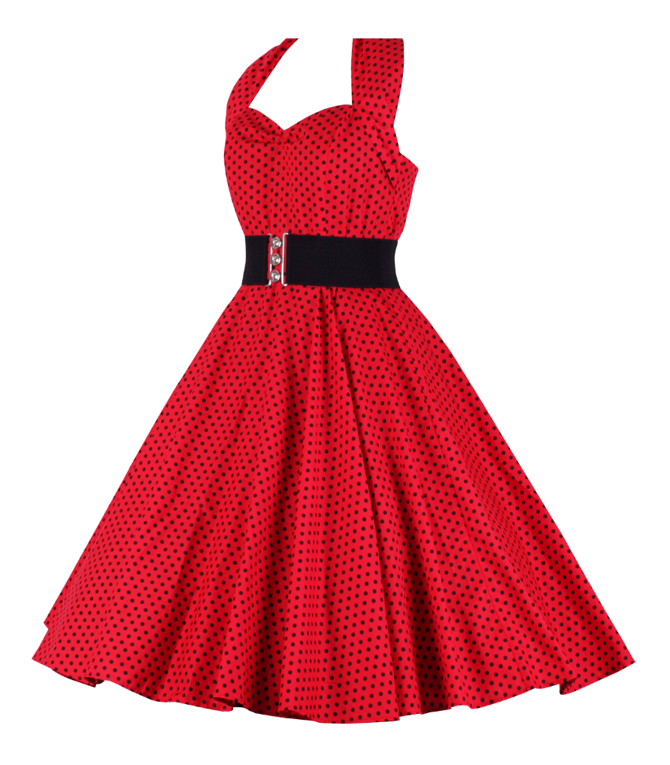
Red Dress
FOR WOMEN
100% Cotton
Free Size
$100
Notes:
https://www.pngfly.com/png-gnlycx/download.html

Slide 8
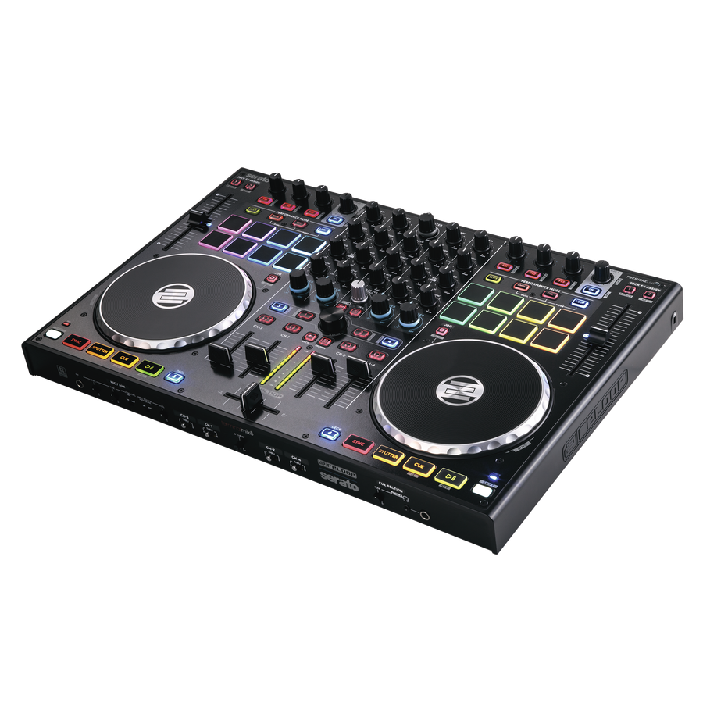
REMIX
DJ CONTROLLER MIX
Complete Mixer Set for DJ’s
REMIX
$100
Notes:
https://www.pngfly.com/png-2nc8tf/download.html

Slide 9
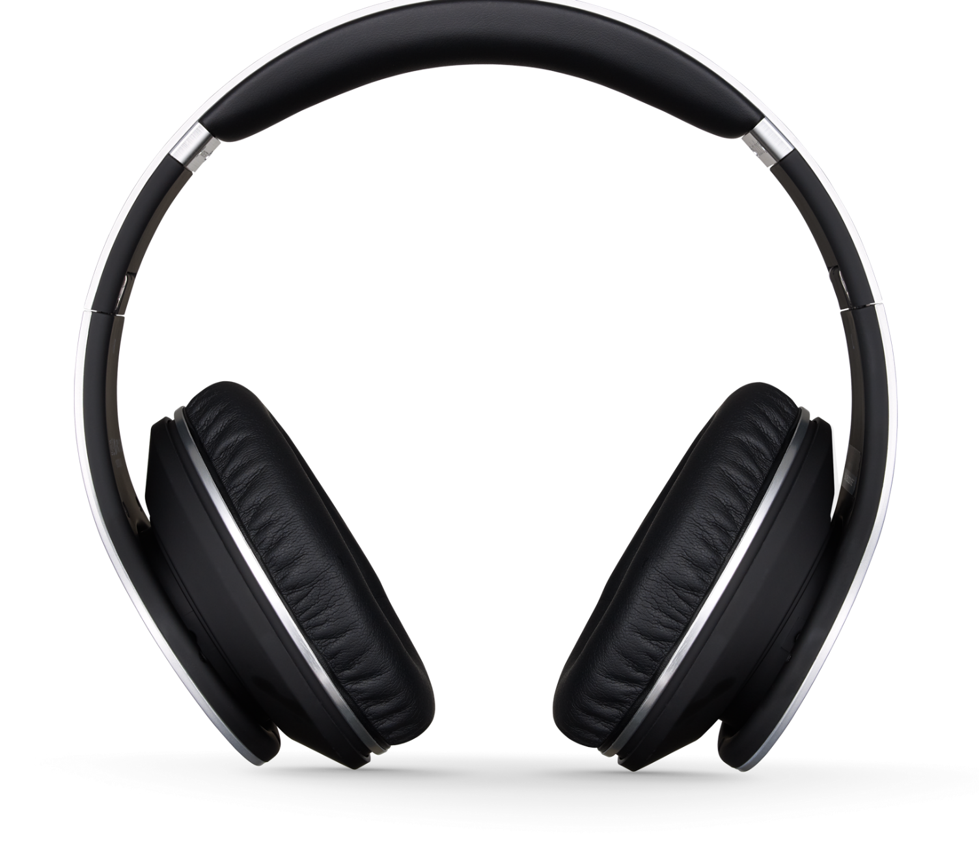
BEAT
Headset
FOR MUSICA
w/ Noise Cancellation Headphone
BEAT
$20
Notes:
https://www.pngfly.com/png-rm6q4u/download.html

Slide 10
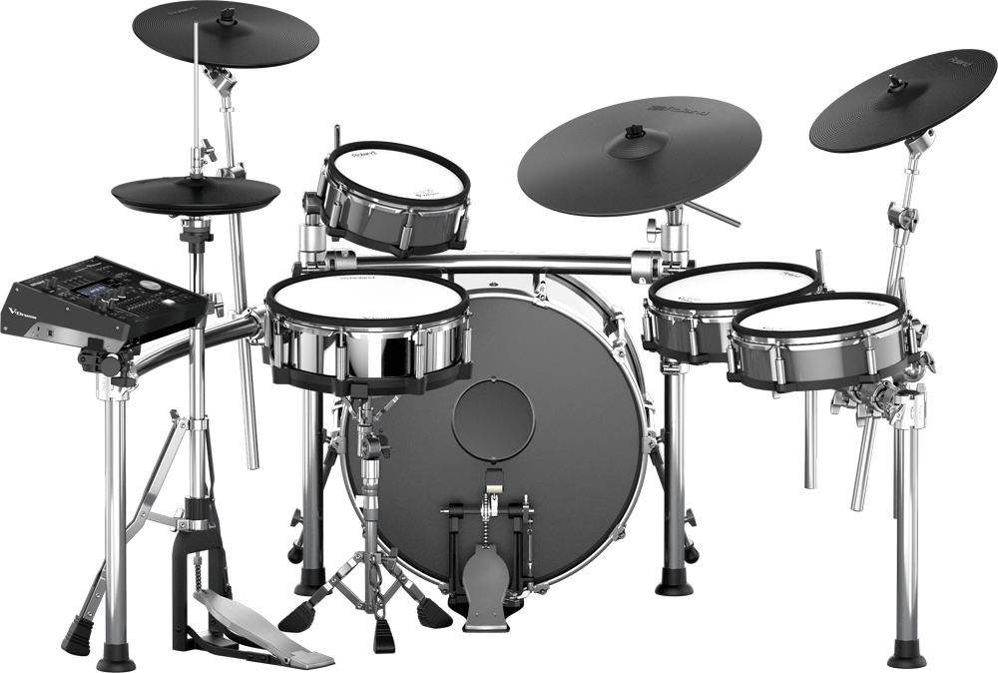
MUSIC
V-Drum
System
Complete drums setup
MUSIC
$2500
Notes:
https://www.pngfly.com/png-rm6q4u/download.html

Slide 11
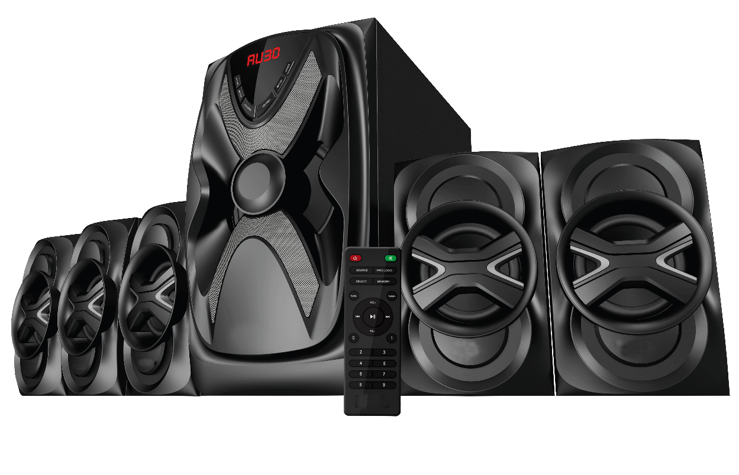
MUSIC
High Performance Speaker
High quality speaker set with remote control and microphone.
MUSIC
$2000
Notes:
https://www.pngfly.com/png-rm6q4u/download.html

Slide 12
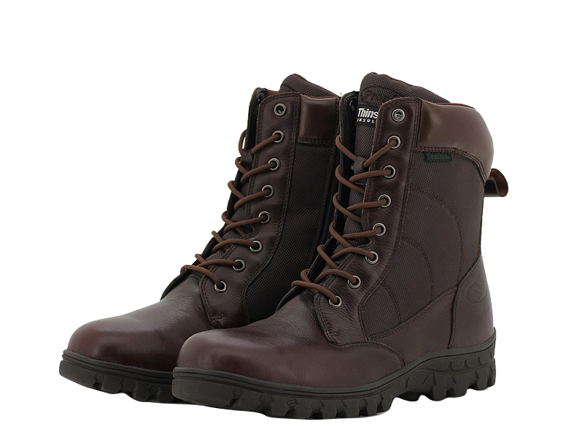
COMFORT
Boots Martin
Shoes
Leather Boots for Men
Color: Brown, Black
$80
Notes:
https://www.pngfly.com/png-r22209/download.html

Slide 13
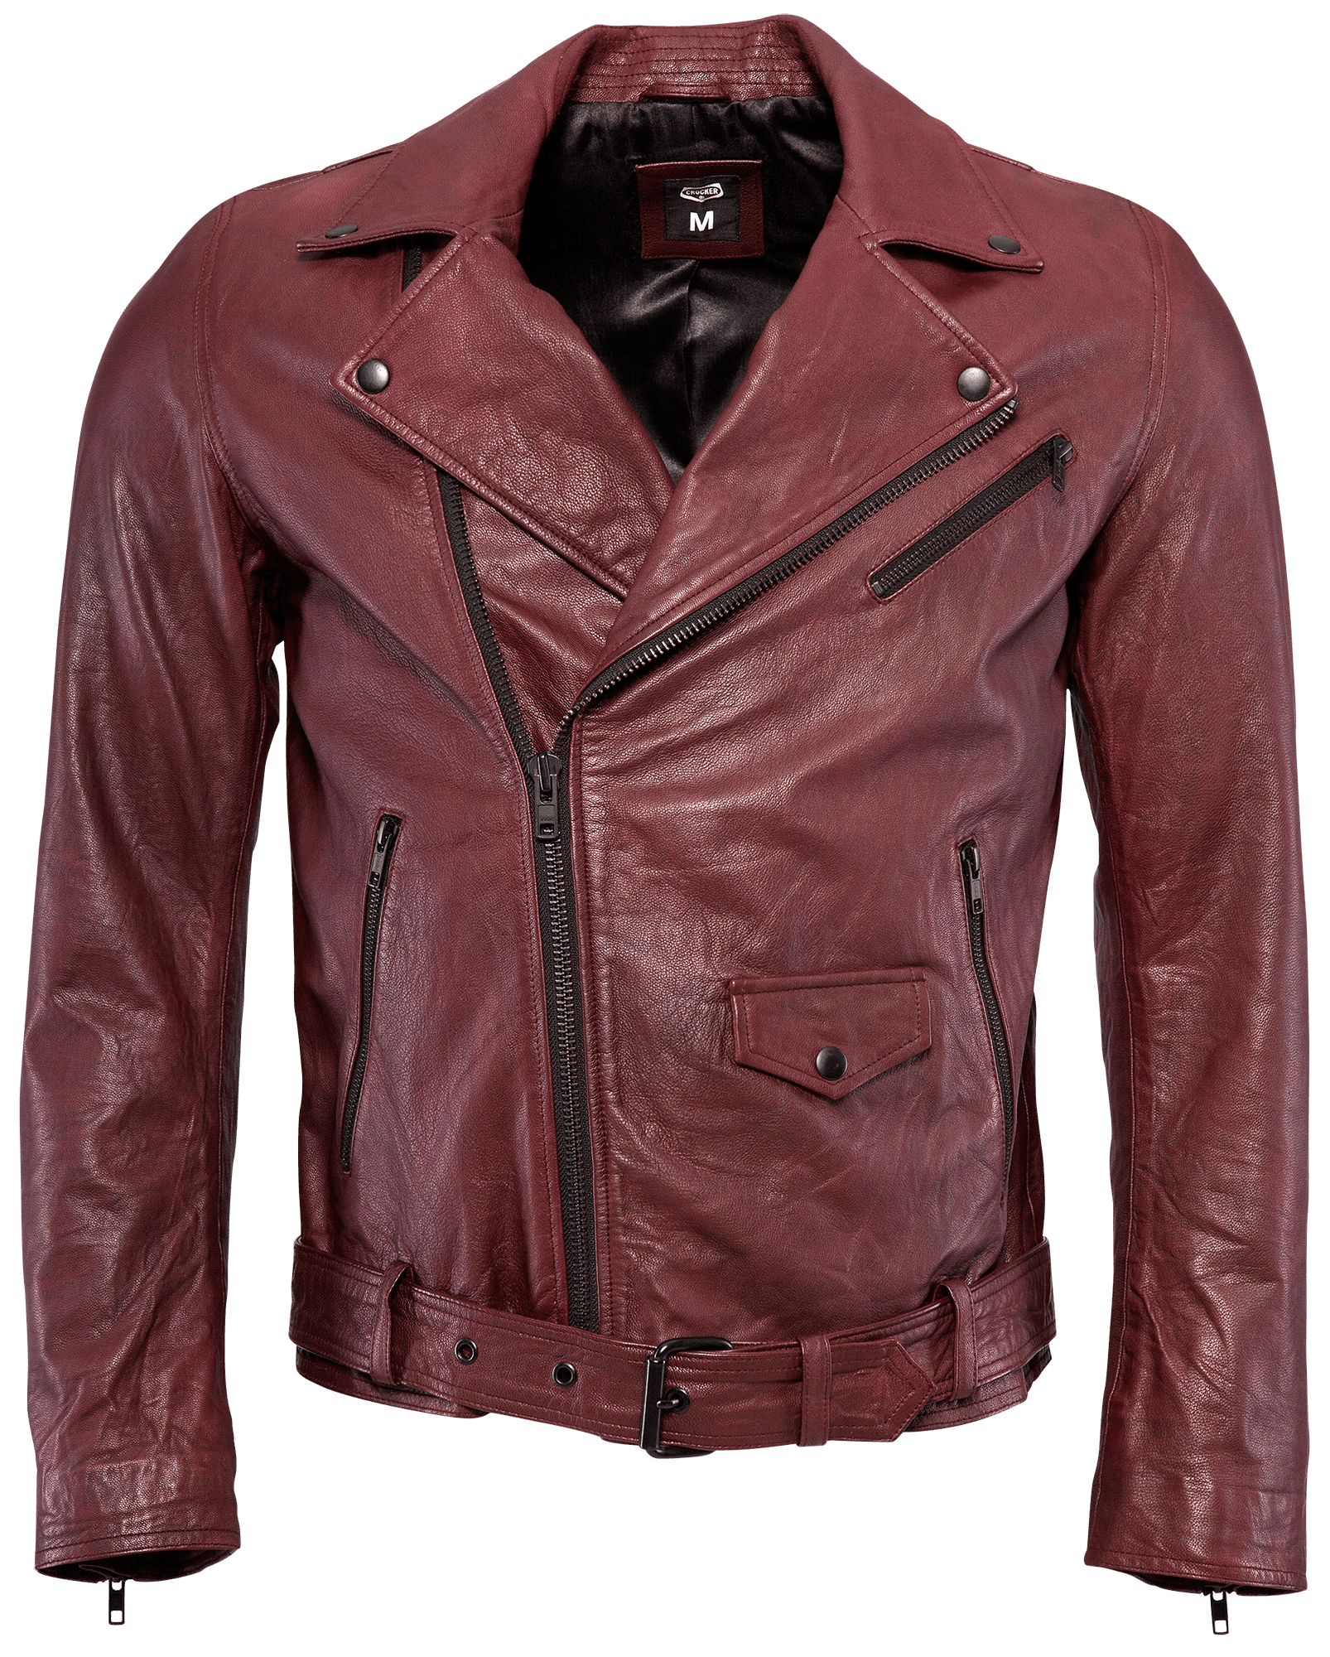
LEATHER
Leather
JACKET
UNISEX
Color: Brown
Sizes: Free Size
$50
Notes:
https://www.pngfly.com/png-san396/download.html

Slide 14
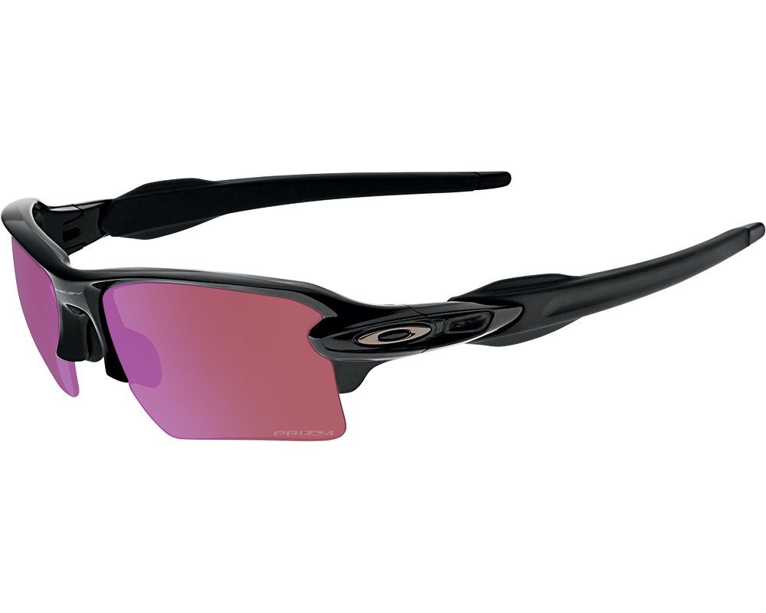
SUNLIGHT
Polarized
SPORTS SUNGLASSES
Color: Black, Blue, Pink
$30
Notes:
https://www.pngfly.com/png-z7fvum/download.html

