Slide 1
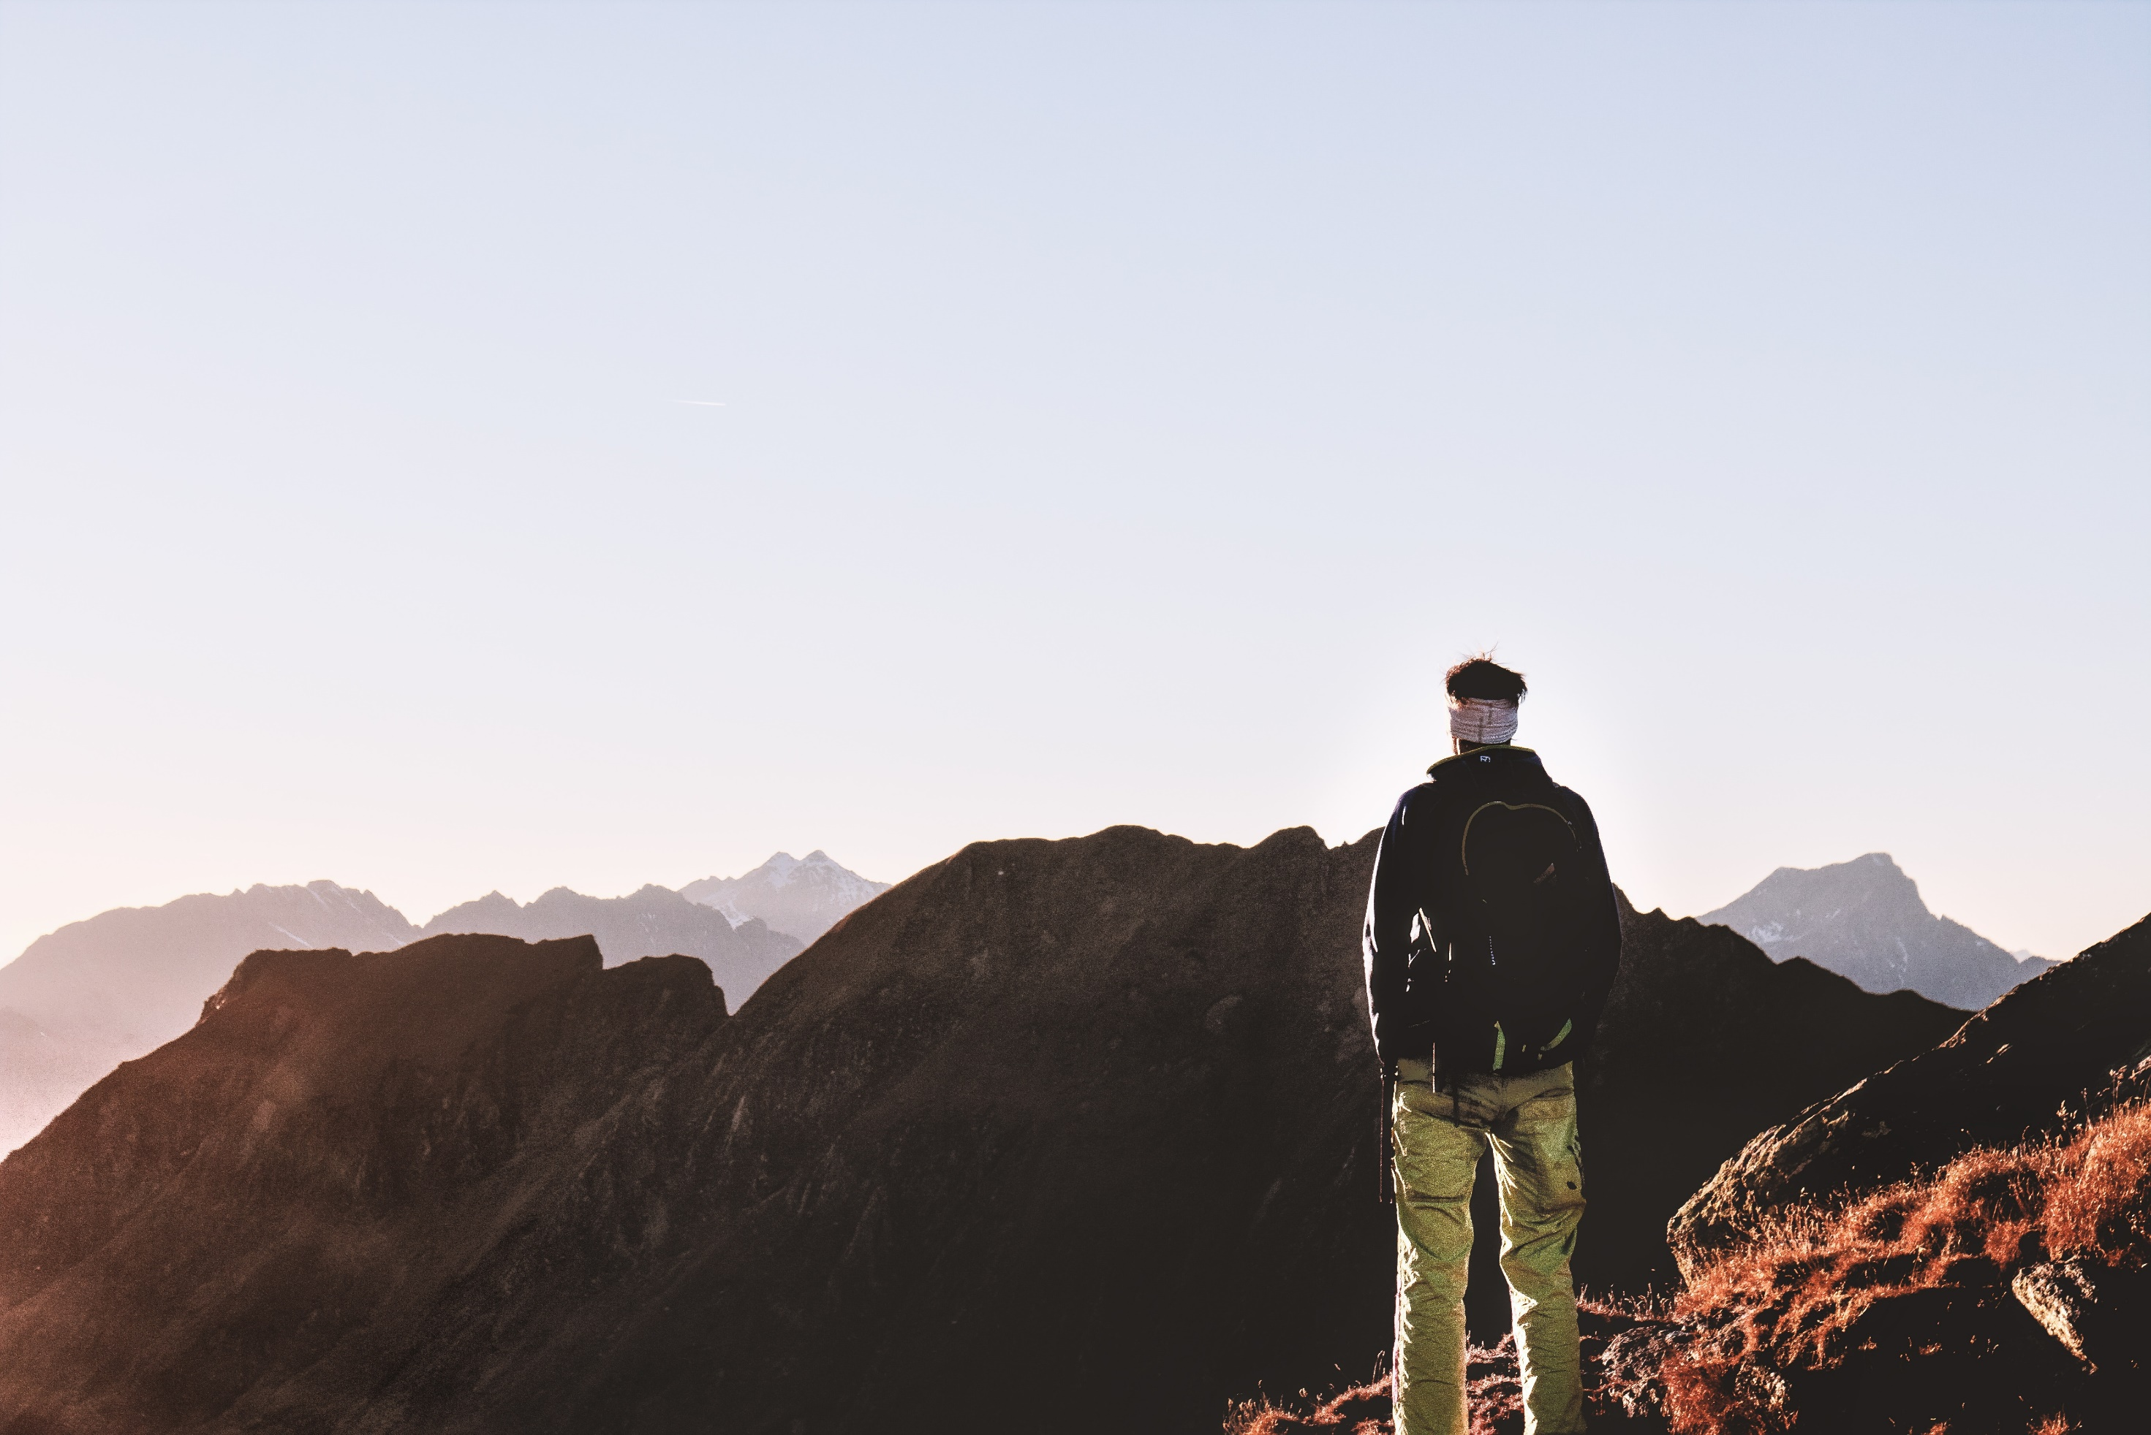
35.90 N__115.1236 S.
PRODUCT CODE
//November
//JABESHONLINESHOP.COM

Slide 2
NEW ARRIVAL
TERRAIN SHOES
//jabeshonlineshop.com
Made with high quality material for longer durability.
PRICE $100
35.90 N__115.1236 S.
Notes:
Photo by Tyler Lastovich from Pexels

Slide 3
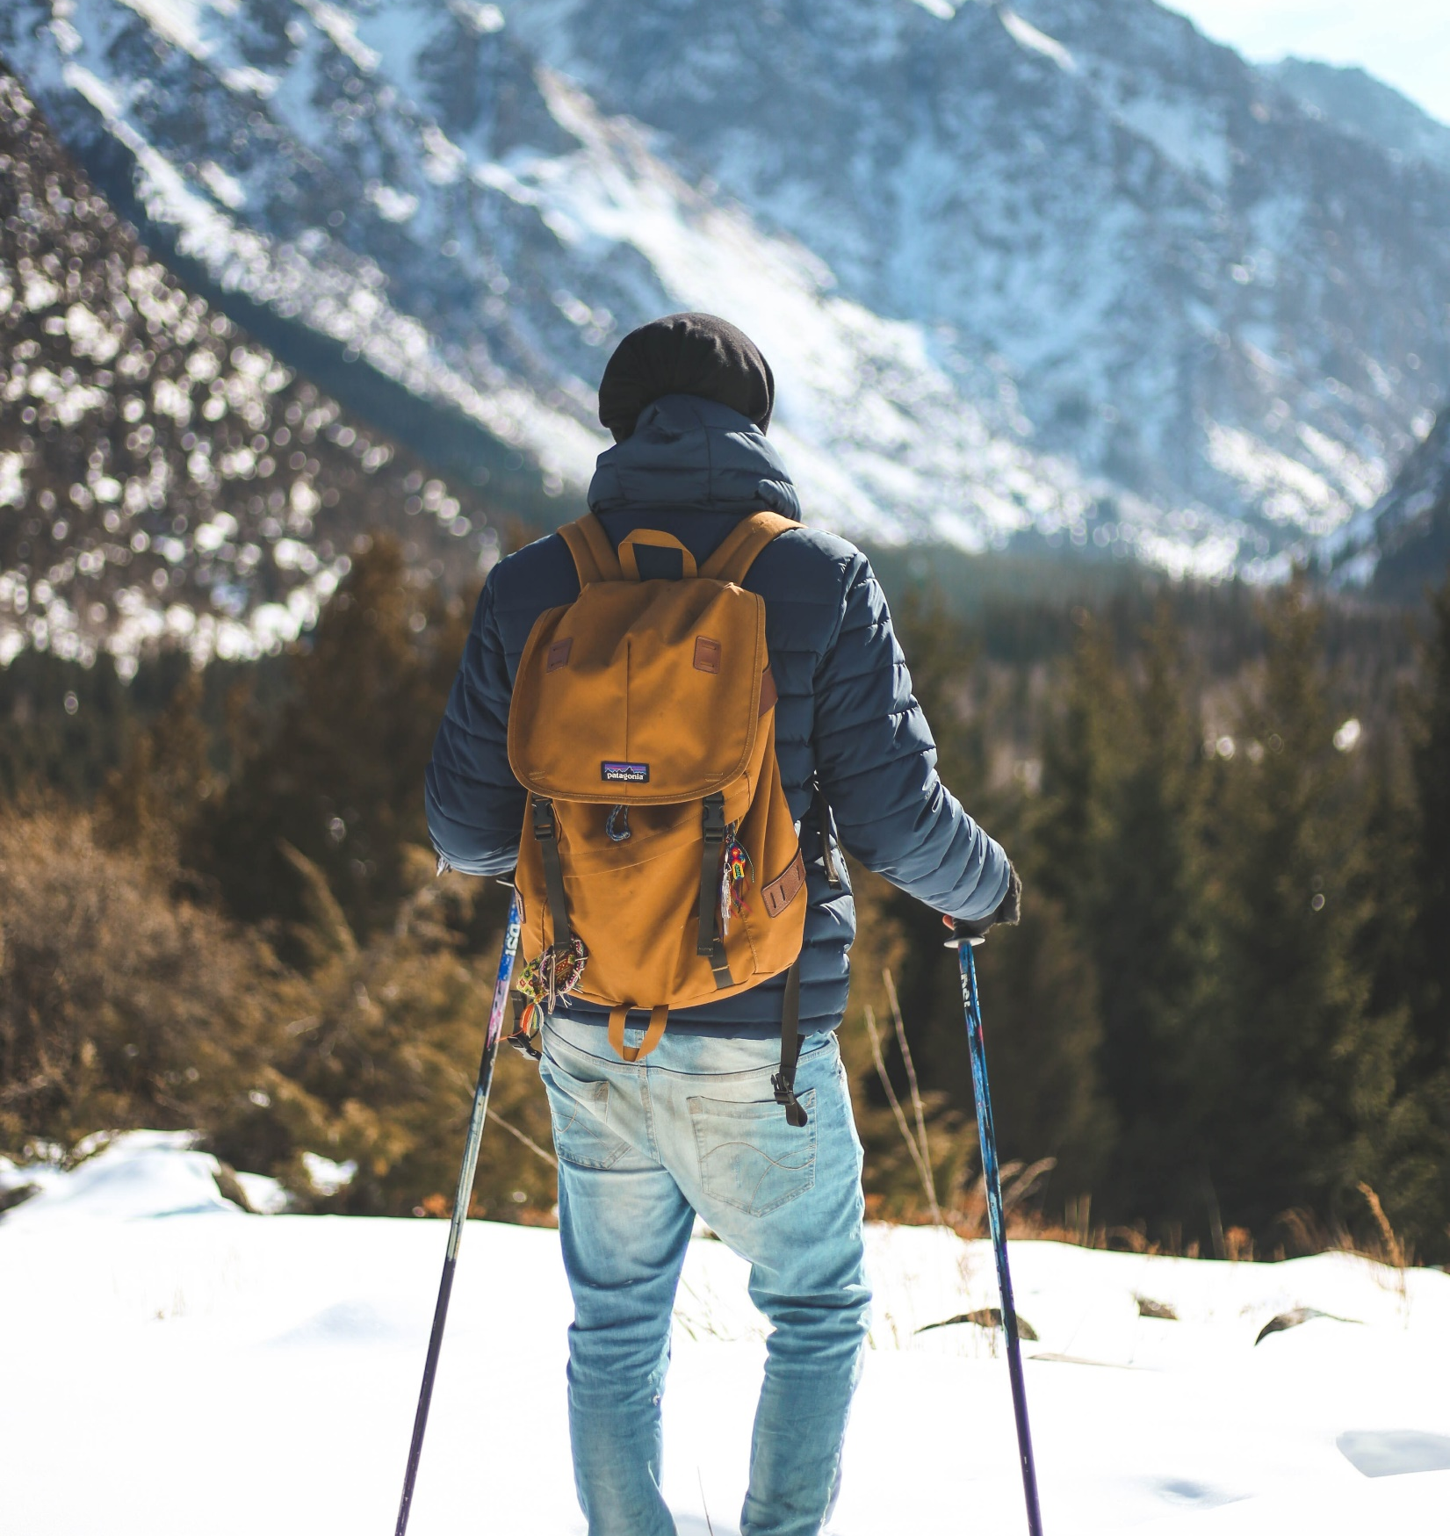
NEW ARRIVAL
BAGPACK
Orange Travelling Bag Pack w/ password. Good for travelling.
//jabeshonlineshop.com
PRICE $50
35.90 N__115.1236 S.
Notes:
Photo by Oziel Gómez from Pexels

Slide 4
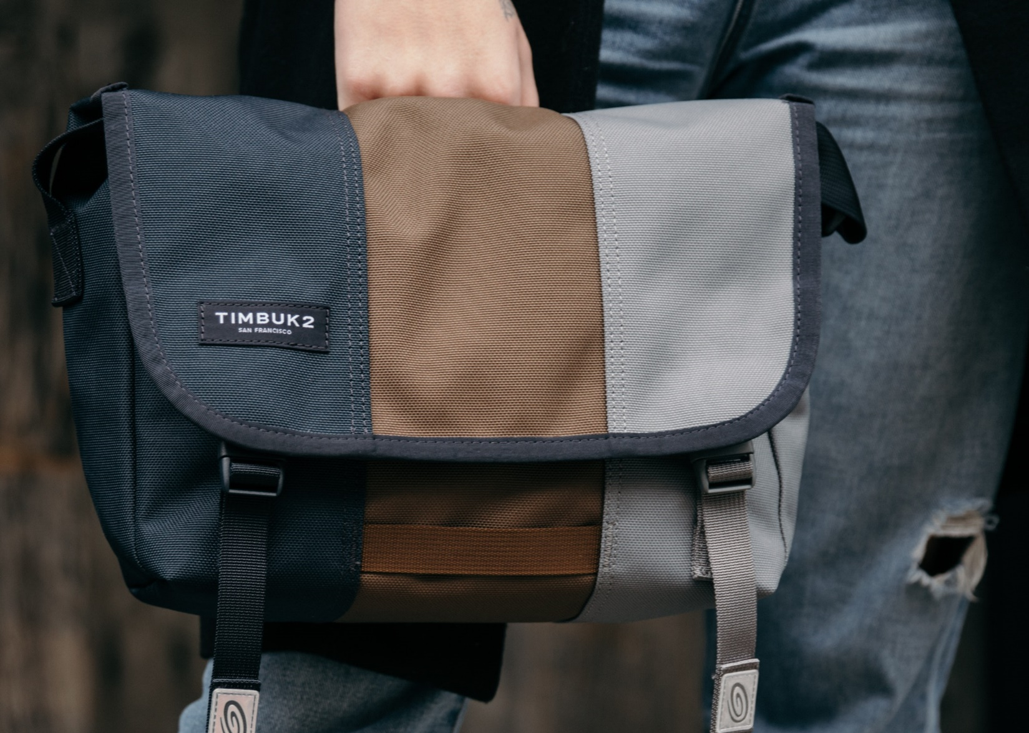
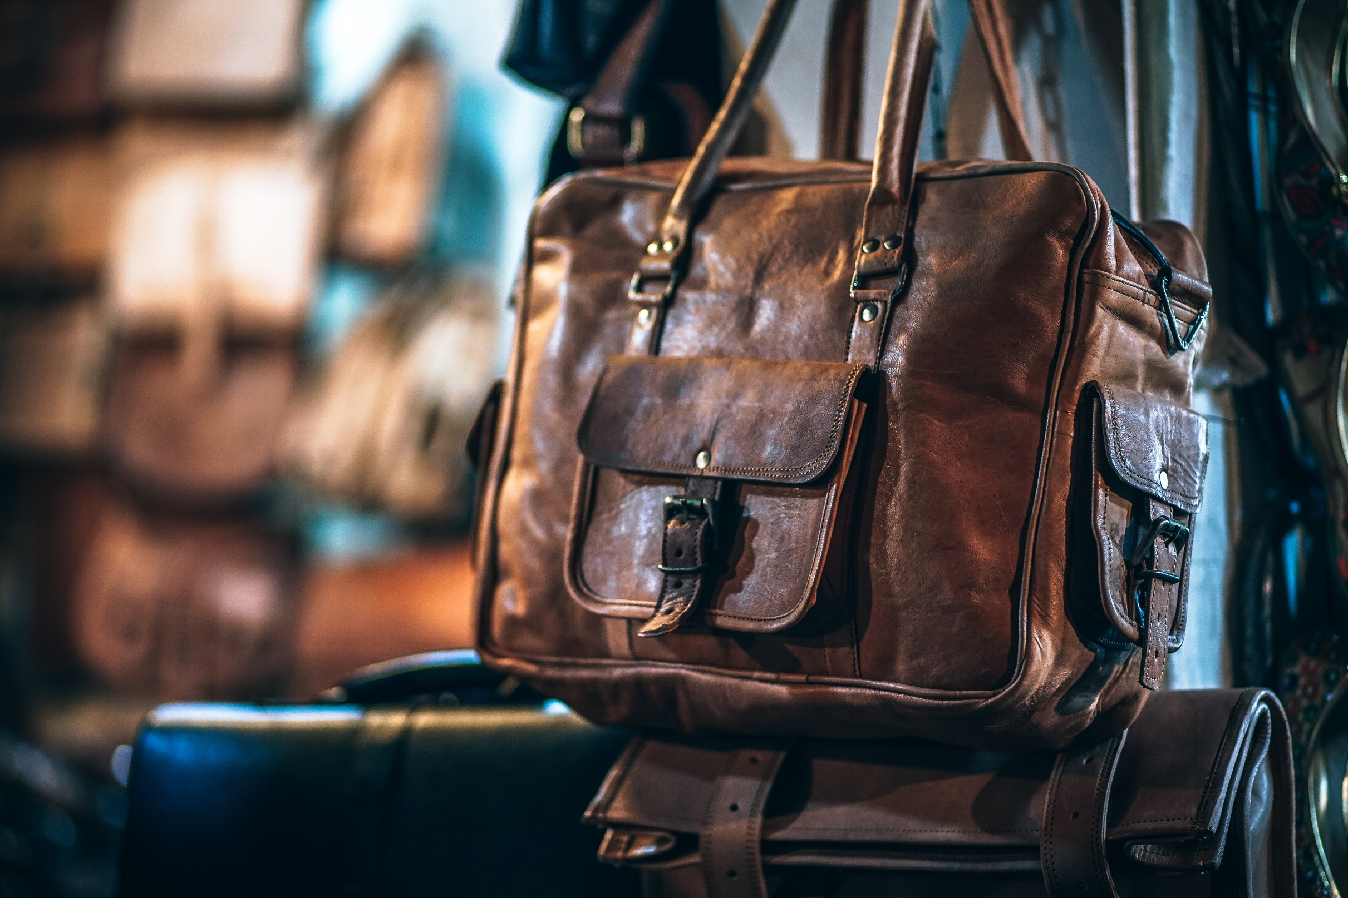
50% DISCOUNT
HANDBAGS
Leather fashion handbags – Unisex
//jabeshonlineshop.com
NOW FOR $50
35.90 N__115.1236 S.

Slide 5
50% DISCOUNT
DSLR CAMERA
SALE PRICE $200
//jabeshonlineshop.com
35.90 N__115.1236 S.

Slide 6
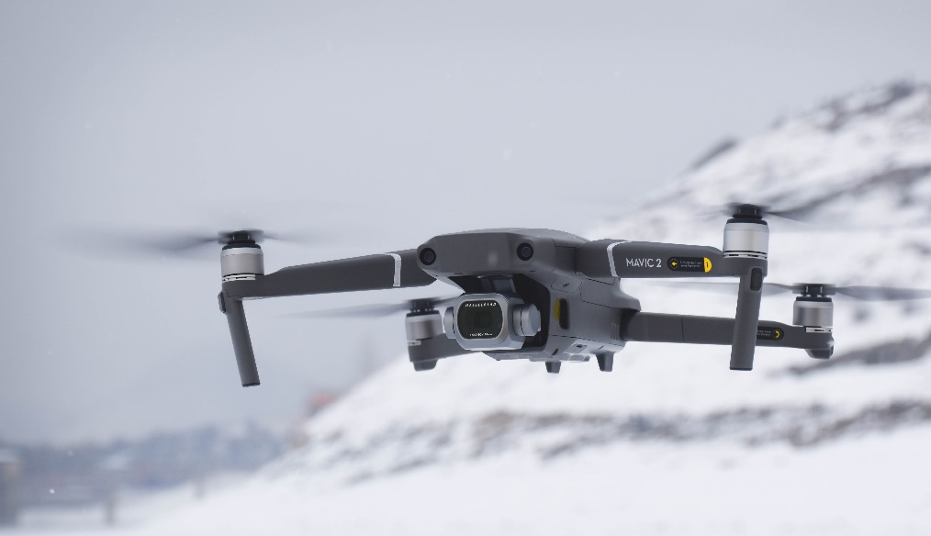
TRENDING ITEM
4K DRONE
Remote Control Flying Drone With 2MP HD Camera - Blue Steel
//jabeshonlineshop.com
NOW FOR $299
35.90 N__115.1236 S.

Slide 7
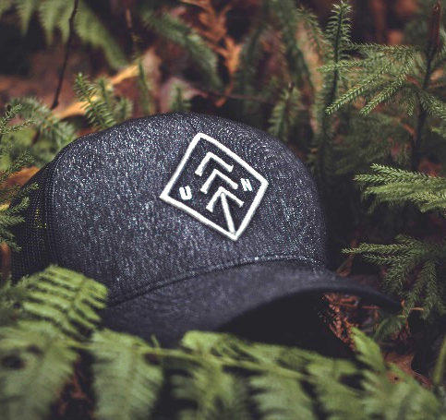
NEW ARRIVAL
FLAT 50% OFF
SUNGLASSES
HANDWATCH
OUTDOOR CAP
PRICE $100
PRICE $100
PRICE $100
35.90 N__115.1236 S.
//jabeshonlineshop.com
Notes:
Photo by Fabio Partenheimer from Pexels

Slide 8
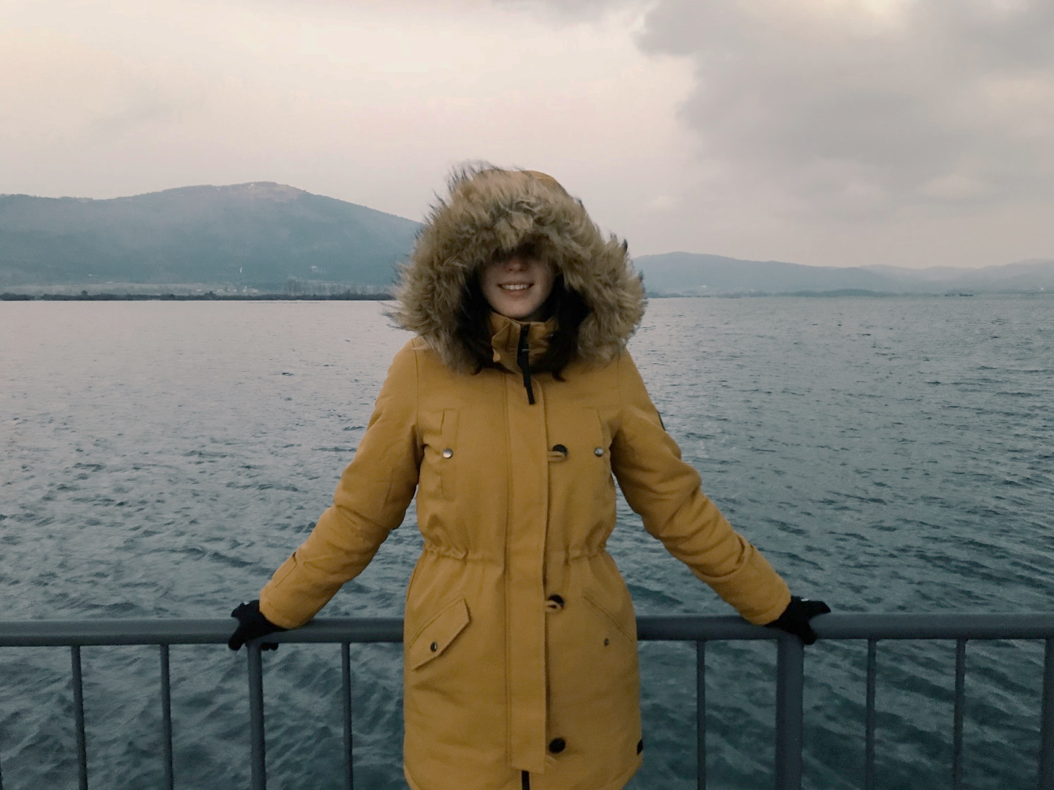
SALE SEASON
TENCH COAT
//jabeshonlineshop.com
Made with high quality material for longer durability.
PRICE $70
35.90 N__115.1236 S.
Notes:
Photo by Tyler Lastovich from Pexels

Slide 9
NEW ARRIVAL
//jabeshonlineshop.com
ANTIQUE COMPAS
100% High Quality
Vintage Fashion
Unisex
PRICE $50
35.90 N__115.1236 S.
Notes:
Photo by Oziel Gómez from Pexels

Slide 10
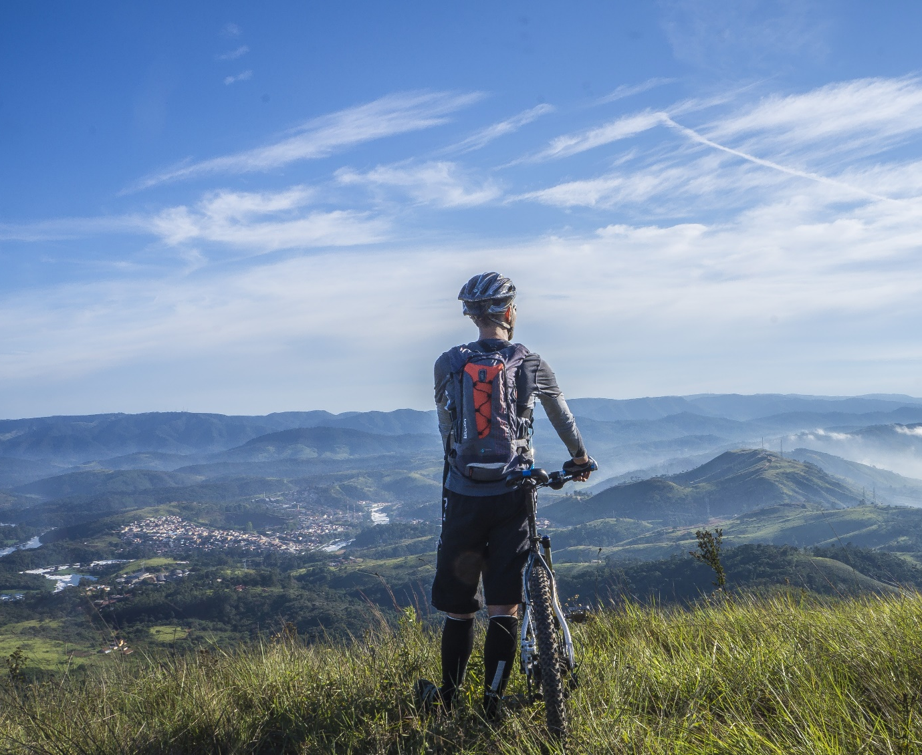
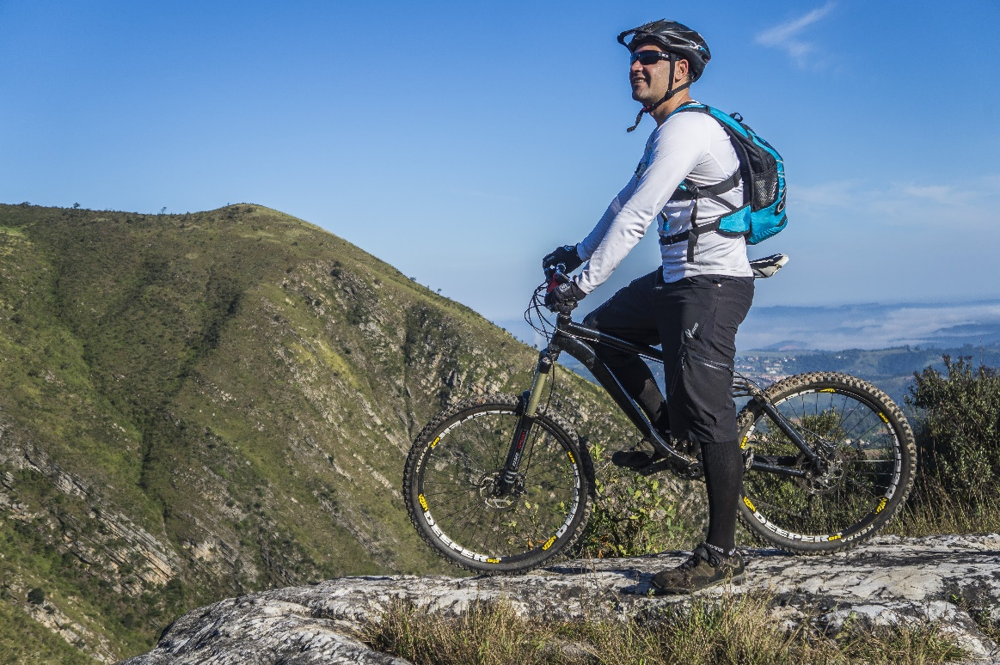
TREKKING ITEM
MOUNTAIN BIKE
Mountain Bike – Framed 3.0
20-inch Wheel
Aluminum Full Suspension
//jabeshonlineshop.com
Now for $399
35.90 N__115.1236 S.

Slide 11
25% DISCOUNT
OUTDOOR BOOTS
SALE PRICE $200
//jabeshonlineshop.com
35.90 N__115.1236 S.

Slide 12
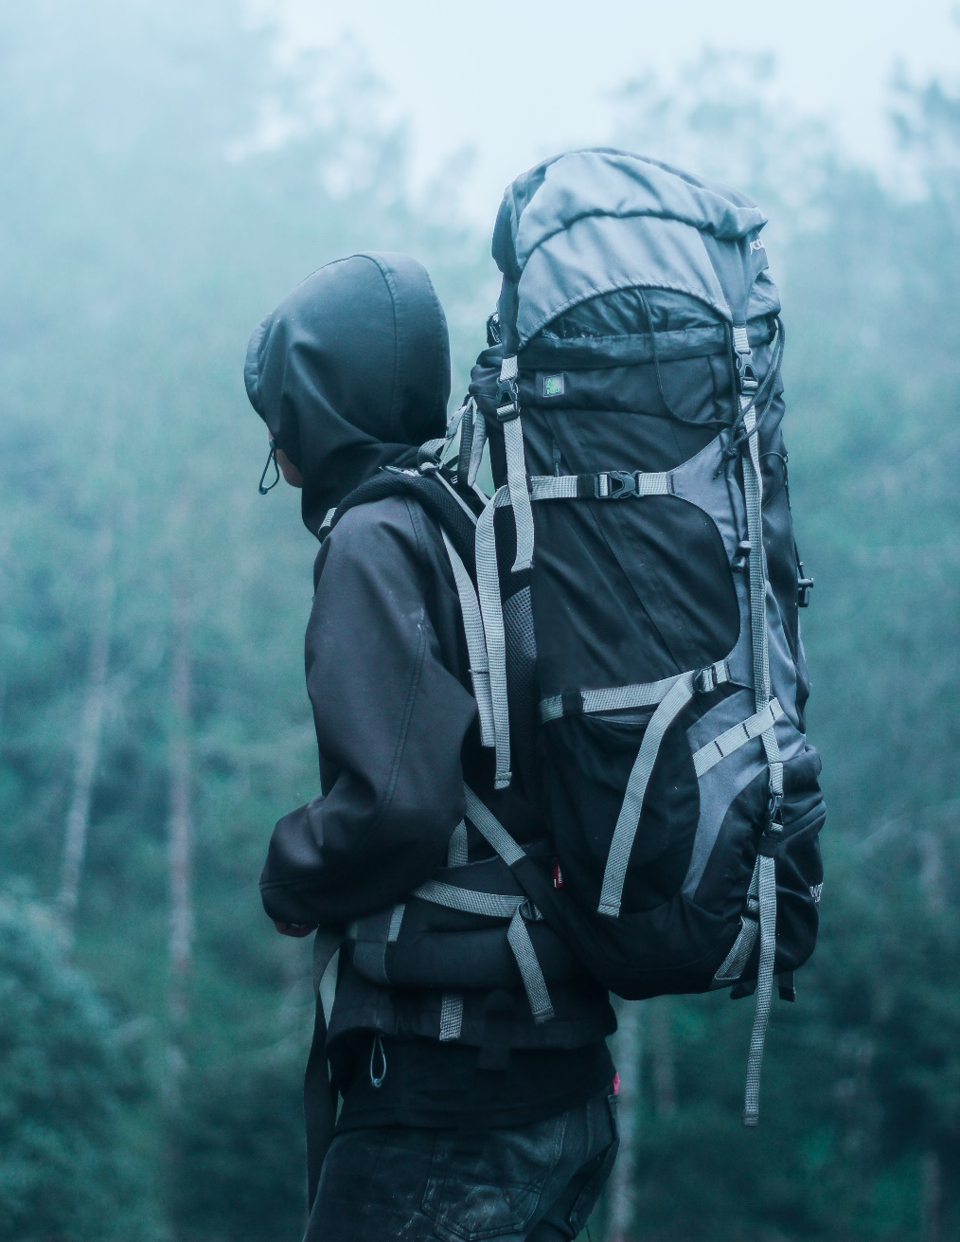
50% DISCOUNT
TREKKING BAGS
Waterproof Sports Trekking Bags
//jabeshonlineshop.com
NOW FOR $50
35.90 N__115.1236 S.

Slide 13
35.90 N__115.1236 S.
//JABESHONLINESHOP.COM

