Slide 1
The Smell that will make you feel like a goddess

Slide 2
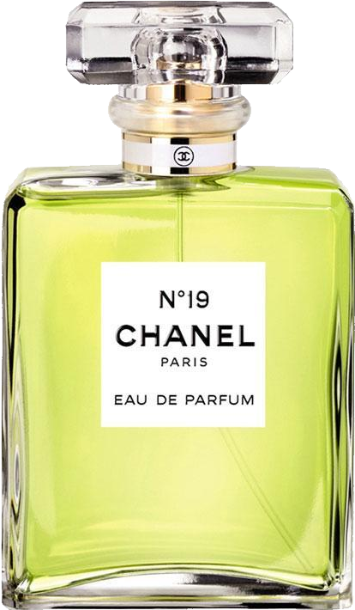
CHANEL PARIS
PREMIUM COLLECTION
$200.5
An aromatherapy blend designed to help nurture your mind, heart and body.

Slide 3
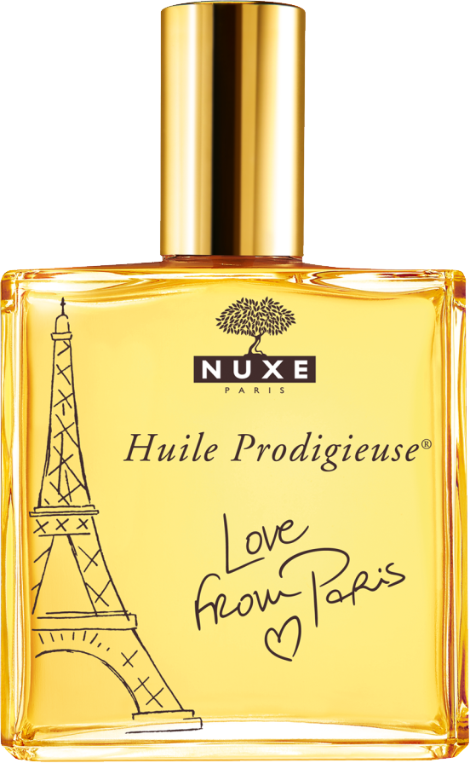
Huile Profigieuse
PREMIUM COLLECTION
$150
Pure Love will bring you the scent of flowers.

Slide 4
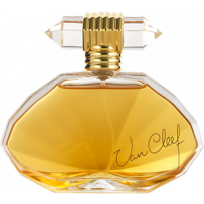
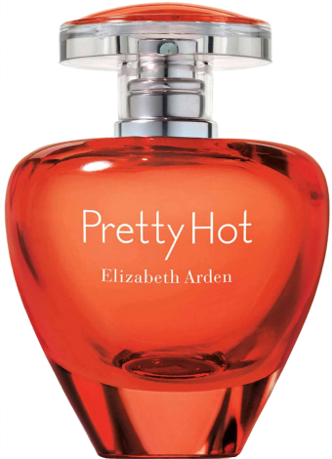
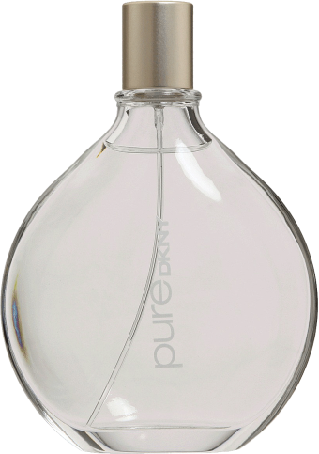
PRIME CHOICE
DKN PURE
VAN CLIFF
PRETTY HOT
Women Perfume 100ml
Women Perfume 150ml
Women Perfume 100ml
$99.99
$199.99
$299.99

Slide 5
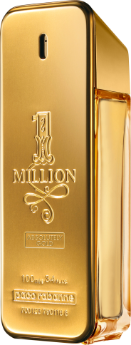
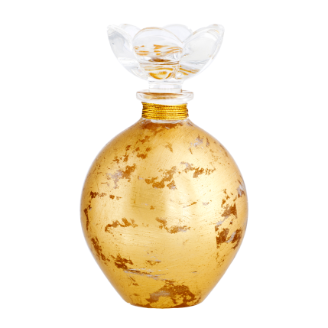
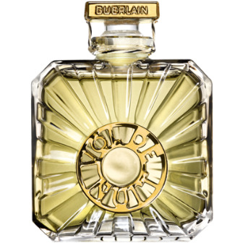
PRIME CHOICE
DKN PURE
VAN CLIFF
PRETTY HOT
Women Perfume 100ml
Women Perfume 150ml
Women Perfume 100ml
$99.99
$199.99
$299.99

Slide 6
BEST SELLING
PRETTY CHARLIE
This is a one in a million perfume. This will change your mood on any given day!
$99.99

Slide 7
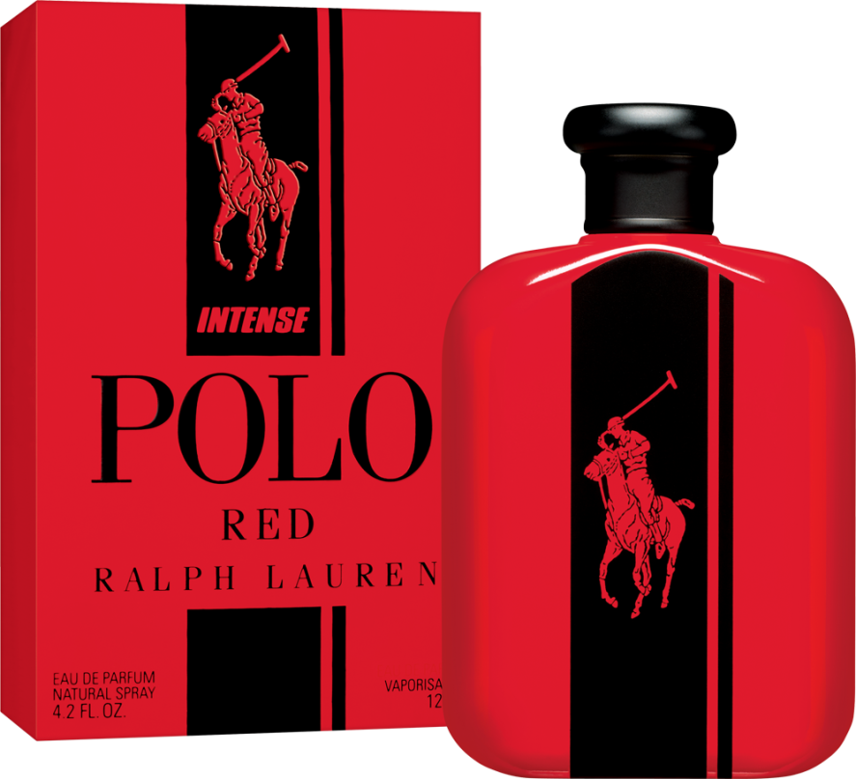
50% OFF
PRETTY CHARLIE
Super Long Lasting. Very Feminine smell
$99.99

Slide 8
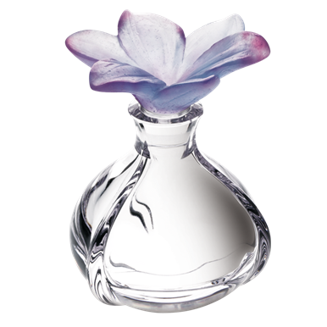
CHANEL PARIS
PREMIUM COLLECTION
$200.5
Best Seller of all times.

Slide 9
Huile Profigieuse
PREMIUM COLLECTION
$150
Pure and beautiful woman whose spontaneity and beauty have been sought-after wearing this perfume.

Slide 10
The Smell that will make you feel like a goddess

