Slide 1
/eieyewearoptical
/eieyewearoptical
/eieyewearoptical
/eieyewearoptical
Beautiful In Your Eyes!

Slide 2
MODERN ROUNDED
3 colors available
PRODUCT CODE
#9308
Style: Rectangle
Frame Material: Plastic
Gender: Unisex
Lens Height: 43MM
Lens Width: 53MM
Eyewear Type: Sunglasses
ALL NEW PRIME COLLCETION
Selective articles
PRODUCT CODE
#9306
MODERN ROUNDED
3 colors available
Style :Rectangle
Frame Material: Metal
Gender: Unisex
Lens Height: 43MM
Lens Width: 53MM
Eyewear Type: Sunglasses
PRODUCT CODE
#9305
PRODUCT CODE
#9307
PRODUCT CODE
#9309

Slide 3
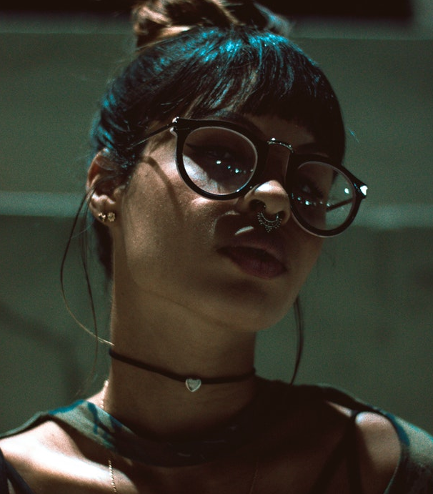
MODERN ROUNDED
3 colors available
PRODUCT CODE
#9313
Style: Rectangle
Frame Material: Metal
Gender: Men
Lens Height: 43MM
Lens Width: 53MM
Eyewear Type :Eyeglasses
ALL NEW PRIME COLLCETION
Selective articles
PRODUCT CODE
#9311
MODERN ROUNDED
3 colors available
Style: Rectangle
Frame Material: Metal
Gender: Woen
Lens Height: 43MM
Lens Width: 53MM
Eyewear Type: Sunglasses
PRODUCT CODE
#9310
PRODUCT CODE
#9312
PRODUCT CODE
#9314

Slide 4
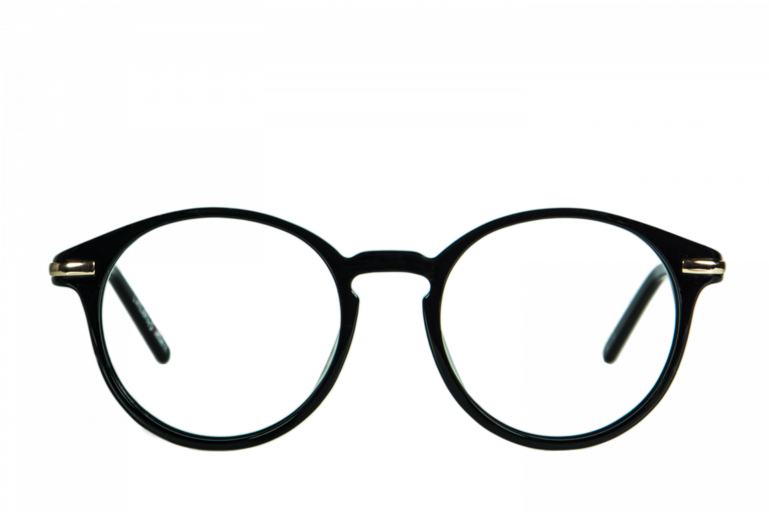
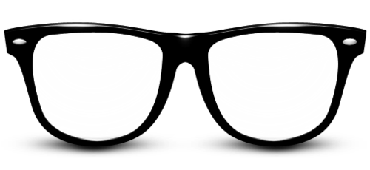
Fresh Stock
Sale up to 50%
30%
20%
PRODUCT CODE
#9315
PRODUCT CODE
#9316
Style: Rectangle
Frame Material: Metal
Lens Height: 43MM
Lens Width: 53MM
Style: Rectangle
Frame Material: Plastic
Lens Height: 43MM
Lens Width: 53MM
150$
200$

Slide 5
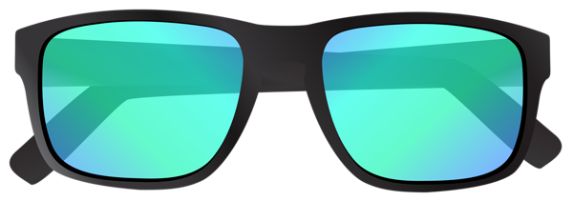
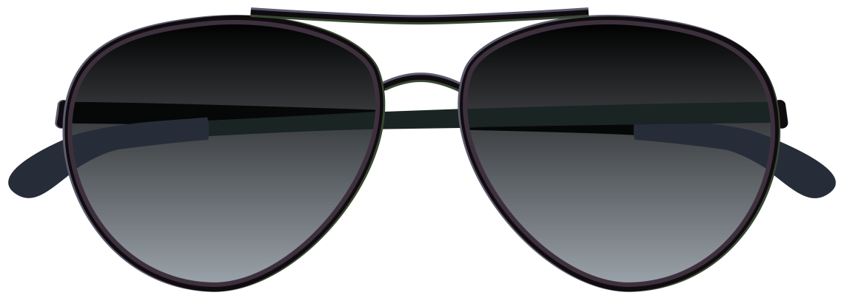
Fresh Stock
Sale up to 50%
30%
50%
PRODUCT CODE
#9317
PRODUCT CODE
#9318
Style: Rectangle
Frame Material: Plastic
Lens Height: 43MM
Lens Width: 53MM
Style: Rectangle
Frame Material: Metal
Lens Height: 43MM
Lens Width: 53MM
70$
110$

Slide 6
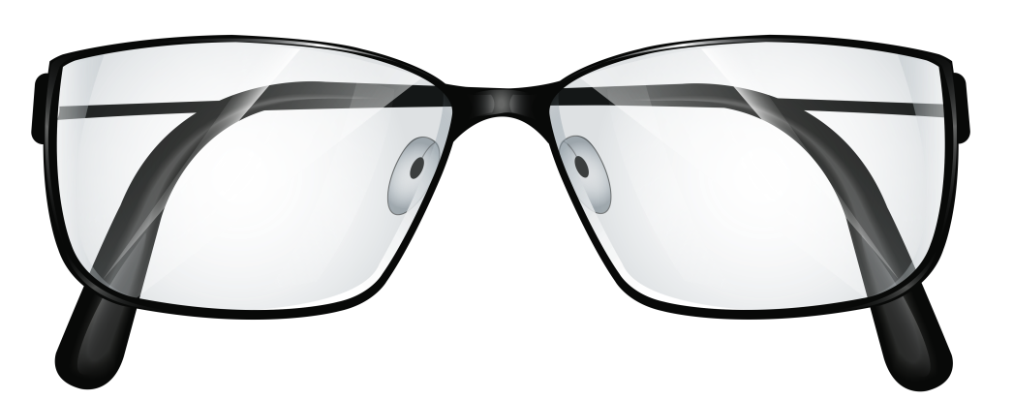
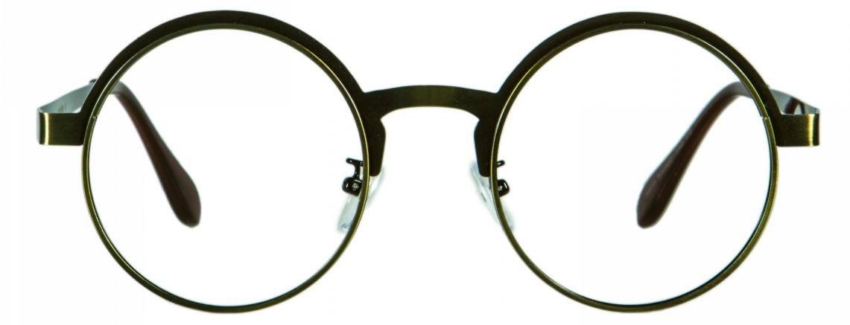
Fresh Stock
Sale up to 50%
50%
50%
PRODUCT CODE
#9317
PRODUCT CODE
#9318
Style: Rectangle
Frame Material: Metal
Lens Height: 43MM
Lens Width: 53MM
Style: Rectangle
Frame Material: Metal
Lens Height: 43MM
Lens Width: 53MM
150$
120$

Slide 7
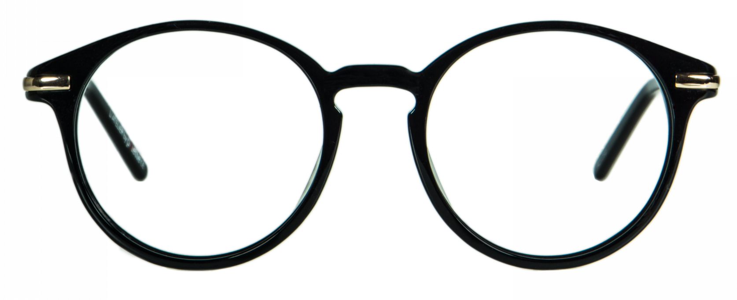
Fresh Stock
Sale up to 50%
Exclusive articles
Style: Rectangle
Frame Material: Metal
Gender: Men
Lens Height: 43MM
Lens Width: 53MM
Eyewear Type: Eyeglasses
Available Colors

Slide 8
Fresh Stock
Sale up to 50%
Exclusive articles
Style: Rectangle
Frame Material: Plastic
Gender: Men
Lens Height: 43MM
Lens Width: 53MM
Eyewear Type: Eyeglasses
Available Colors

Slide 9
/eieyewearoptical
/eieyewearoptical
/eieyewearoptical
/eieyewearoptical
Beautiful In Your Eyes!

