Slide 2
ASK US FOR DETAILS
1-800-123-4567
www. insurancecompany.com
info@insurancecompany.com
WE ARE OPEN MONDAY TO FRIDAY
ELDERLY: SAVE FOR YOUR GRANDCHILDREN
We Yolooe believe that life insurance is a WANT to get life insurance for their children.

Slide 3
ASK US FOR DETAILS
1-800-123-4567
www. insurancecompany.com
info@insurancecompany.com
WE ARE OPEN MONDAY TO FRIDAY
HOME LOANS: BUY YOUR OWN DREAM HOME
Each month home cost including mortgage, property taxes, insurance and maintenance, into a money-market account You'll quickly know whether you can afford the house.

Slide 4
ASK US FOR DETAILS
1-800-123-4567
www. insurancecompany.com
info@insurancecompany.com
WE ARE OPEN MONDAY TO FRIDAY
0% DOWN PAYMENT
CAR LOANS: GET YOUR DREAM CAR
To qualify, the availed auto loan should meet the following criteria:
Vehicle must be brand new and for private use
Minimum loan amount of $3,000
Minimum loan term of 36 months
QUICK DELIVERY
LOWEST INTEREST

Slide 5
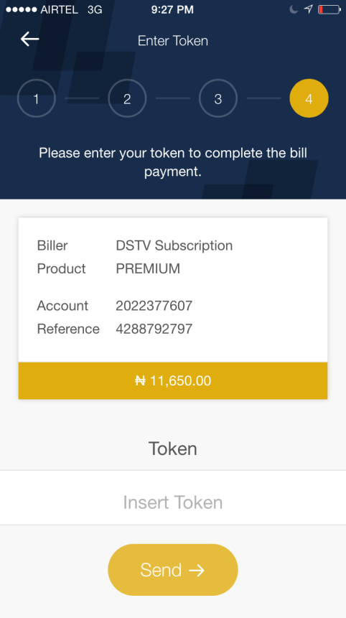
ASK US FOR DETAILS
1-800-123-4567
www. insurancecompany.com
info@insurancecompany.com
WE ARE OPEN MONDAY TO FRIDAY
01
Vehicle must be brand new and for private use
02
Minimum loan amount of $3,000
03
Protect your new vehicle from damage and repair expenses

Slide 6
ASK US FOR DETAILS
1-800-123-4567
www. insurancecompany.com
info@insurancecompany.com
WE ARE OPEN MONDAY TO FRIDAY
Easy to qualify when you visit your nearest branch
Free comprehensive insurance for 2 year
Coverage includes acts of nature

Slide 7
ASK US FOR DETAILS
1-800-123-4567
www. insurancecompany.com
info@insurancecompany.com
WE ARE OPEN MONDAY TO FRIDAY
DEATH INSURANCE PLAN
Accidental death is a policy that pays benefits to the beneficiary if the cause of death is an accident.

Slide 8
ASK US FOR DETAILS
1-800-123-4567
www. insurancecompany.com
info@insurancecompany.com
WE ARE OPEN MONDAY TO FRIDAY
EDUCATION LOAN PLAN
This helps the financial burden of providing an undergraduate or graduate college education to eligible dependent children.

