Slide 1
1-800-123-4567
www.shoppateeshoppers.com
1177 Avenue of the Americas, New York, NY

Slide 2
UP TO 50% FLAT SALE
STARTING DEC 25 – DEC 31

Slide 4
ALL NEW STOCK
30% OFF TRENDING! USE CODE: GET30
ORDER NOW

Slide 5
NEW ARRIVALS
25% OFF TRENDING FASHION
ORDER NOW

Slide 6
NEW ARRIVALS
20% OFF SPORTS WEAR! USE CODE: GET20
ORDER NOW

Slide 7
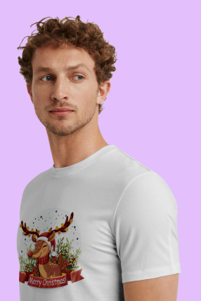
CUSTOM PRINTS
10% off Use code: GET10. No minimum spend. Ends March 20 noon. Selected items only
ORDER NOW

Slide 8
CUSTOM PRINTS
20% off Use code: GET20. No minimum spend. Ends March 20 noon. Selected items only
ORDER NOW

Slide 9
CUSTOM PRINTS
NEW DESIGN
50% OFF

Slide 10
1-800-123-4567
www.shoppateeshoppers.com
1177 Avenue of the Americas,
New York, NY

