Slide 1
+123456789
www.beautifulcitytratvelttagency.com
A-25, New York, New York

Slide 2
MAKE HOLIDAYS MORE FUN!!
1
2
MAKE HOLIDAYS MORE FUN!!
MAKE HOLIDAYS MORE FUN!!
Round Trip From China To Tokyo, Japan
Round Trip From Taiwan To New York
09-12 DEC
02-15 JAN
Free Lunch & Dinner
Free Lunch & Dinner

Slide 3
BEST PLACES TO CHOOSE
MAKE HOLIDAYS MORE FUN!!
Your Partner in Travel! We offer Great Deals for your dream destination.
TRAVEL
HOTELS
ROOM VIEW
OUTDOORS
3 Days / 2 Nights
1 room 3 guests
Refreshing Rooms w/ Dining
Hiking, Beach Swimming, Biking

Slide 4
EASY PROCESS AND EXCITING DESTINATIONS TO VISIT
Beautiful City is a professional Destination Management
Company by Mr. John Doe. He has a decade’s experience for high service standards in providing tour & travel related services.
Expect that we will give you the best service for your travel.
We suggest to try our fittings!!
MAKE HOLIDAYS MORE FUN!!
We are looking forward for an opportunity to be of assistance in providing for your travel services. We do have a handling network for every destination worldwide...

Slide 5
MAKE HOLIDAYS MORE FUN!!
EASY PROCESS AND EXCITING DESTINATIONS TO VISIT
MAKE HOLIDAYS MORE FUN!!
Beautiful City is a professional Destination Management
Company by Mr. John Doe. He has a decade’s experience for high service standards in providing tour & travel related services.
Expect that we will give you the best service for your travel.
We suggest to try our fittings!!
MAKE HOLIDAYS MORE FUN!!
MAKE HOLIDAYS MORE FUN!!

Slide 6
START
EXPLORING
We specializes in catering to every need of our foreign tourist that visits amazing places! Be it leisure, special interests, anniversaries, birthdays, holidays, etc…

Slide 7
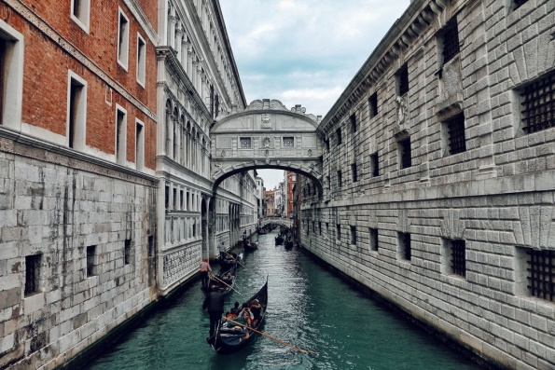
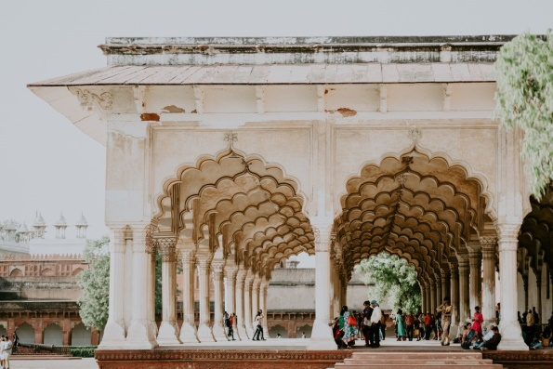
BIG THINGS START FROM HERE
Beautiful City travel related services are all professionally offered in a special way....
01
02
03

Slide 8
BIG THINGS START FROM HERE
Special Interest Tours
Adventure Tours
We specializes in making tour packages for individuals & groups
to all holiday destinations all over the world.

Slide 9
EASY PROCESS AND EXCITING DESTINATIONS TO VISIT
Beautiful City is a professional Destination Management
Company by Mr. John Doe. He has a decade’s experience for high service standards in providing tour & travel related services.
Expect that we will give you the best service for your travel.
We suggest to try our fittings!!
200+ DESTINATIONS
150+ AIRLINES

Slide 10
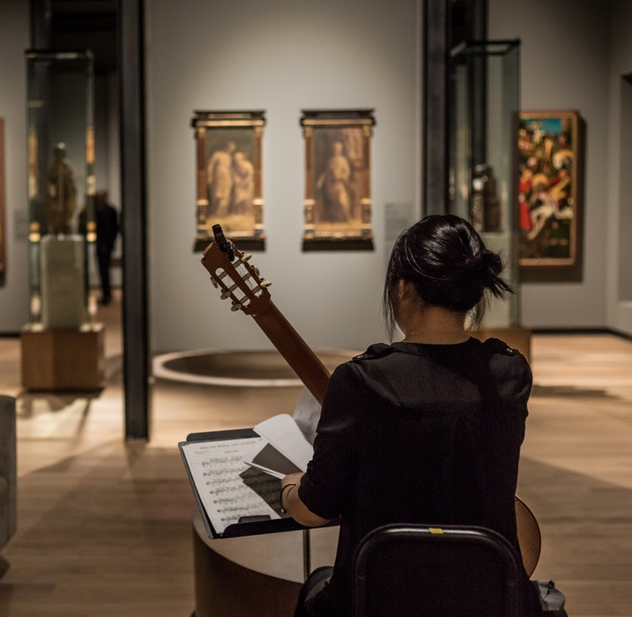
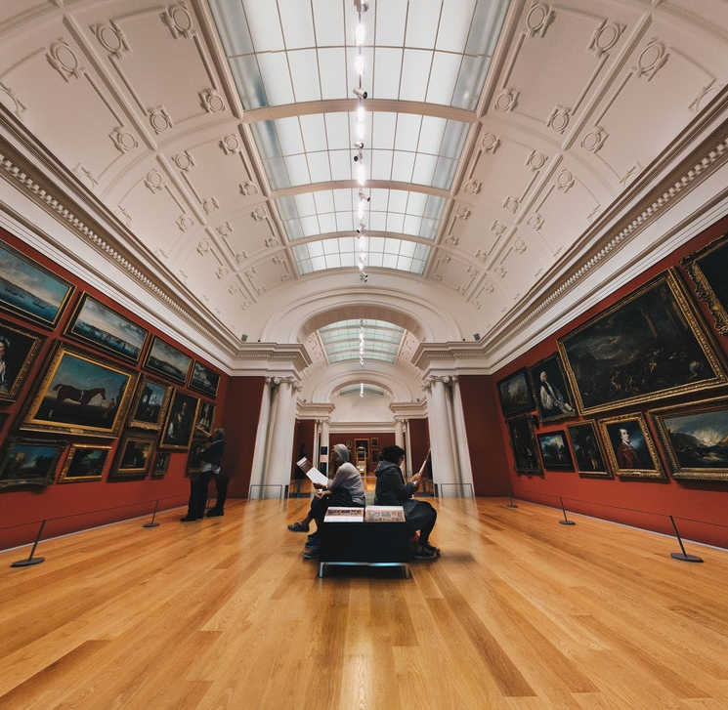
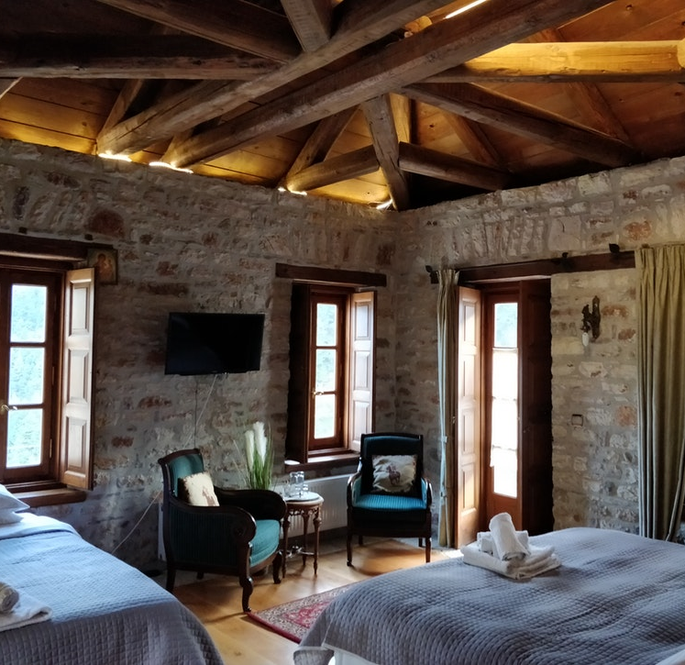
3 Days / 3 Nights
TORQUE HOTEL
MADRID, SPAIN
HOTELS FACILITY
With over 2 types of rooms to choose
Standard Room to Ambassador Suite, Torque Hotel guarantees a comfortable good night's sleep.
All rooms are air-conditioned.
TV with cable programing, coffee and tea making facilities, other standard room amenities, and a private toilet and bath with hot and cold shower.
Each room comes with an individual balcony overlooking the scenic view of the beach.

Slide 11
TRAVELLING FEATURES
GET 15% OFF
EXCLUSIVE OFFERS
ON YOUR NEXT TRAVEL
BUDGET THAILAND TOURS
BUDGET SPAIN TOURS
Enjoy the best of Thai with 15% off our brand new Budget tours. Offer ends 15th March.
Enjoy the best of Spain with 15% off our brand new Budget tours. Offer ends 15th March.
PROMOTION CODE 2020: 15% OFF for your next trip!
Sign up now and get 5% off your first journey using a discount code.
BUDGET NY TOURS
BUDGET CHINA TOURS
Enjoy the best of NY with 15% off our brand new Budget tours. Offer ends 15th March.
Enjoy the best of China with 15% off our brand new Budget tours. Offer ends 15th March.

Slide 12
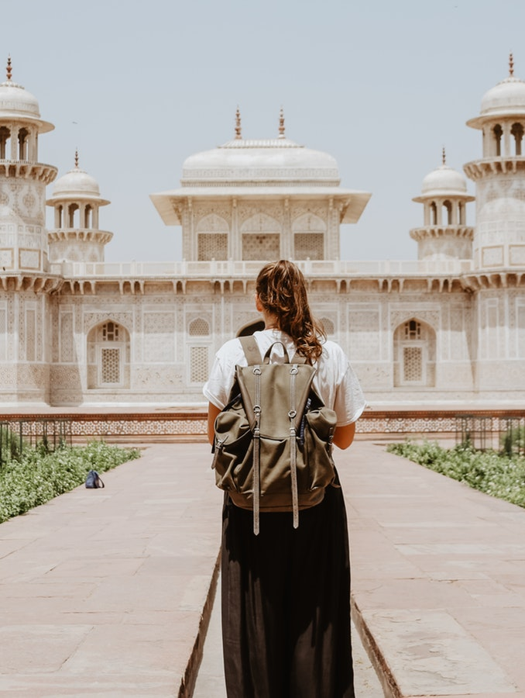
TRAVELLING PACKAGE
Save up to 20% on Flight + Hotel Travel Packages
24
$799
DECEMBER
HOTELS OPTIONS
Plan a trip now! Book your airline tickets and hotel rooms at the same time to get cheaper prices. With Beautiful City latest tour packages. You can choose from the various packages that we offer, and modify as you like to enjoy the ultimate adventure.
Save up to 20% on Flight + Hotel Travel Packages + Foods
$899

Slide 13
FACILITY DETAILS
DAY 01
DAY02
DAY 03
DAY 04
Go to Island and island hop to nearby Island for a short day trip
Arrive at International Airport
Go to Falls
Head back to accommodation
Get an early start and travel up north Island
Try island hopping and snorkeling with colorful marine life
Rent a bike and explore the island
Head to Paradise beach and chill with your friends

Slide 14
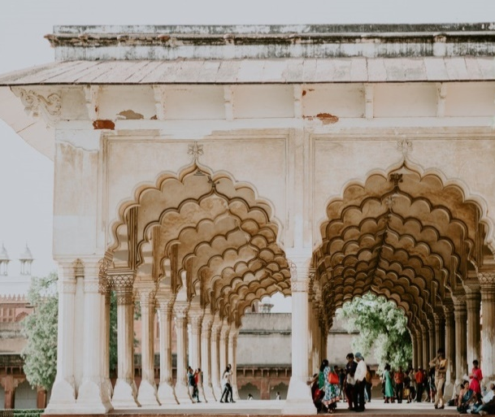
TRAVELLING PACKAGES
Save up to 20% on Round Trip Flight + Hotel Travel Packages in the following countries
China
Philippines
Rome
CHINA
PHILIPPINES
ROME
TRAVELLING PACKAGES
Save up to 10% on Round Trip Flight + Hotel Travel Packages in the following countries:
Turkey
Italy
Alaska
TURKEY
ITALY
ALASKA

Slide 15
+923322641998
www.mywebsite.com
A-52, Hyderabad Banglows

