Slide 1
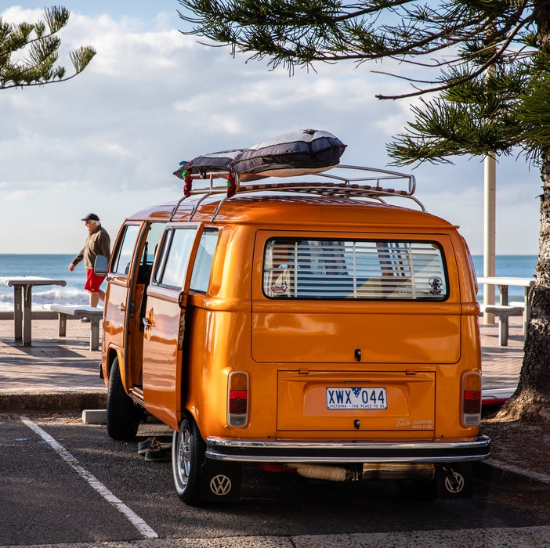
+123456789
www.birdflightta.com

Slide 2
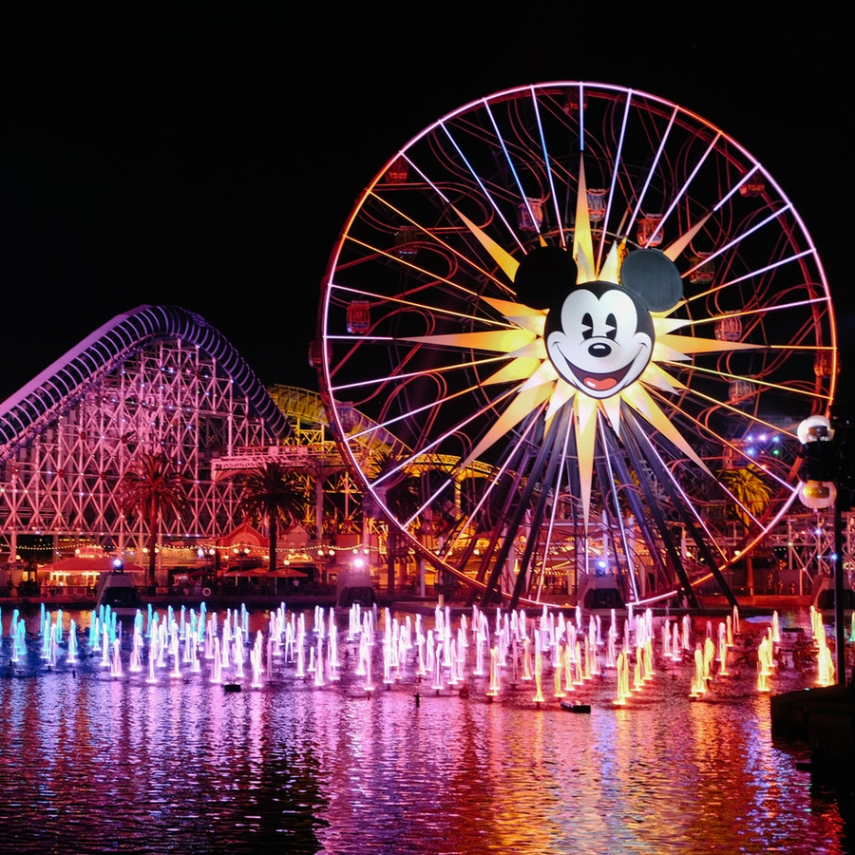
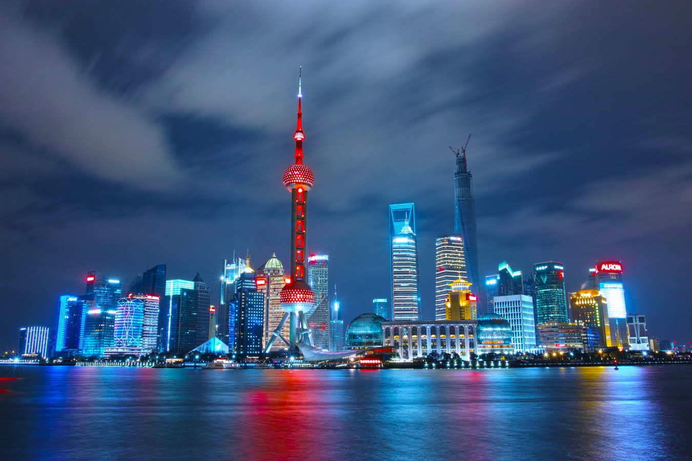
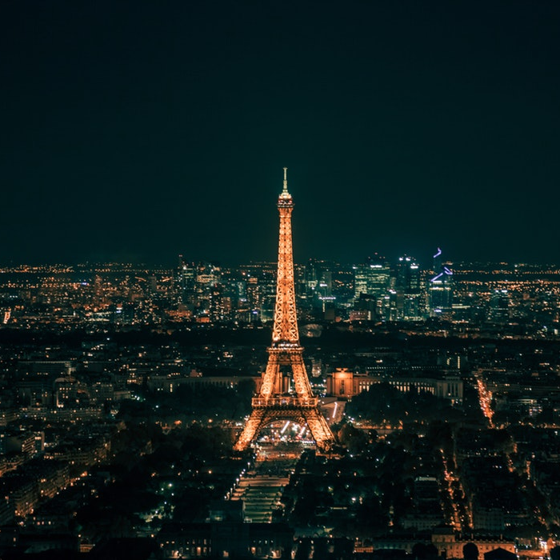
LETS MAKE EXCITING HOLIDAYS
CHINE - BEIJING
BORACAY PHILIPPINES
SINGAPORE W/ SENTOSA SUNSET
INLAND TOUR
SINGAPORE W/ DISNEYLAND
HONGKONG W/ OCEAN PARK
5 Days 4-Nights
5 Days 4-Nights
5 Days 4-Nights
5 Days 4-Nights
5 Days 4-Nights
5 Days 4-Nights

Slide 3
WE

Slide 4
OFFER

Slide 5
EXCITING

Slide 6
DEALS

Slide 7
FOR YOU!!

Slide 12
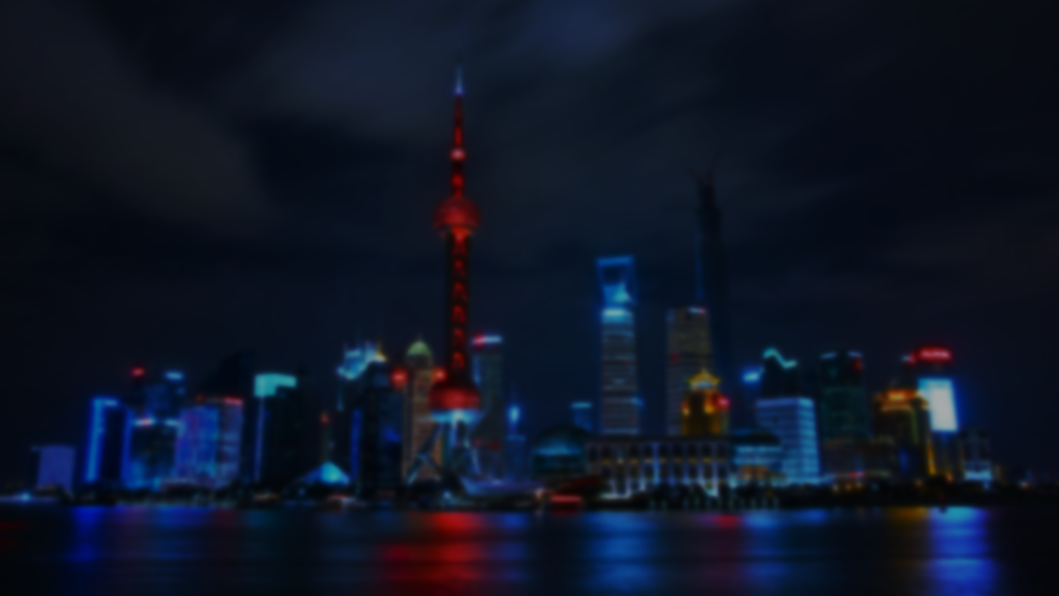
EXPERIENCE
THE JOURNEY ANYWHERE IN THE WORLD

Slide 13
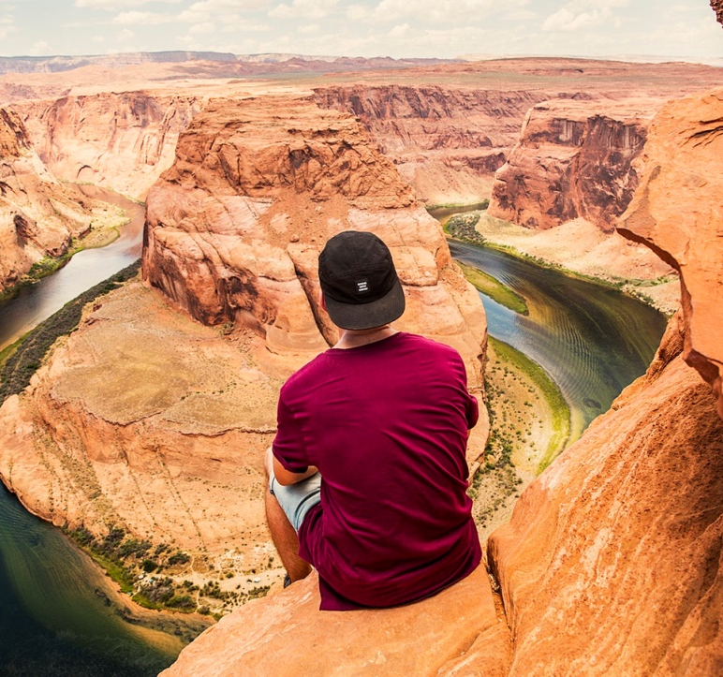
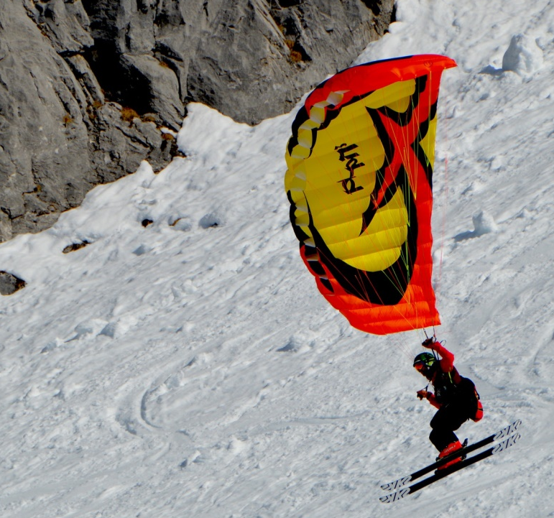
EXCITING OFFERS – SINGLE PERSON
01
02
03
NEW YORK CITY
GRAND CANYON USA
ALASKA
5 DAYS 4 NIGHTS ROUND TRIP WITH BREAKFAST, LUNCH AND DINNER
$399 / PERSON

Slide 14
EXCITING OFFERS – PARTNERS DEAL
01
02
03
BANGKOK THAILAND
KOREA – JEJU ISLAND
PARIS
5 DAYS 4 NIGHTS ROUND TRIP WITH BREAKFAST, LUNCH AND DINNER
$399 / PARTNER

Slide 15
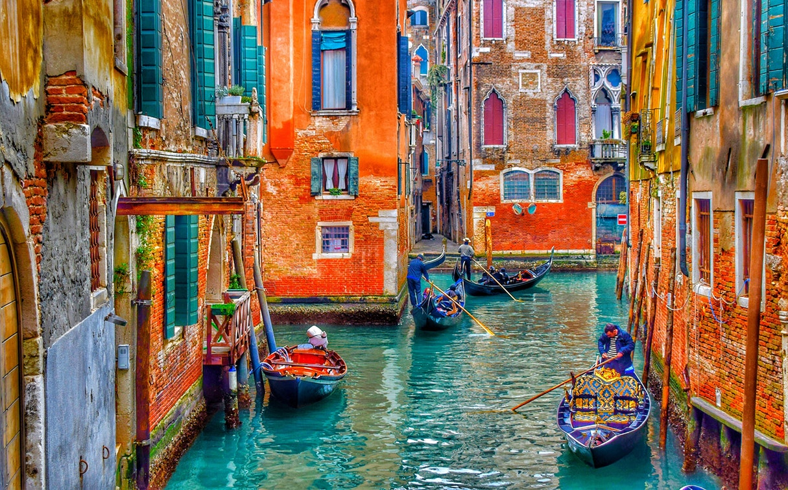
ANYWHERE YOU WANT TRAVEL
MALDIVES ISLAND
3 DAYS AND 2 NIGHTS ROUND TRIP
GRAND VENICE
3 DAYS AND 2 NIGHTS ROUND TRIP
$799
$469

Slide 16
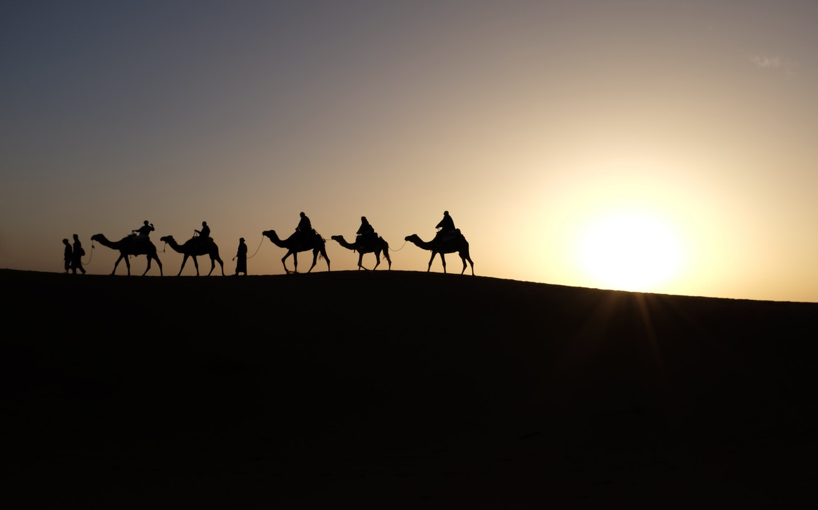
ANYWHERE YOU WANT TRAVEL
MIDDLE EAST
5 DAYS AND 4 NIGHTS ROUND TRIP
DUBAI
5 DAYS AND 4 NIGHTS ROUND TRIP
$899
$699

Slide 17
+123456789
www.birdflightta.com

Slide 18
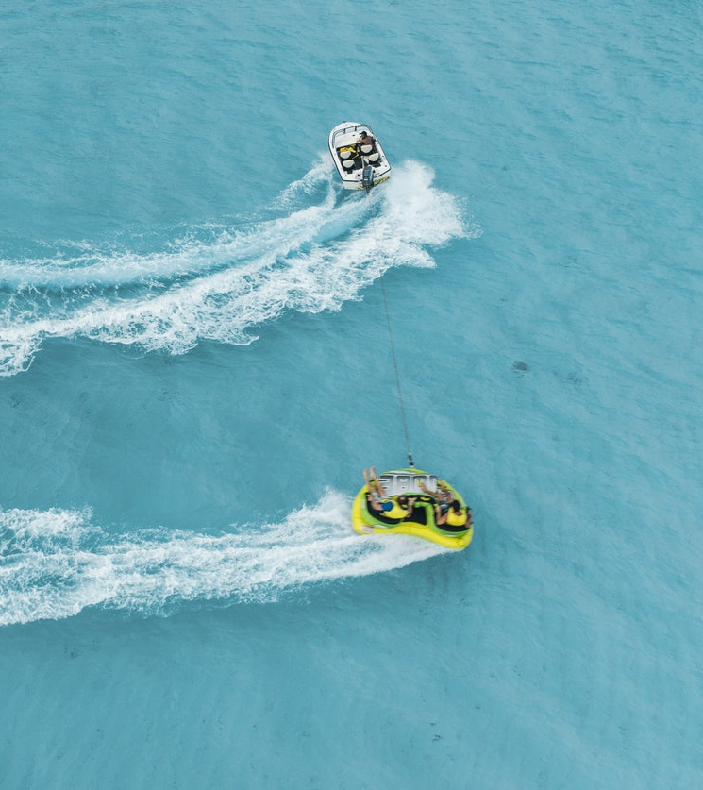
TRIP TO
MALDIVES
The Maldives is a tropical nation in the Indian Ocean composed of 26 ring-shaped atolls, which are made up of more than 1,000 coral islands. It’s known for its beaches, blue lagoons and extensive reefs. The capital, Malé, has a busy fish market, restaurants and shops on the main road, Majeedhee Magu, and 17th-century Hukuru Miskiy (also known as Friday Mosque) made of carved white coral.

Slide 19
EASY
PAYMENTS
GATEWAY

Slide 20
GATEWAY
PAYMENTS
EASY

