Slide 1
1-800-123-4567
www.unipuregold.com
New York, NY

Slide 2
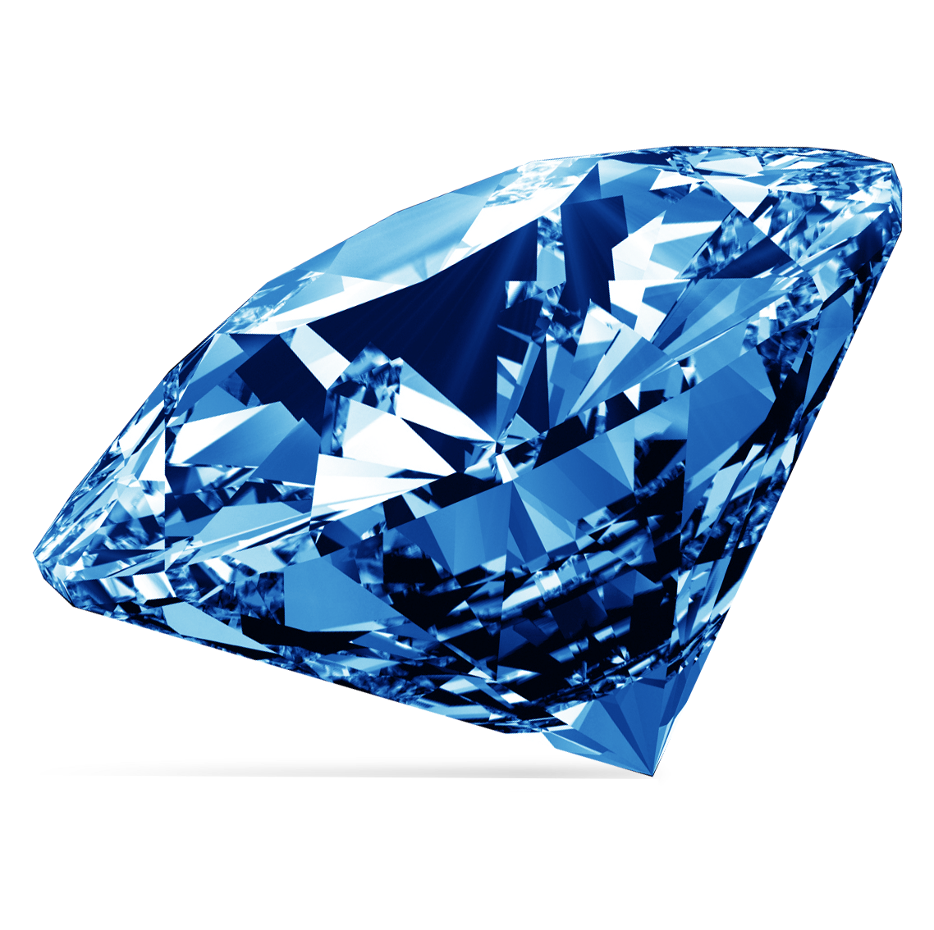
ORIGINAL BLUE SAPPHIRE STONE
5cm blue sapphire stone
$399
Model RS00-001
24 X 7 SERVICE
RETURN POLICY
ISO CERTIFIED

Slide 3
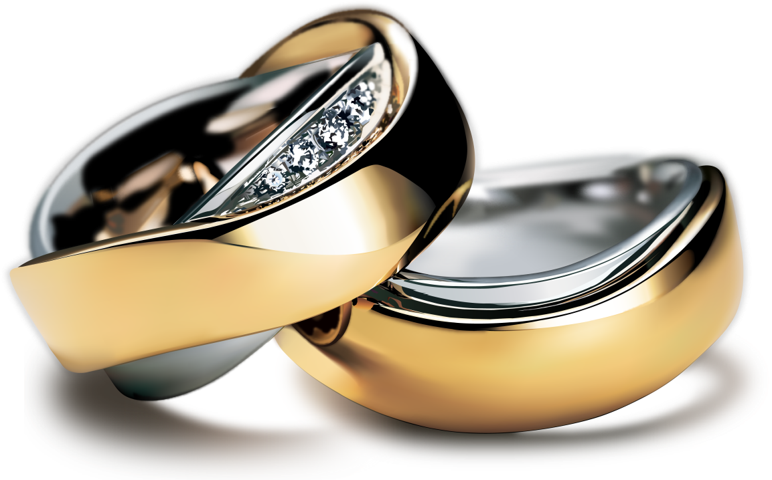
DIAMOND SPECIAL RING
6cm Gold Ladies Ring
$399
Model RS00-002
24 X 7 SERVICE
RETURN POLICY
ISO CERTIFIED

Slide 4
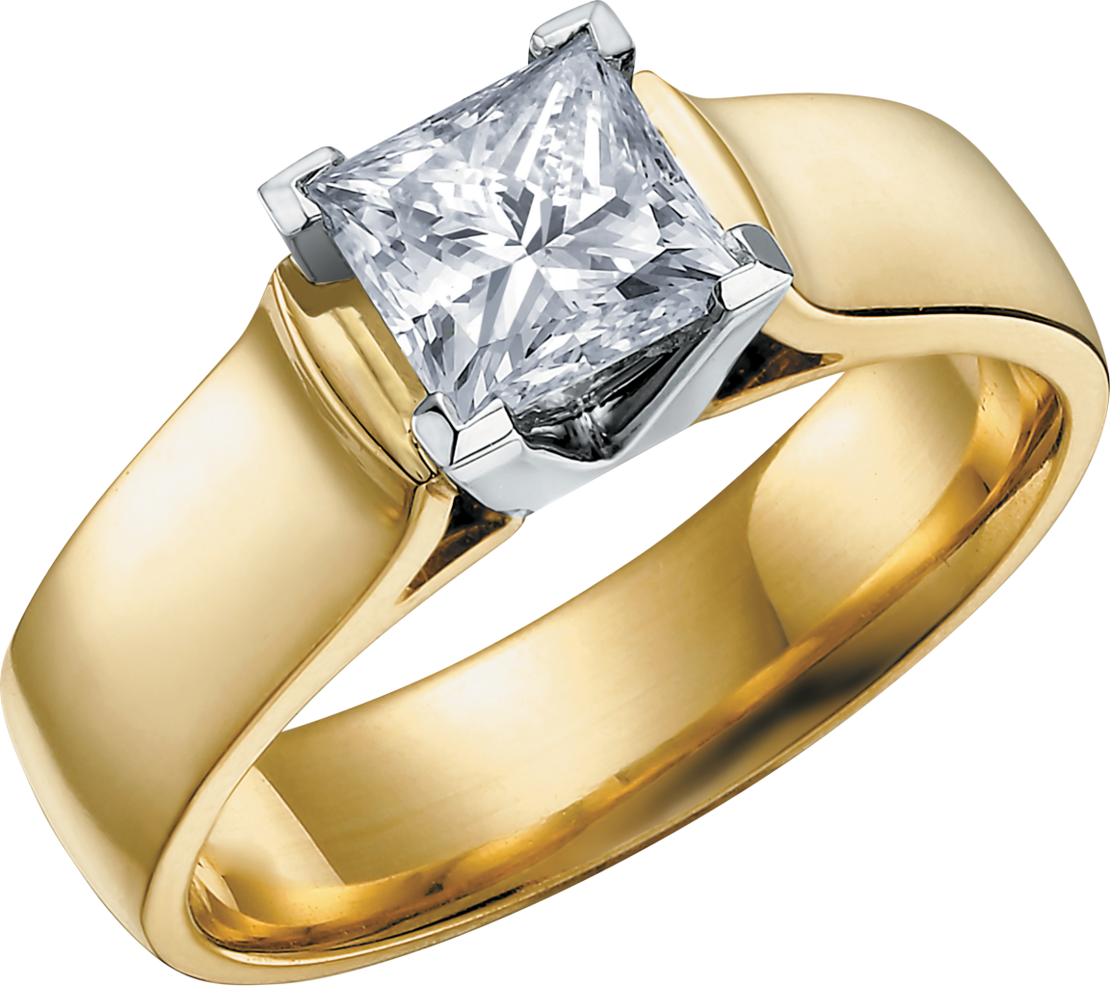
WEDDING DIAMOND RING
6cm wedding gold ring with diamond stone
$599
Model RS00-003
24 X 7 SERVICE
RETURN POLICY
ISO CERTIFIED

Slide 5
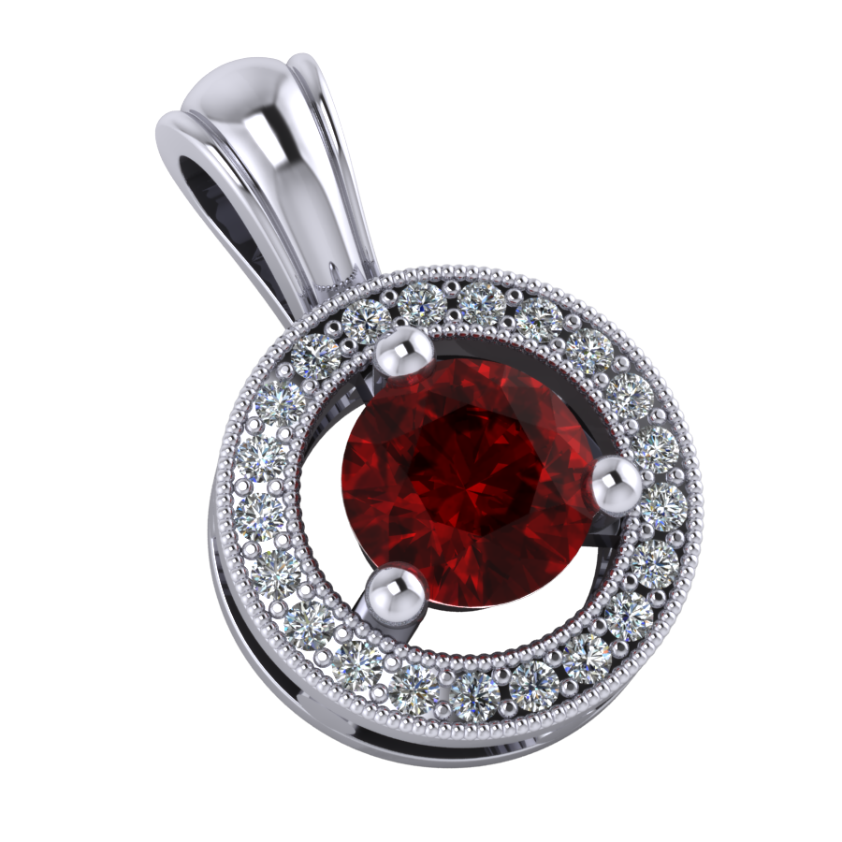
RED DIAMOND NECKLACE PENDANT
Red diamond necklace pendant with silver plated round design
$599
Model RS00-004
24 X 7 SERVICE
RETURN POLICY
ISO CERTIFIED

Slide 6
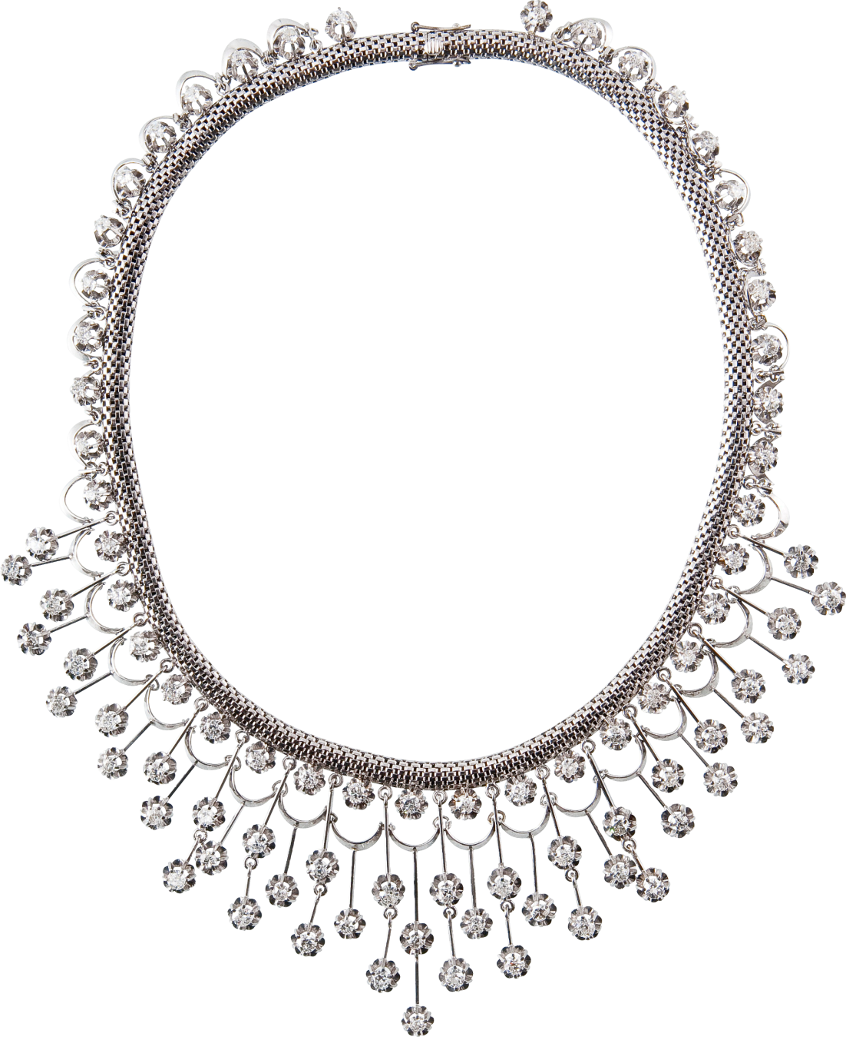
DIOMAND SPECIAL NECKLACE
Ladies necklace chain by silver flowers
$899
24 X 7 SERVICE
RETURN POLICY
Model RS00-005
ISO CERTIFIED

Slide 7
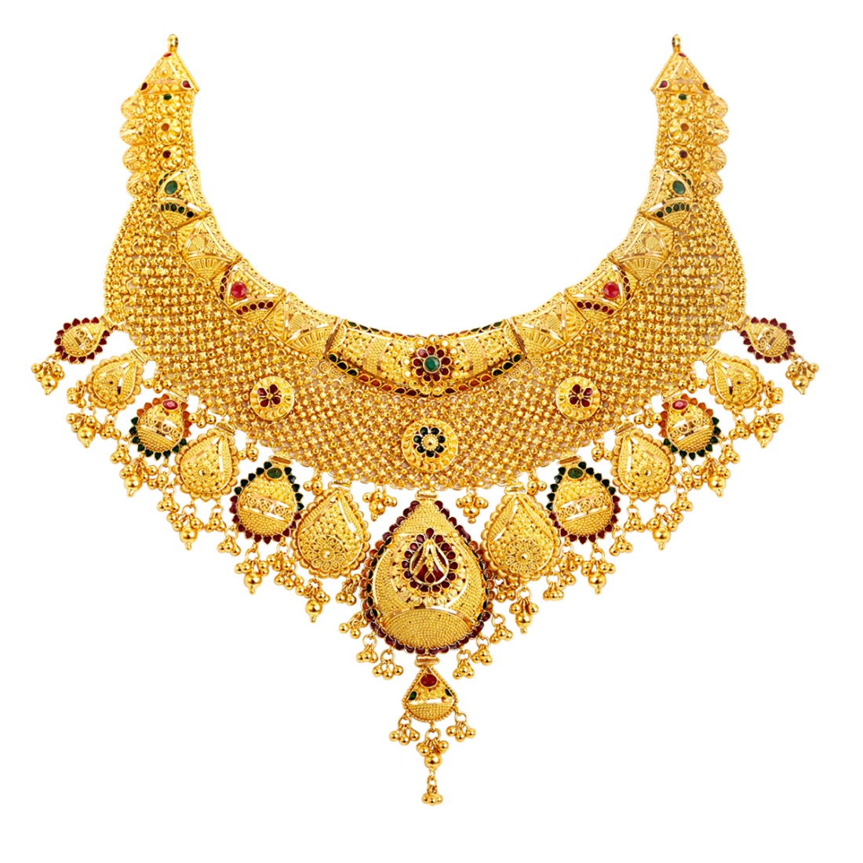
INDIAN GOLD NECKLACE
Ladies necklace chain by gold plated pendants
$1,299
24 X 7 SERVICE
RETURN POLICY
Model RS00-006
ISO CERTIFIED

Slide 8
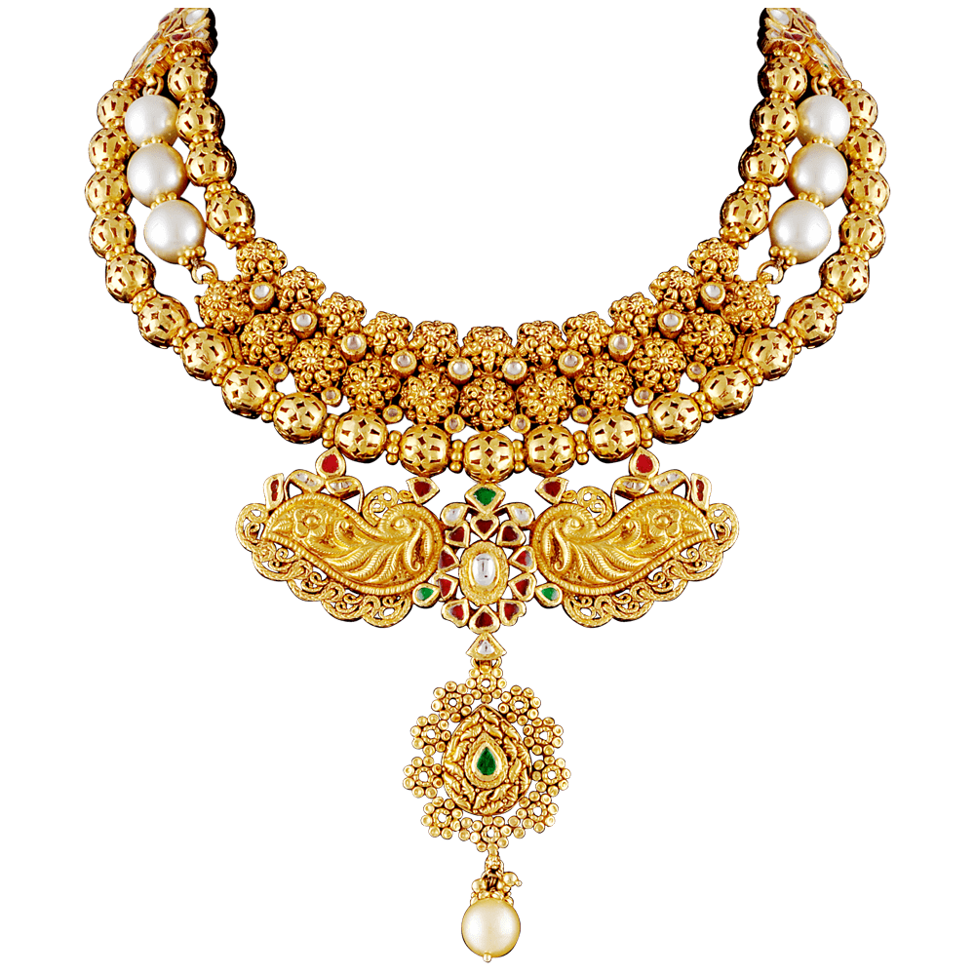
INDIAN GOLD NECKLACE
Ladies necklace chain by gold and pearl pendants
$1,999
24 X 7 SERVICE
RETURN POLICY
Model RS00-007
ISO CERTIFIED

Slide 9
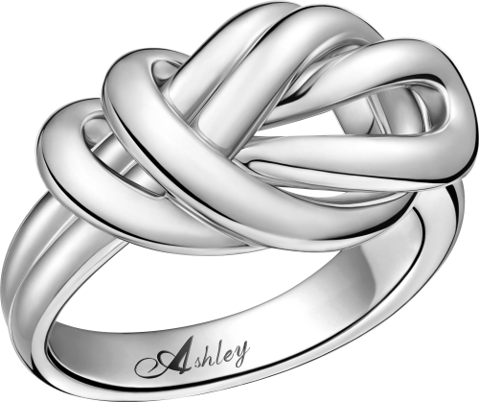
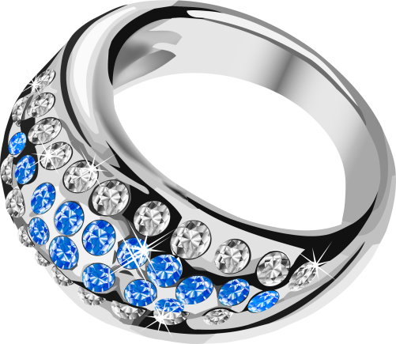
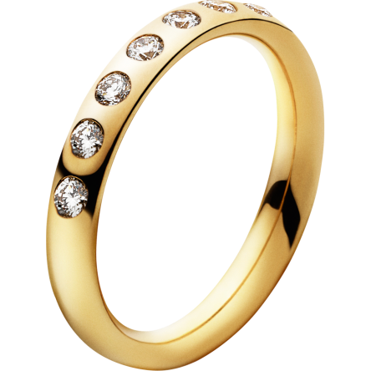
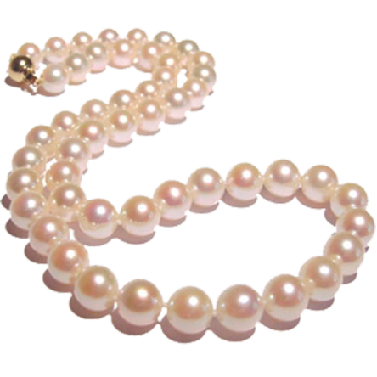
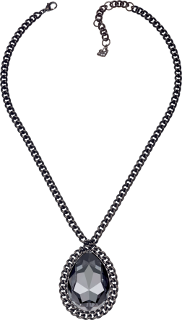
20%
OFF
20%
OFF
20%
OFF
GOLD DIAMOND RING
SILVER LADIES RING
BLUE SILVER LADIES RING
20%
OFF
20%
OFF
20%
OFF
ENGAGEMENT RING
PINK PEARL
METAL NECKLACE

Slide 10
1-800-123-4567
www.unipuregold.com
New York, NY

