Slide 1
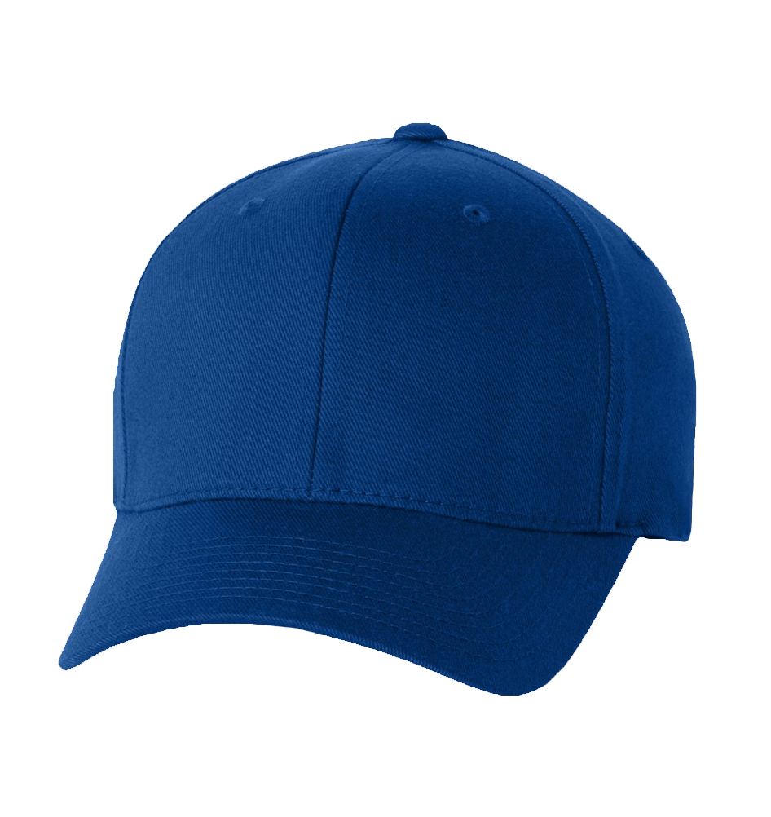
Blue Cap
Universal size for adult, Casual Hat, Baseball Cap
99
12
$
OFF
-20%
www.shopnadeeto.com
Notes:
<a href="https://www.freepngimg.com/png/1144-baseball-cap-png-image">Baseball Cap Png Image FreePNGImg.com</a>

Slide 2
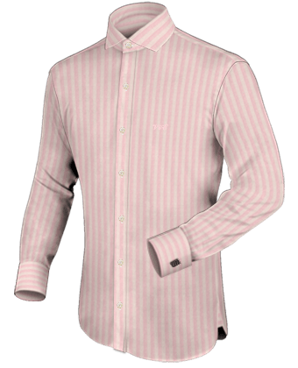
Long Sleeve
American-style men long sleeved body
type Formal
99
14
$
OFF
-20%
www.shopnadeeto.com
Notes:
<a href="https://www.freepngimg.com/png/2115-dress-shirt-png-image">Dress Shirt Png Image FreePNGImg.com</a>

Slide 3
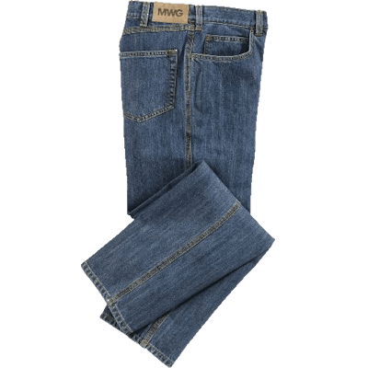
Blue Jeans
Modern vintage elements and whiskering characterize the relaxed look of these Clockhouse jeans
99
39
$
OFF
-20%
www.shopnadeeto.com
Notes:
<a href="https://www.freepngimg.com/png/6777-jeans-png-image">Jeans Png Image FreePNGImg.com</a>

