Slide 1
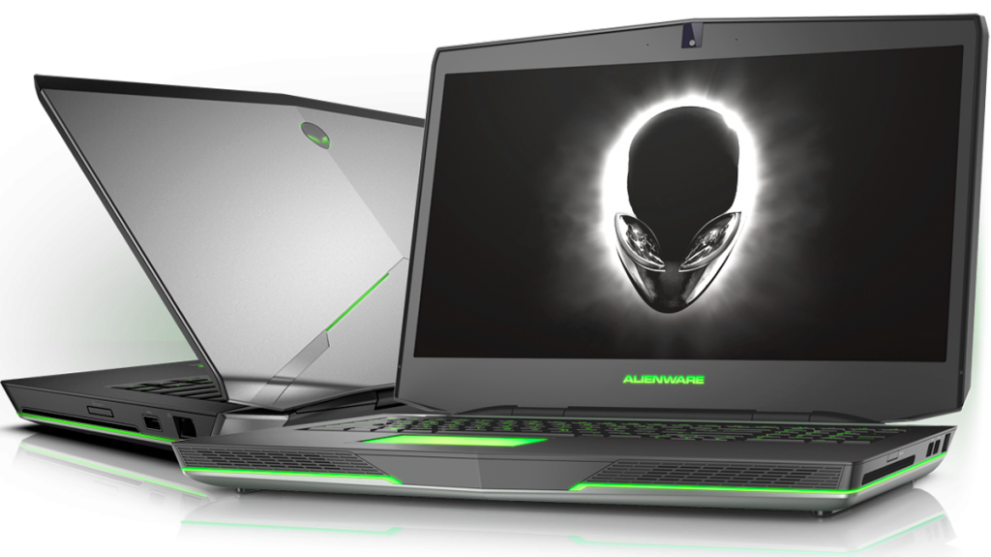
Graphics Controller: NVIDIA GEFORCE GTX 970M
17.3 inch
$999.00
-10%
Laptopkid-Alienware17R3
Alienware Gaming Laptop
ALIENWARE LAPTOP
www.yourwebsite.com
Notes:
<a href="https://www.freepngimg.com/png/24472-alienware-transparent-background">Alienware Transparent Background FreePNGImg.com</a>

Slide 2
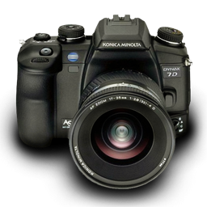
Video resolution: 1920 x 1080p
Screen size and type: 3.2" Rear Screen Tilting LCD
$799.00
Camera resolution: 24.3 MP
-20%
Camera resolution: 24.3 MP
Minolta 7000 with Minolta Maxxum AF Zoom 35-70mm 1:4 (22)
DIGITAL CAMERA
www.yourwebsite.com
Notes:
<a href="https://www.freepngimg.com/png/24986-photo-camera-file">Photo Camera File FreePNGImg.com</a>

Slide 3
Operation distance: 10m
Frequency response: 20Hz-20KHz
$199.00
-50%
Speaker diameter: 40mm
Nia Q1 Bluetooth Headsets with Micro SD and AUX Slot/FM Radio Multifunction Headphones With Free AUX Wire
WIRELESS HEADPHONES
www.yourwebsite.com
Notes:
<a href="https://www.freepngimg.com/png/2472-headphones-png-image">Headphones Png Image FreePNGImg.com</a>

Slide 4
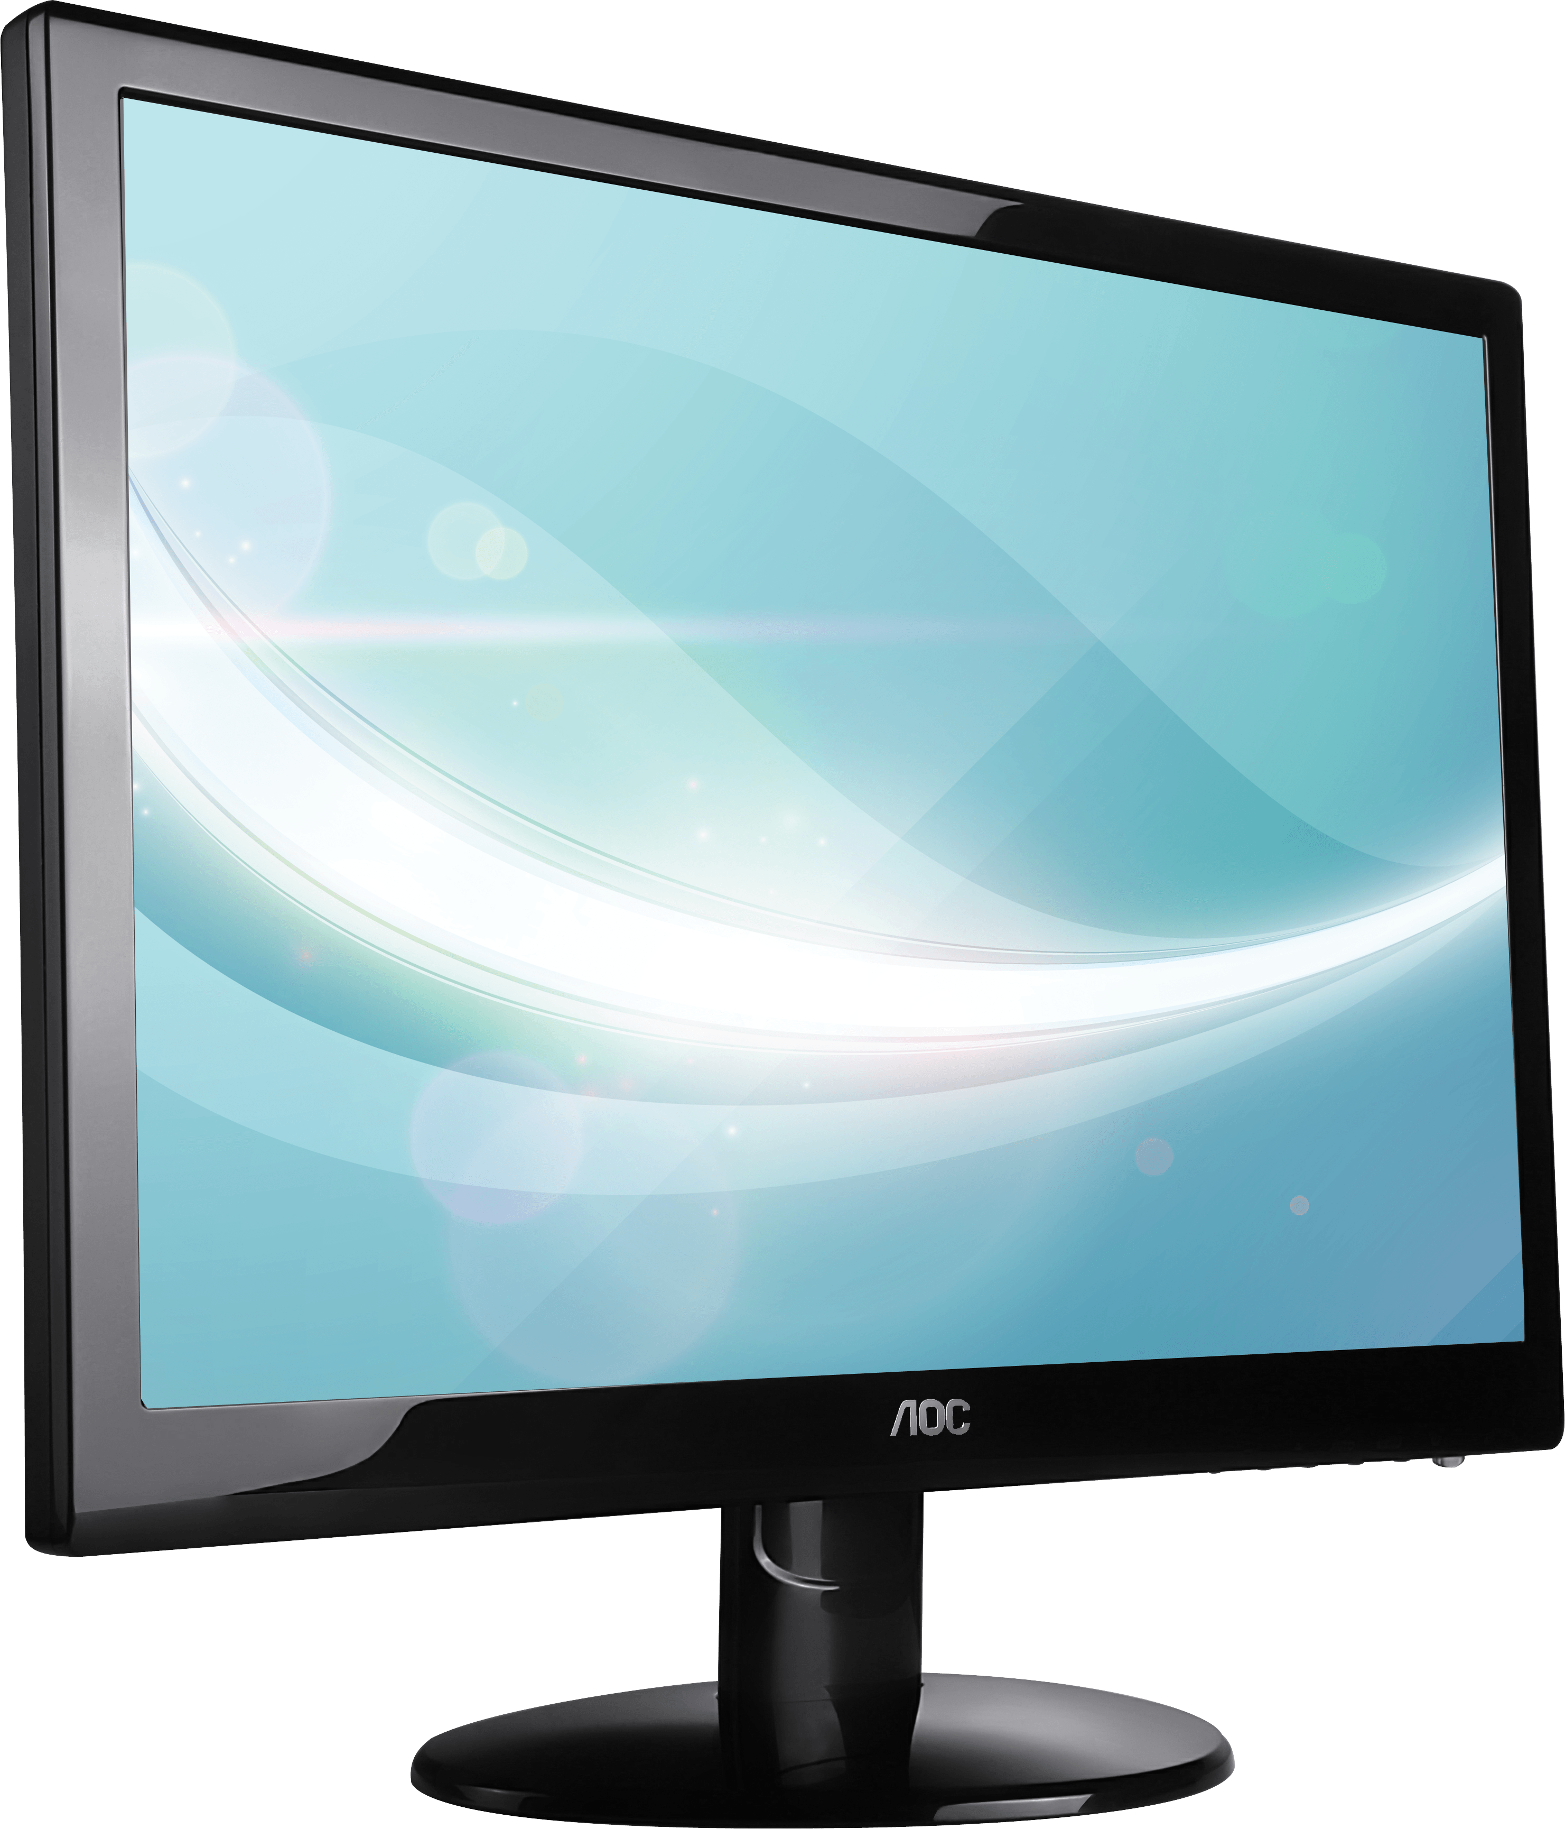
Display size and type: 27" Ultra-wide viewing angle
$299.00
1800R screen and Eye Saver Mode for increased viewing comfort
-30%
800R screen and Eye Saver Mode for increased viewing comfort
Curved 27" LC27F390FHE Full HD Curved LED Monitor (Black) with 3 Years Warranty
MONITOR
www.yourwebsite.com
Notes:
<a href="https://www.freepngimg.com/png/1167-monitor-png-image">Monitor Png Image FreePNGImg.com</a>

