Slide 1
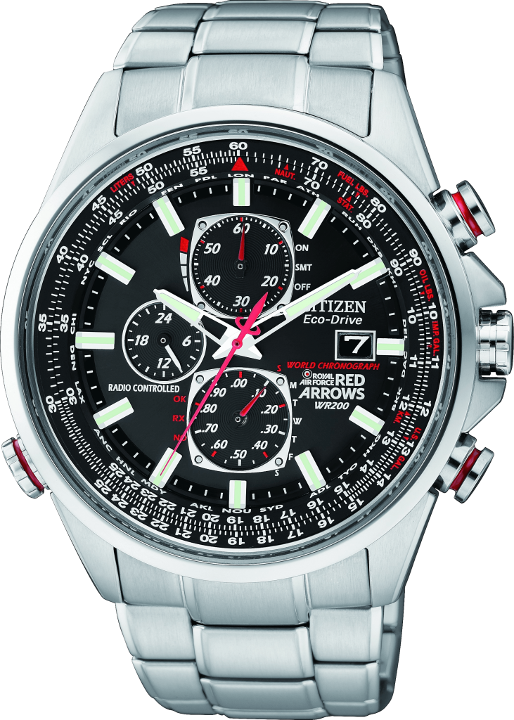
WRISTWATCH
Colors: Silver
Case Material: Metal
Band Material: PU Strap
$79
-20% OFF
Notes:
<a href="https://www.freepngimg.com/png/3018-wristwatch-png-image">Wristwatch Png Image FreePNGImg.com</a>

Slide 2
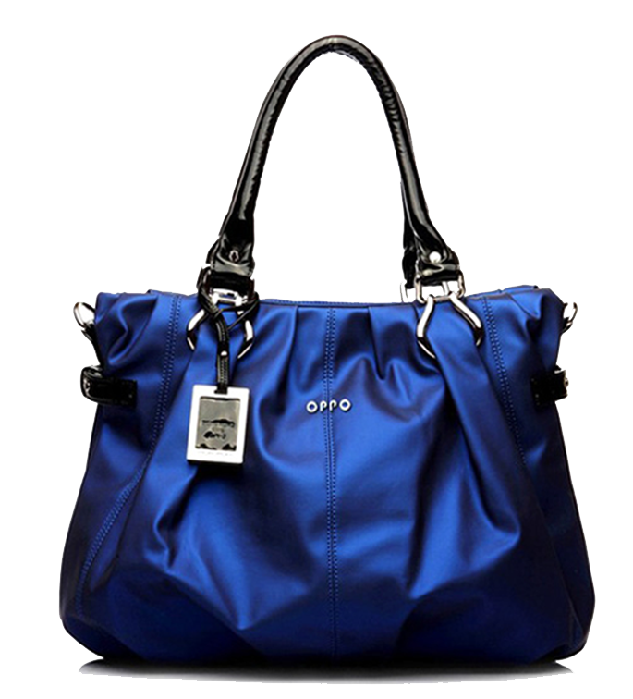
LADIES BAG
Color Blue stylish purse
$69
-10% OFF
Notes:
<a href="https://www.freepngimg.com/png/18298-samsung-mobile-phone-picture">Samsung Mobile Phone Picture FreePNGImg.com</a>

Slide 3
IPHONE
Super Retina HD display
6.5‑inch (diagonal) all‑screen OLED Multi‑Touch display
HDR display
$699
-20% OFF

Slide 4
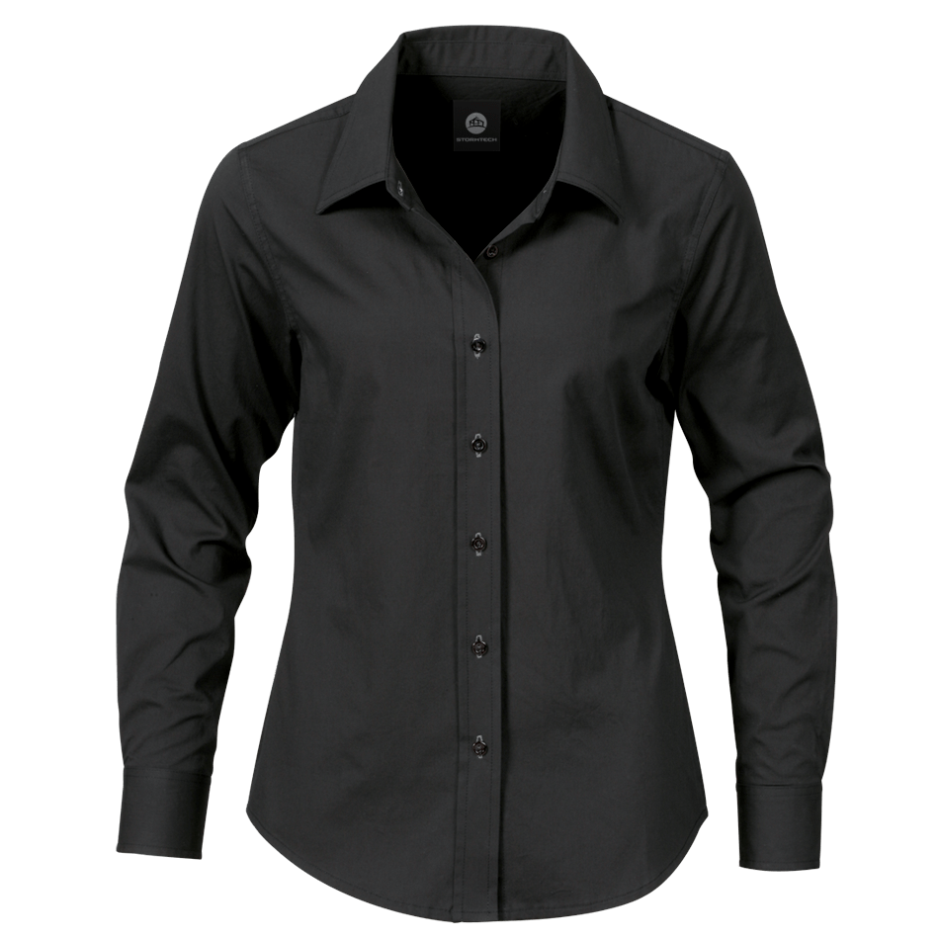
BLACK DRESS SHIRT
Men's long sleeves with collar
Unique and Stylish design
$69
-30% OFF
Notes:
<a href="https://www.freepngimg.com/png/2103-black-dress-shirt-png-image">Black Dress Shirt Png Image FreePNGImg.com</a>

Slide 5
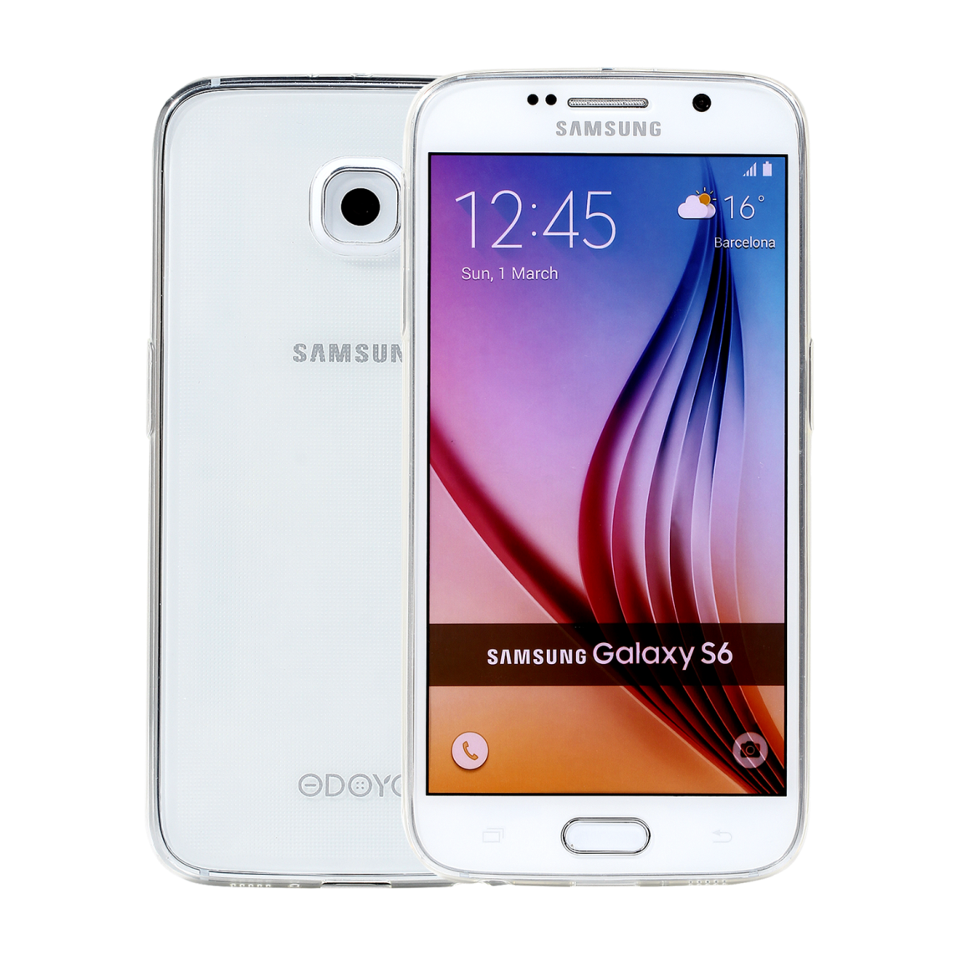
SAMSUNG MOBILE
Super Retina HD display
3.5‑inch (diagonal) all‑screen OLED Multi‑Touch display
HDR display
$699
-40% OFF
Notes:
<a href="https://www.freepngimg.com/png/18298-samsung-mobile-phone-picture">Samsung Mobile Phone Picture FreePNGImg.com</a>

Slide 6
CHAINSAW
21 inches Husqvarna chainsaw
$469
-10% OFF
Notes:
<a href="https://www.freepngimg.com/png/2103-black-dress-shirt-png-image">Black Dress Shirt Png Image FreePNGImg.com</a>

