Slide 1
IPHONE
Super Retina HD display
6.5‑inch (diagonal) all‑screen OLED Multi‑Touch display
HDR display
$
699
-10%

Slide 2
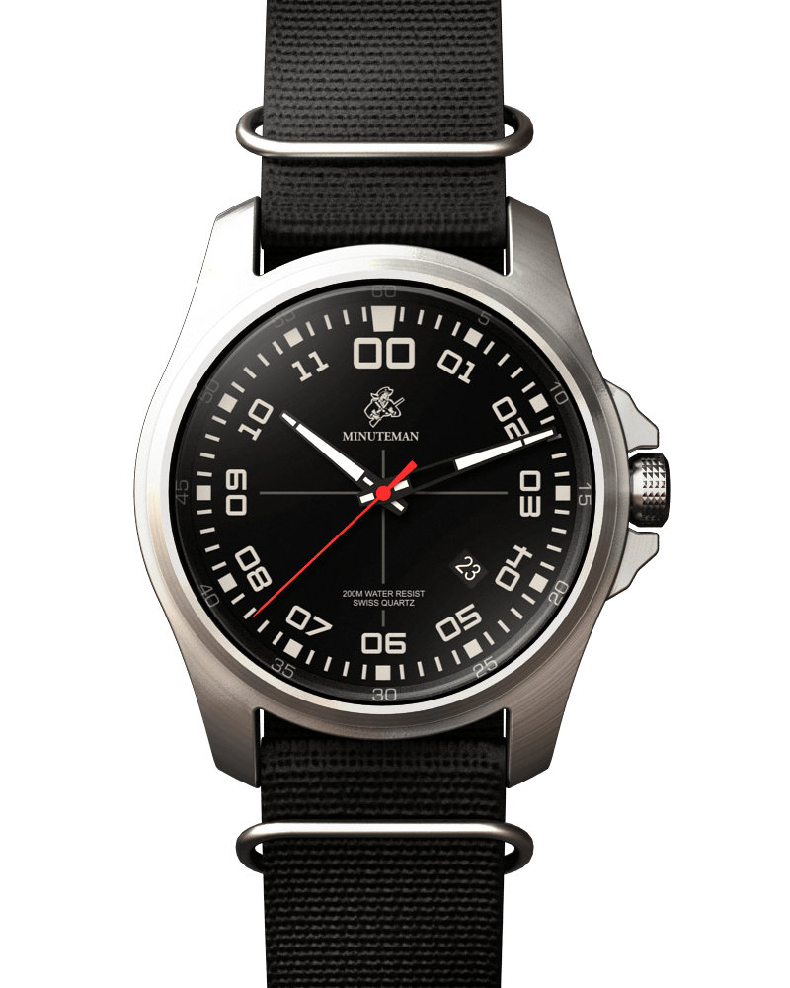
BLACK WRISTWATCH
Colors: Black
Case Material: Metal
Band Material: PU Strap
$
77.9
-20%
Notes:
<a href="https://www.freepngimg.com/png/3004-wristwatch-png-image">Wristwatch Png Image FreePNGImg.com</a>

Slide 3
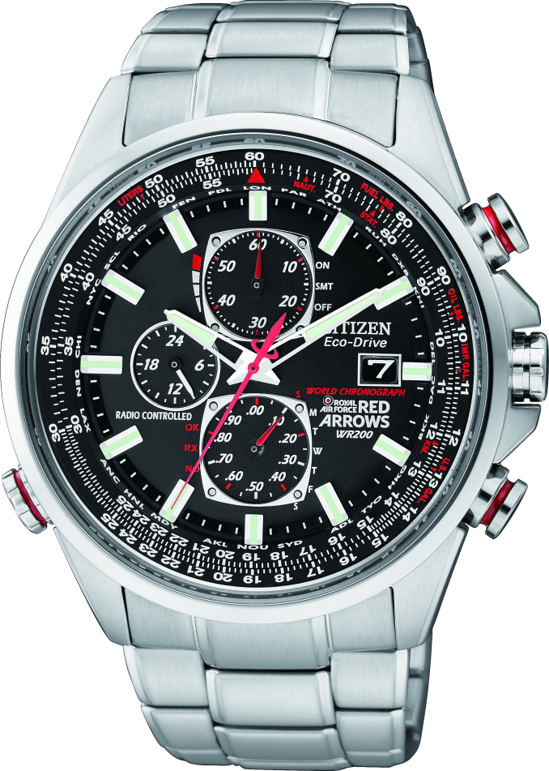
WHITE WRISTWATCH
Colors: Silver
Case Material: Metal
Band Material: PU Strap
$
699
-30%
Notes:
<a href="https://www.freepngimg.com/png/3018-wristwatch-png-image">Wristwatch Png Image FreePNGImg.com</a>

Slide 4
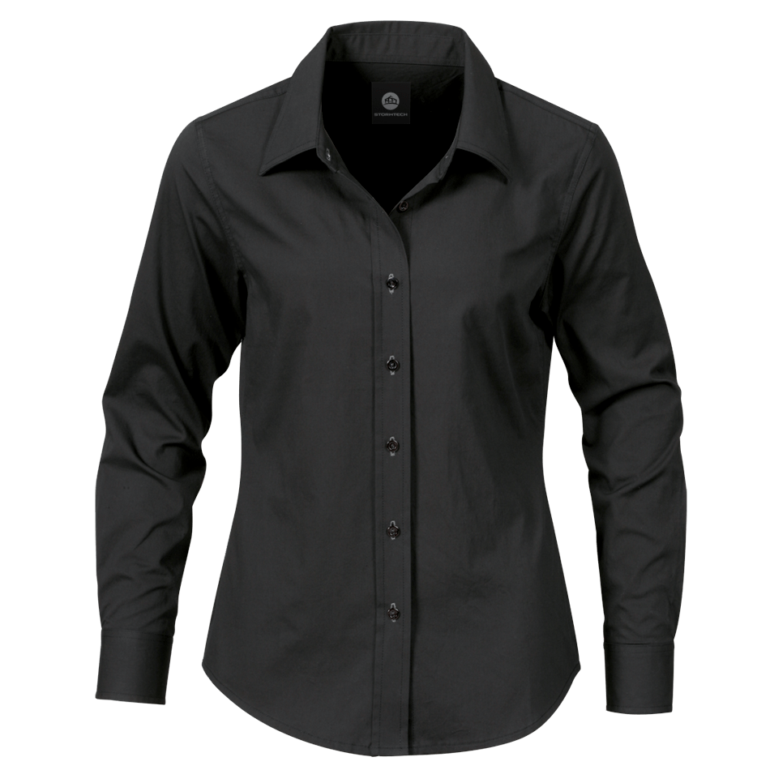
BLACK long sleeve for men
Men's long sleeves with collar
Unique and Stylish design
$
49
-40%
Notes:
<a href="https://www.freepngimg.com/png/2103-black-dress-shirt-png-image">Black Dress Shirt Png Image FreePNGImg.com</a>

Slide 5
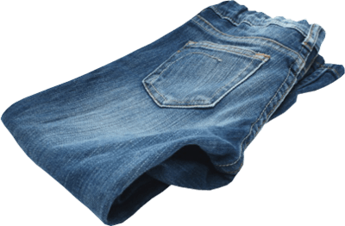
BLUE JEANS
These straight fit jeans in a 5-pocket style impress as comfortable classics for everyday wear
$
45.99
-30%
Notes:
<a href="https://www.freepngimg.com/png/6772-jeans-png-image">Jeans Png Image FreePNGImg.com</a>

Slide 6
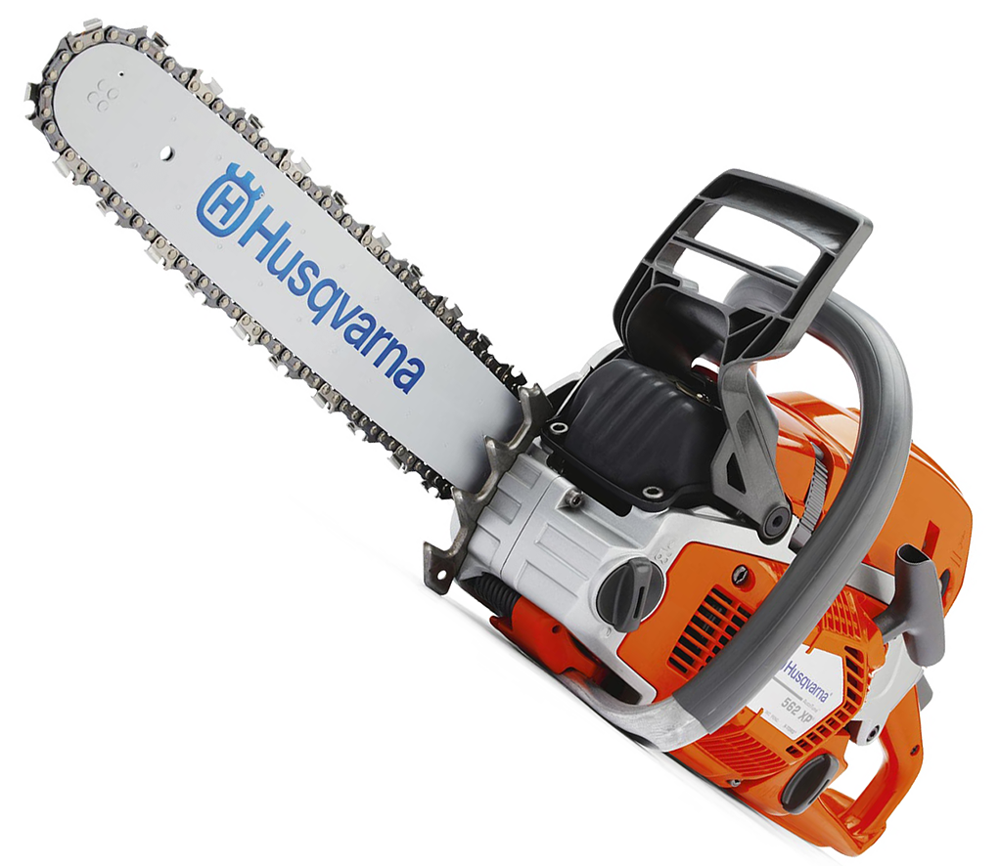
CHAIN SAW
The chain saw is amongst the most powerful product of its kind.
$
89
-10%
Notes:
<a href="https://www.freepngimg.com/png/2103-black-dress-shirt-png-image">Black Dress Shirt Png Image FreePNGImg.com</a>

Slide 7
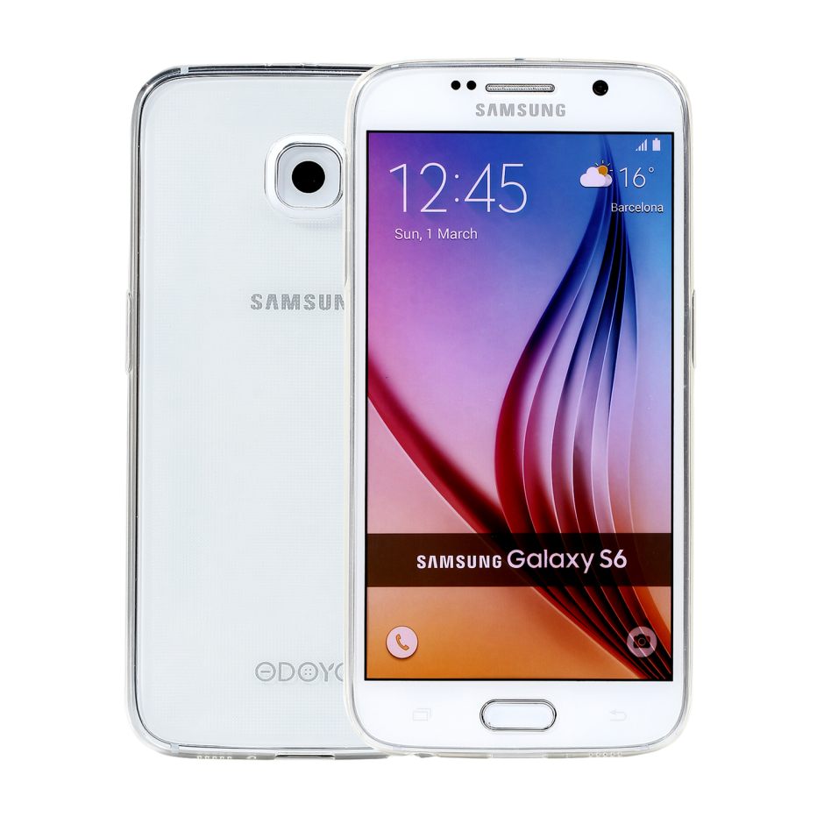
SAMSUNG PHONE
Super Retina HD display
4.5‑inch (diagonal) all‑screen OLED Multi‑Touch display
HDR display
$
699
-10%
Notes:
<a href="https://www.freepngimg.com/png/18298-samsung-mobile-phone-picture">Samsung Mobile Phone Picture FreePNGImg.com</a>

Slide 8
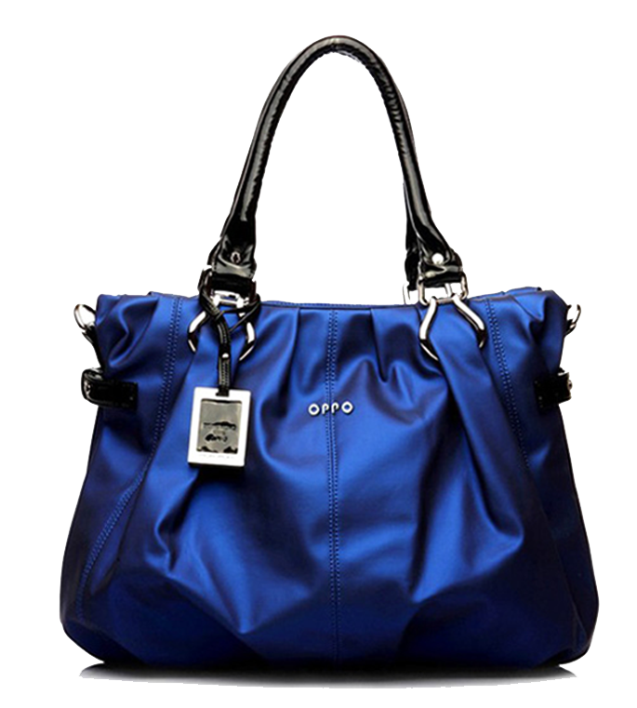
LADIES PURSE
Color Blue stylish purse
$
199
-20%
Notes:
<a href="https://www.freepngimg.com/png/18298-samsung-mobile-phone-picture">Samsung Mobile Phone Picture FreePNGImg.com</a>

