Slide 1
BEST BBQ IN TOWN!

Slide 2
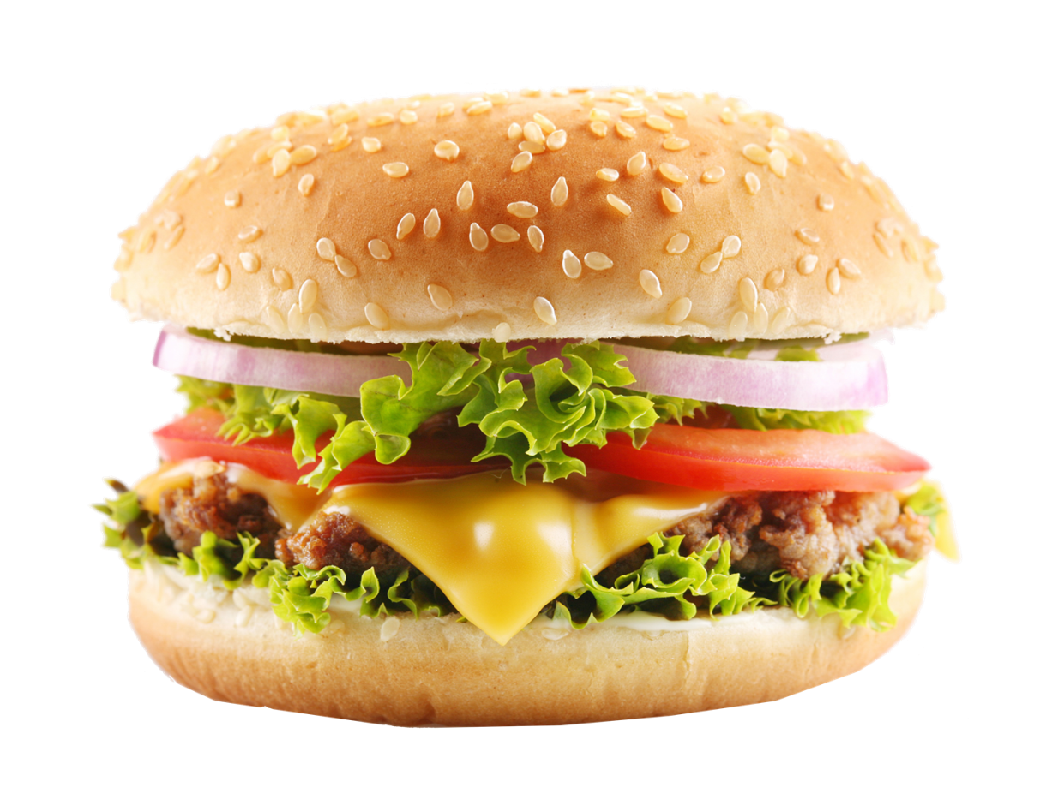
CHEESEBURGER
12 thick & amazing slices.
-10%
$
4.99
(6.99)

Slide 3
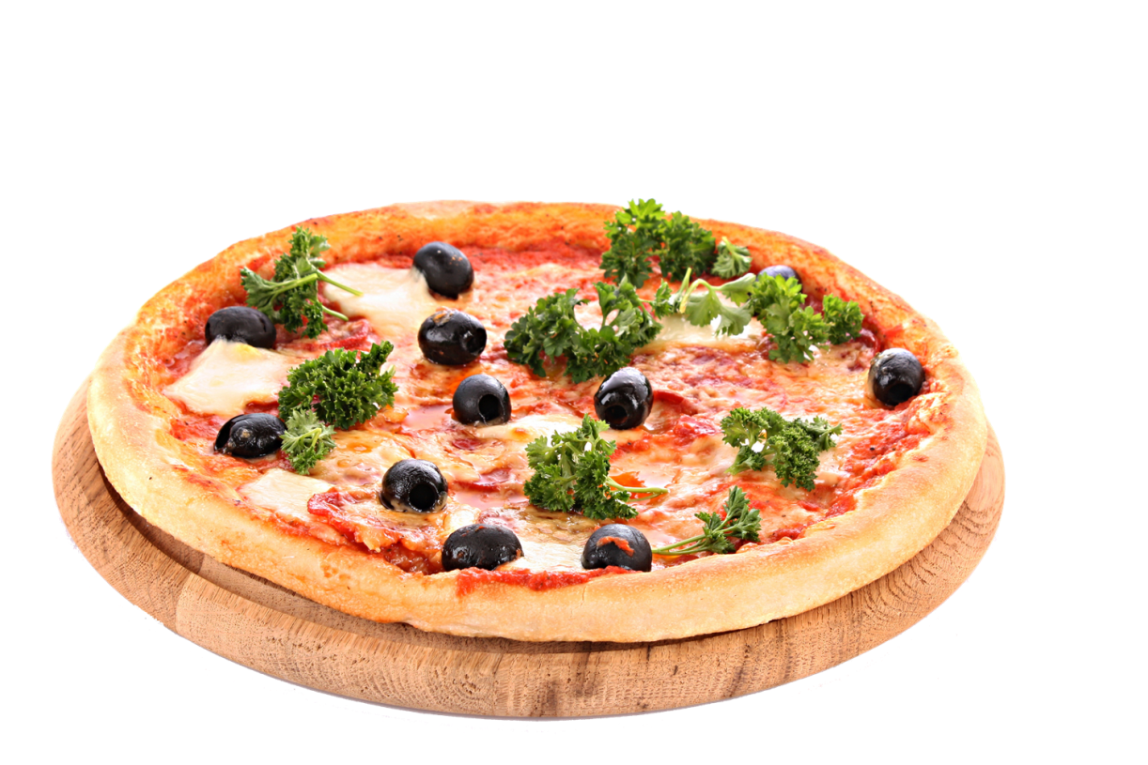
PIZZAS
CHOOSE YOUR TOPPINGS
-30%
$
5.99

Slide 4
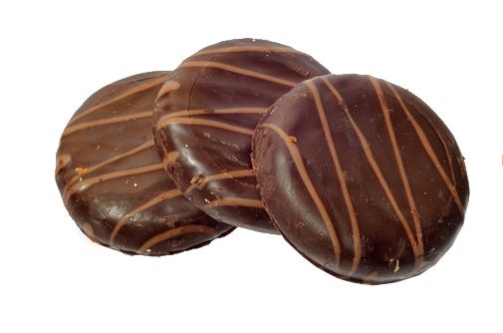
CHOCOLATE COOKIE
3 pieces of chocolate cookies
-30%
$
7.99

Slide 5
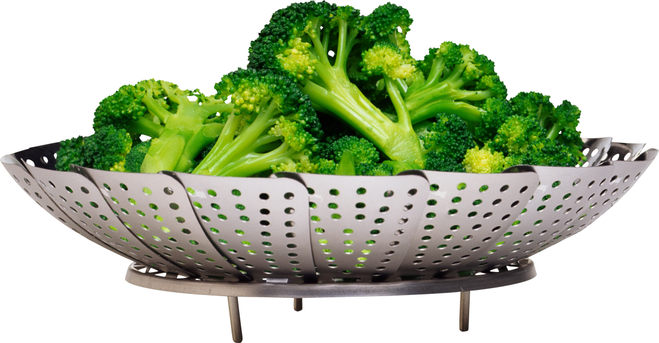
FRESH BROCCOLI SALAD
1 plate of fresh broccoli salad
-10%
$
1.99

Slide 6
BEER
Bottomless
-10%
$
6.99

