Slide 1
YOUR SUPERSTORE

Slide 2
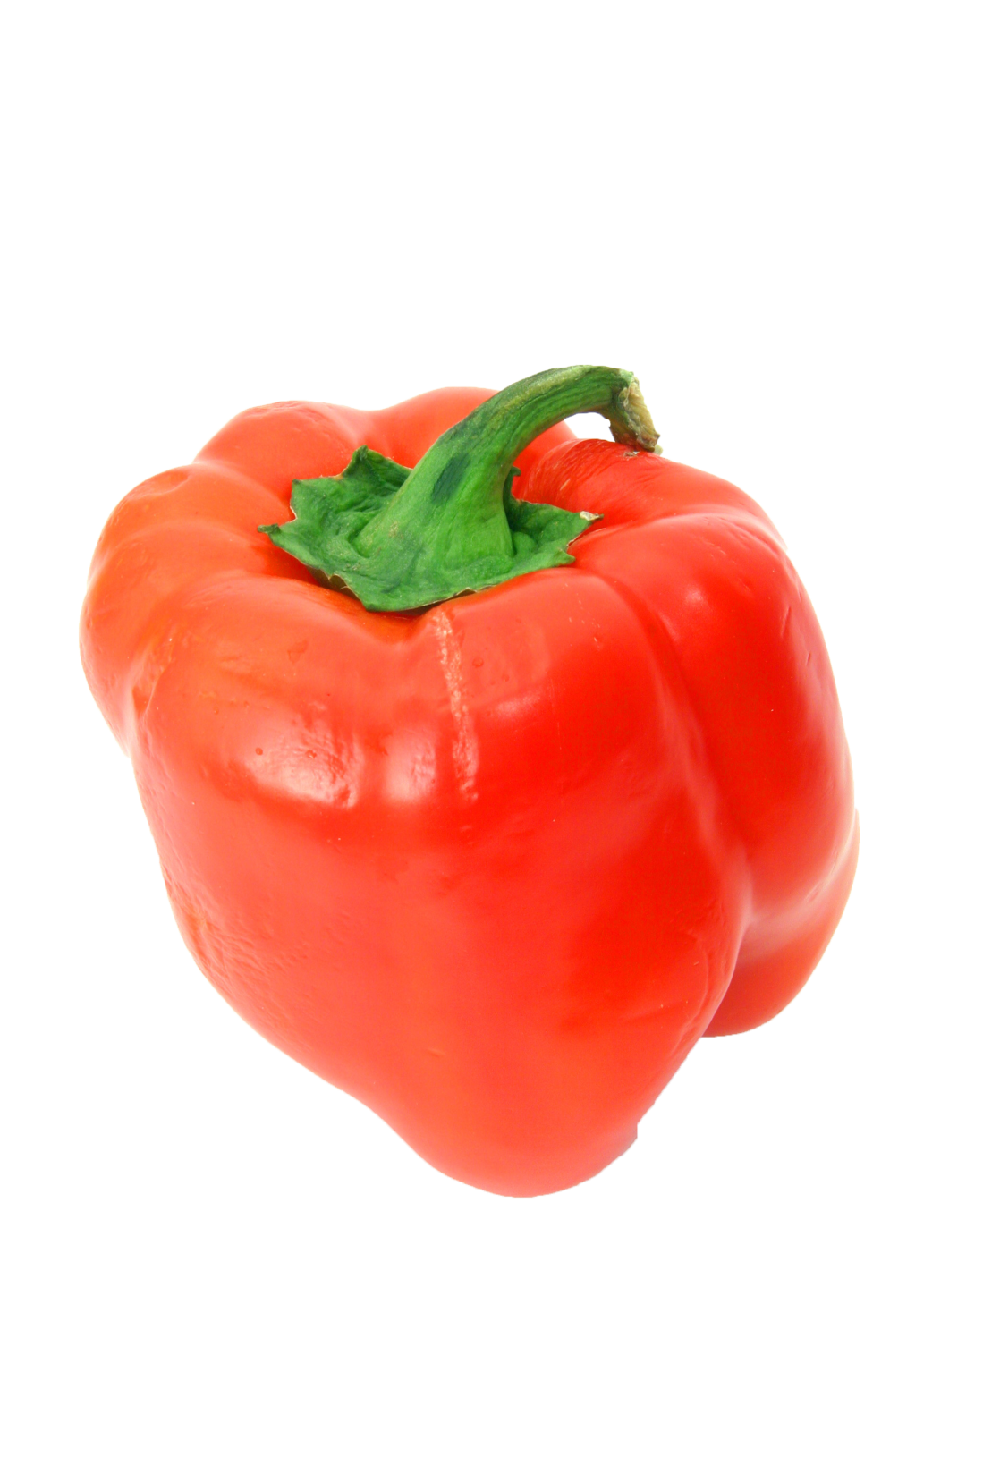
PAPRIKAs
Locally grown
-20%
$
1.79
lb.
(6.99)

Slide 3
APPLES
Fresh Apple
-20%
$
1.79
lb.
(6.99)

Slide 4
BANANA
Fresh Banana
-30%
$
2.79
lb.
(6.99)

Slide 5
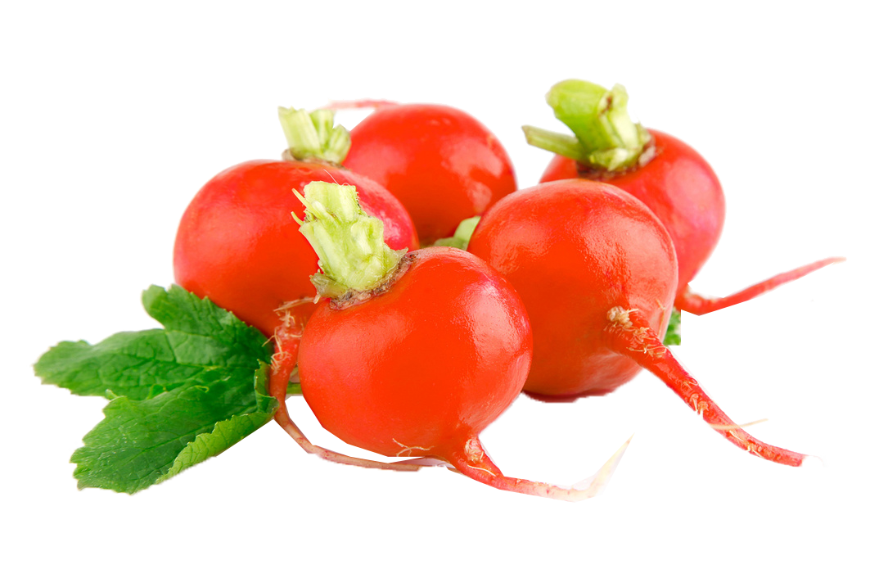
radishes
Fresh Radishes
-30%
$
2.79
lb.
(6.99)

Slide 6
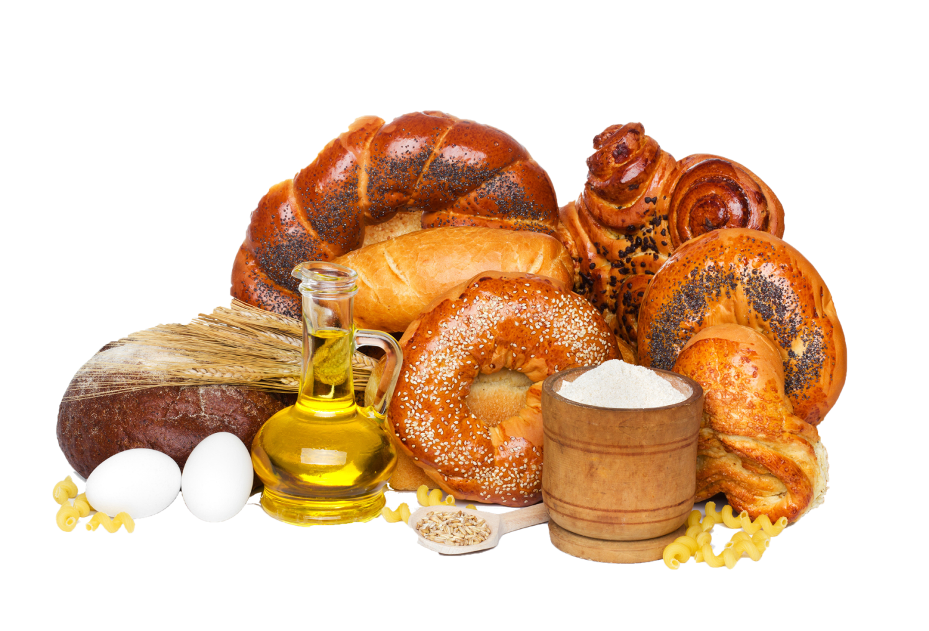
BAKED BREAD
Hot Bread
-30%
$
2.79
lb.
(6.99)

Slide 7
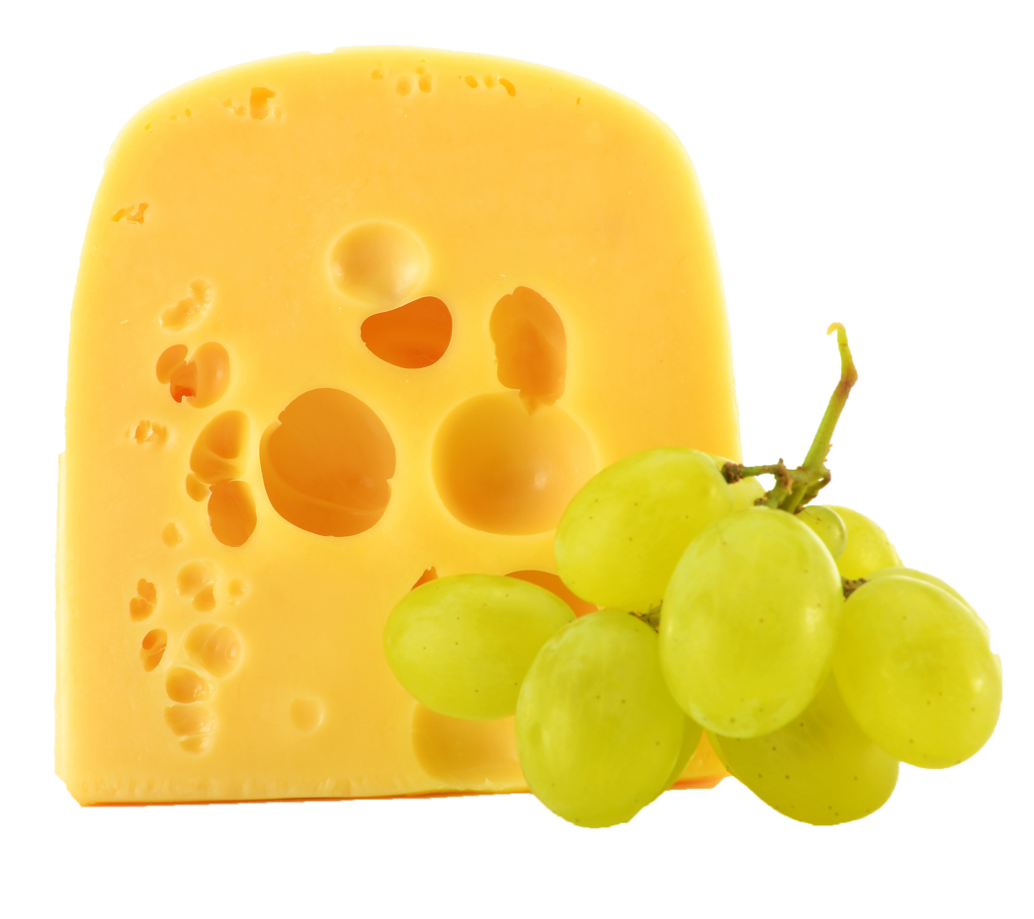
COTTAGE CHEESE
CHEEZY
-30%
$
2.79
lb.
(6.99)

