Slide 1
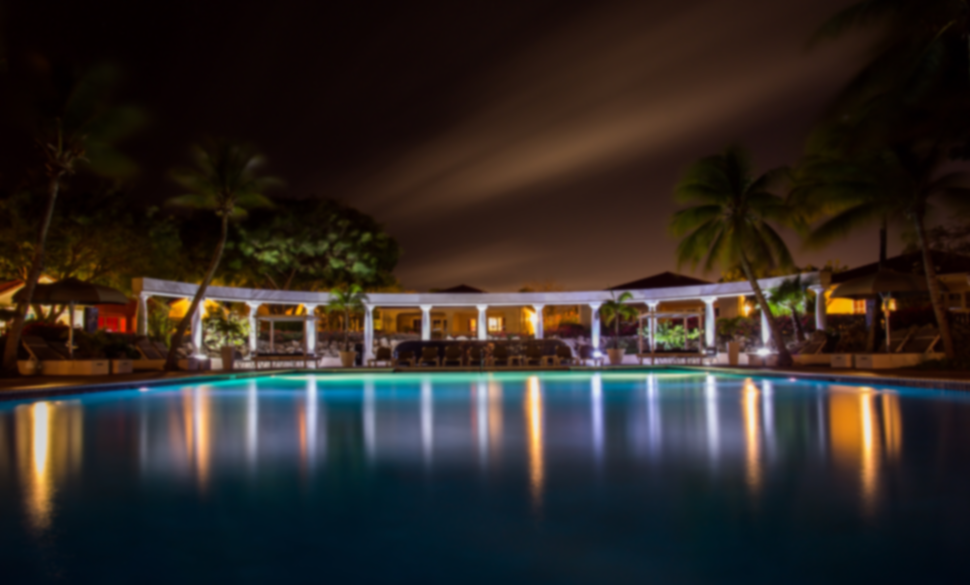
www.SPECIALREDLUXURY.com

Slide 2
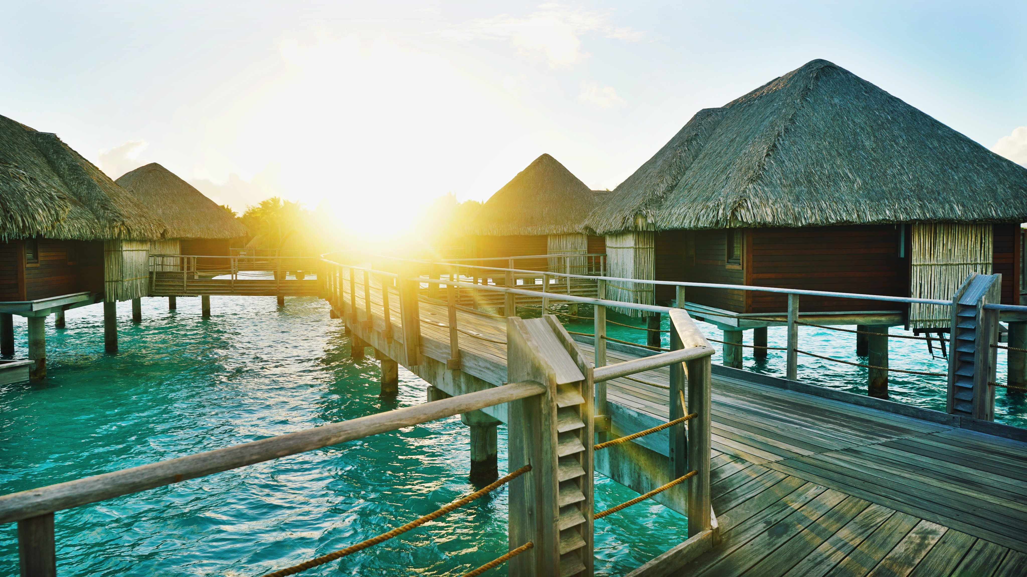
Near Ocean
Meeting Hall
Movie Theater
Outdoor Café
Sports Area
Restaurant
Parking
More…

Slide 3
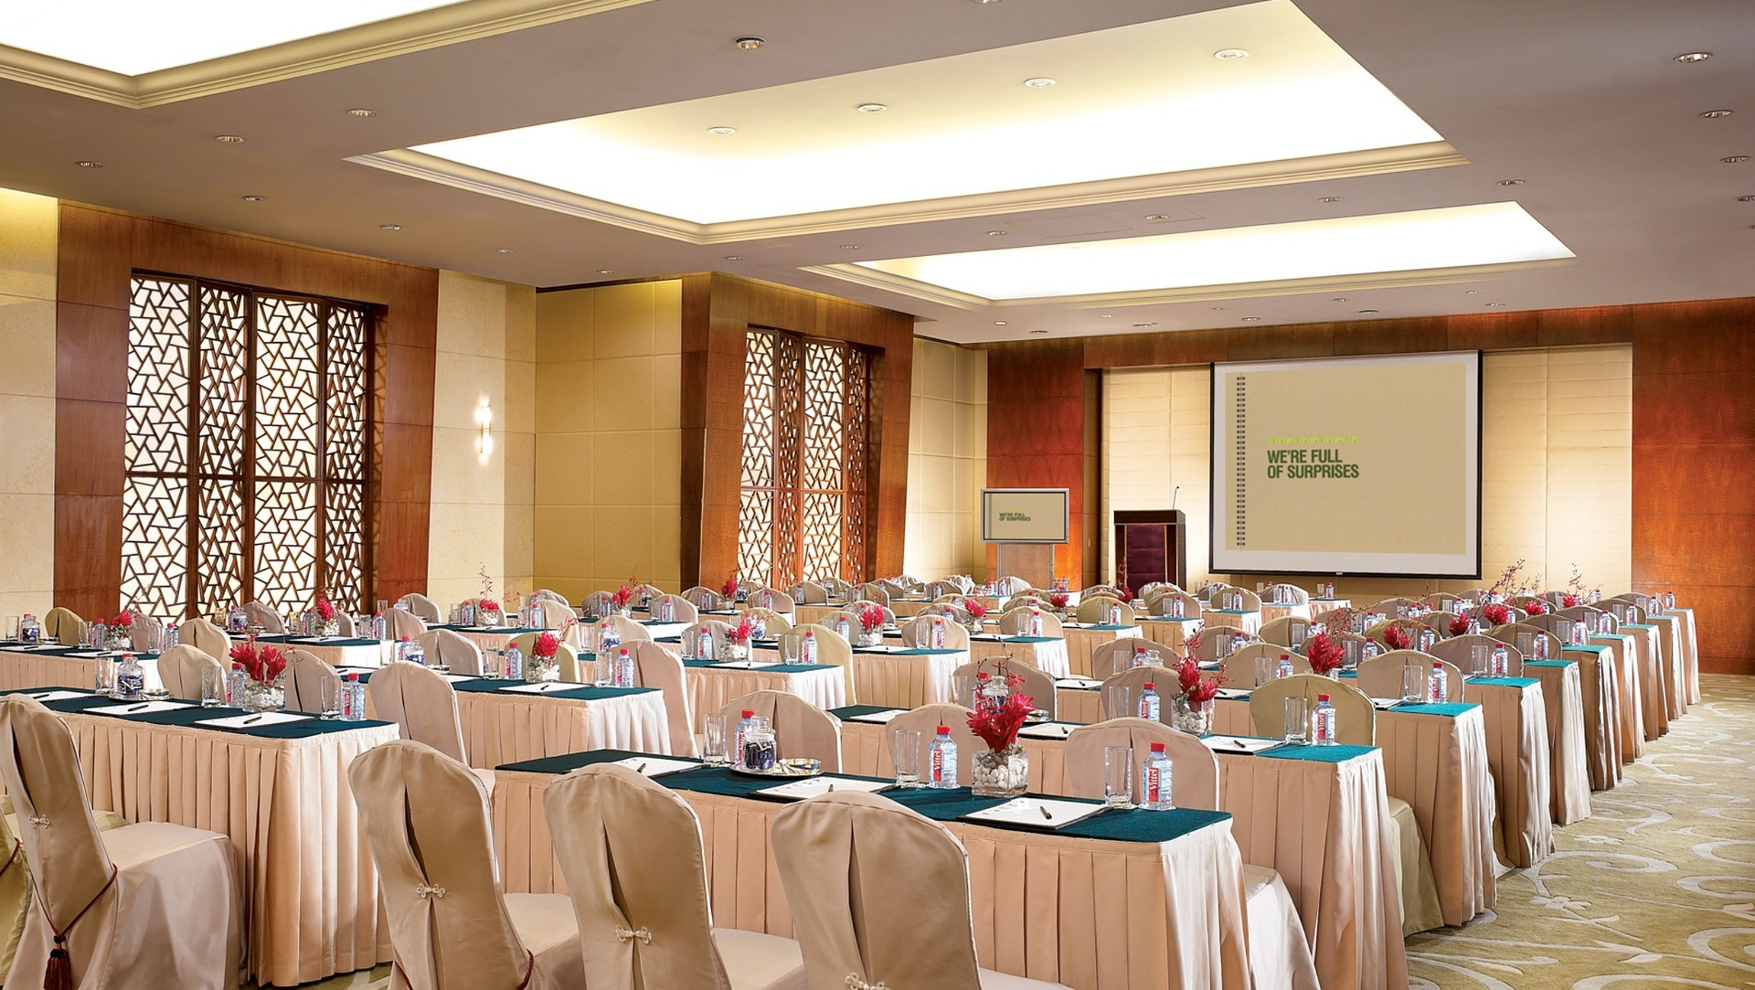
Near Ocean
Meeting Hall
Movie Theater
Outdoor Café
Sports Area
Restaurant
Parking
More…

Slide 4
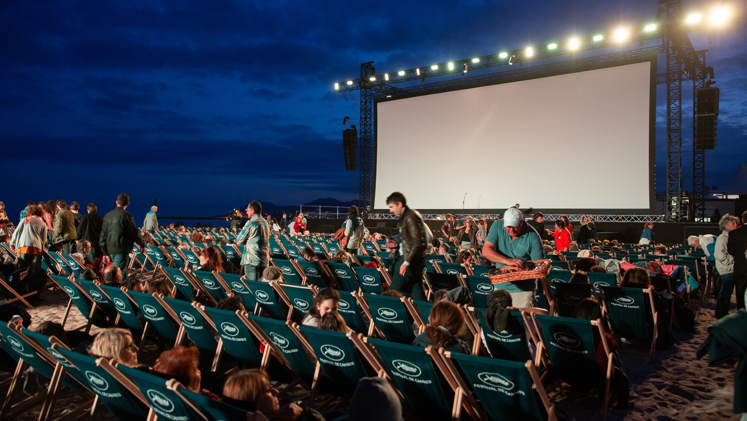
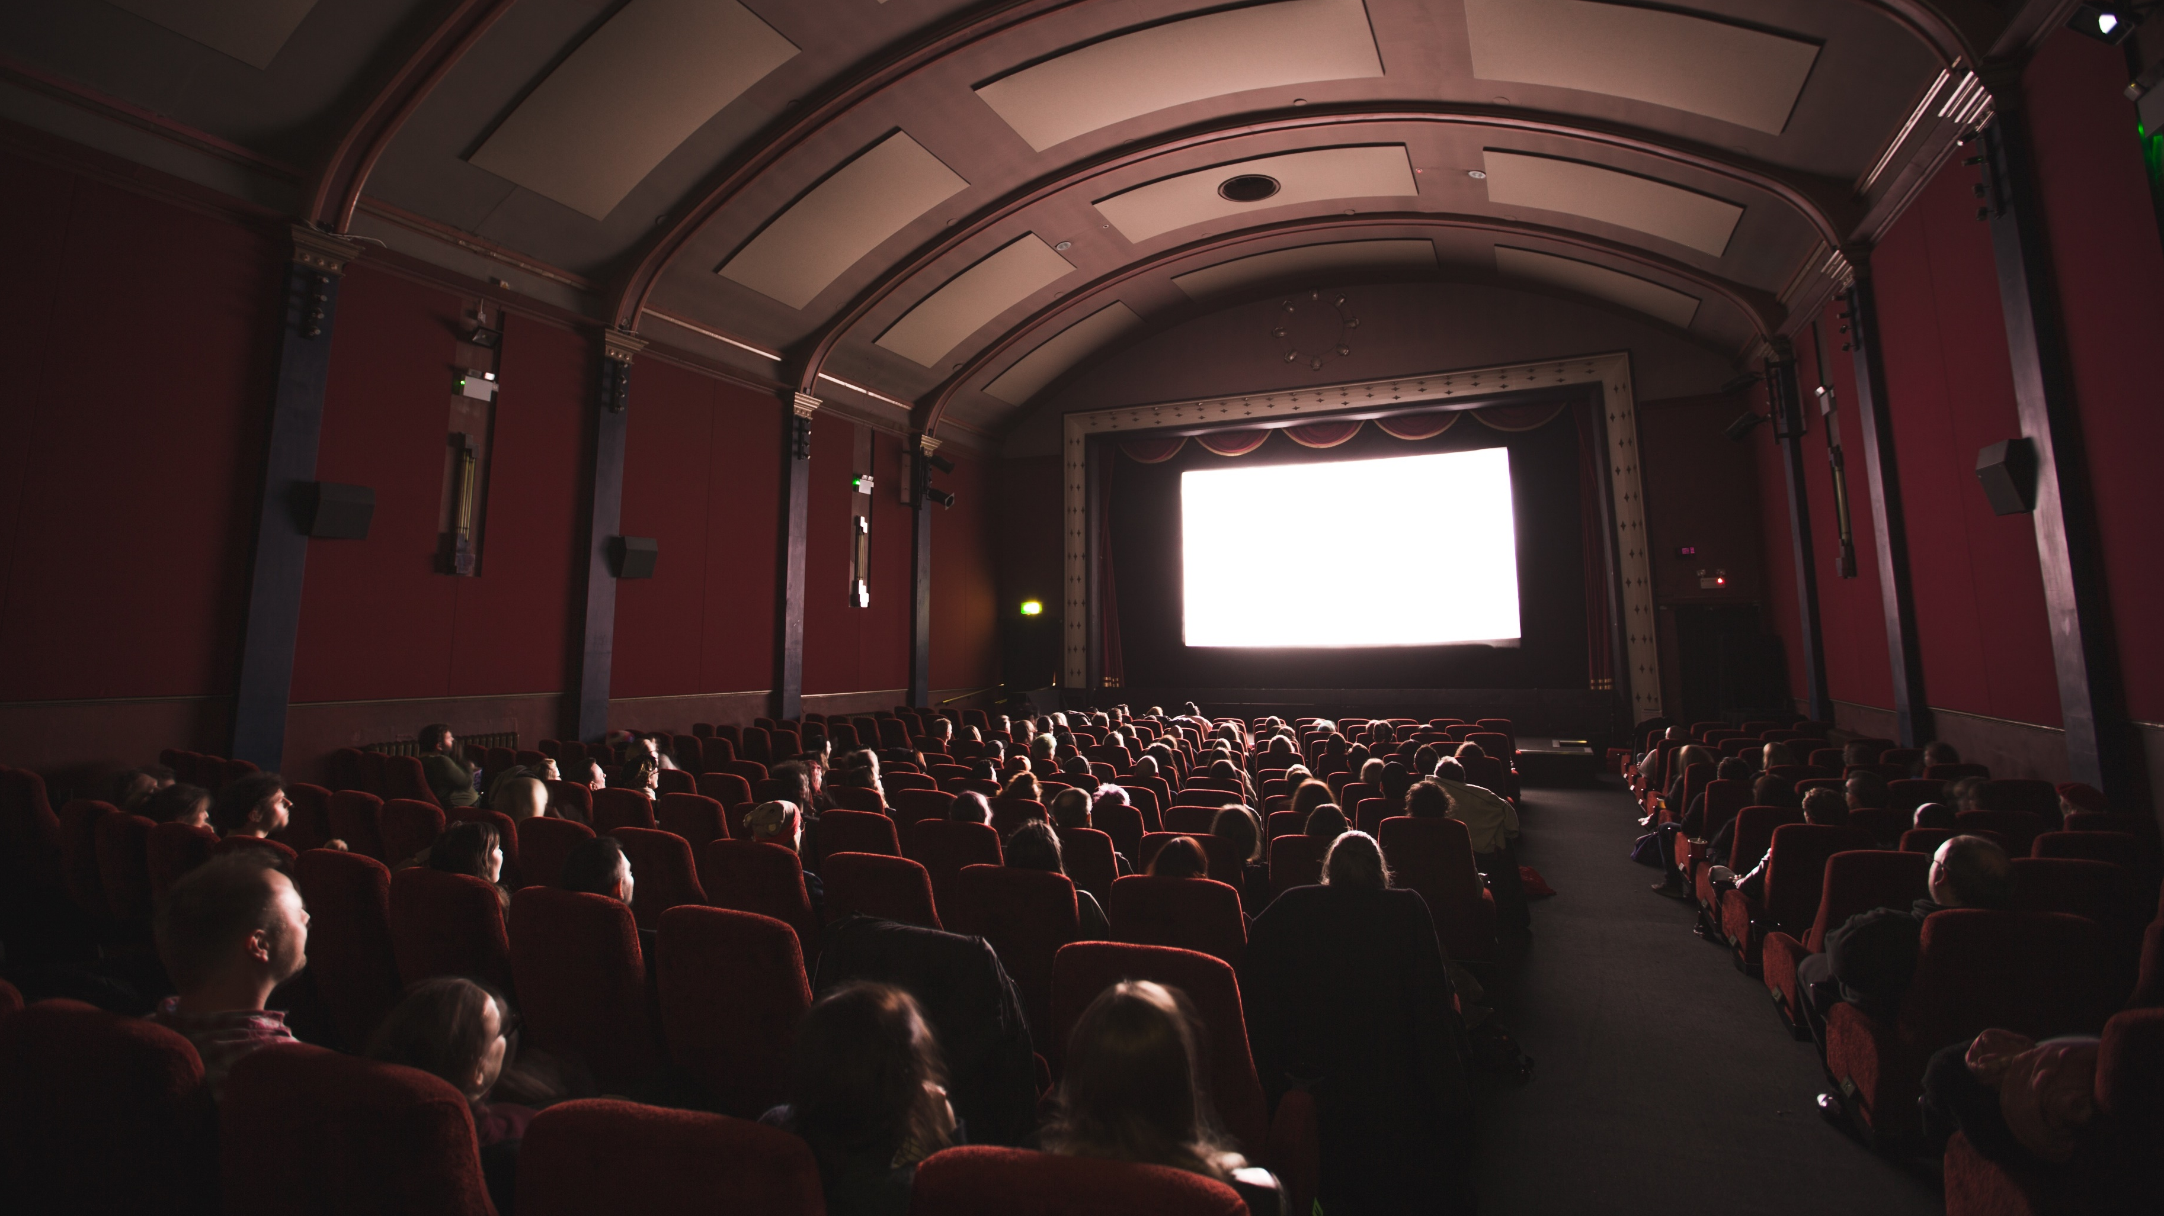
Near Ocean
Meeting Hall
Movie Theater
Outdoor Café
Sports Area
Restaurant
Parking
More…

Slide 5
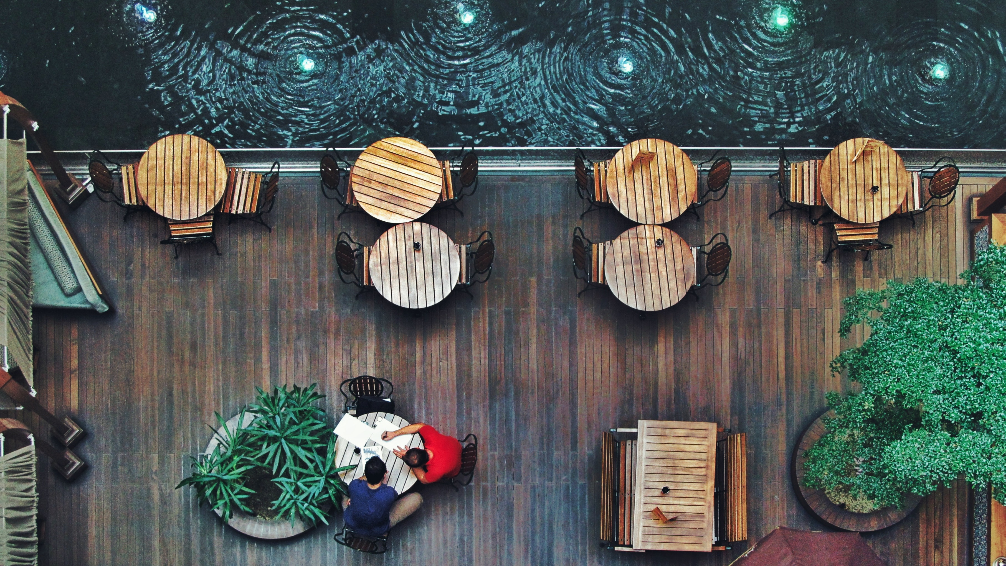
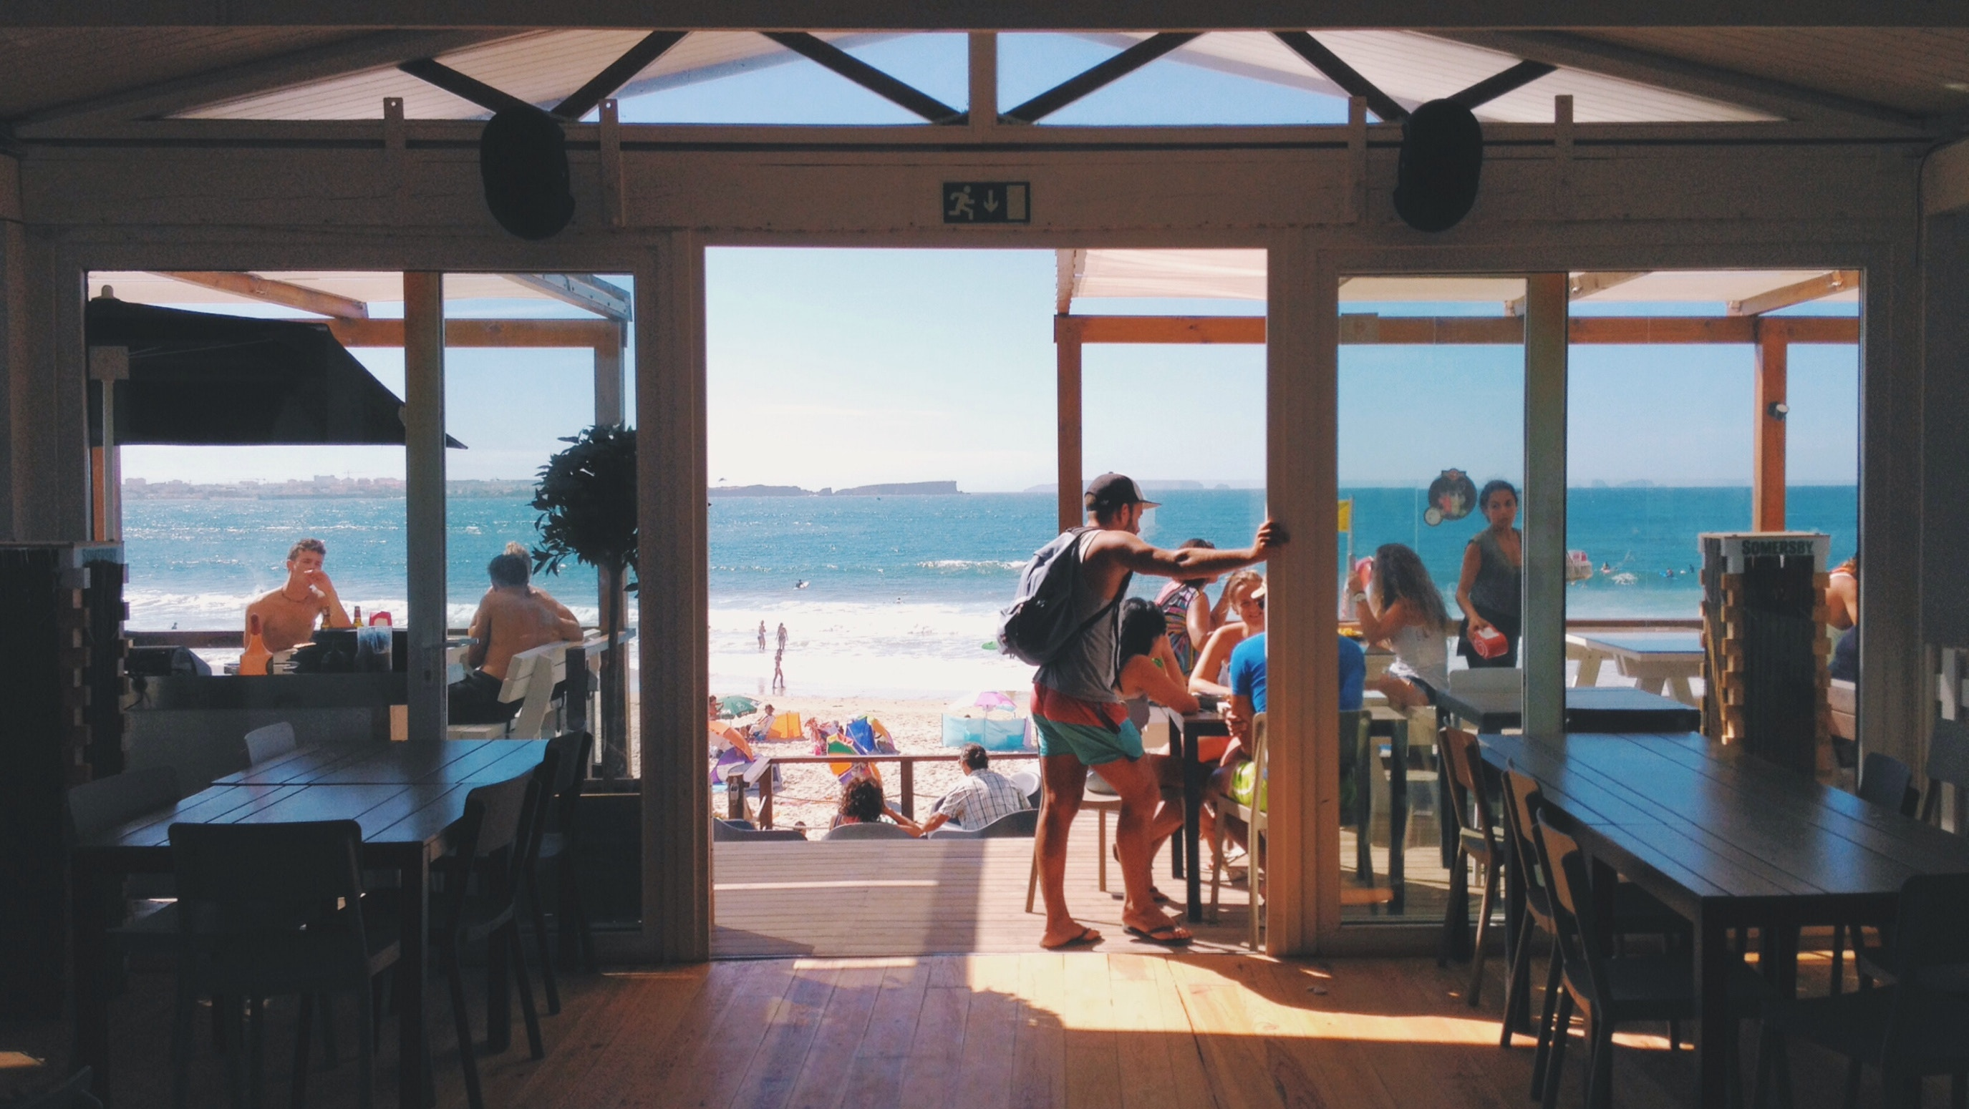
Near Ocean
Meeting Hall
Movie Theater
Outdoor Café
Sports Area
Restaurant
Parking
More…

Slide 6
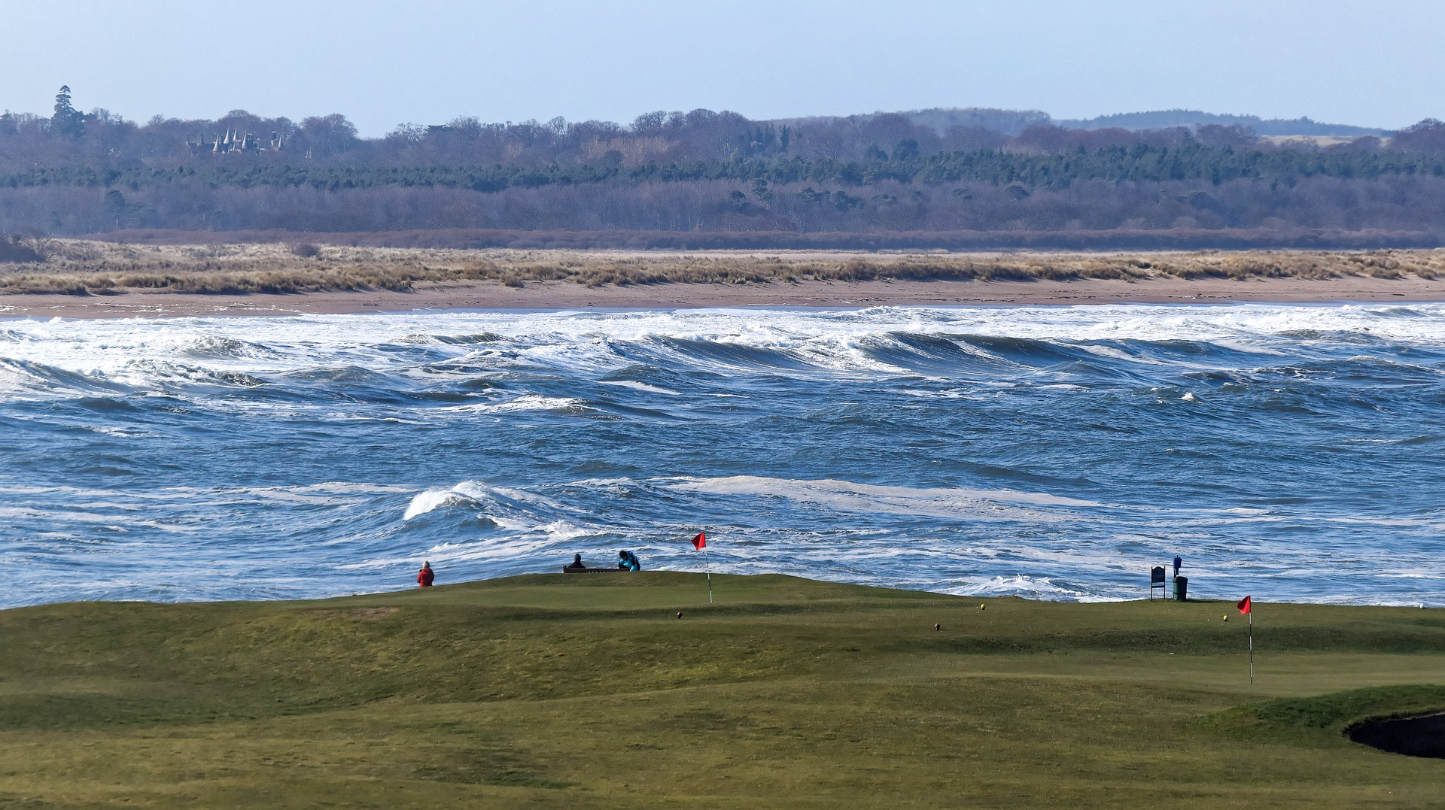
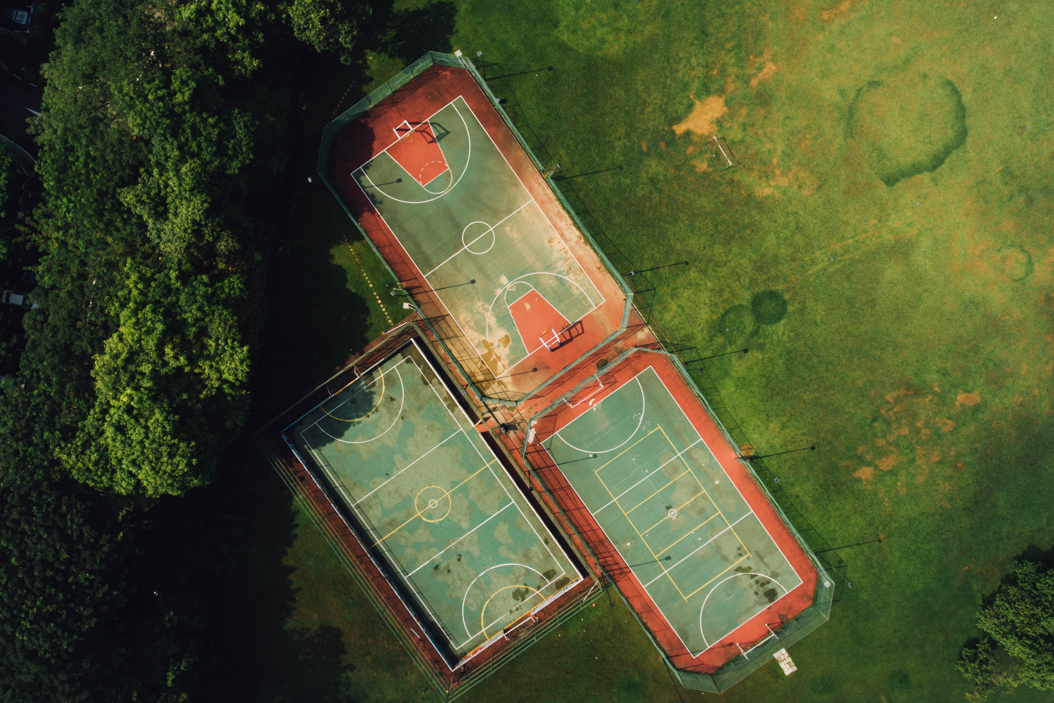
Near Ocean
Meeting Hall
Movie Theater
Outdoor Café
Sports Area
Restaurant
Parking
More…

Slide 7
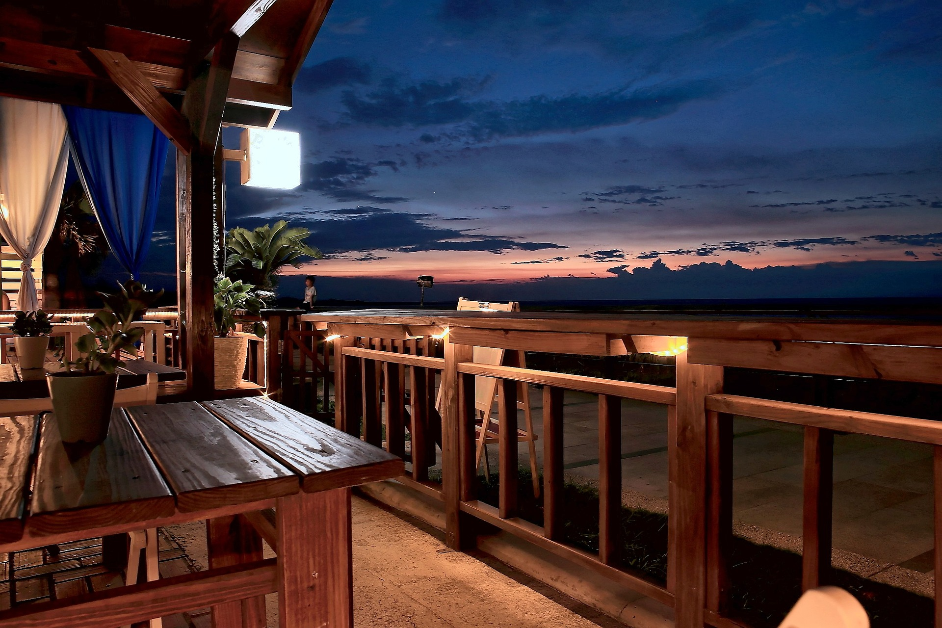
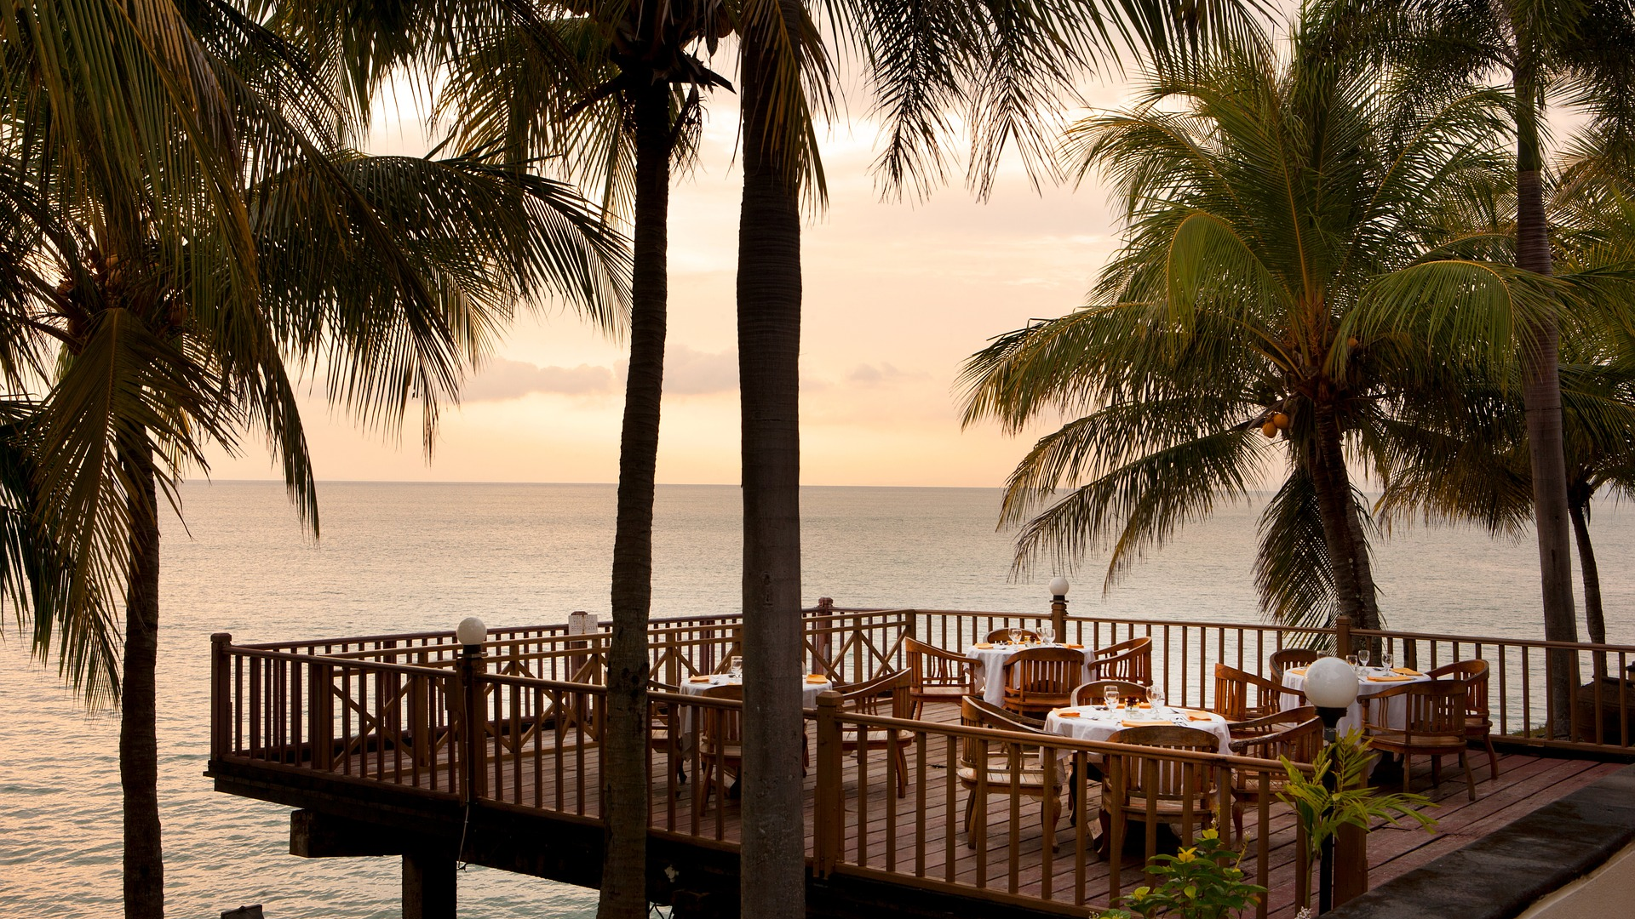
Near Ocean
Meeting Hall
Movie Theater
Outdoor Café
Sports Area
Restaurant
Parking
More…

Slide 8
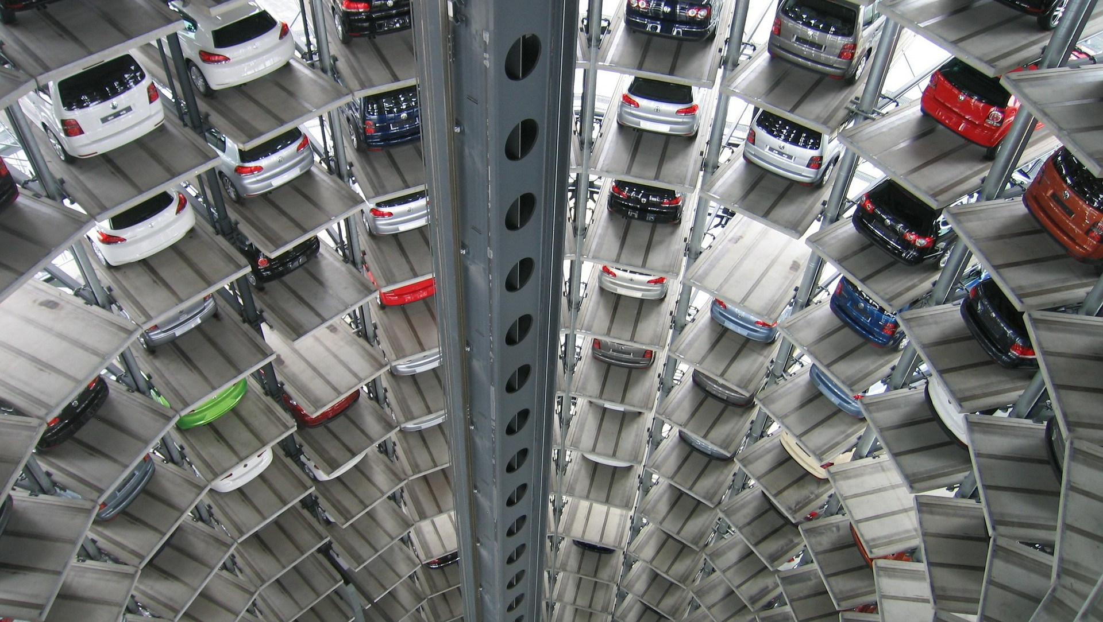
Near Ocean
Meeting Hall
Movie Theater
Outdoor Café
Sports Area
Restaurant
Parking
More…

Slide 9
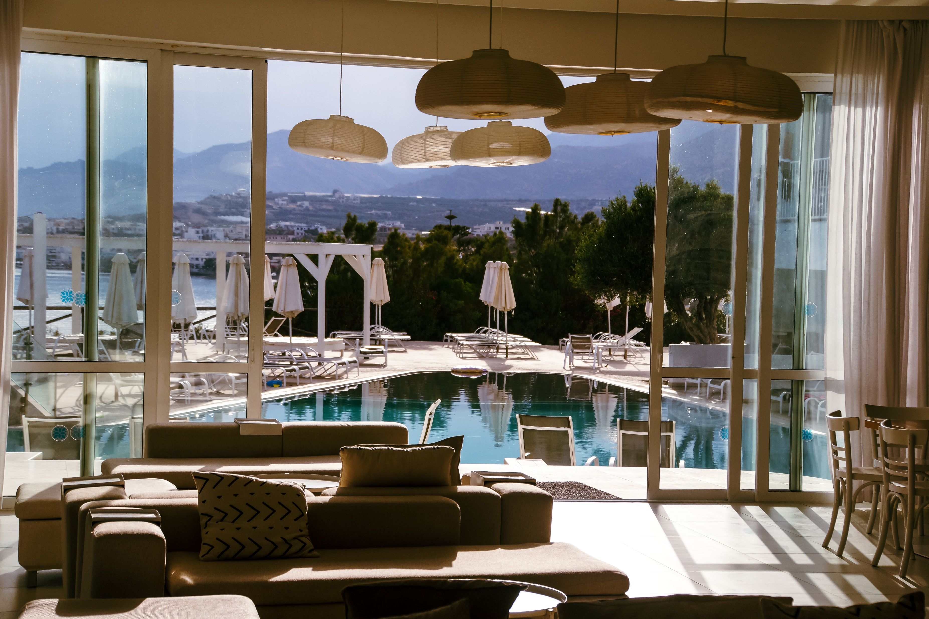
Near Ocean
Meeting Hall
Big Rooms
Movie Theater
Outdoor Café
Sports Area
Restaurant
Parking
More…

Slide 10
Near Ocean
Meeting Hall
Spa Salon
Movie Theater
Outdoor Café
Sports Area
Restaurant
Parking
More…

Slide 11
Near Ocean
Meeting Hall
Night Party
Movie Theater
Outdoor Café
Sports Area
Restaurant
Parking
More…

Slide 12
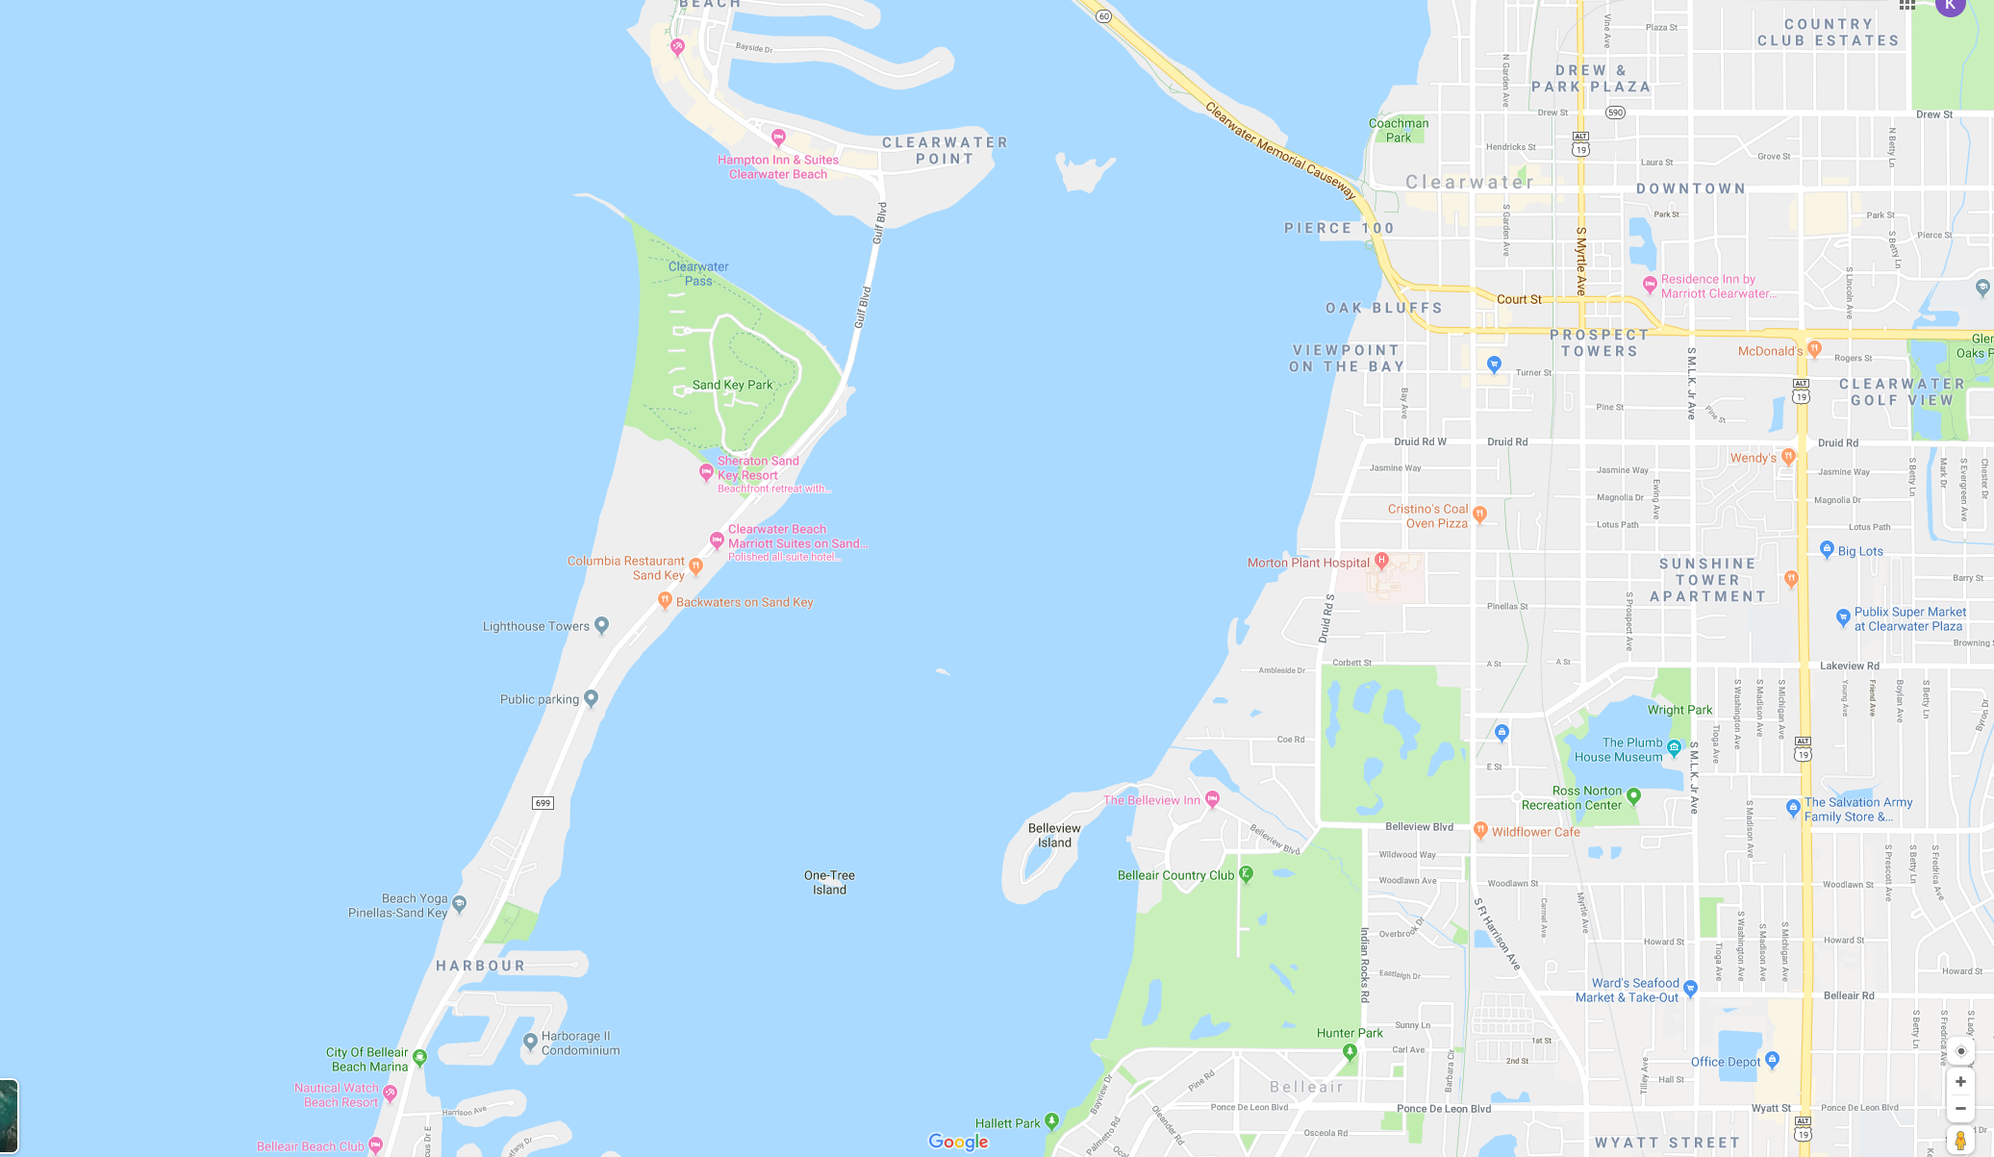
1160 Gulf Blvd, Clearwater Beach, FL 33767, USA
Phone : 1-800-123-4567
Website:
SPECIALREDLUXURY.com
Email: info@specialredluxury.com

