Slide 1
ONLINE SHOPPING STORE
WWW.SHAPPYTERIA.COM

Slide 2
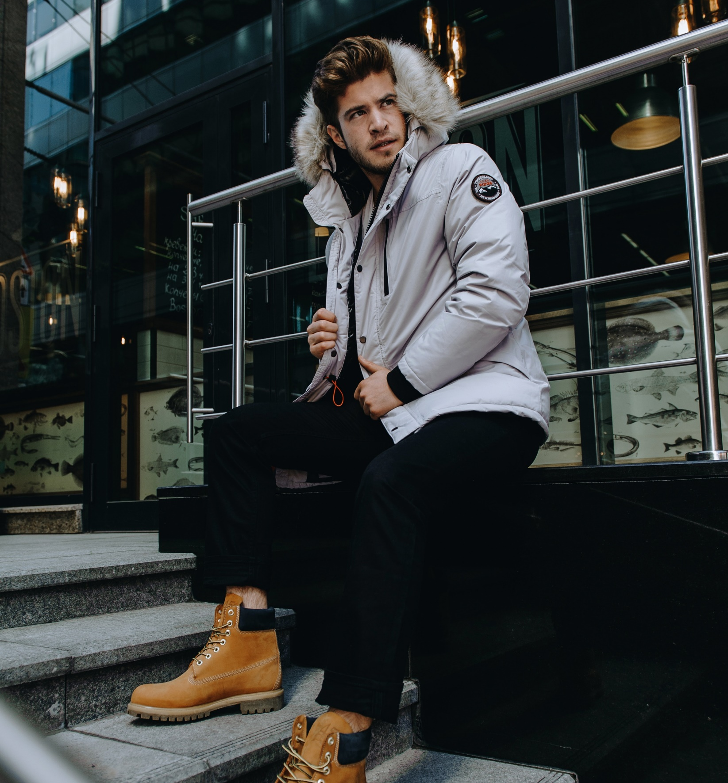
MENS JACKET
Time-to-market : 2020
Wear way : Outerwear
Sleeve length : Jacket
Neckline : collar
Brand : Levis
Application of the season. : Winter
Thickness : Thick
$69
D
D
D
D

Slide 3
EMBROIDERED COTTON BLOUSE
Time-to-market : 2020
Wear way : Outerwear
Sleeve length : Sleeveless Jacket
Neckline : collar
Brand : Levis
Application of the season. : Winter
Thickness : Thick
$79
D
D
D
D

Slide 4
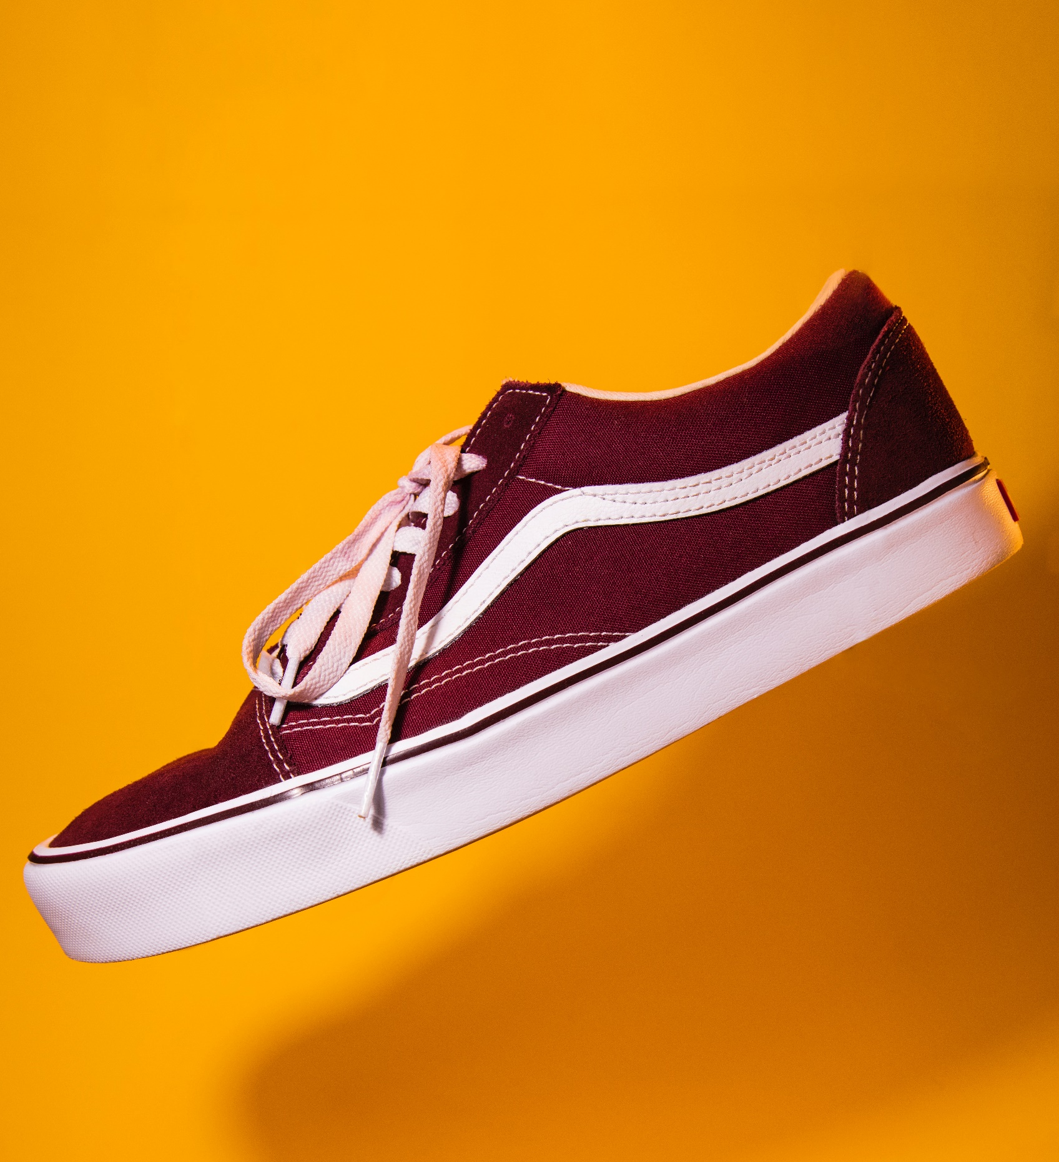
RED SHOES
2020 New style red canvas shoes
$49
D
D
D
D

Slide 5
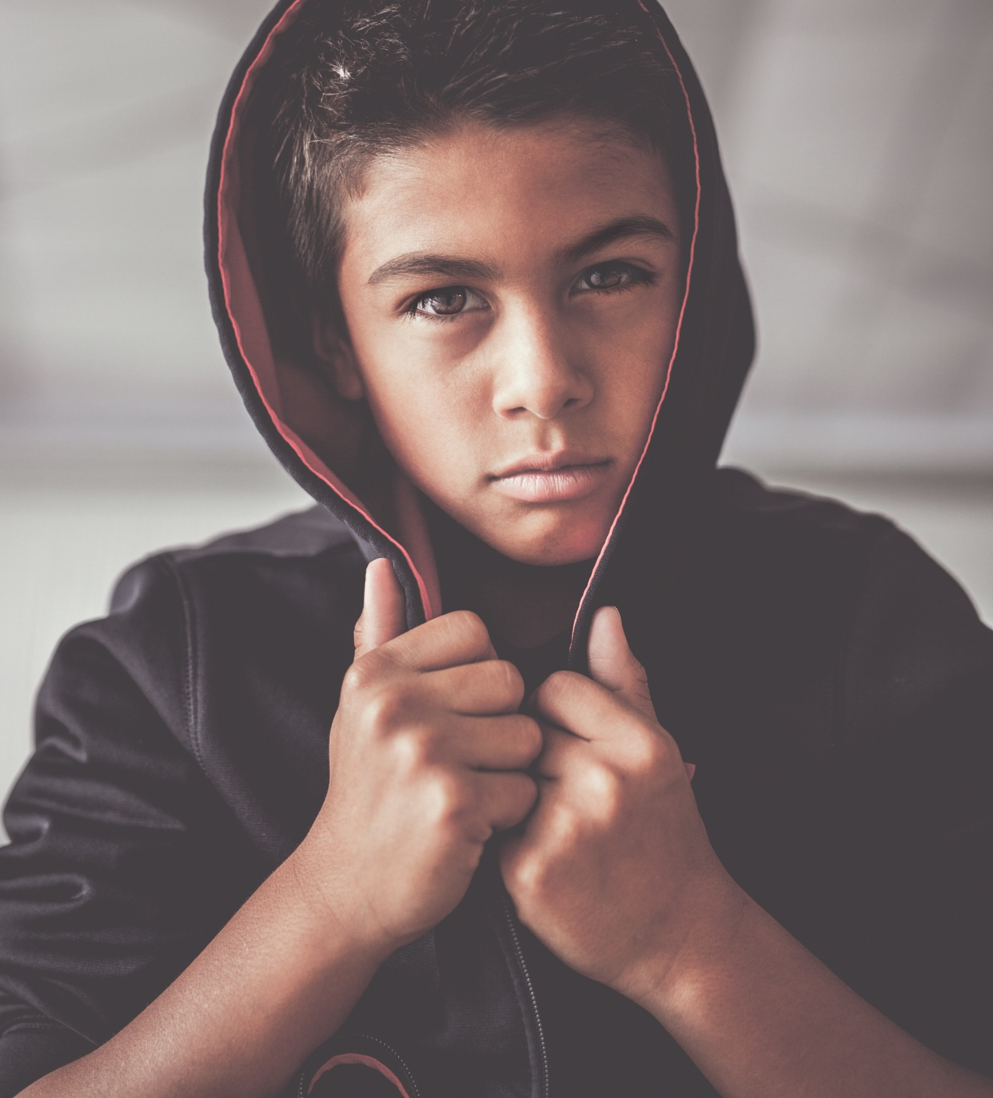
EMBROIDERED COTTON JACKET
Time-to-market : 2020
Wear way : Outerwear
Sleeve length : Jacket
Neckline : collar
Brand : Levis
Application of the season. : Winter
Thickness : Thick
$70
D
D
D
D

Slide 6
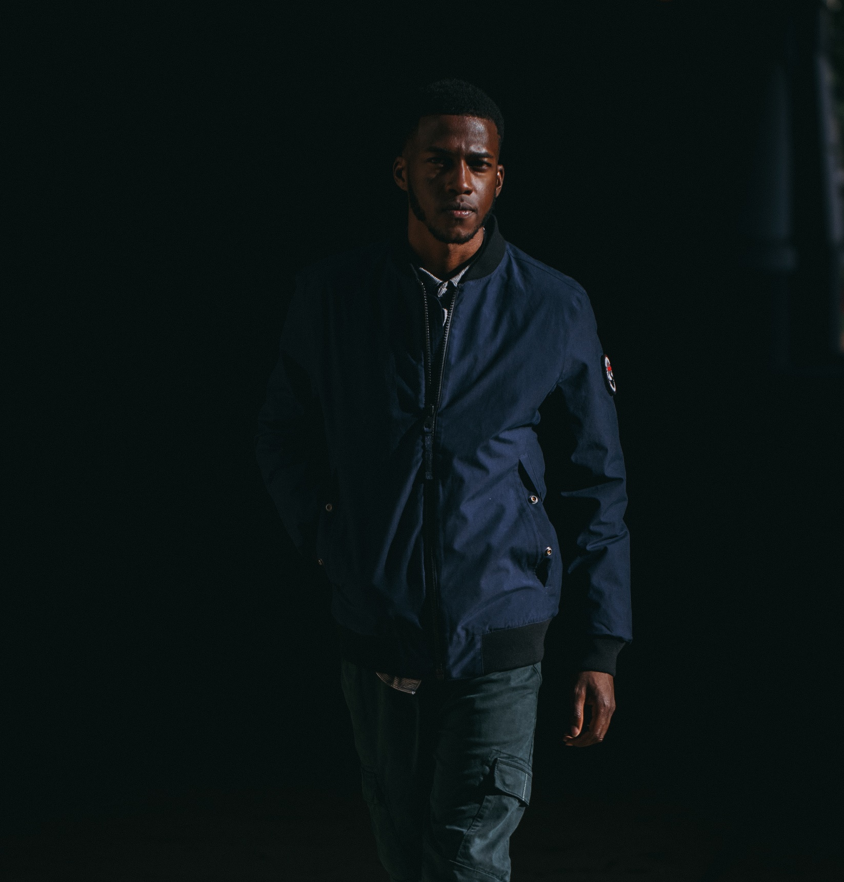
KOREAN STYLE JACKET
Time-to-market : 2020
Wear way : Outerwear
Sleeve length : Jacket
Neckline : collar
Brand : Levis
Application of the season. : Winter
Thickness : Thin
$66
D
D
D
D

Slide 7
LADIES JACKET
Time-to-market : 2020
Wear way : Outerwear
Sleeve length : Jacket
Neckline : collar
Brand : Levis
Application of the season. : Winter
Thickness : Thick
$99
D
D
D
D

Slide 8
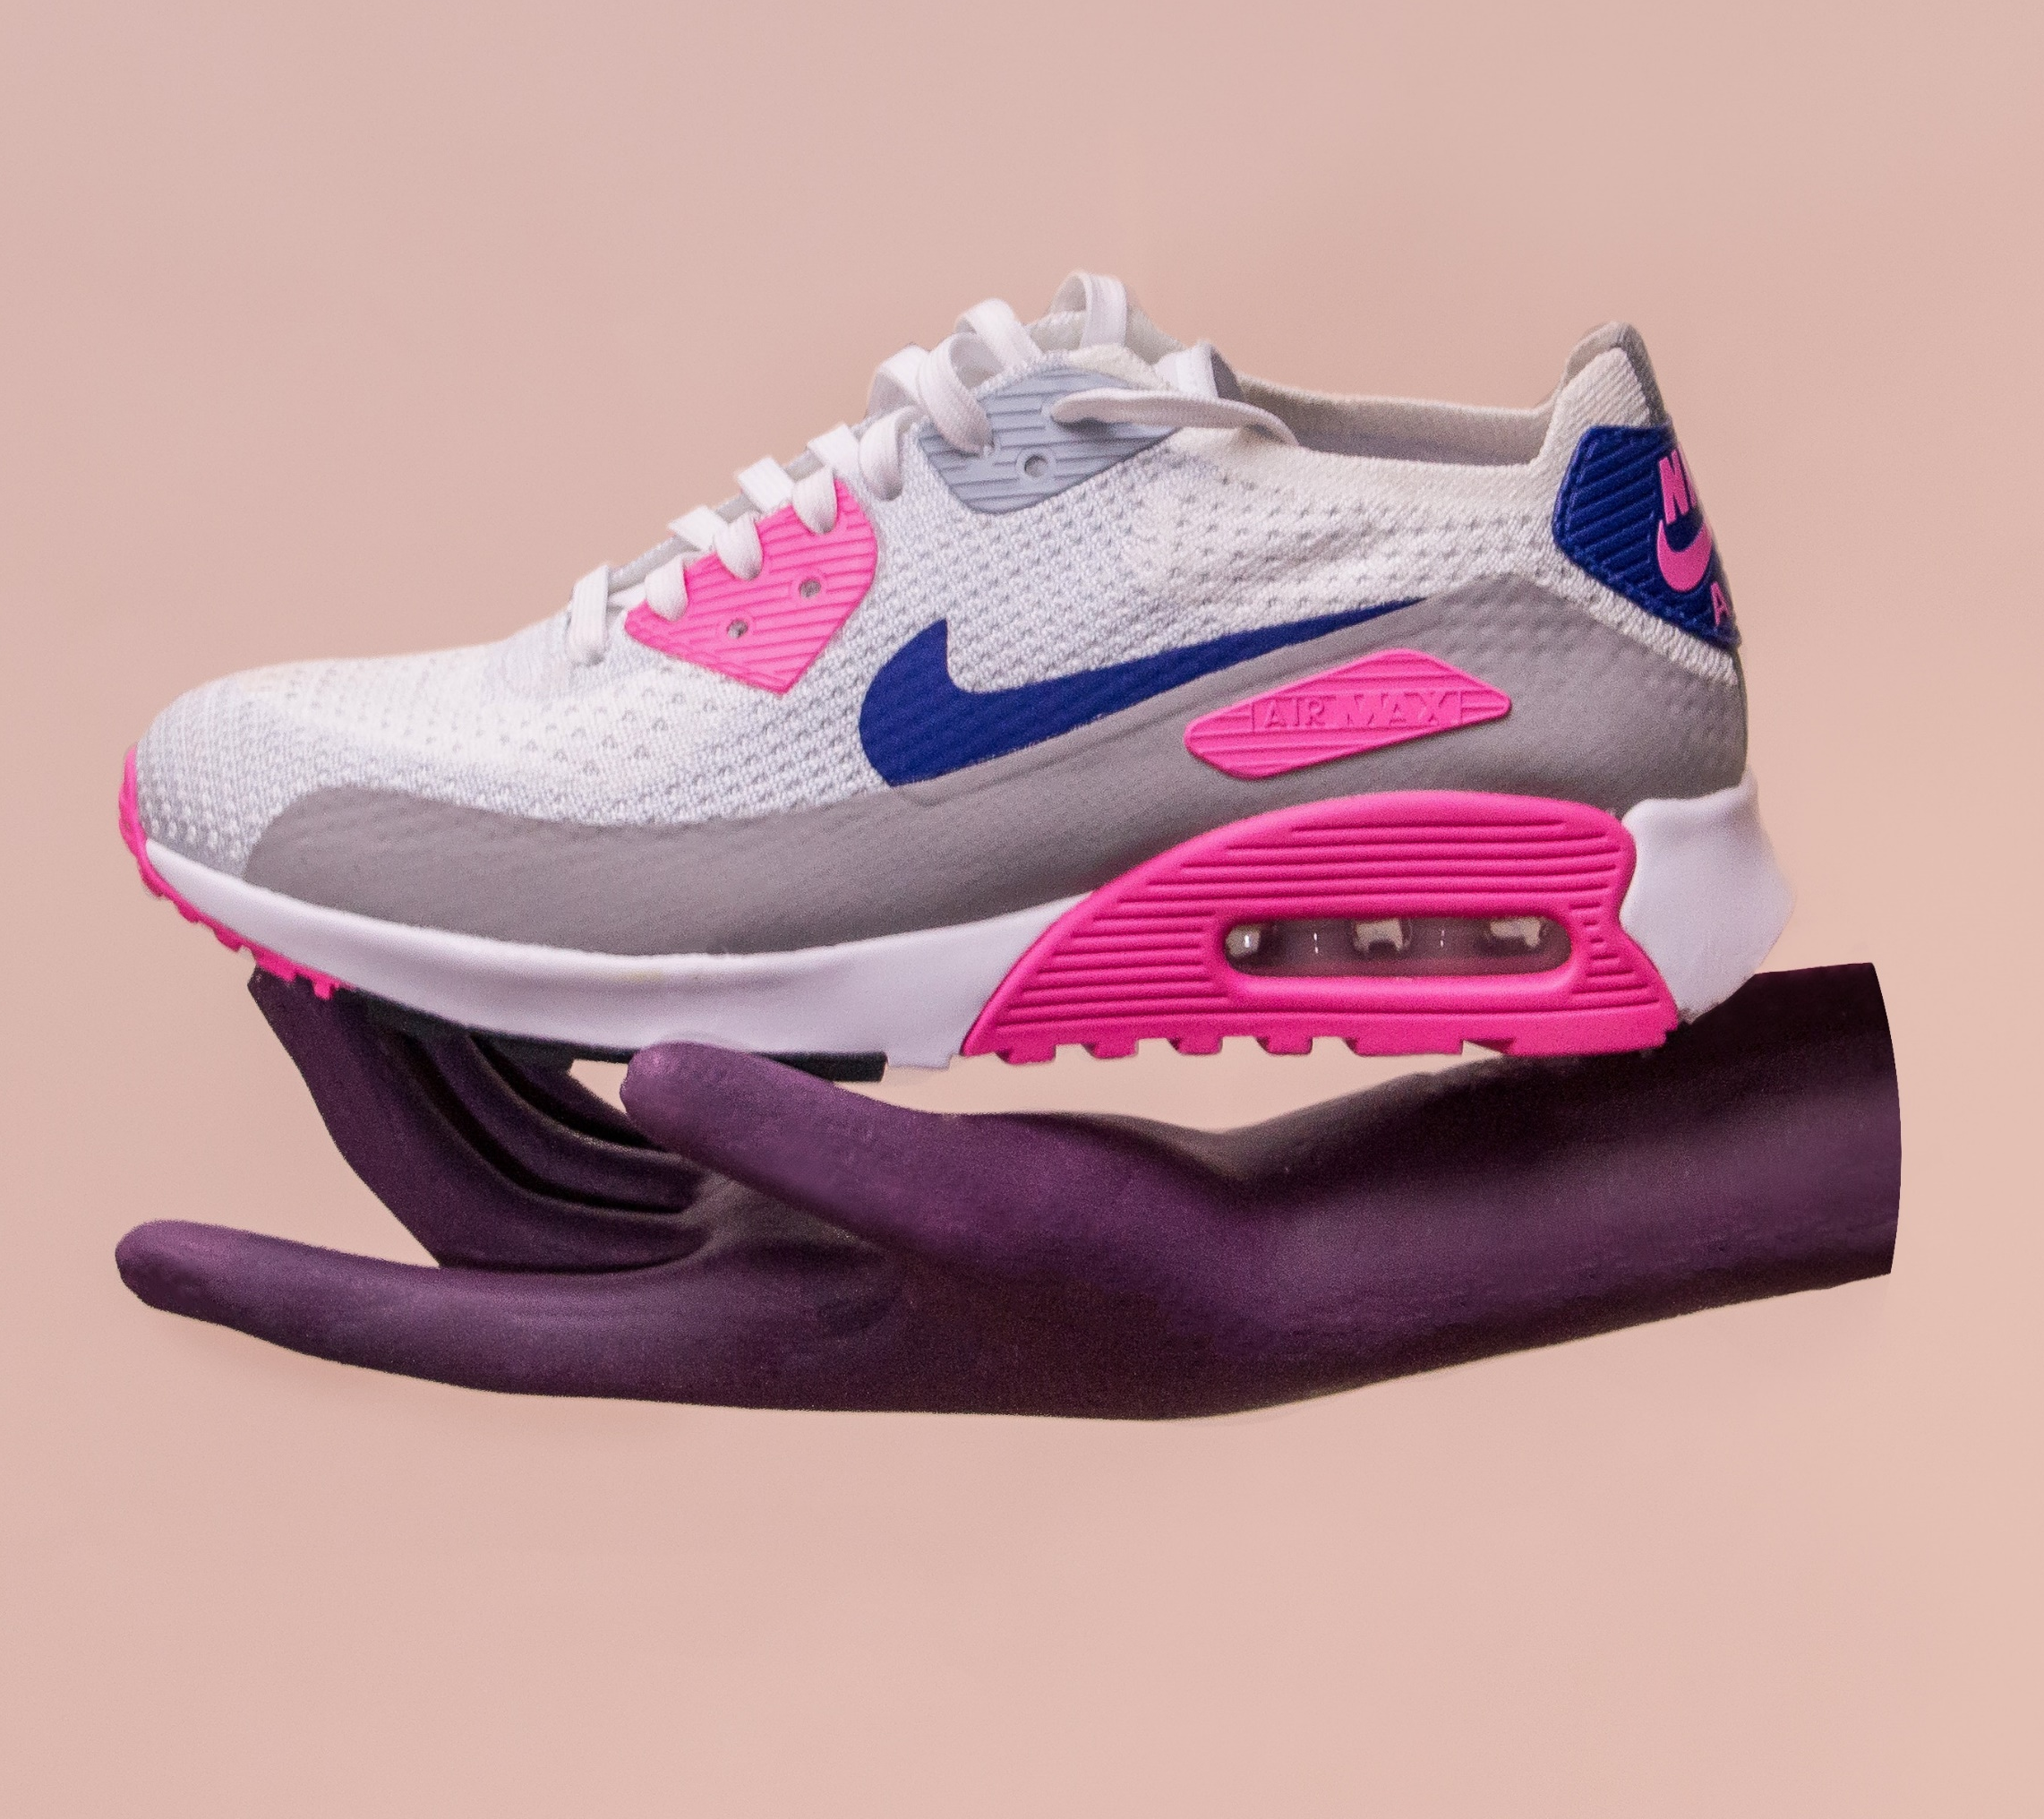
WHITE SHOES
2020 New style female pink canvas shoes
$49
D
D
D
D

Slide 9
ONLINE SHOPPING STORE
WWW.SHAPPYTERIA.COM

Slide 10
ONLINE SHOPPING STORE
WWW.FOODTRIPDINE.COM

Slide 11
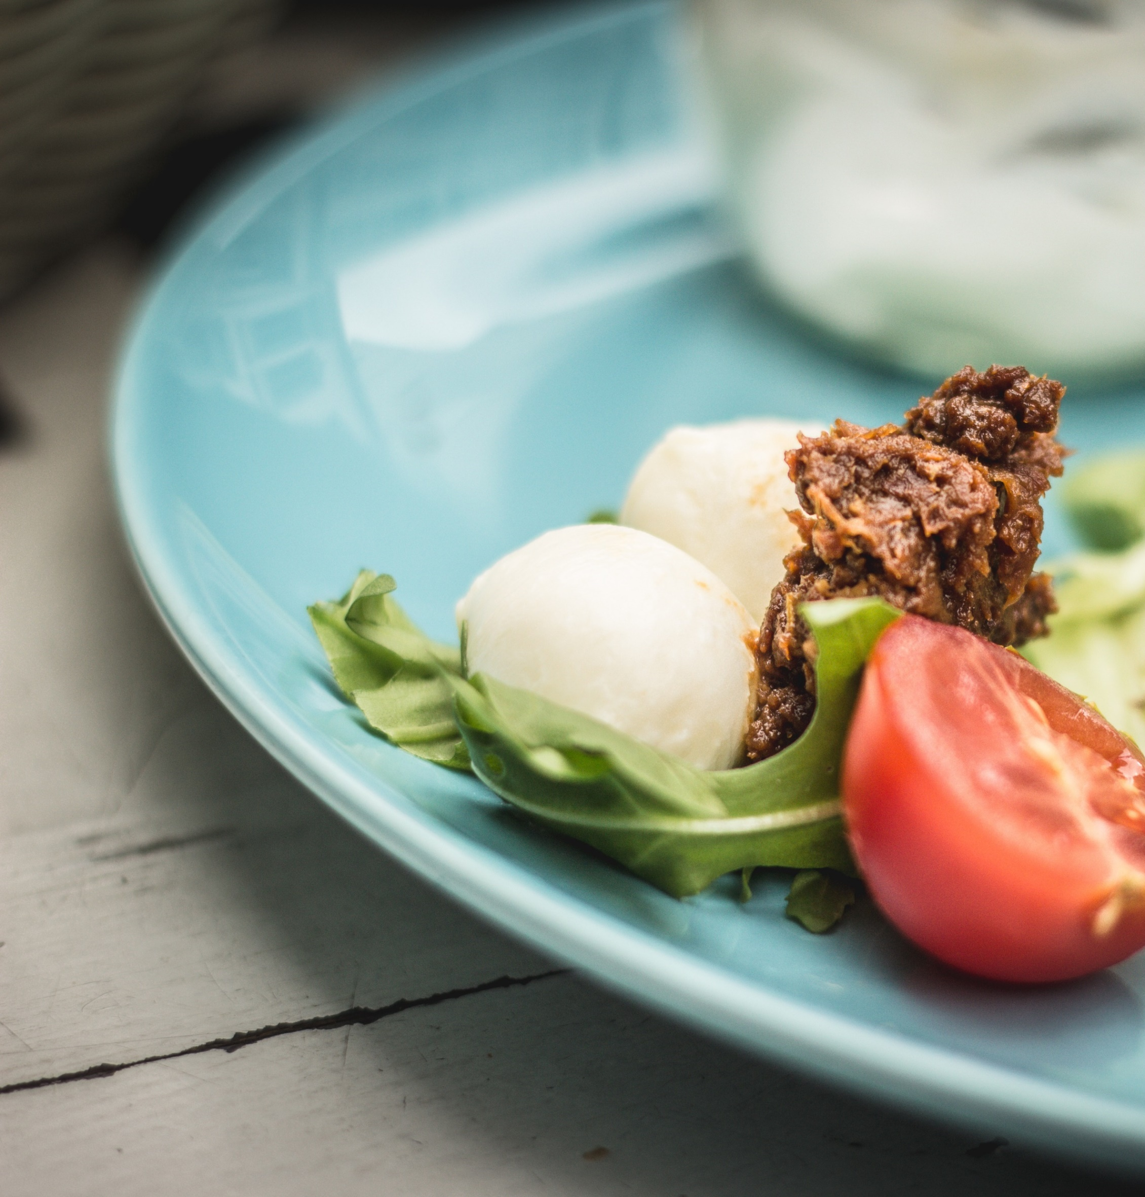
Z
EGG SALAD
Egg salad with mayonnaise and onions
$8

Slide 12
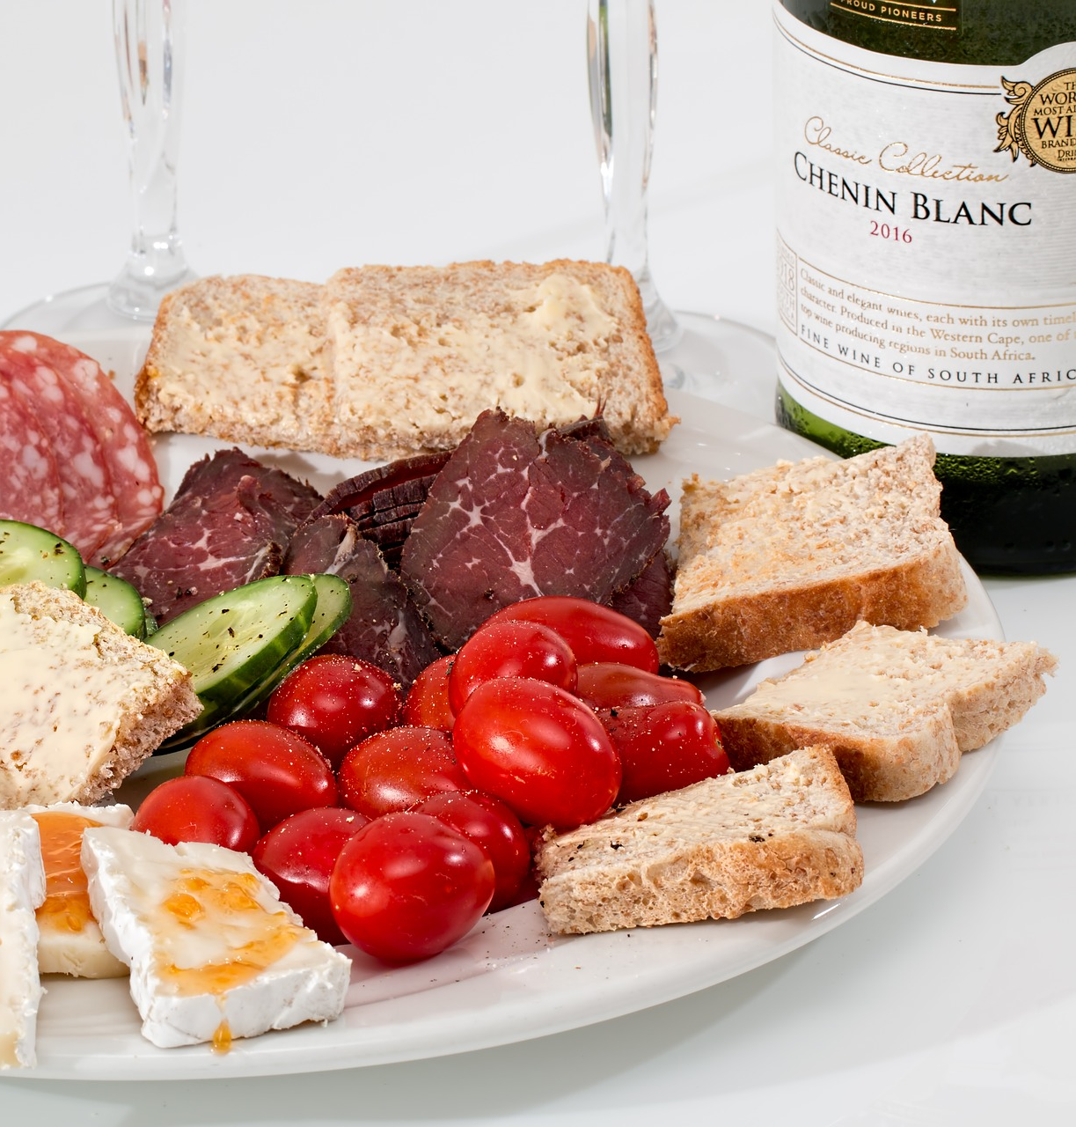
EGG SANDWICH
Sandwich with onions, tomatoes, cucumber and lettuce
$9

Slide 13
CUCUMBER SLICE
Cucumber slices with ice
$5

Slide 14
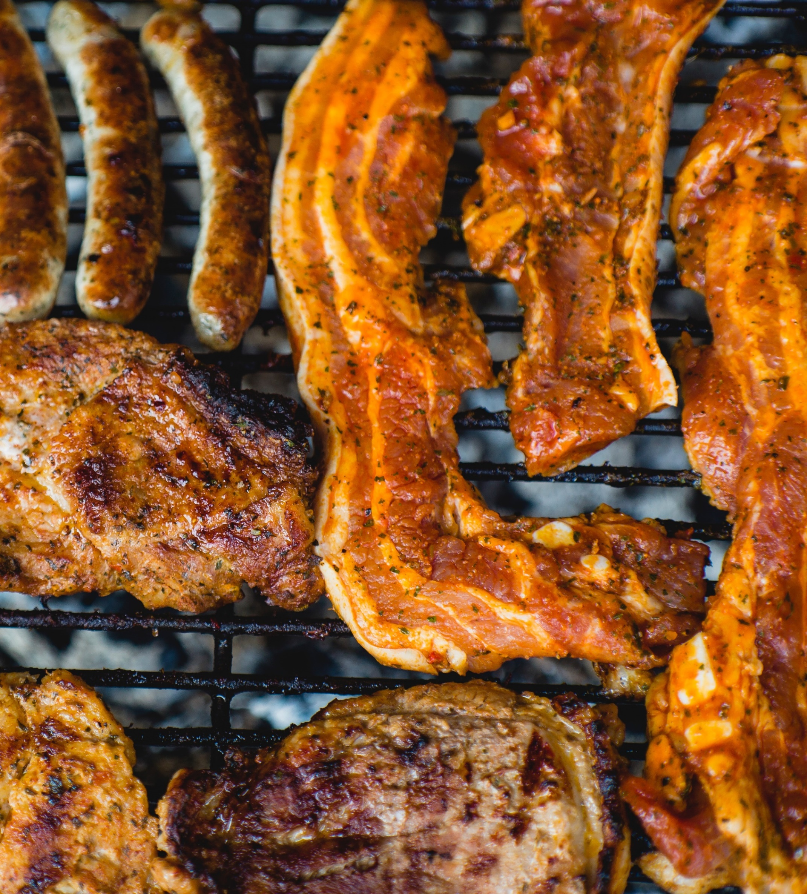
PORK BARBECUE
Grilled Pork
$12

Slide 15
HOT CAKE WITH BERRIES
Hot cakes with berries
$7

Slide 16
MUSHROOM SOUP
Mushroom flavored soup
$6

Slide 17
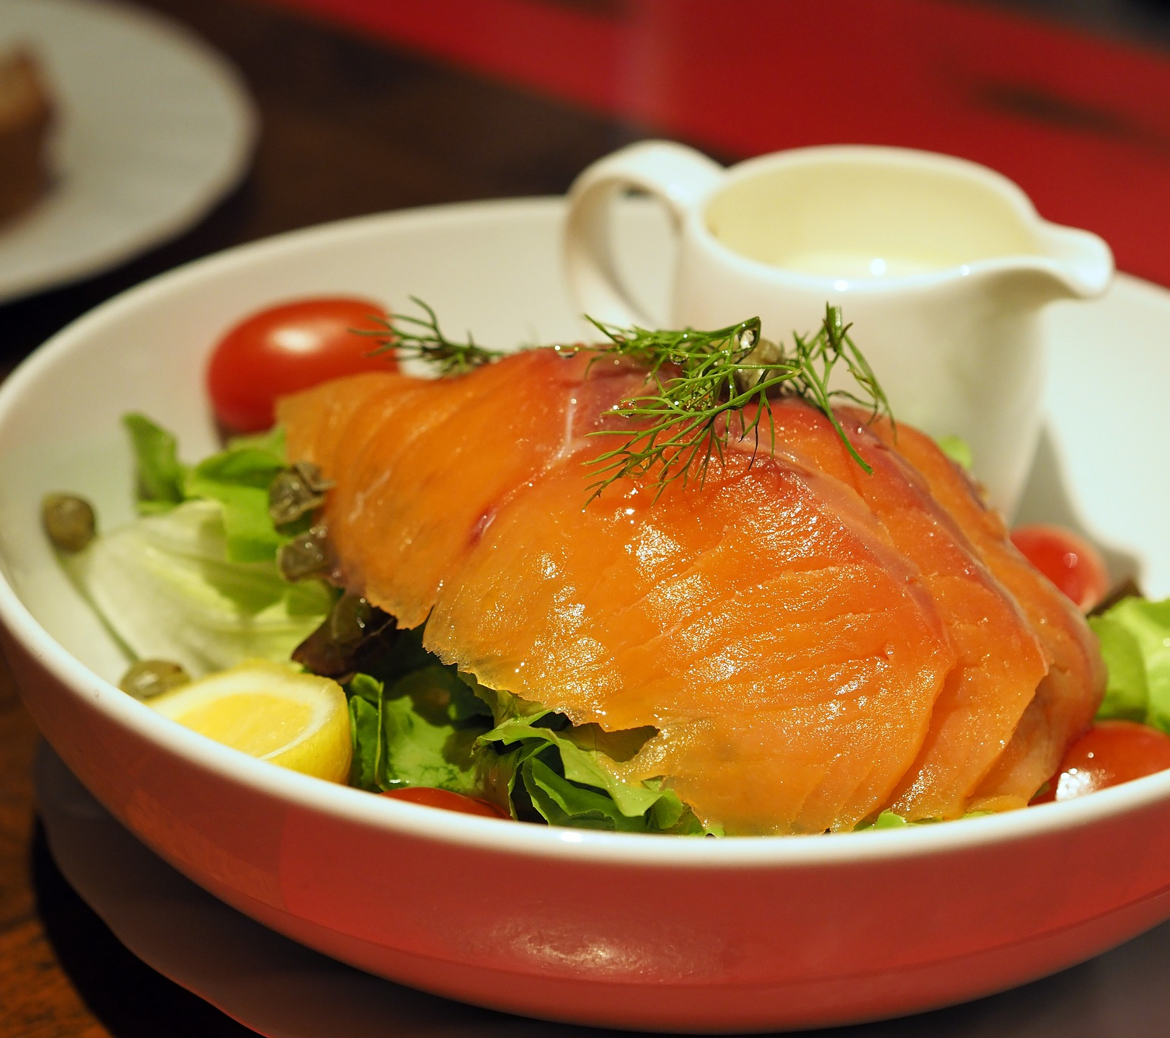
SMOKED
SALMON
Salmon smoked fish
$12

Slide 18
ONLINE SHOPPING STORE
WWW.FOODTRIPDINE.COM

