Slide 1
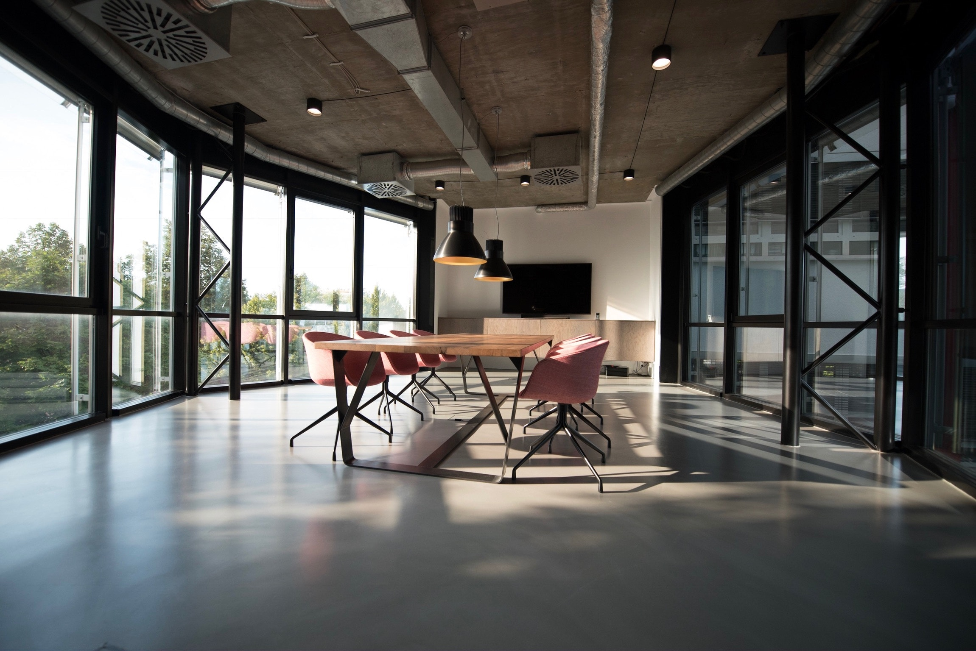
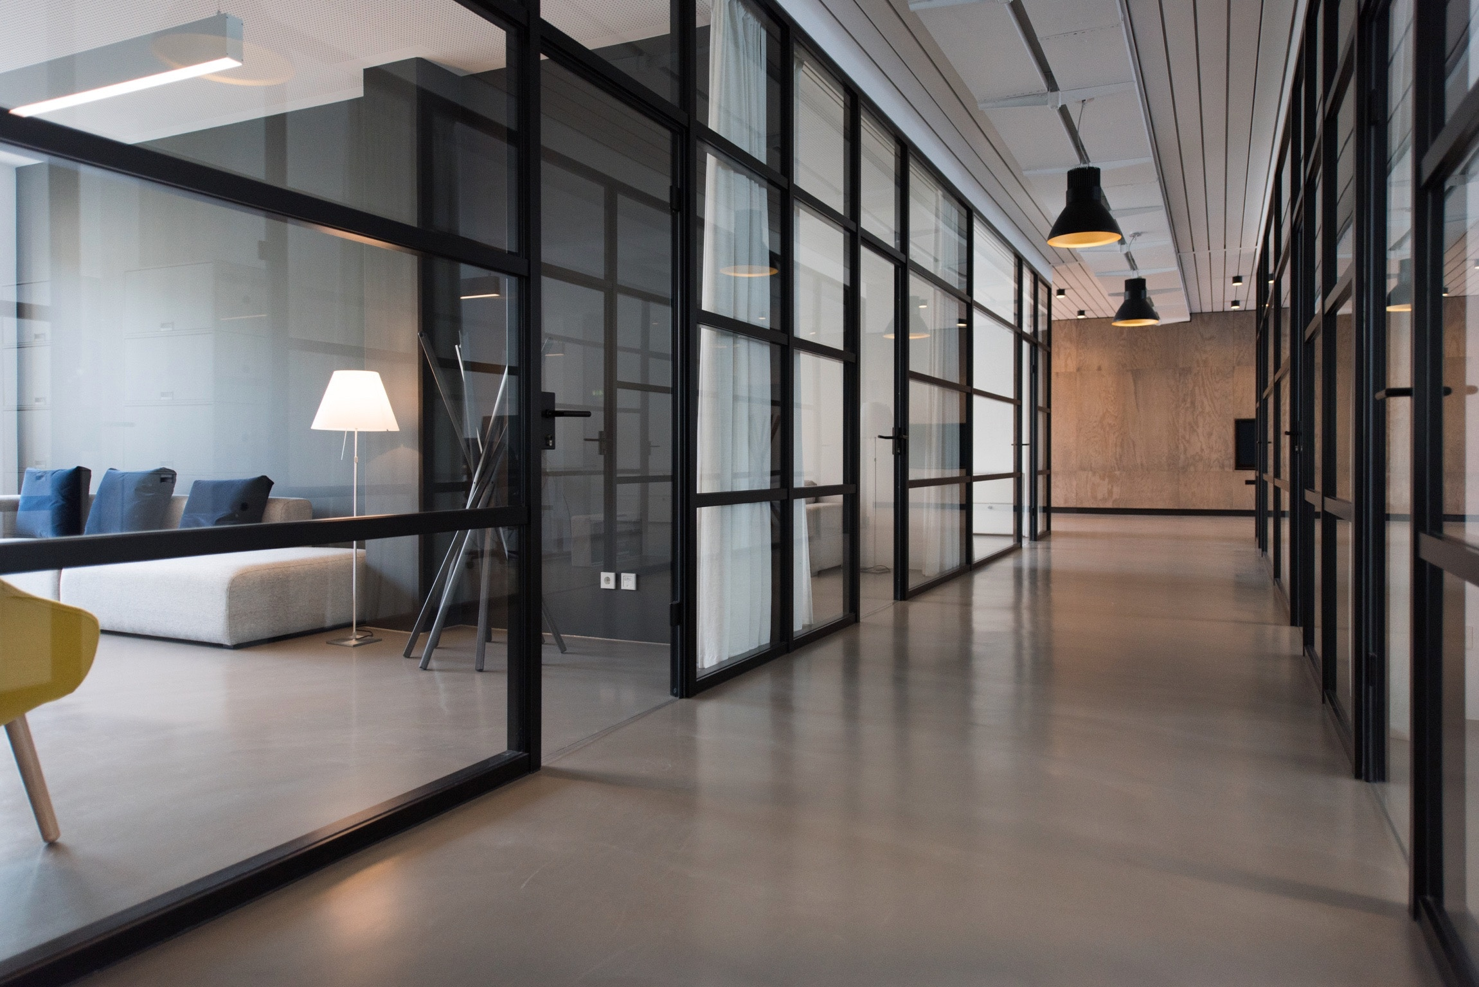
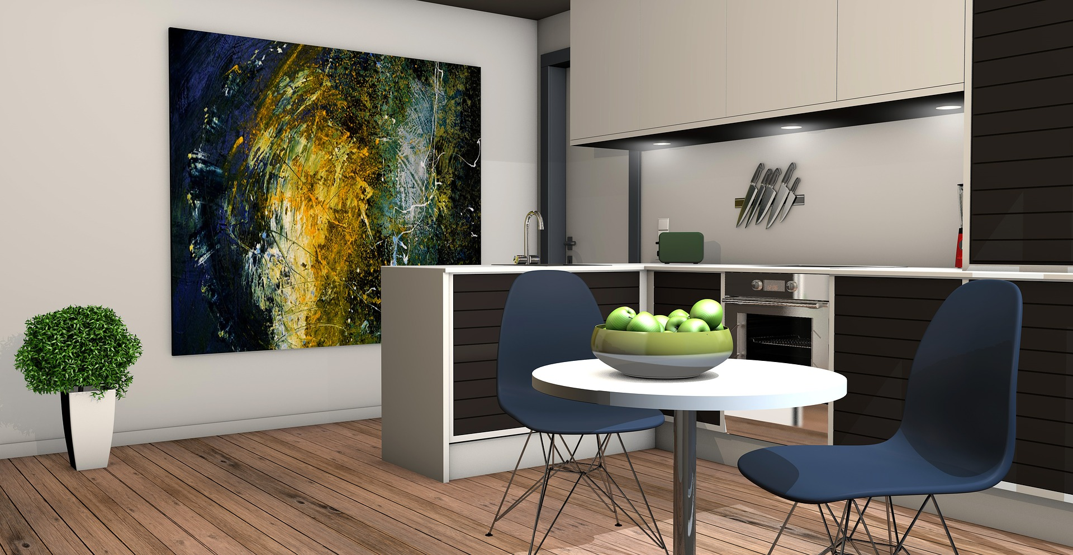
WE SUPPORT COMFORT LIVING
WWW.PLANETSW.COM
PLANETSW
REAL ESTATE

Slide 2
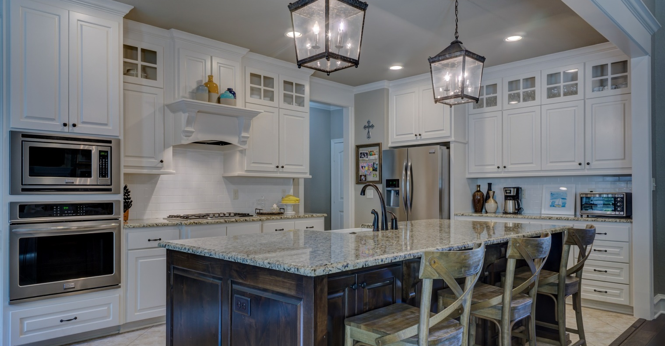
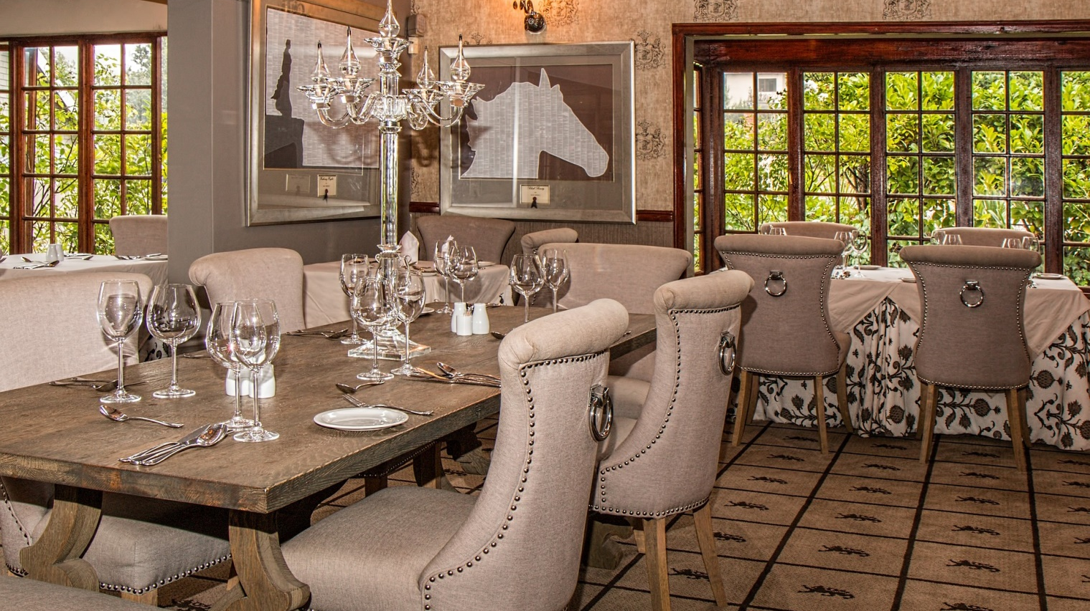
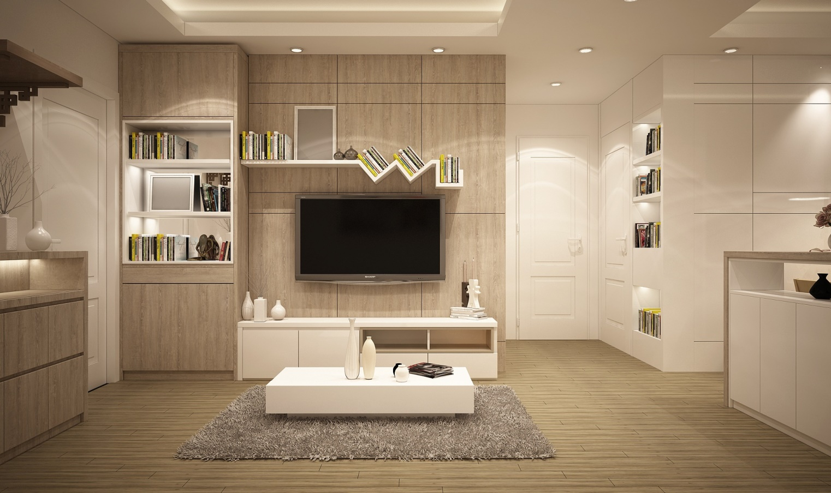
NEW
DEVELOPMENT
3 BEDROOM PENTHOUSE FITZROVIA
CONTACT US
LEASEHOLD 121, YEARSENTRANCE HALL, OPEN PLAN RECEPTION, DINING ROOM/KITCHEN, HUGE ROOF TERRACE, 3 BEDROOMS, 3 ENSUIT BATHROOMS, 3RD BATHROOM, GUEST WC, UTILITY ROOM, INDEDPENDENT HEATING
TEL: 1-800-123-4567
MAIL: INFO@PLANETSW.COM
WWW.PLANETSW.COM
PLANETSW
$1,950,000
REAL ESTATE

Slide 3
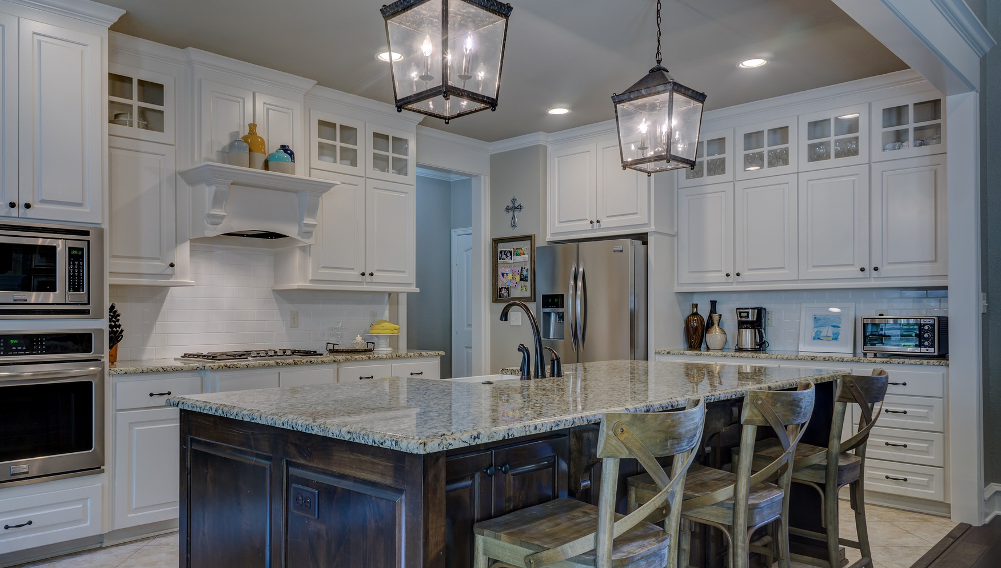
NEW
DEVELOPMENT
3 BEDROOM PENTHOUSE FITZROVIA
CONTACT US
LEASEHOLD 121, YEARSENTRANCE HALL, OPEN PLAN RECEPTION, DINING ROOM/KITCHEN, HUGE ROOF TERRACE, 3 BEDROOMS, 3 ENSUIT BATHROOMS, 3RD BATHROOM, GUEST WC, UTILITY ROOM, INDEDPENDENT HEATING
TEL: 1-800-123-4567
MAIL: INFO@PLANETSW.COM
WWW.PLANETSW.COM
PLANETSW
$1,950,000
REAL ESTATE

Slide 4
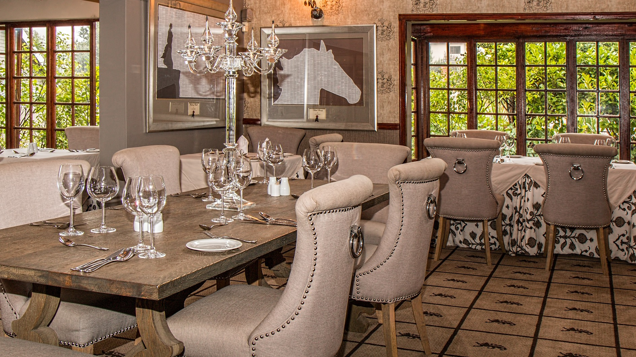
NEW
DEVELOPMENT
3 BEDROOM PENTHOUSE FITZROVIA
CONTACT US
LEASEHOLD 121, YEARSENTRANCE HALL, OPEN PLAN RECEPTION, DINING ROOM/KITCHEN, HUGE ROOF TERRACE, 3 BEDROOMS, 3 ENSUIT BATHROOMS, 3RD BATHROOM, GUEST WC, UTILITY ROOM, INDEDPENDENT HEATING
TEL: 1-800-123-4567
MAIL: INFO@PLANETSW.COM
WWW.PLANETSW.COM
PLANETSW
$3,950,000
REAL ESTATE

Slide 5
NEW
DEVELOPMENT
3 BEDROOM PENTHOUSE FITZROVIA
CONTACT US
LEASEHOLD 121, YEARSENTRANCE HALL, OPEN PLAN RECEPTION, DINING ROOM/KITCHEN, HUGE ROOF TERRACE, 3 BEDROOMS, 3 ENSUIT BATHROOMS, 3RD BATHROOM, GUEST WC, UTILITY ROOM, INDEDPENDENT HEATING
TEL: 1-800-123-4567
MAIL: INFO@PLANETSW.COM
WWW.PLANETSW.COM
PLANETSW
$6,950,000
REAL ESTATE

Slide 6
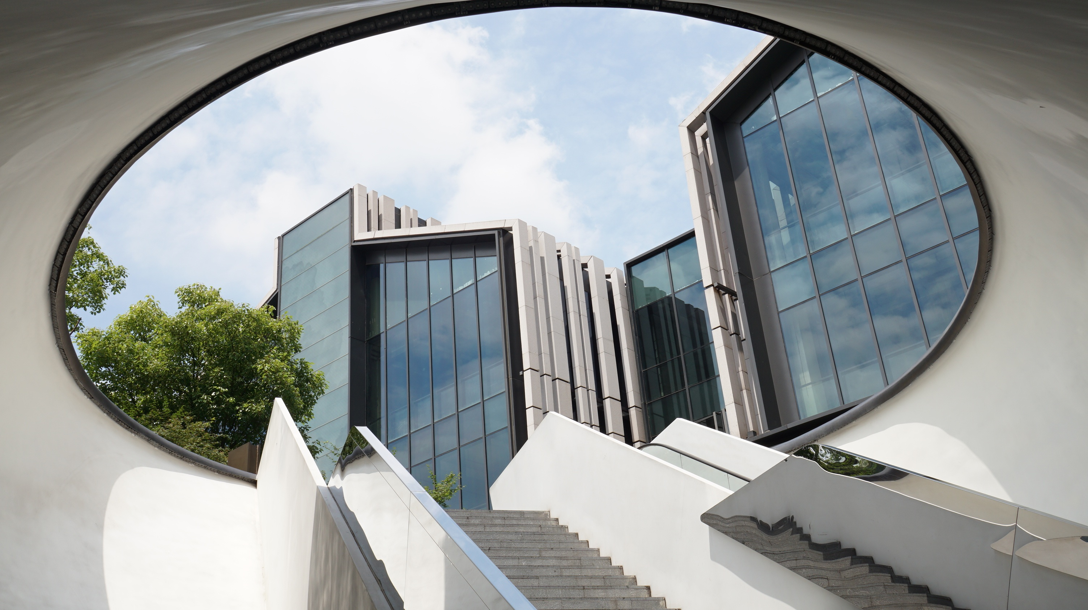
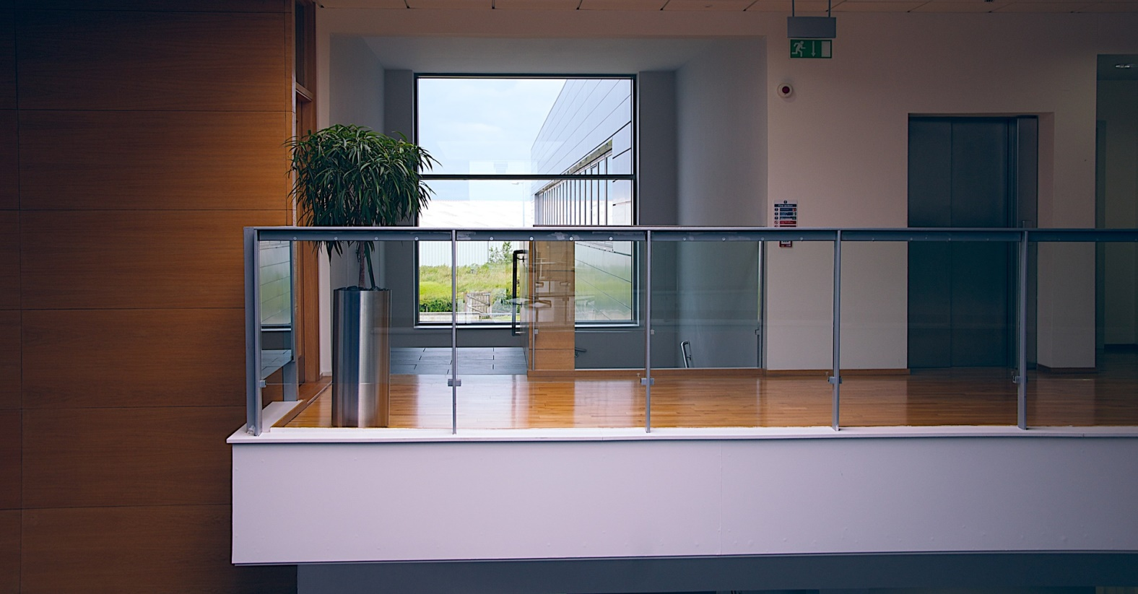
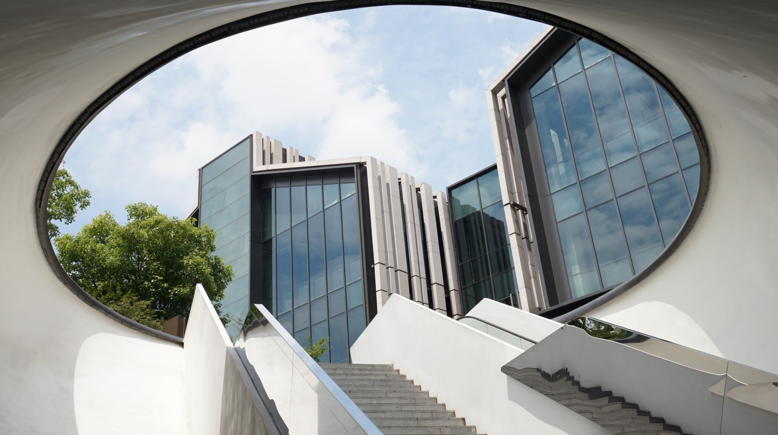
NEW
DEVELOPMENT
CONTACT US
GREAT PORTLAND STREET, LONDON W1W
TEL: 1-800-123-4567
MAIL: INFO@PLANETSW.COM
WWW.PLANETSW.COM
LEASEHOLD 121, YEARSENTRANCE HALL, OPEN PLAN RECEPTION, DINING ROOM/KITCHEN
3 BEDROOMS, 3 ENSUIT BATHROOMS, 3RD BATHROOM, GUEST WC, UTILITY ROOM, INDEDPENDENT HEATING
$4,950,000
PLANETSW
REAL ESTATE

Slide 7
NEW
DEVELOPMENT
CONTACT US
GREAT PORTLAND STREET, LONDON W1W
TEL: 1-800-123-4567
MAIL: INFO@PLANETSW.COM
WWW.PLANETSW.COM
LEASEHOLD 121, YEARSENTRANCE HALL, OPEN PLAN RECEPTION, DINING ROOM/KITCHEN
3 BEDROOMS, 3 ENSUIT BATHROOMS, 3RD BATHROOM, GUEST WC, UTILITY ROOM, INDEDPENDENT HEATING
$1,950,000
PLANETSW
REAL ESTATE

Slide 8
NEW
DEVELOPMENT
GREAT PORTLAND STREET, LONDON W1W
CONTACT US
TEL: 1-800-123-4567
MAIL: INFO@PLANETSW.COM
WWW.PLANETSW.COM
LEASEHOLD 121, YEARSENTRANCE HALL, OPEN PLAN RECEPTION, DINING ROOM/KITCHEN
3 BEDROOMS, 3 ENSUIT BATHROOMS, 3RD BATHROOM, GUEST WC, UTILITY ROOM, INDEDPENDENT HEATING
$2,950,000
PLANETSW
REAL ESTATE

Slide 9
NEW
DEVELOPMENT
GREAT PORTLAND STREET, LONDON W1W
CONTACT US
TEL: 1-800-123-4567
MAIL: INFO@PLANETSW.COM
WWW.PLANETSW.COM
LEASEHOLD 121, YEARSENTRANCE HALL, OPEN PLAN RECEPTION, DINING ROOM/KITCHEN
3 BEDROOMS, 3 ENSUIT BATHROOMS, 3RD BATHROOM, GUEST WC, UTILITY ROOM, INDEDPENDENT HEATING
$4,950,000
PLANETSW
REAL ESTATE

Slide 10
PLANET SW
REAL ESTATE
WWW.PLANETSW.COM
1-800-123-4567
INFO@PLANETSW.COM

