Slide 1
WE SUPPORT COMFORT LIVING

Slide 2
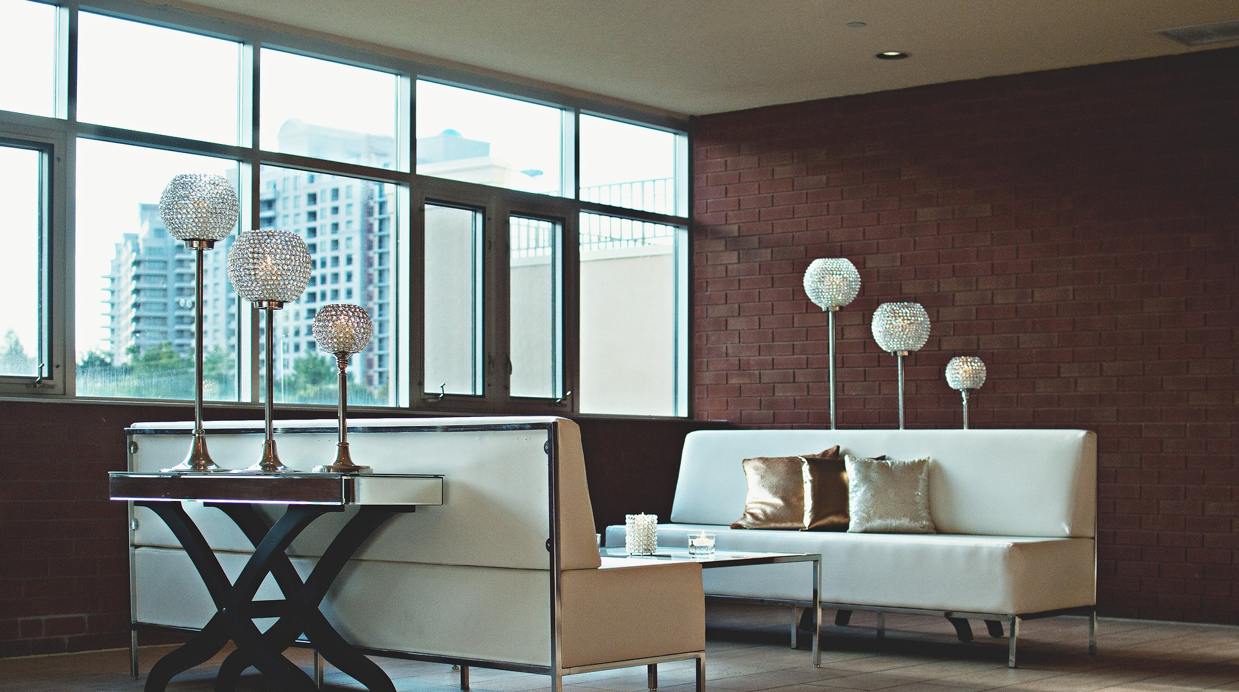
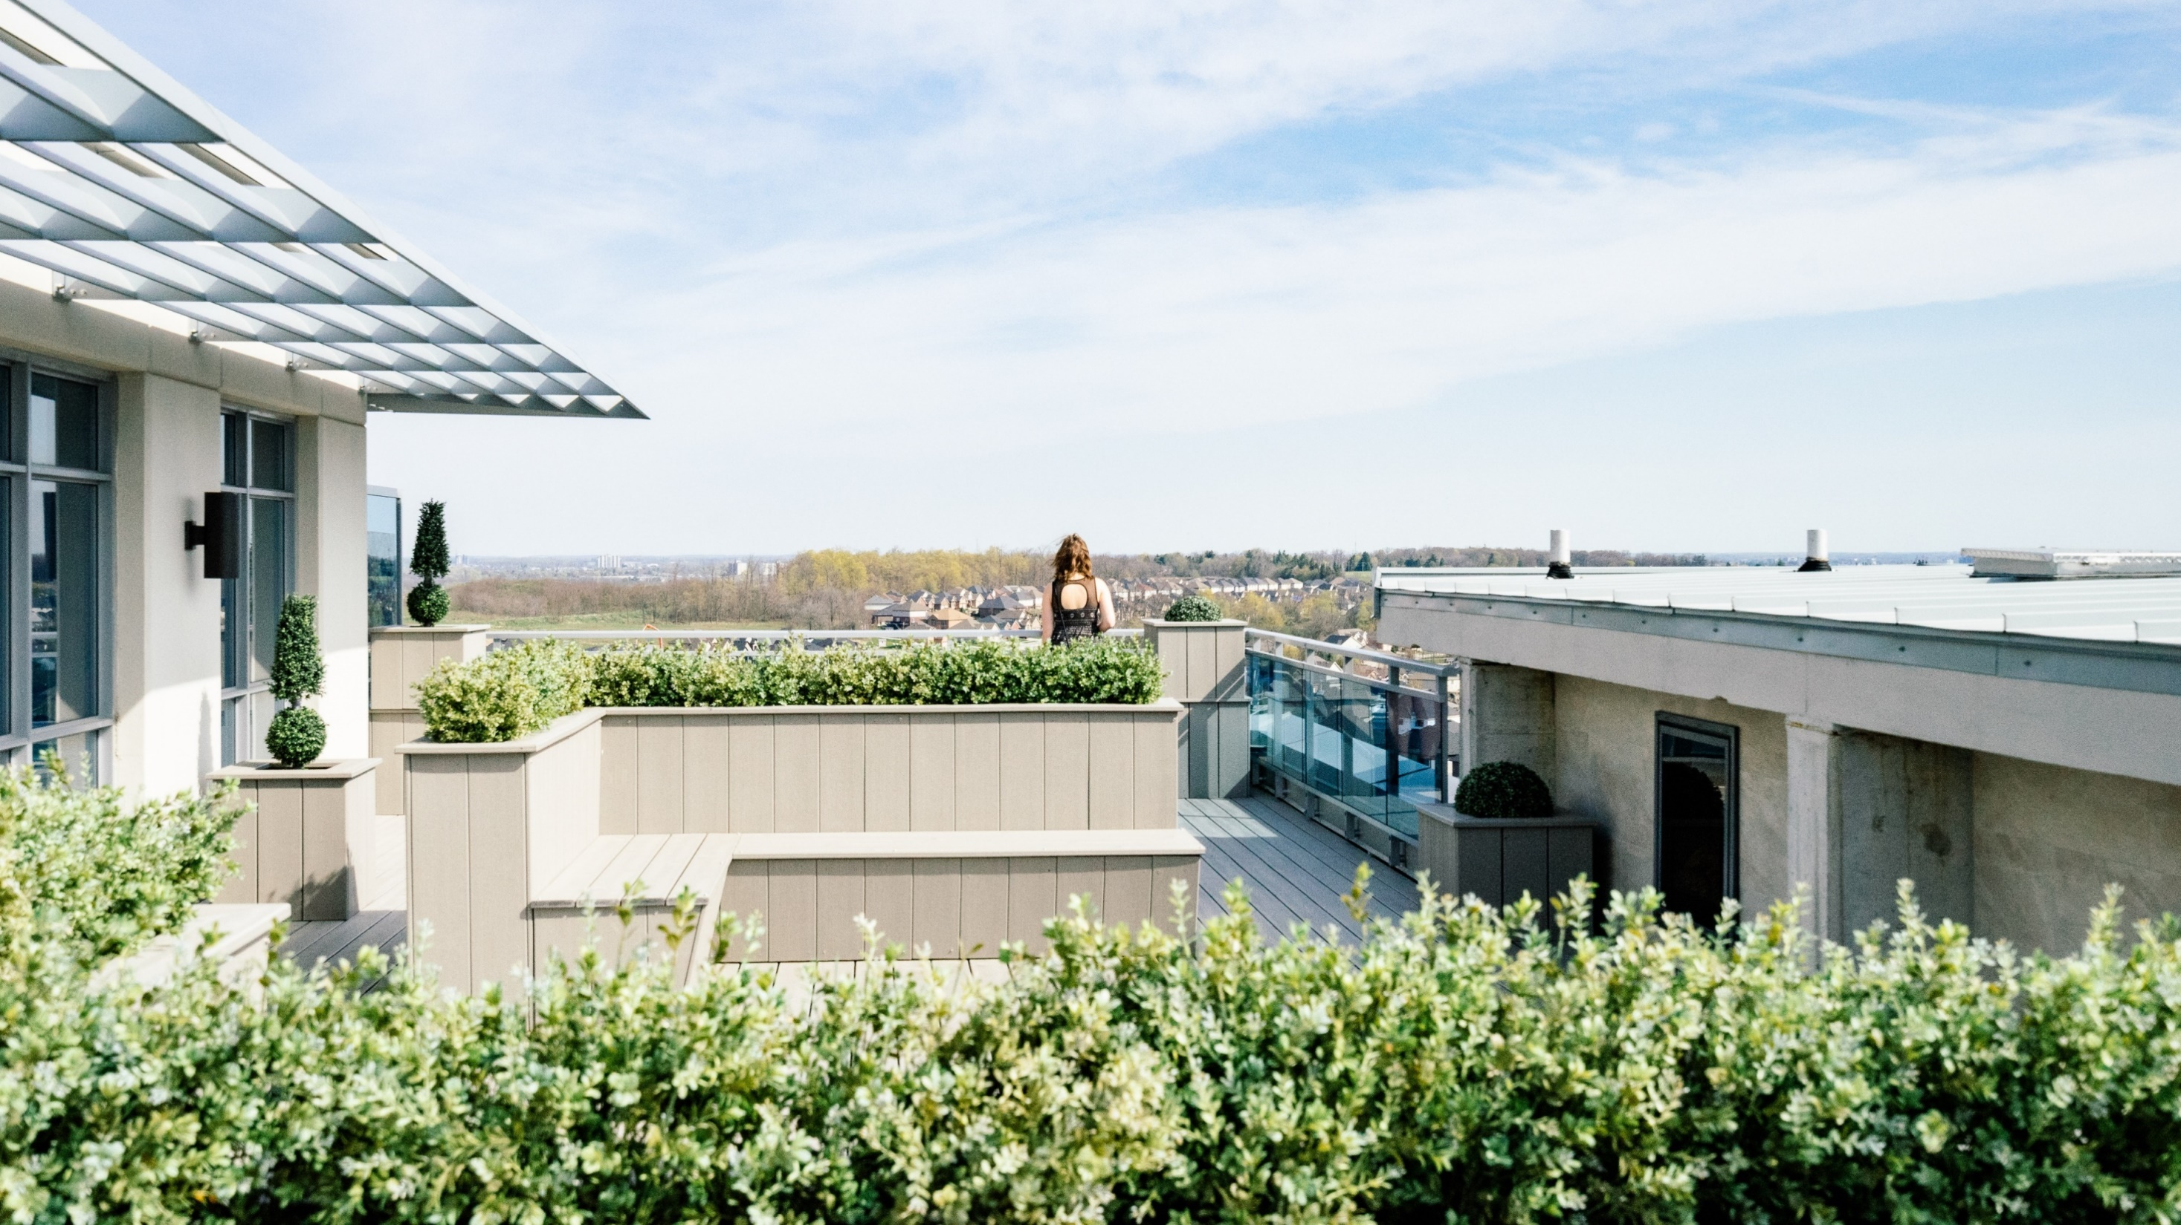
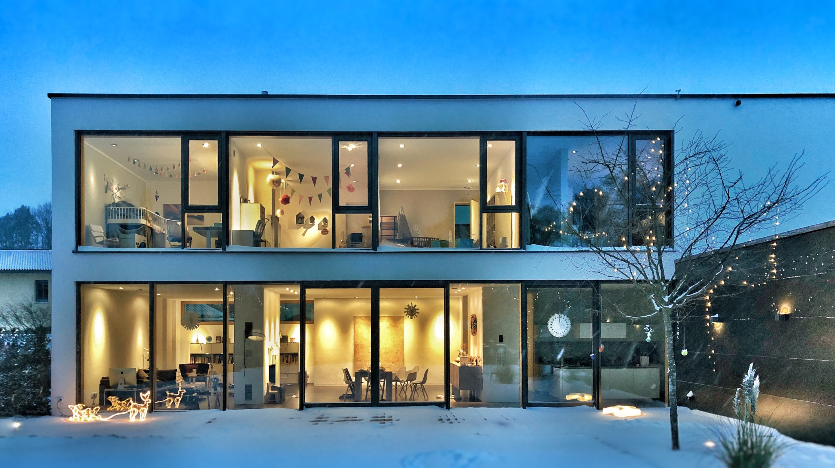
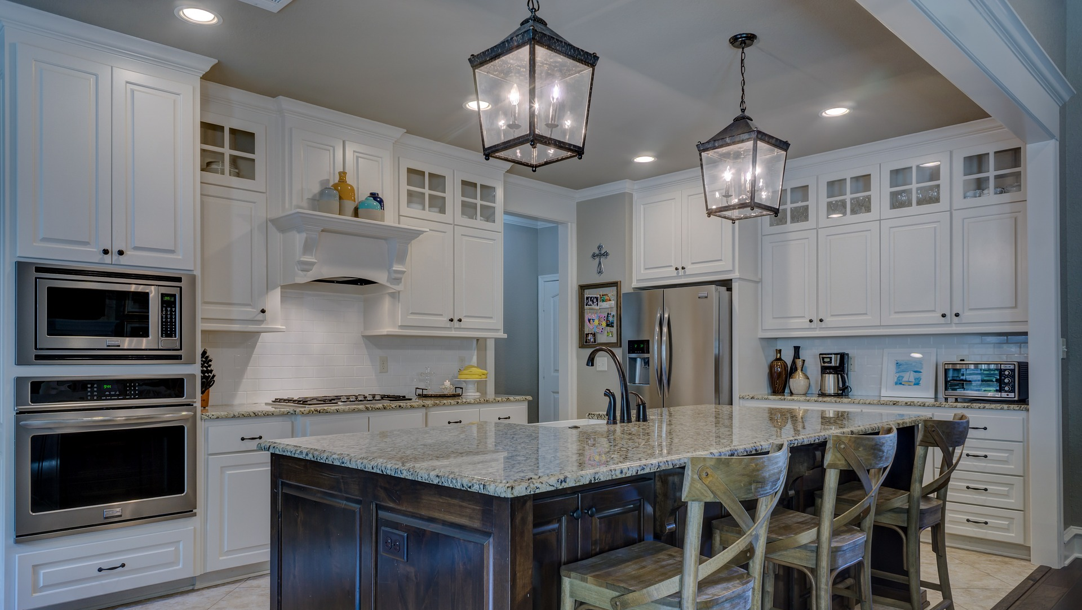
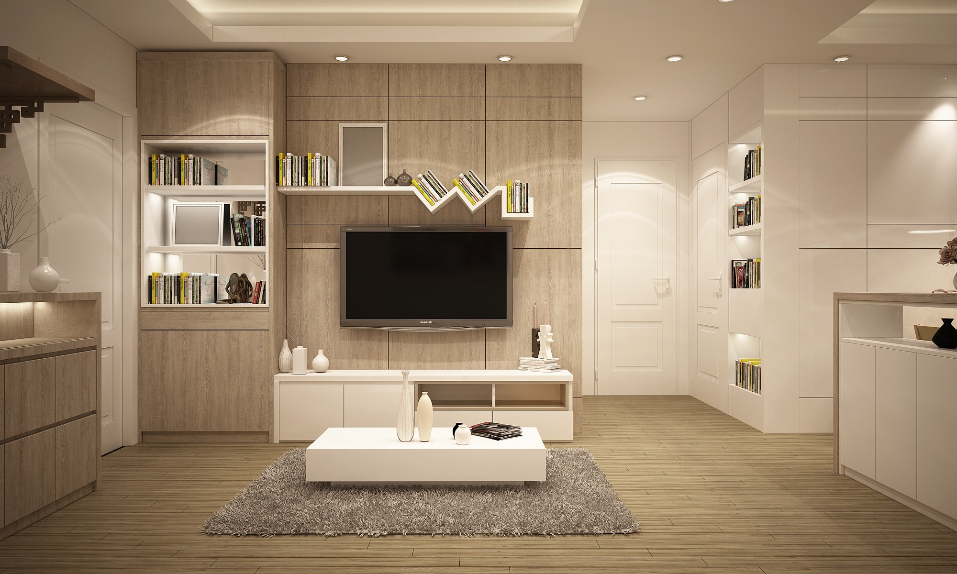
PROPERTY FOR SALES
3 BEDROOM PENTHOUSE
FITZROVIA APARTMENTS
BOLSOVER STREET W1W
LEASEHOLD 121 YEARS
ENTRANCE HALL
OPEN PLAN RECEPTION
DINING ROOM/KITCHEN
HUGE ROOF TERRACE
3 BEDROOMS
3 ENSUIT BATHROOMS
3RD BATHROOM
GUEST WC
UTILITY ROOM
INDEPENDENT HEATING
$5,950,000
CONTACT US
TEL: 1-800-123-4567
MAIL: info@universalhome.com
WWW.UNIVERSALHOME.COM

Slide 3
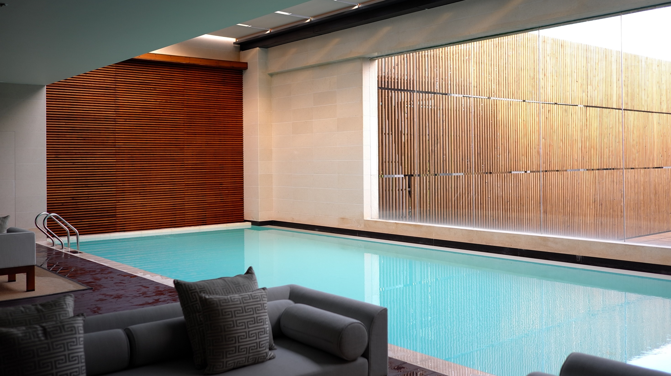
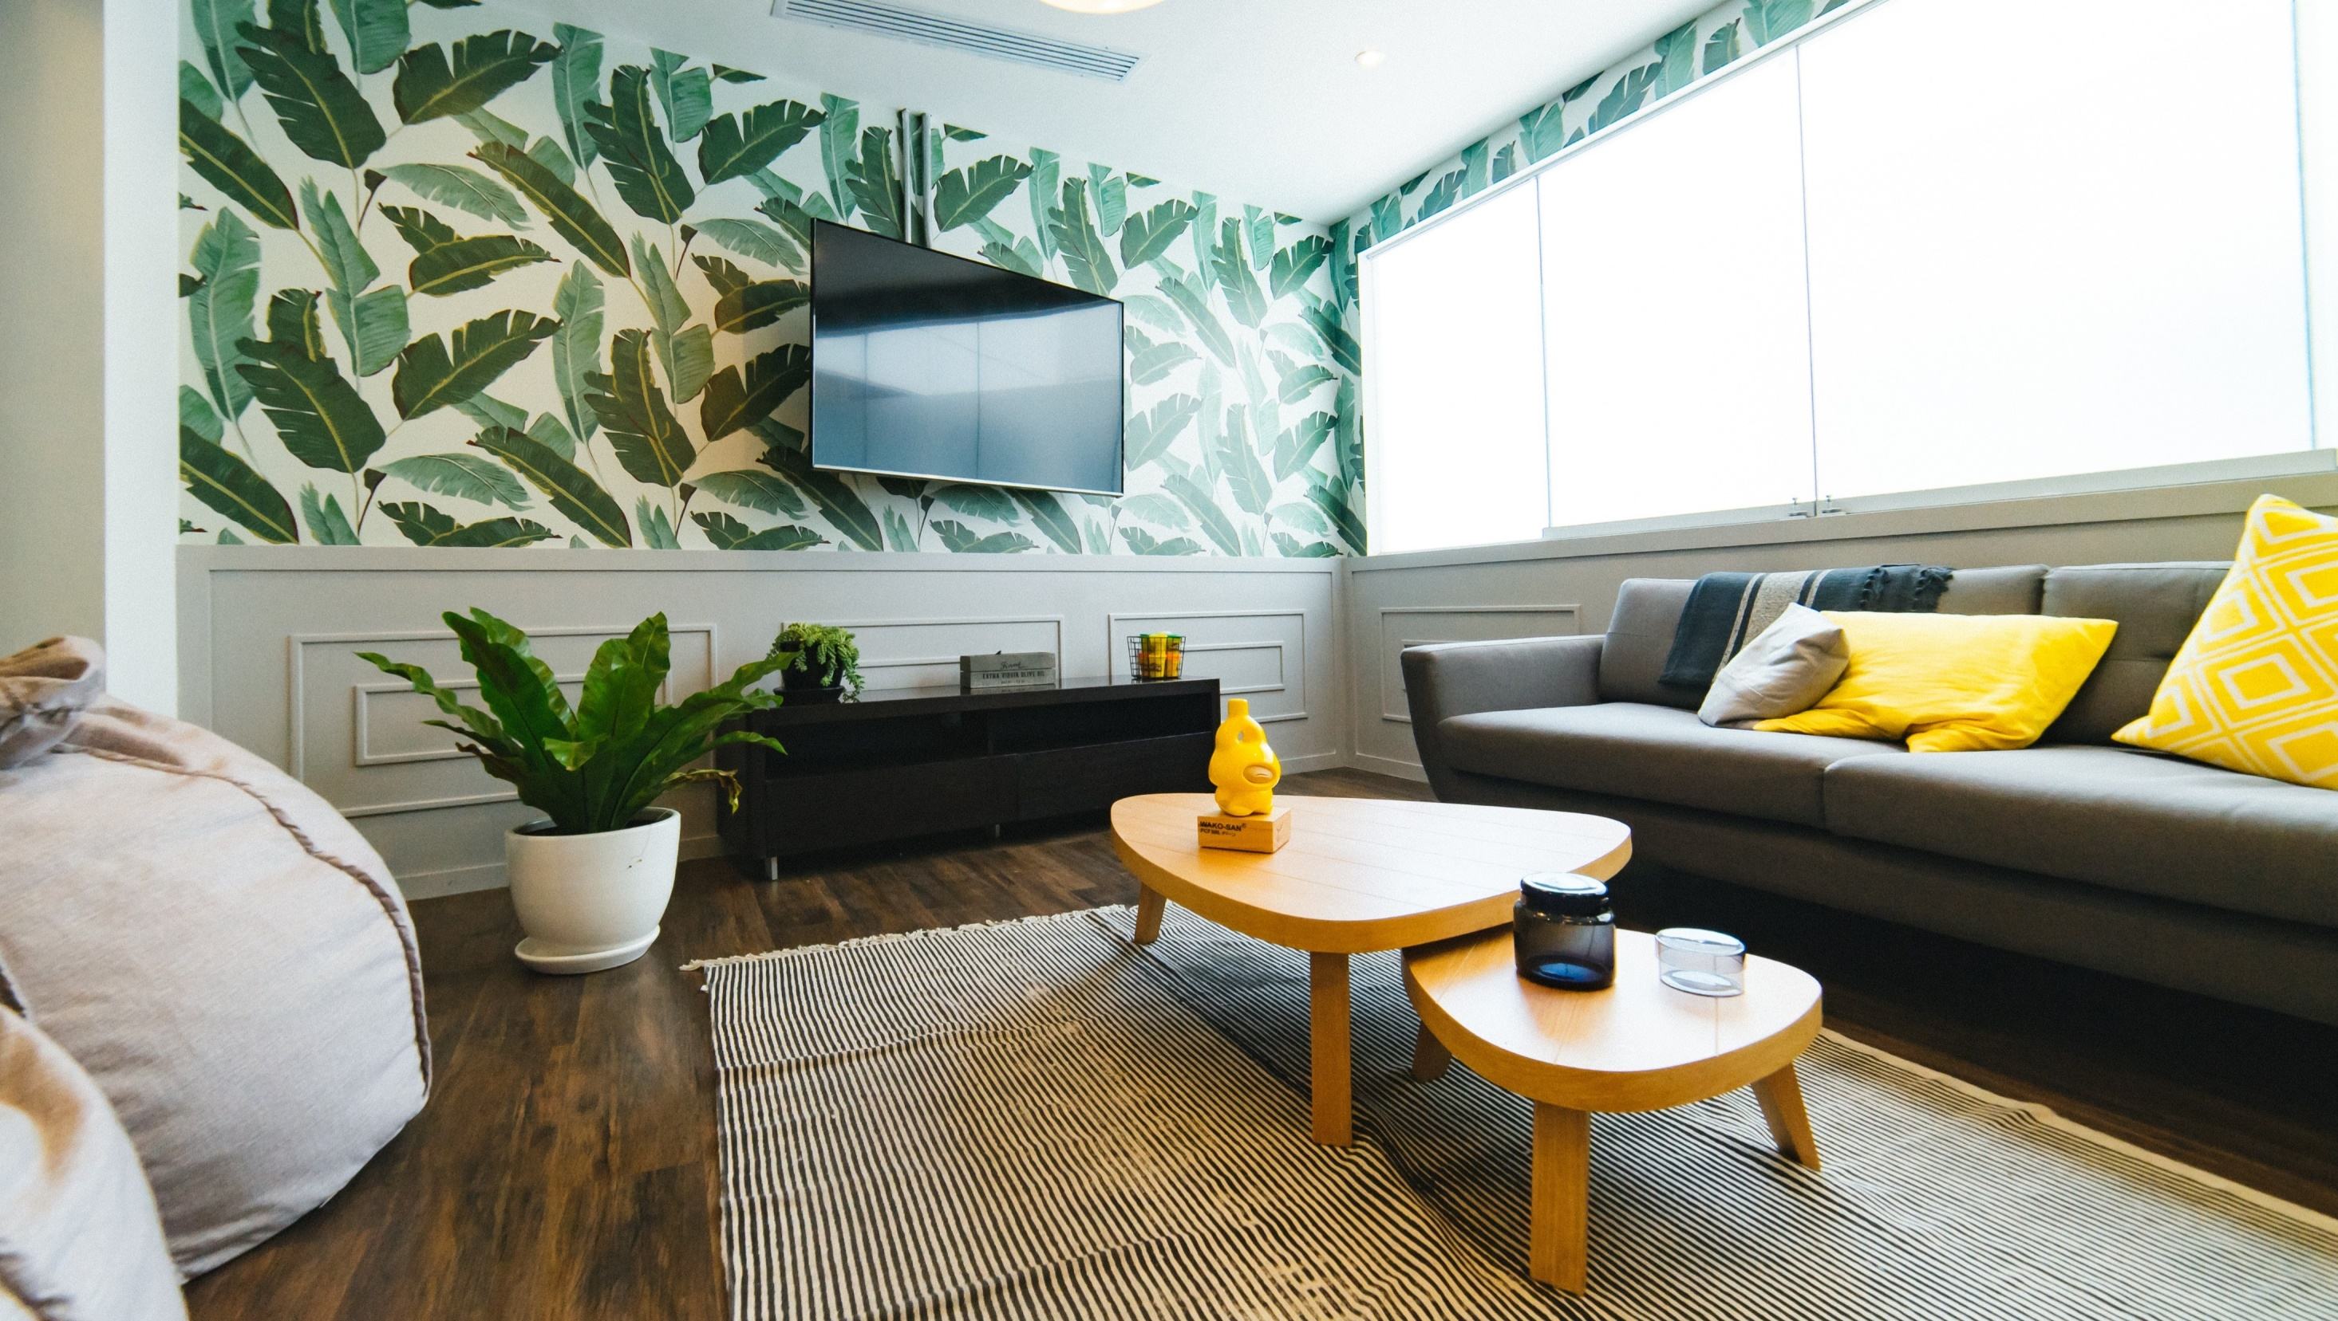
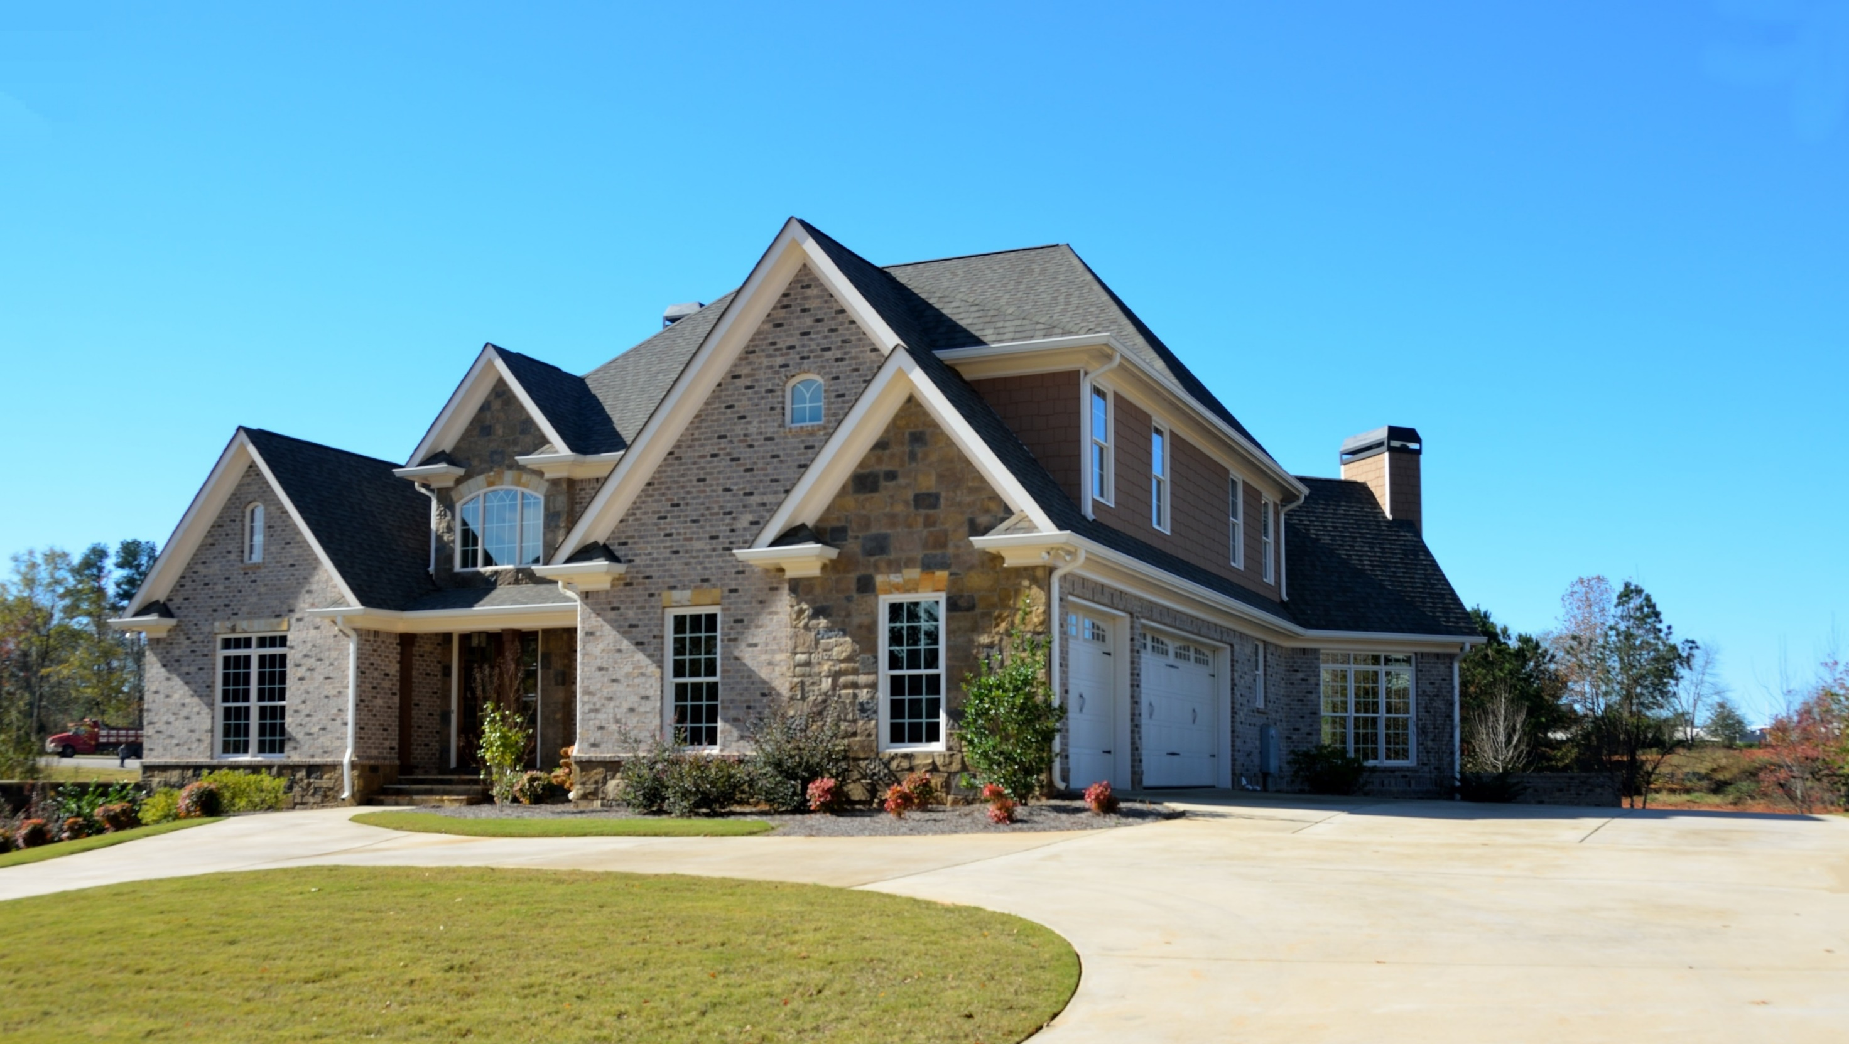
PROPERTY FOR LET
2 BEDROOM PROPERTY
FITZROY PLACE,
FITZROVIA W1Q
LEASEHOLD 121 YEARS
ENTRANCE HALL
OPEN PLAN RECEPTION
DINING ROOM/KITCHEN
HUGE ROOF TERRACE
3 BEDROOMS
2 ENSUIT BATHROOMS
3RD BATHROOM
GUEST WC
UTILITY ROOM
INDEPENDENT HEATING
$2,000 month
CONTACT US
TEL: 1-800-123-4567
MAIL: info@universalhome.com
WWW.UNIVERSALHOME.COM

Slide 4
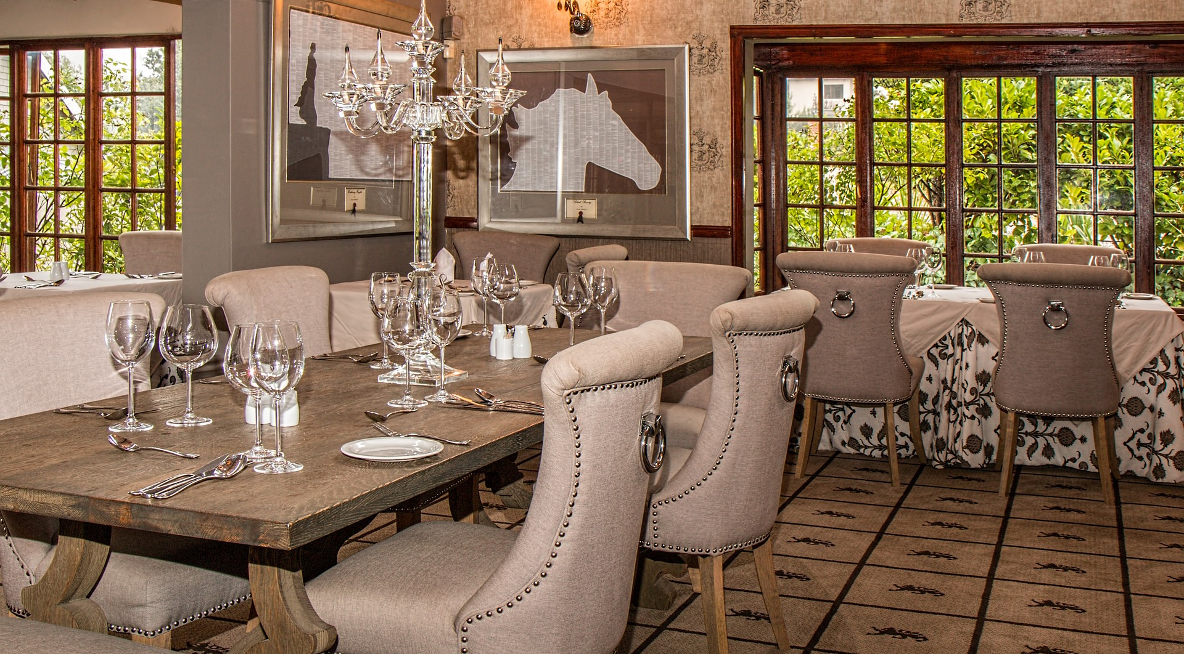
UNDER OFFER
2 BEDROOM PENTHOUSE
FITZROVIA APARTMENTS
BOLSOVER STREET W1W
LEASEHOLD 121 YEARS
ENTRANCE HALL
OPEN PLAN RECEPTION
DINING ROOM/KITCHEN
HUGE ROOF TERRACE
3 BEDROOMS
2 ENSUIT BATHROOMS
3RD BATHROOM
GUEST WC
UTILITY ROOM
INDEPENDENT HEATING
$4,950,000
CONTACT US
TEL: 1-800-123-4567
MAIL: info@universalhome.com
WWW.UNIVERSALHOME.COM

Slide 5
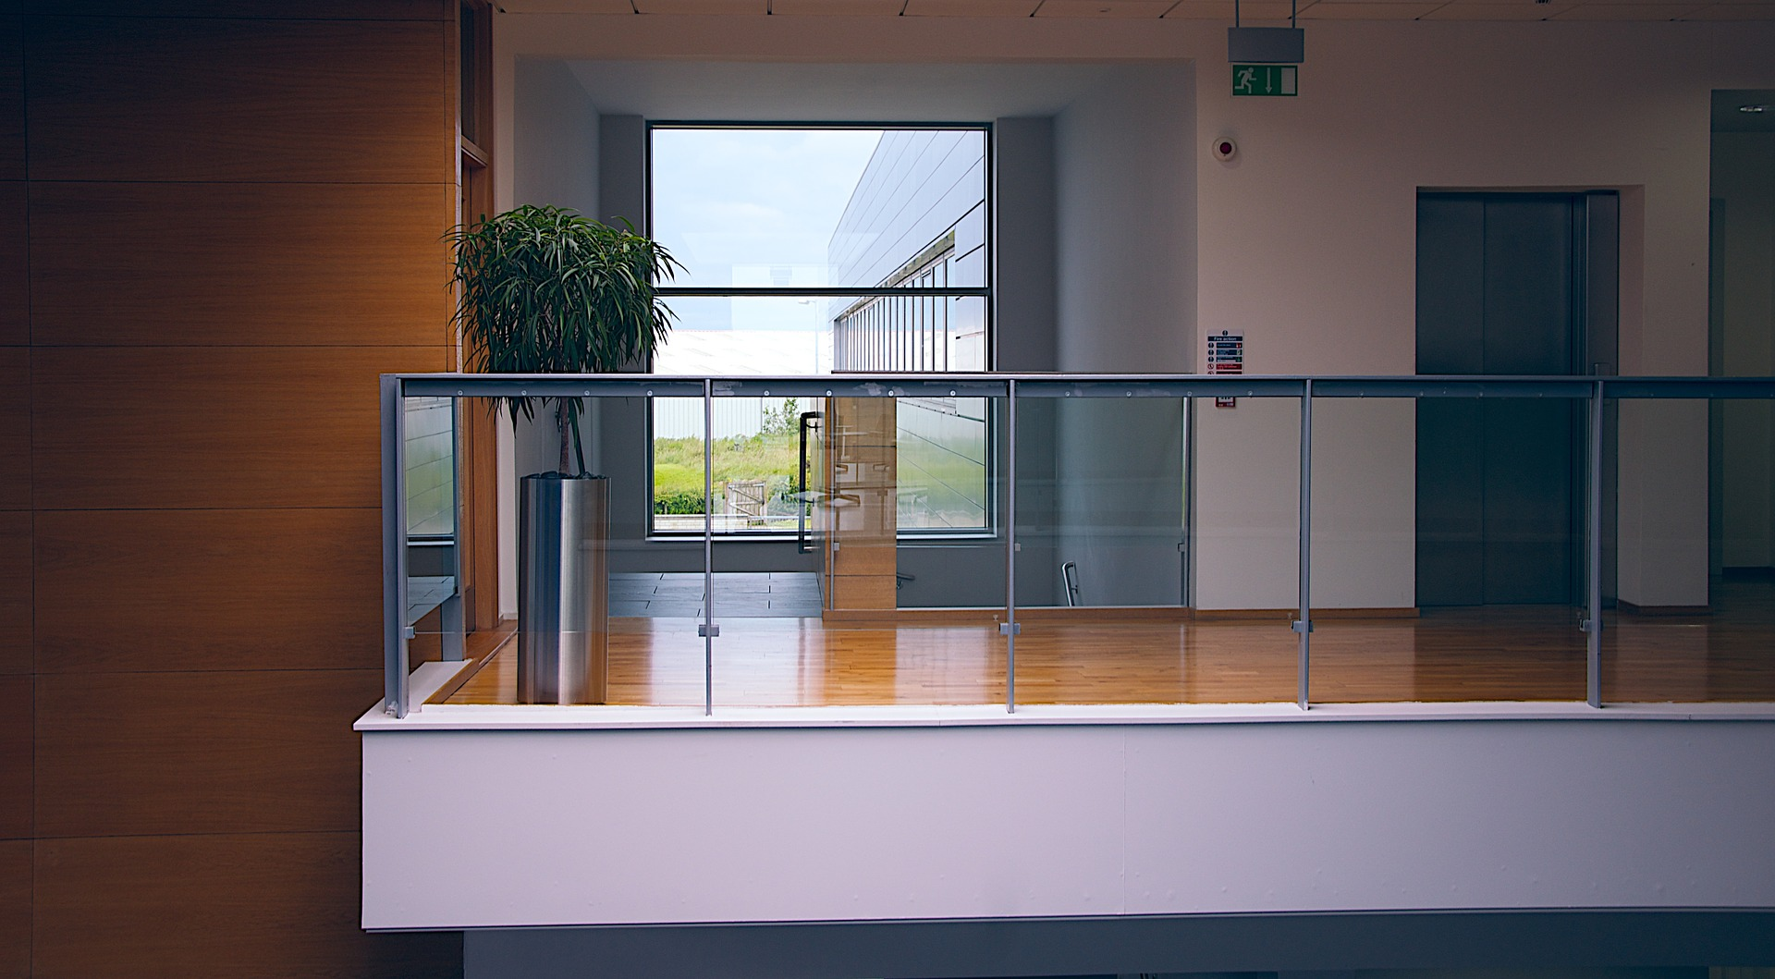
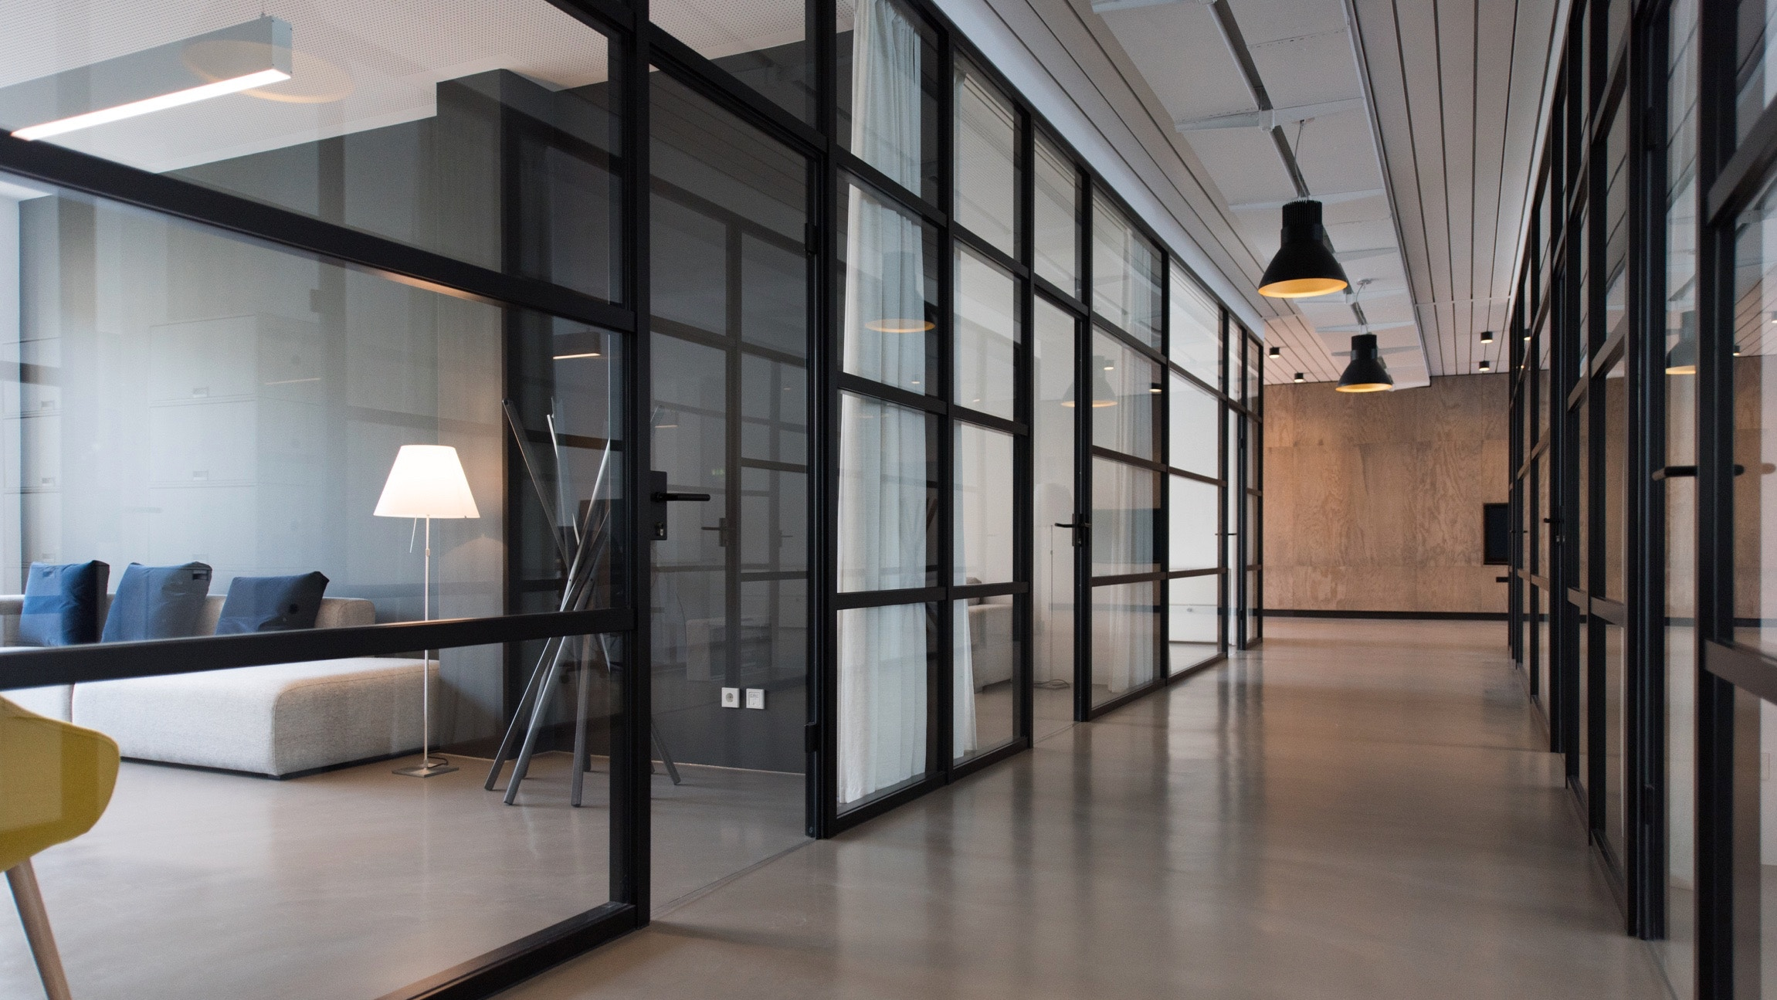
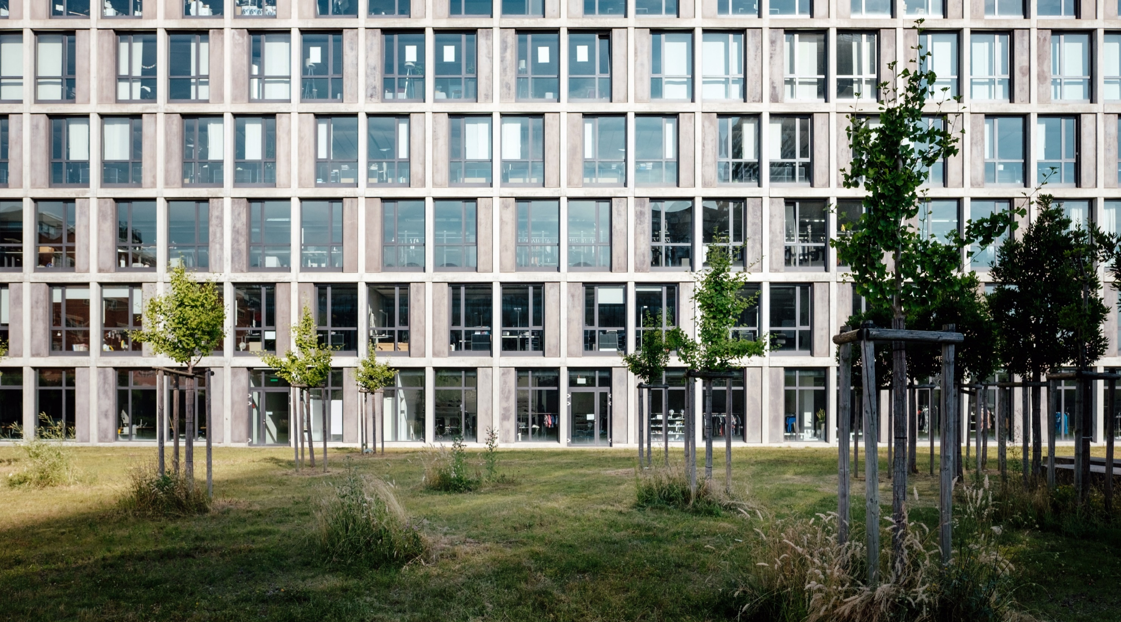
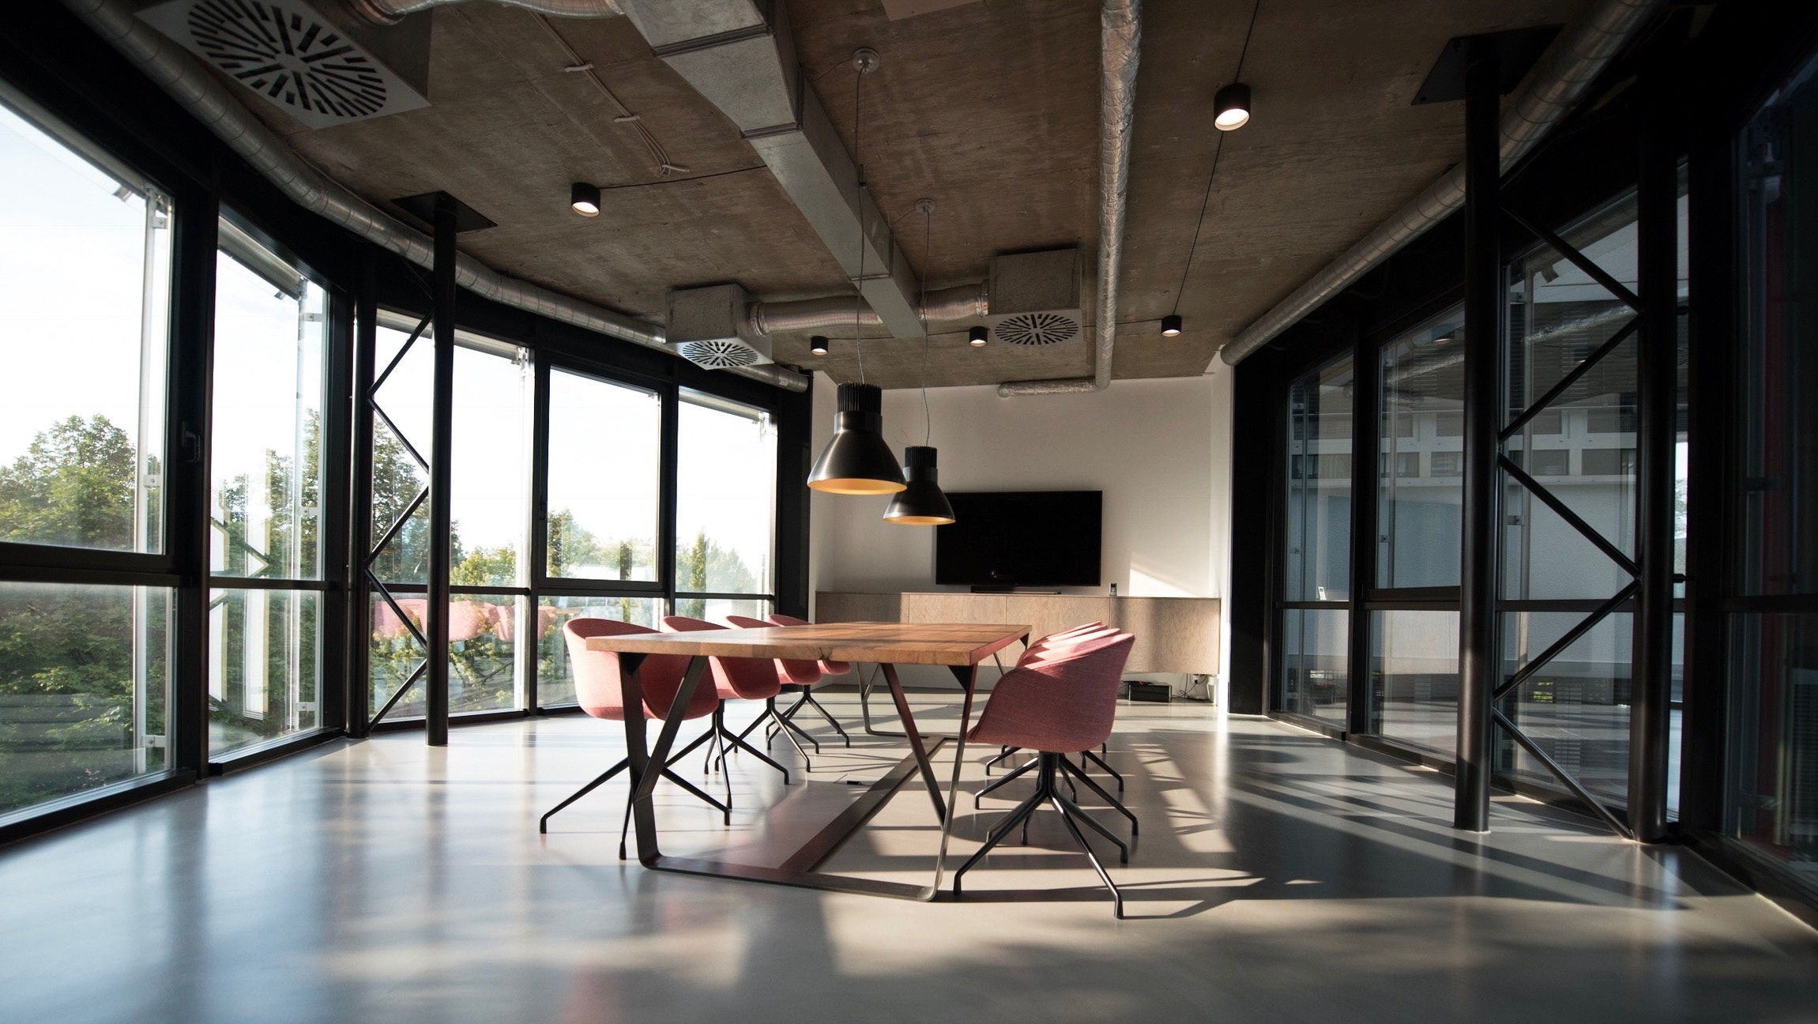
COMMERCIAL SPACE
4 BEDROOM PROPERTY
GREAT PORTLAND STREET,
LONDON W1W
LEASEHOLD 121 YEARS
ENTRANCE HALL
OPEN PLAN RECEPTION
DINING ROOM/KITCHEN
HUGE ROOF TERRACE
3 BEDROOMS
2 ENSUIT BATHROOMS
3RD BATHROOM
GUEST WC
UTILITY ROOM
INDEPENDENT HEATING
$3,250,000
CONTACT US
TEL: 1-800-123-4567
MAIL: info@universalhome.com
WWW.UNIVERSALHOME.COM

Slide 6
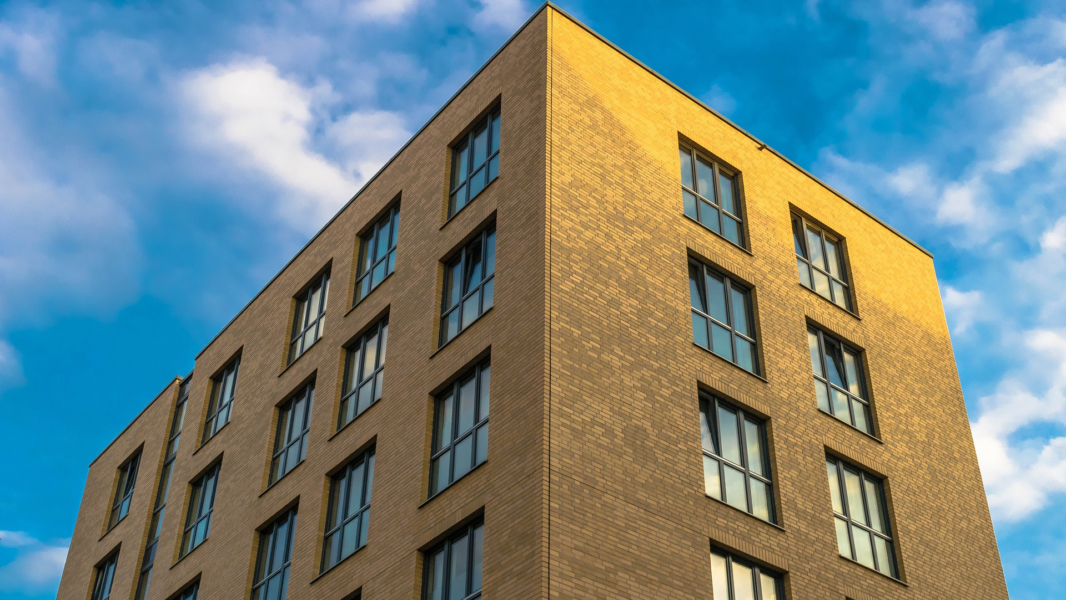
NEW DEVELOPMENT
2 BEDROOM PENTHOUSE
FITZROVIA APARTMENTS
BOLSOVER STREET W1W
LEASEHOLD 121 YEARS
ENTRANCE HALL
OPEN PLAN RECEPTION
DINING ROOM/KITCHEN
HUGE ROOF TERRACE
3 BEDROOMS
2 ENSUIT BATHROOMS
3RD BATHROOM
GUEST WC
UTILITY ROOM
INDEPENDENT HEATING
$1,950,000
CONTACT US
TEL: 1-800-123-4567
MAIL: info@universalhome.com
WWW.UNIVERSALHOME.COM

Slide 7
WE SUPPORT COMFORT LIVING
WWW.UNIVERSALHOME.COM
1-800-123-4567
info@ universalhome.com

