Slide 1
Delicious Food and Drinks
taste the difference
EAT FRESH

Slide 2
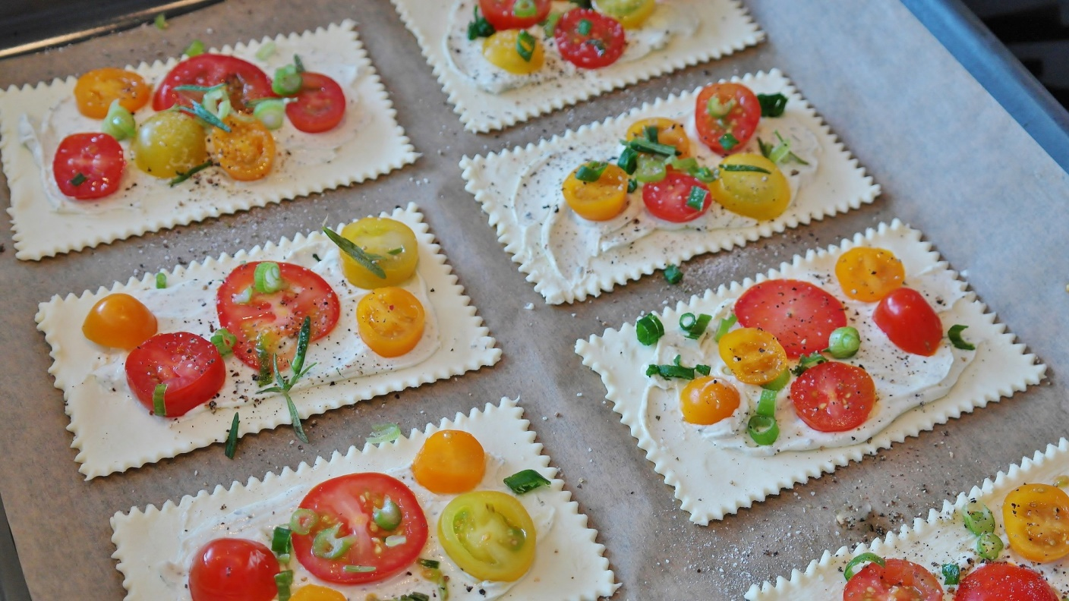
SNALL
PIECES
NEW RECIPE
STARTERS
SOUPS
LOBSTER RAVIOLI
€9.50
GASPACIO
€9.50
€9.50
PLATO DI SATATA
TUSCAN TRADIONAL SOUP
€6.50
GRILLED SALMON WITH LEMON
€14.50
ASPARGUS CREME
€9.50
€4.50
SMOKED MAKREL
HONEST STEW
€6.50
BOILED EGGS
€4.50
FISH DISH
€7.50
SALMON PASTA SALAD
€7.50
Tasteful Starters
Warm Up!

Slide 3
BEST IN TOWN
OFFER OF THE DAY
STONEBAKED
PIZZA
small €11.50
medium €14.50
large €17.50
LOBSTER RAVIOLI WITH SAUTEED ASPARGUS IN A LEMON TARRAGON BUTTER
Honesty Fresh

Slide 4
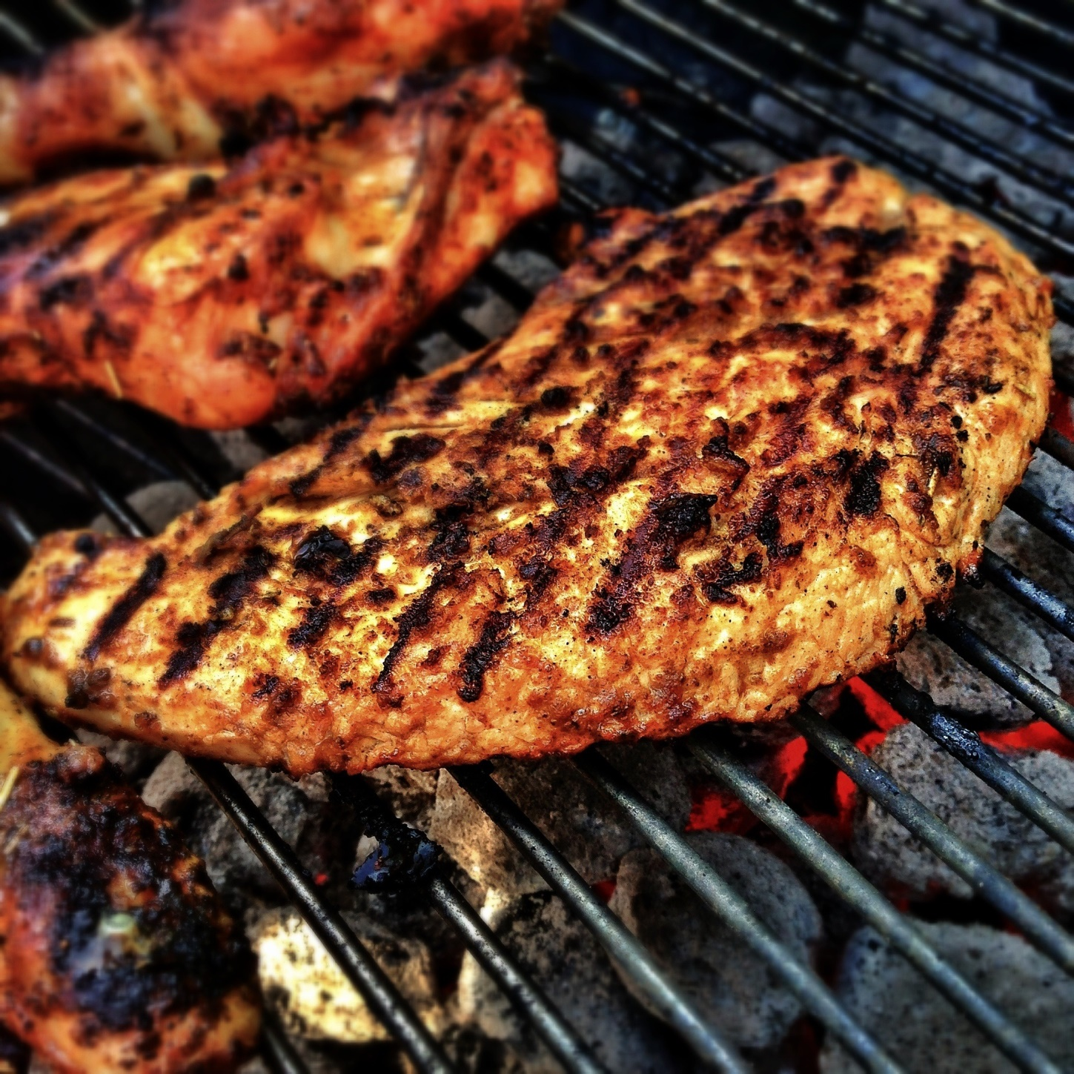
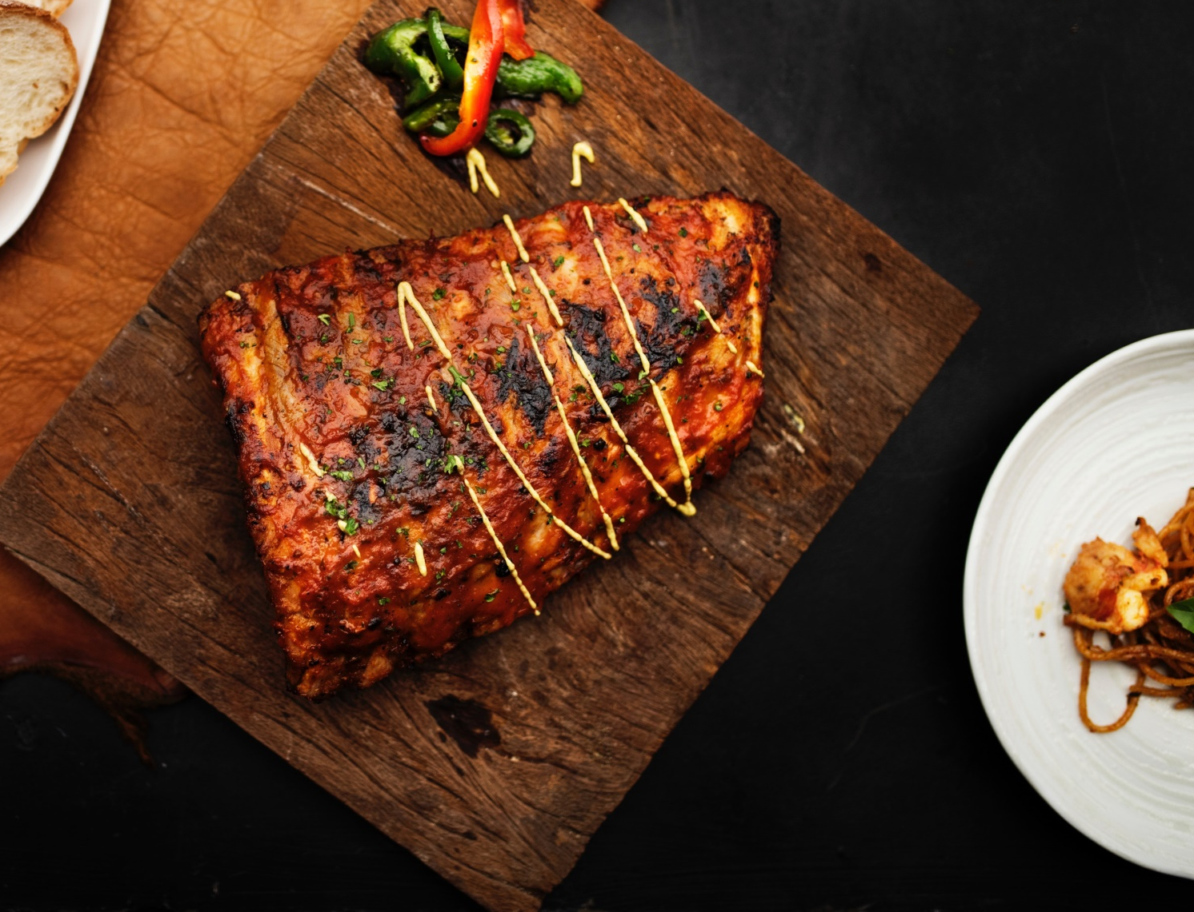
SNALL
PIECES
NEW RECIPE
BEEF DISHES
FISH DISHES
STEAK TARTARE
€11.50
SALMON TARTARE
€16.50
MEAT WITH ONIONS, SOY SAUCE, PEPPERS AND TOMATOES
FRESH SALMON, WITH OLIVE OIL, MUSTARDS, SALT & PEPPER
GRILLED RUMP STEAK
€12.50
GRILLED MACKEREL FILLETS
€18.50
GRILLED SLICED BEEF WITH ONIONS AND GARLIC
MACKEREL, SOY SAUCE, SALT AND RADDISH
SLOW COOKED BRISKET
€14.50
FISH PLATER
€14.50
COOKED BRISKET MEAT FROM BEEF OR VEAL
MACKEREL FILLETS, FRIED SALMON, WITH MUSTARD AND CUCUMBER SALAD
Free Range Beef
Catch of the Day

Slide 5
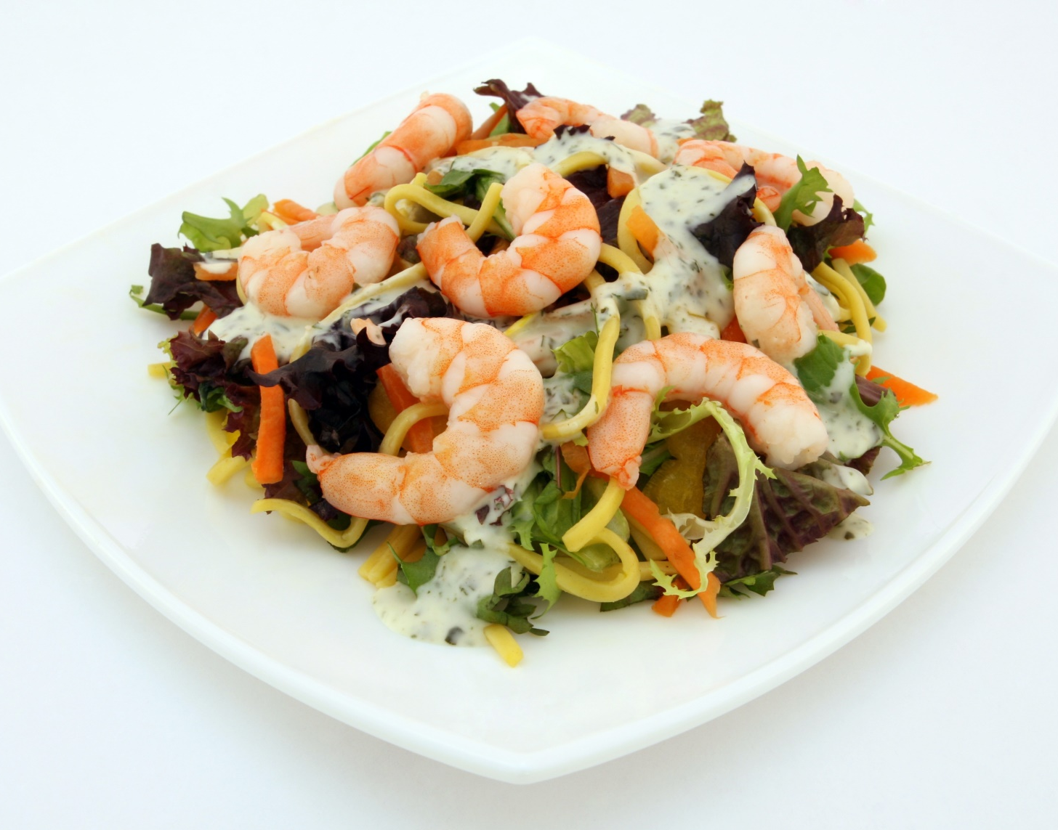
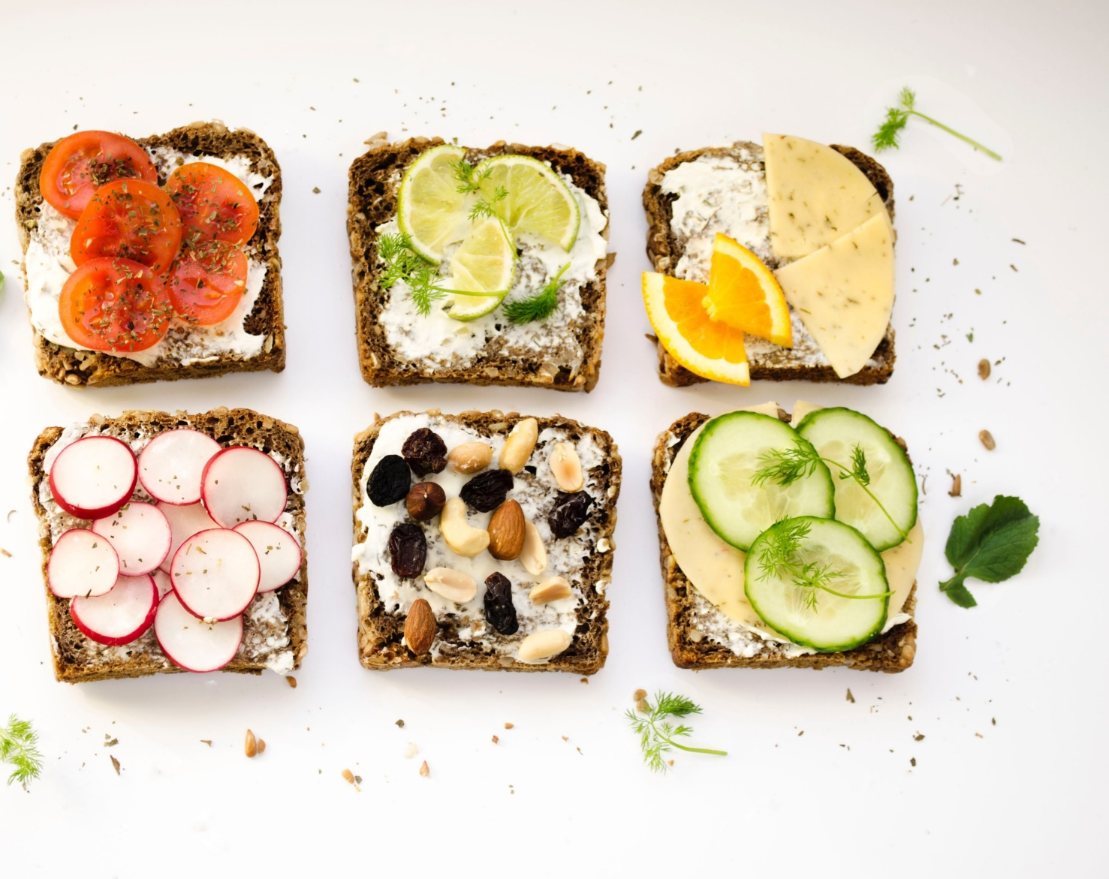
SOME ITALIAN
ON THE GO
FRESH PASTA
HOME BAKED
PASTA SALAD
SANDWICH
SHRIMP, WITH MAYONAISE, GARLIC DIP AND PASTA MIXED LETTUCE AND CARROTS
DIFFERENT SANDWICH STYLE WITH DIFFERENT KINDS OF VEGETABLE MIXED WITH SPECIAL CREAMY SAICE
€11.50
€9.50

Slide 6
ENJOY YOUR CATERING
SPECIAL EVENT
BEST AWARD
WEDDING | BIRTHDAY PARTY
KARAOKE | QUIZ NIGHT
MUSIC EVENTS | CATERING
1-800-123-4567
www.roastsfoodsrestaurant.com
Honesty Fresh

Slide 7
SNALL
PIECES
NEW RECIPE
HOT DRINKS
OUR BREWERY
RISTRETTO
€2.20
PALE ALE
€3.50
€2.00
EXPRESSO
DARK ALE
€3.50
DOUBLE EXPRESSO
€3.20
CZECH LAGER
€4.50
€2.50
CAFFE LATTE
MEXICAN BEER
€6.50
CAPPUCINO
€2.50
FRENCH CIDER
€7.50
HOT WATER
€1.50
WEATH BEER
€7.50
Quality Beans
Carefully Selected

Slide 8
Shrimp Flavored Spaghetti
Enjoy the taste of our new special menu with fresh shrimps, flavored with butter and pasta
NEW RECIPE
€11.50
Vegetable Salad
Enjoy the taste of different flavored salad to satisfy your cravings.
NEW RECIPE
€11.50

Slide 9
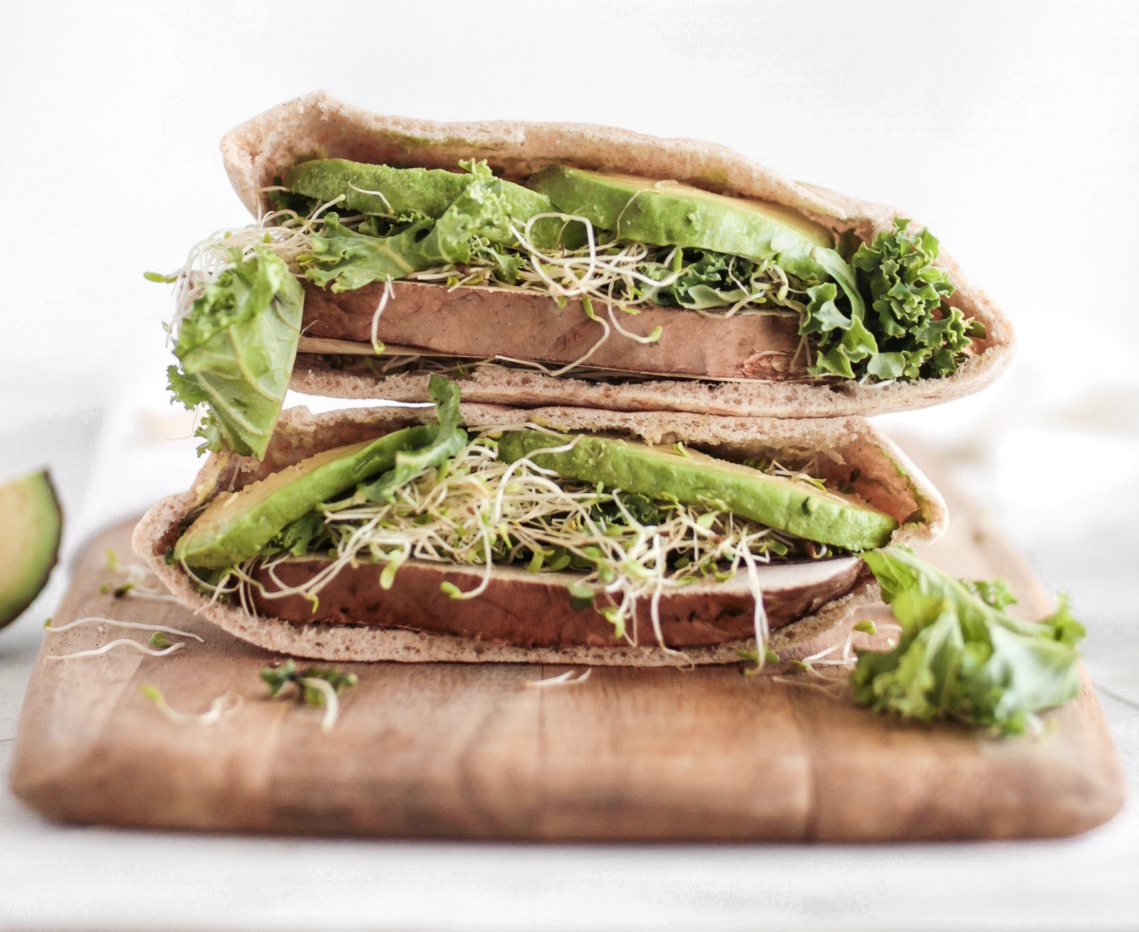
Vegi Burger
small €11.50
medium €14.50
large €17.50
Burger Bun filled with fresh vegetable salads, hot sauce and meat with garlic sauce.
€11.50
Honesty Fresh
NEW

Slide 10
Delicious Food and Drinks
taste the difference
EAT FRESH
info@roastsfoodsrestaurant.com
1-800-123-4567
www..roastsfoodsrestaurant.com

