Slide 1
SWEETS SWEETS SWEETS
coffee / breakfast / lunch / snacks / dinner

Slide 2
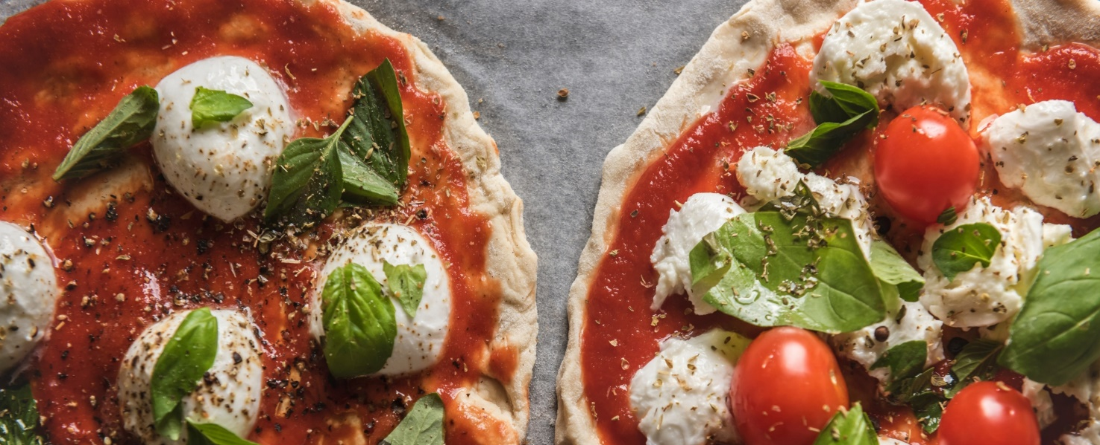
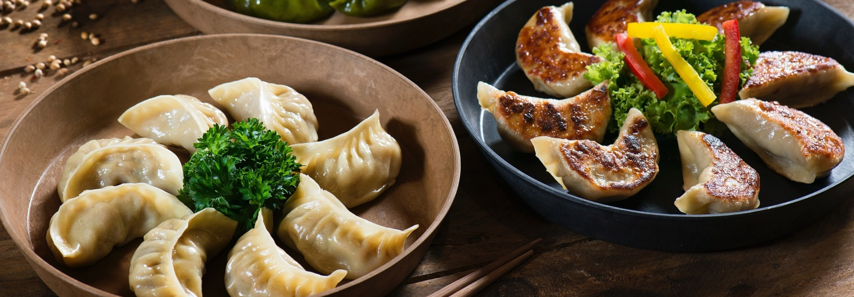
MAIN TITLE NAME HERE
STRAWBERRY CAKE
$ 4
STRAWBERRY DONUT
$ 4
BLUE BERRY CAKE
$ 4
PINK DONUT
$ 4
BANANA CAKE
$ 5
BLUE BERRY HOT CAKE
$ 5
HAWAIIAN PIZZA
$ 5
TOMATO PIZZA
$ 6
TURTLE BREAD
$ 8
SHARK’S FIN
$ 8
Address: A-32 PINK SWEETS RESTO USA
Email: INFO@PINKSWEETSRESTO.COM
Contact No: 1-800-123-4567

Slide 3
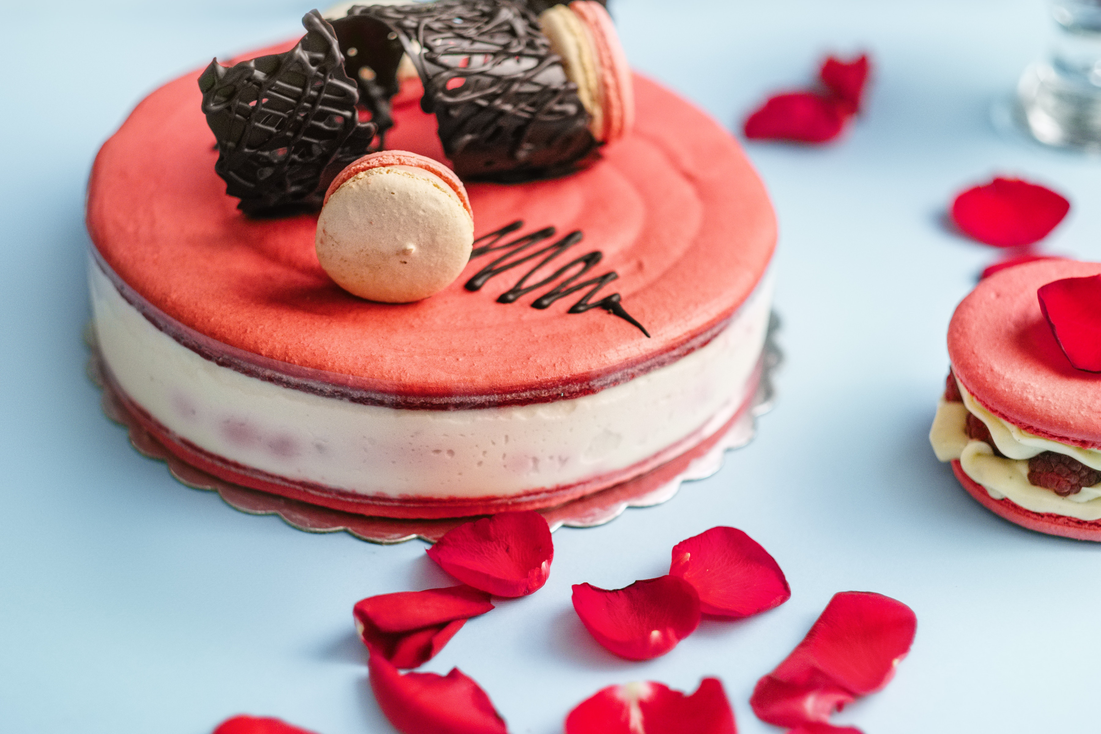
STRAWBERRY CAKE
STRAWBERRY DONUT
$ 6
$ 6
BLUE BERRY CAKE
PINK DONUT
$ 7
$ 7
Address: A-32 PINK SWEETS RESTO USA
Email: INFO@PINKSWEETSRESTO.COM
Contact No: 1-800-123-4567

Slide 4
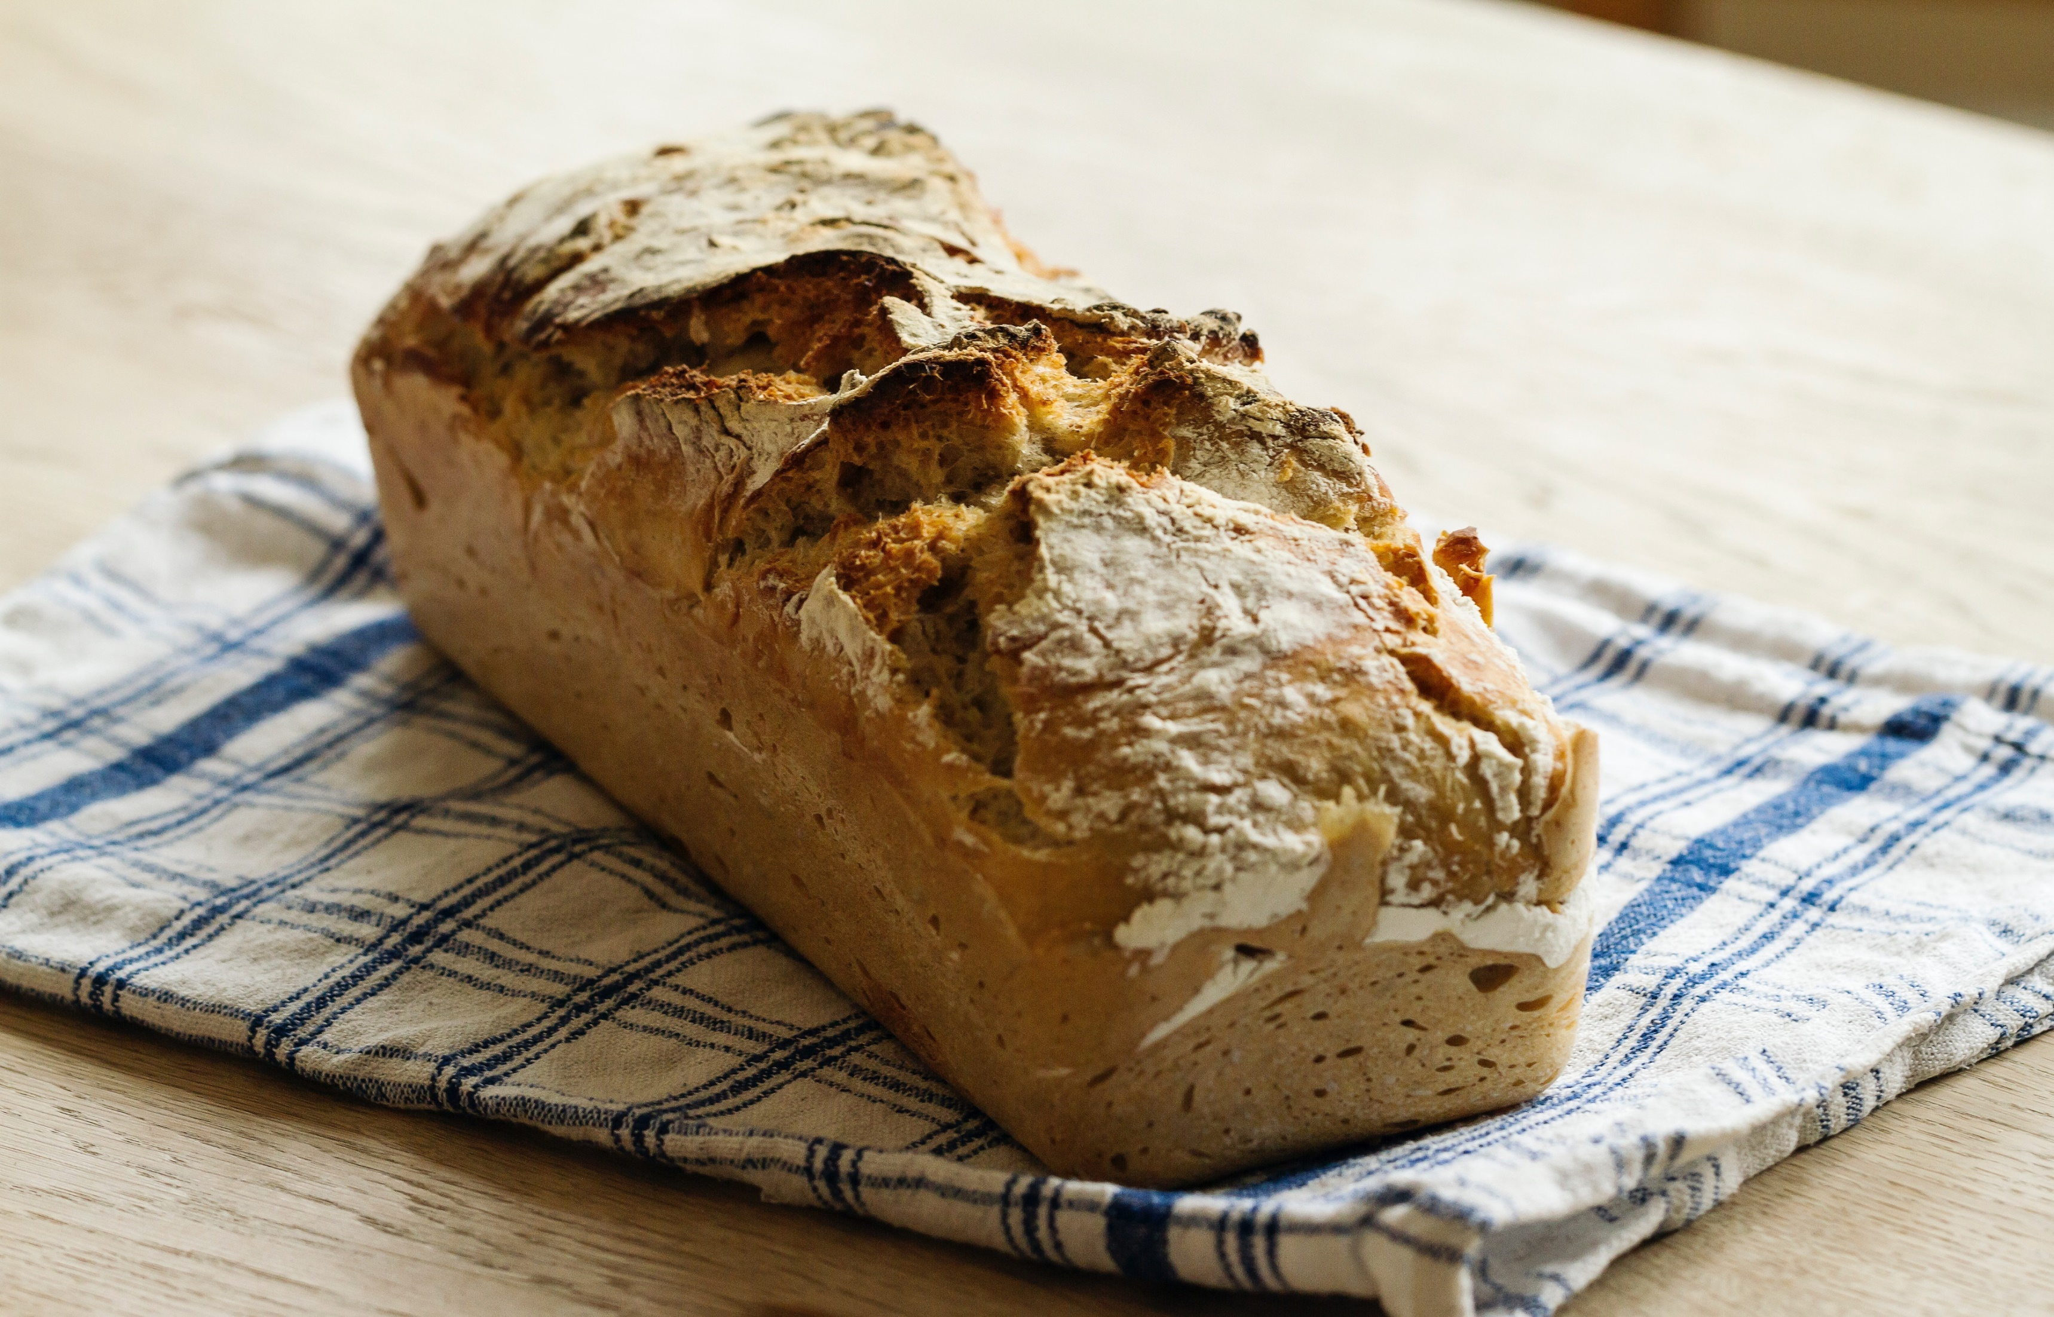
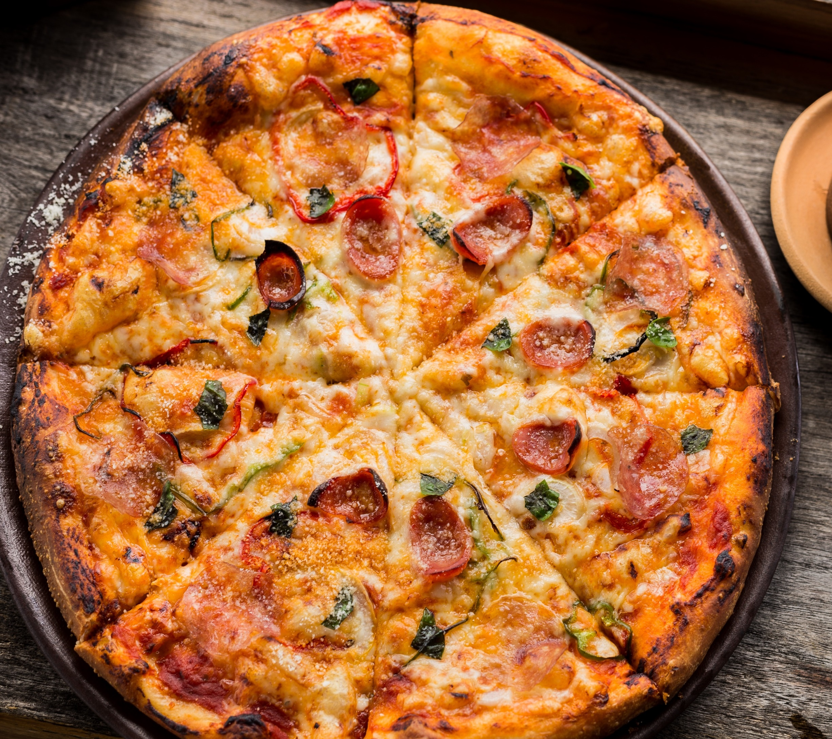
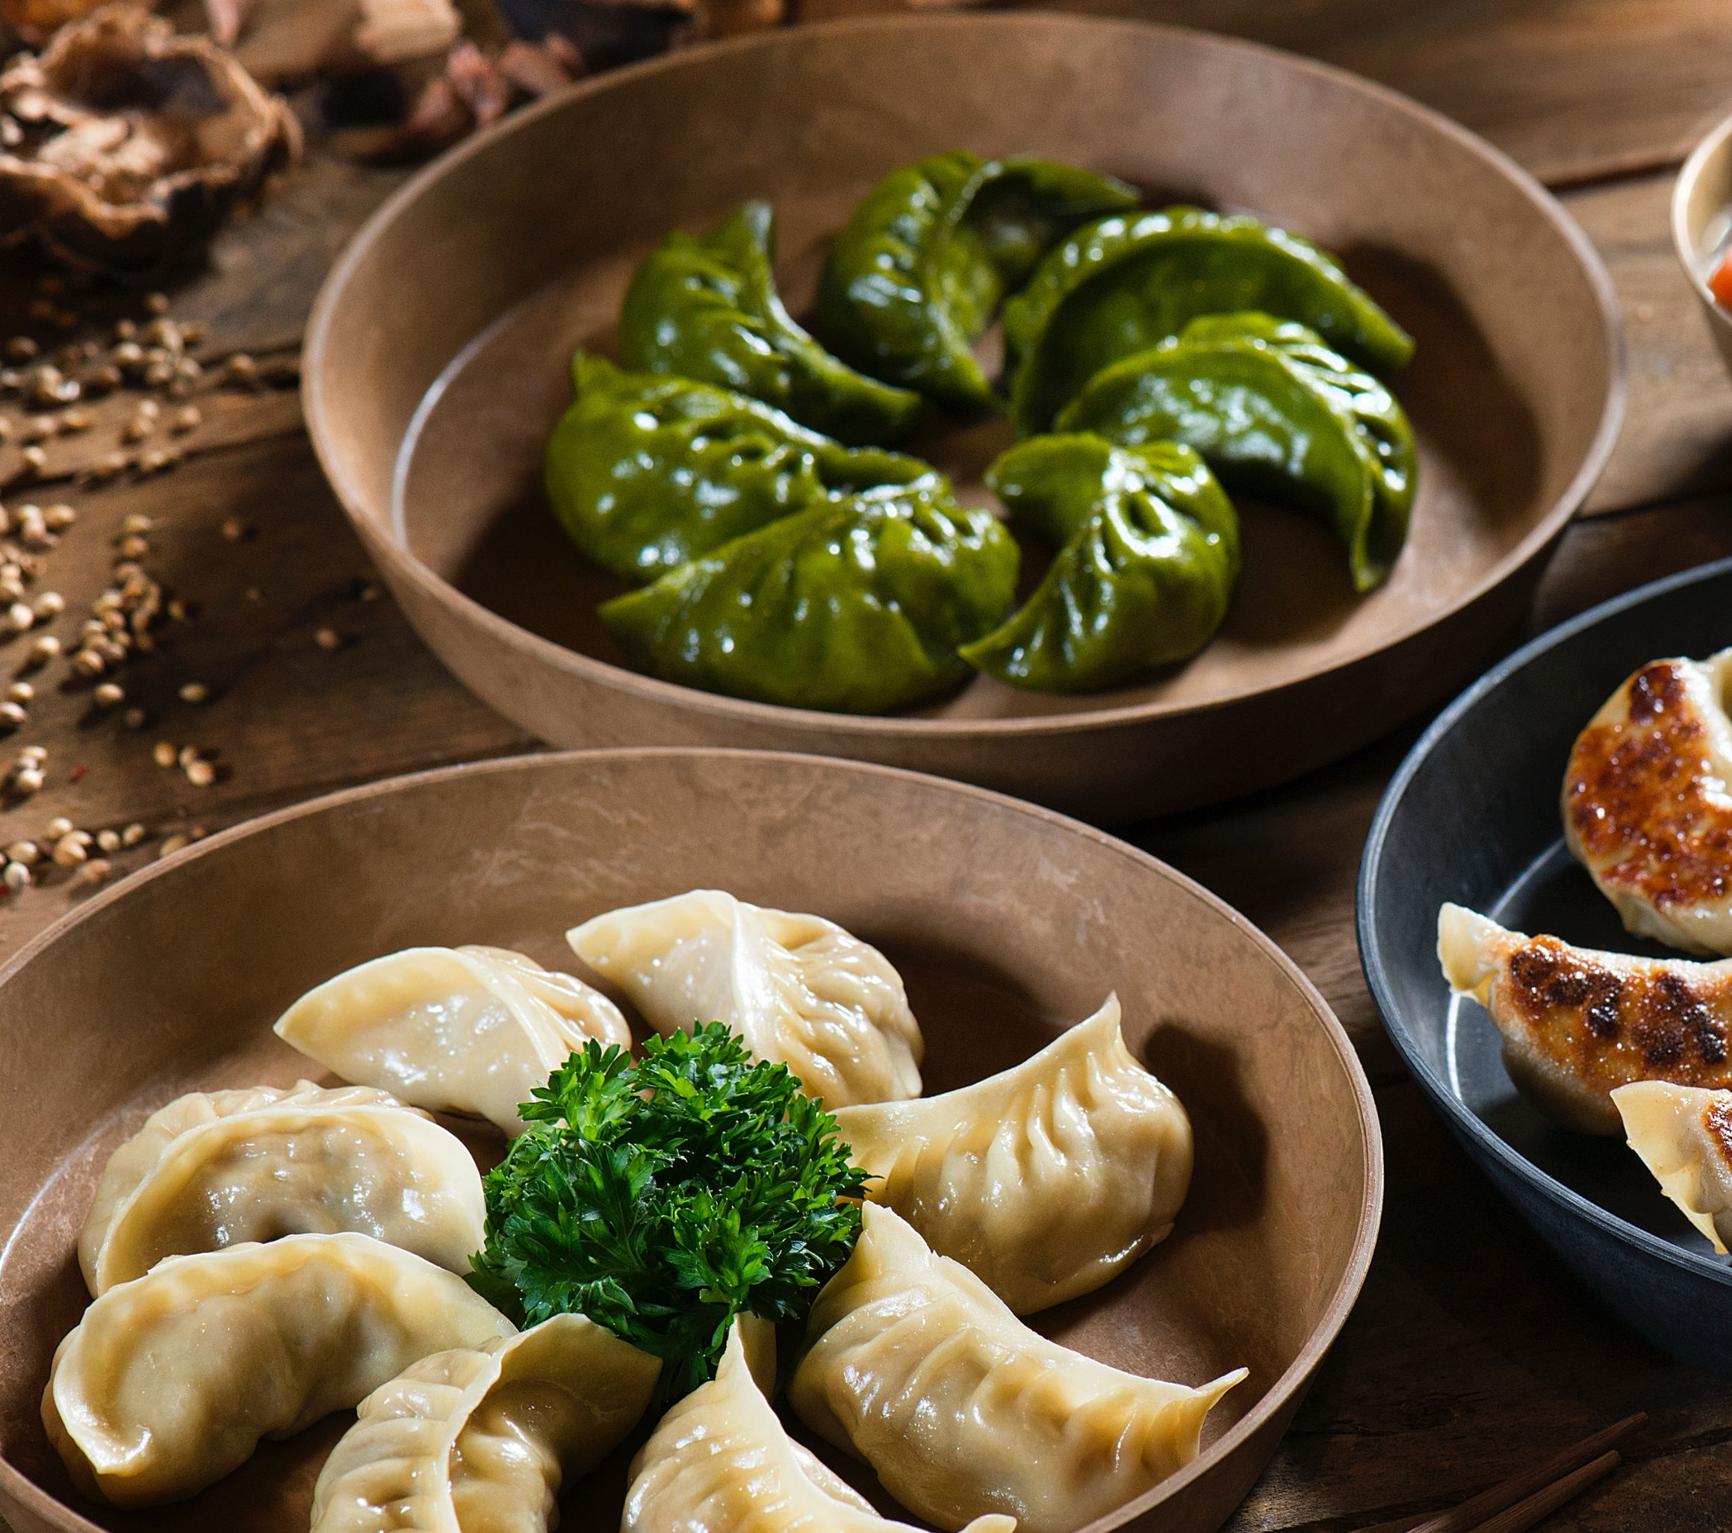
BANANA CAKE
HAWAIIAN PIZZA
$ 3
$ 6
SHARKS FIN
PINK STRAWBERRY DONUT
$ 6
$ 8
Address: A-32 PINK SWEETS RESTO USA
Email: INFO@PINKSWEETSRESTO.COM
Contact No: 1-800-123-4567

Slide 5
$ 08
TOMATO PIZZA
$ 10
BLUE BERRY HOT CAKE
Address: A-32 PINK SWEETS RESTO USA
Email: INFO@PINKSWEETSRESTO.COM
Contact No: 1-800-123-4567

Slide 6
feedback
info@pinksweetsresto.com
The best food in Town

