Slide 1
Sweetie Dearie
coffee / breakfast / lunch / snacks / dinner

Slide 2
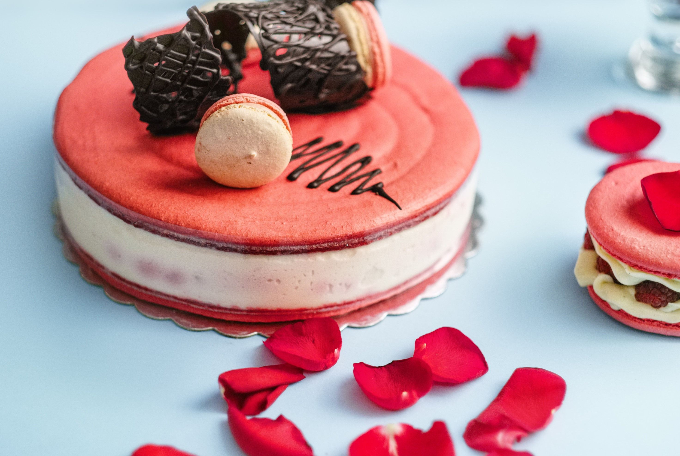
Strawberry Cake
$ 5
*with drinks
Strawberry Flavored Cake w/ chocolate on top
The best food in Town

Slide 3
Strawberry Donut
$ 4
*with drinks
Strawberry Flavored Donut
good taste good food…

Slide 4
Blue Berry Cake
$ 3
*with drinks
Delicious Mocha cake with blue berry cake
The best food in Town

Slide 5
Pink Donut
$ 4
*with drinks
Strawberry mixed mango flavored donut
coffee / breakfast / lunch / snacks / dinner

Slide 6
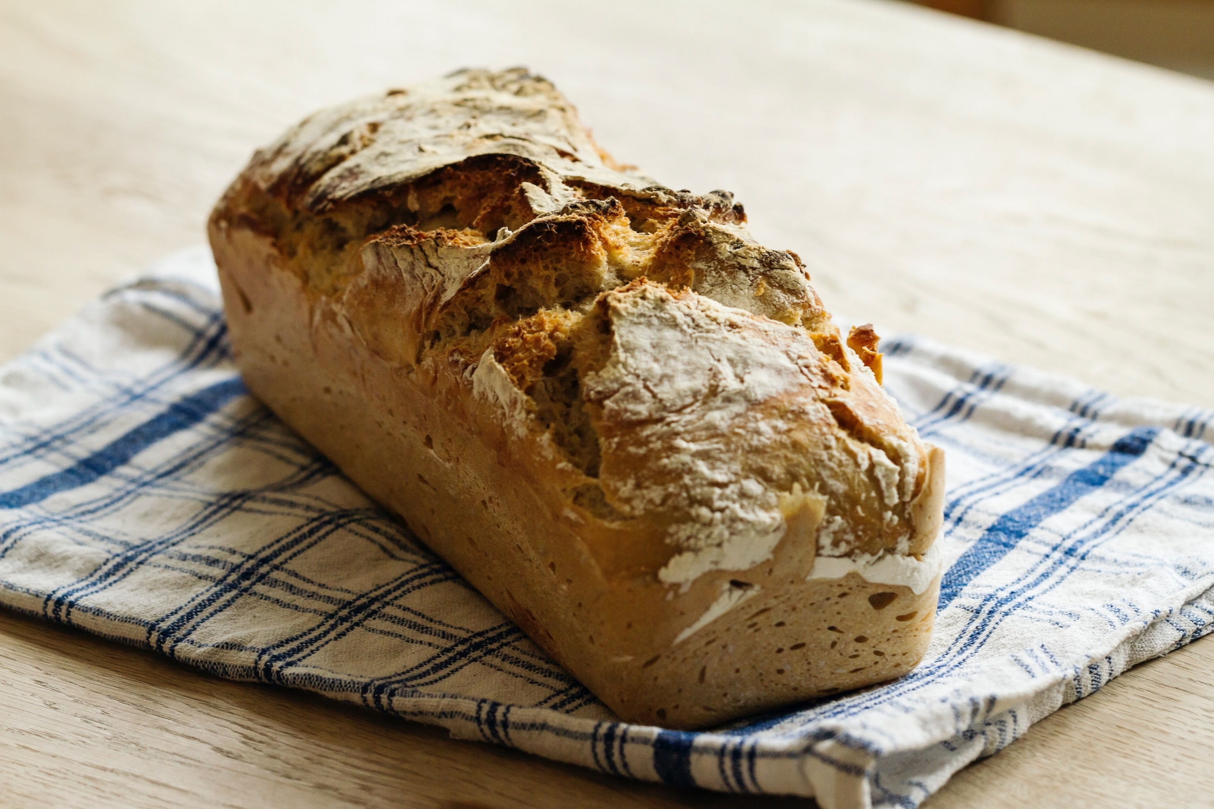
Banana Cake
$ 4
*with drinks
Banana Flavored Cake
The best food in Town

Slide 7
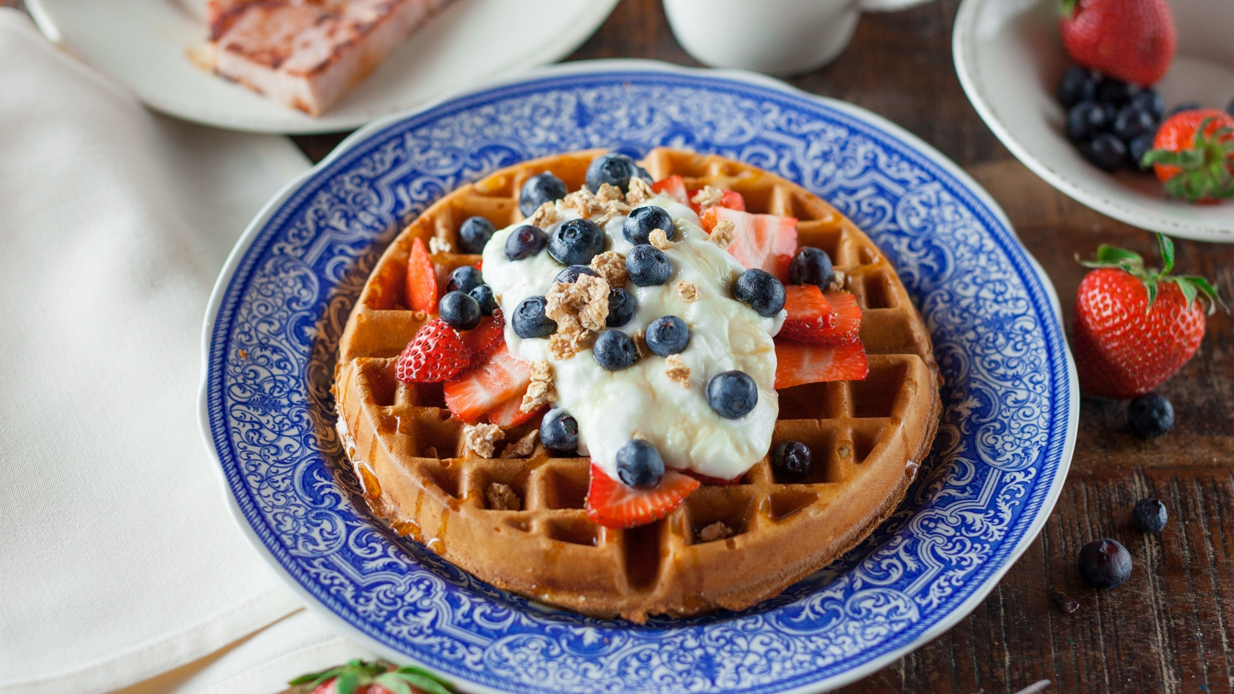
Blue Berry Hot Cake
$ 6
*with drinks
Blue Berry Flavored Hot Cake
good taste good food…

Slide 8
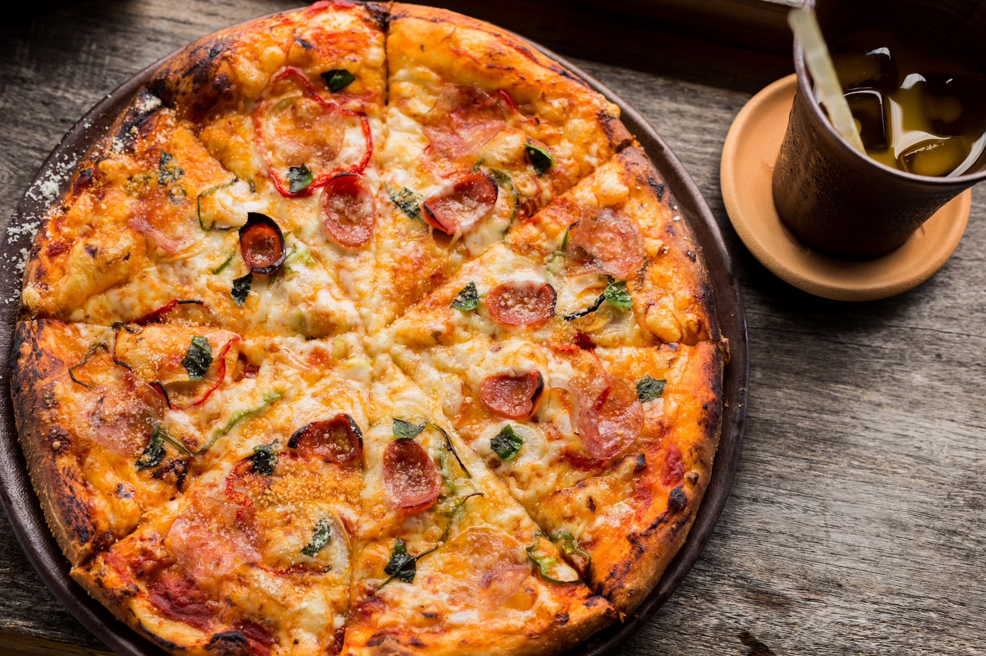
Hawaiian Pizza
$ 6
*with drinks
Hawaiian Flavored Pizza
The best food in Town

Slide 9
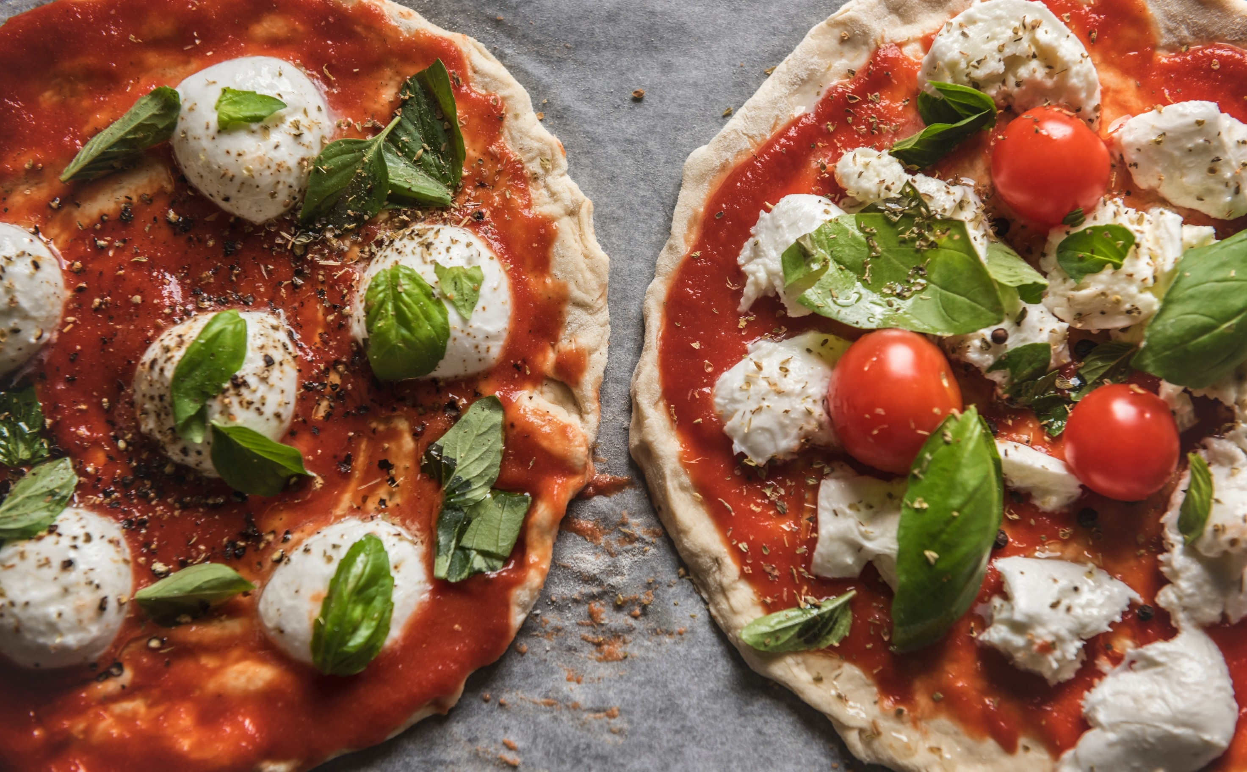
Tomato Pizza
$ 6
*with drinks
Tomato Flavored Pizza
coffee / breakfast / lunch / snacks / dinner

Slide 10
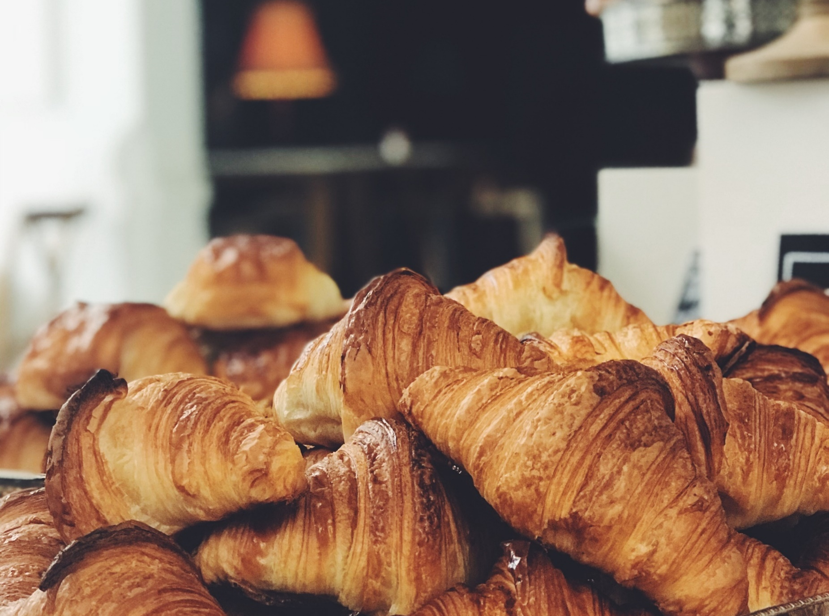
Turtle Bread
$ 3
*with drinks
Turtle Bread is a hard bread that’s fit to your coffee.
The best food in Town

Slide 11
feedback
info@deariesweetscafe.com
The best food in Town

