Slide 1
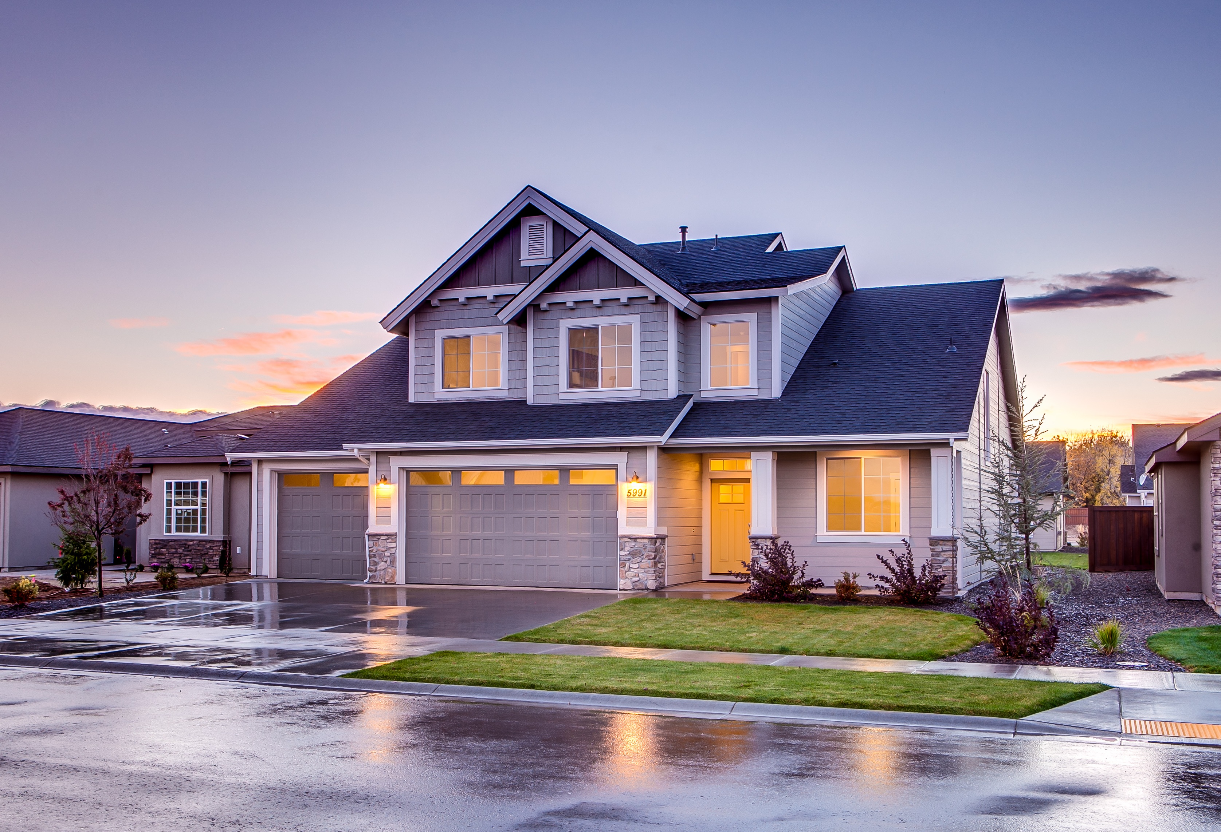
TRUSTED PROPERTIES

Slide 2
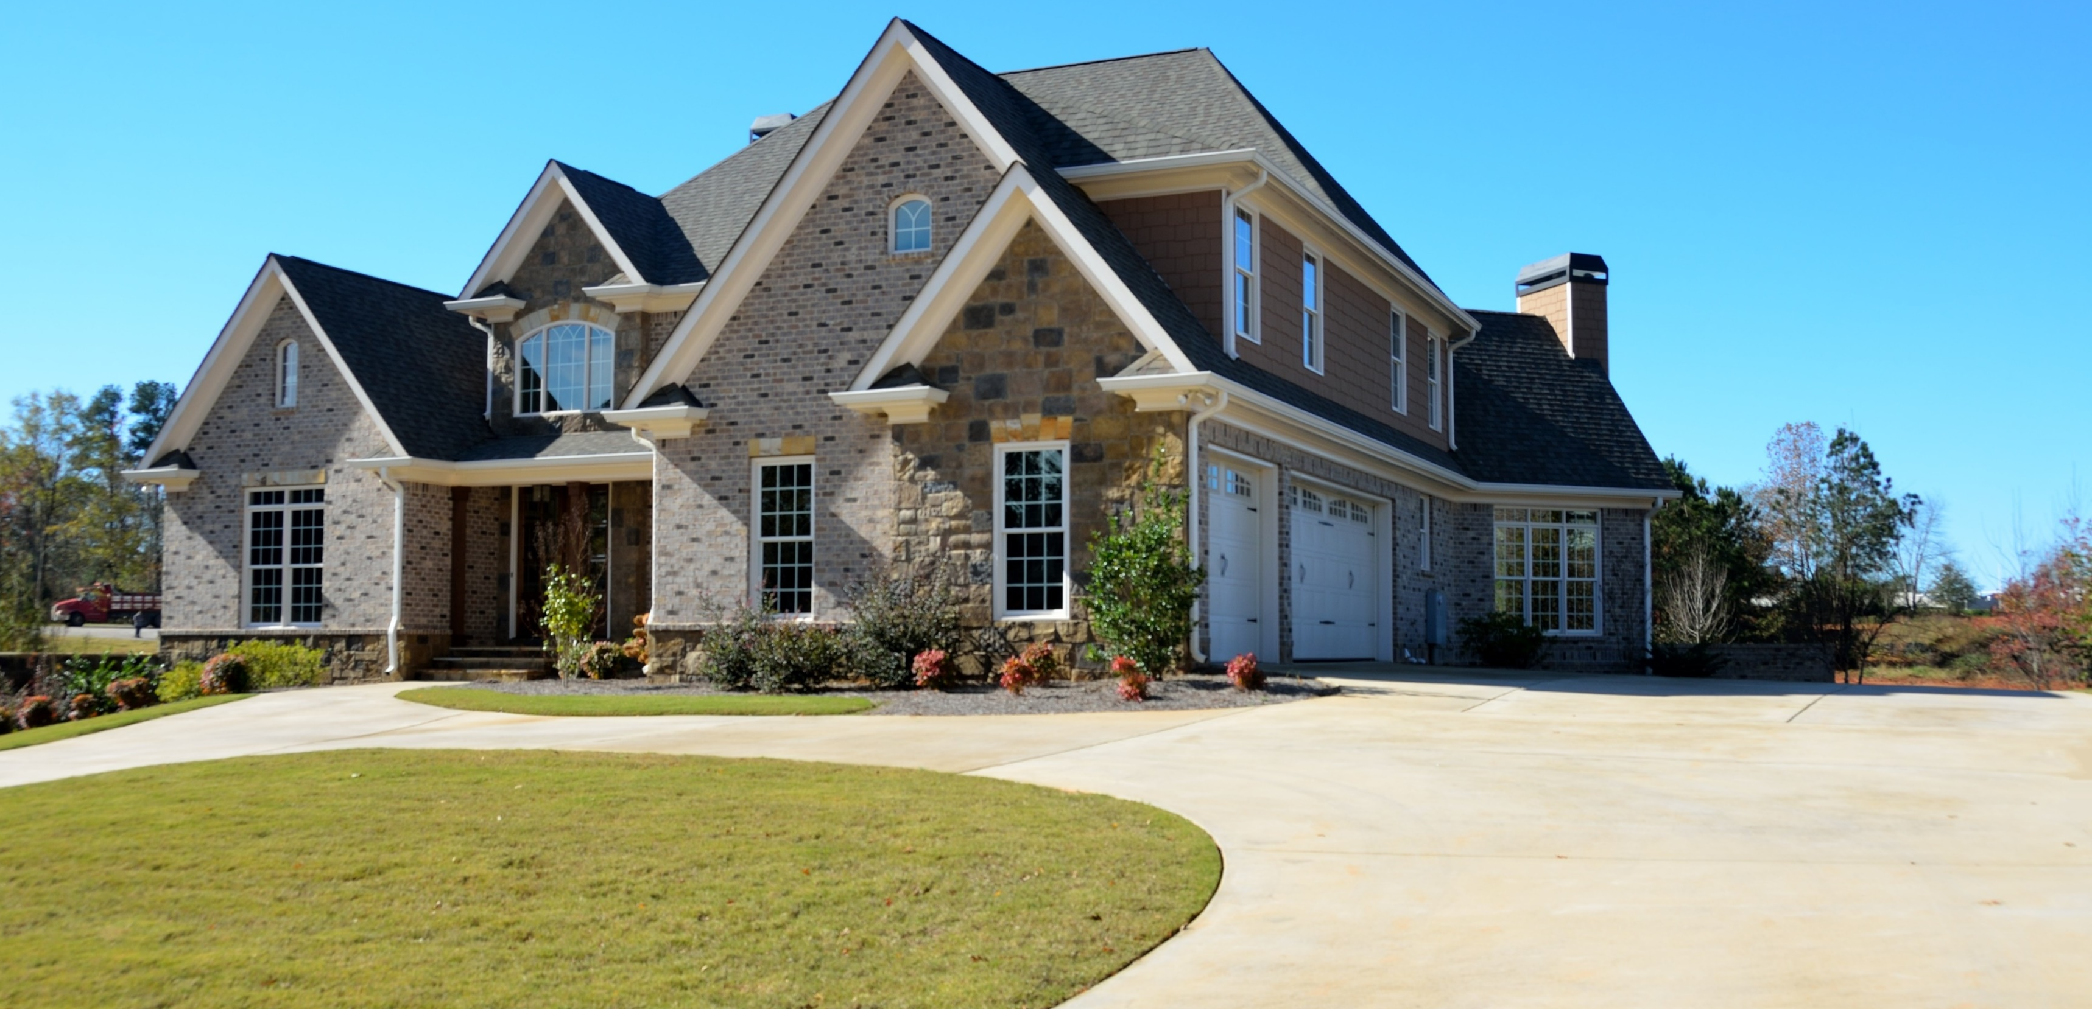
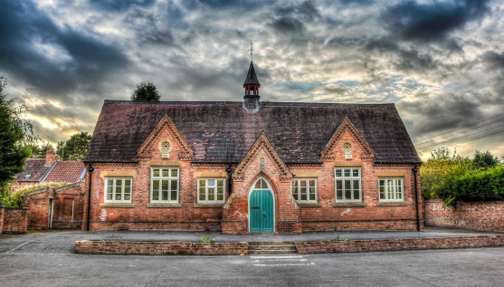
PLANET E VINTAGE
PENTHOUSE
314, PLANET E, DREAM SUBDV.
SB-1965
SCHOOL & NEIGHBORHOOD
FOR SALE
Kinder Garden School 1.3 Miles
$50,000,00
Car Park
Bar
Bathroom
BBQ
Bedroom
Big Space
The 2-storey Planet E Vintage will be a Vintage-inspired residential development that will rise beside schools & neighborhood.

Slide 3
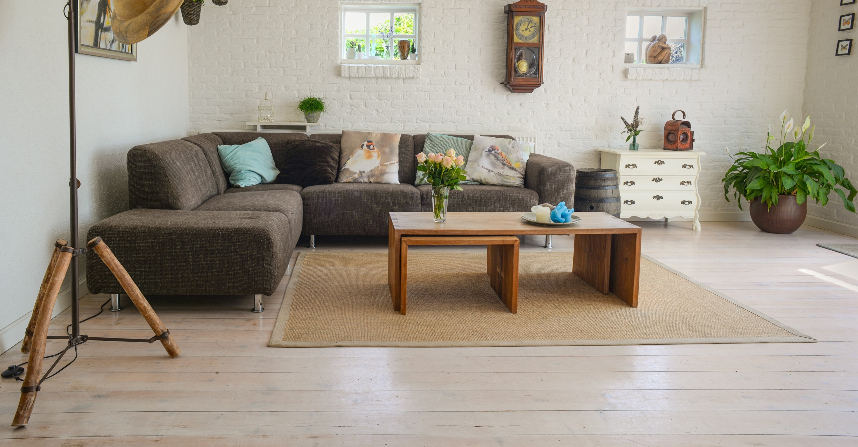
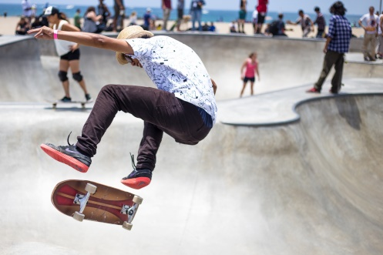
PLANET E SIMPLE
PENTHOUSE
314, PLANET E, DREAM SUBDV.
SB-1965
SCHOOL & NEIGHBORHOOD
FOR SALE
National Sports Center 1.9 Miles
$47,000,00
Car Park
Bar
Bathroom
BBQ
Bedroom
Big Space
The 2-storey Planet E SIMPLE PENTHOUSE will be a condominium-inspired residential
development that will rise beside schools & neighborhood.

Slide 4
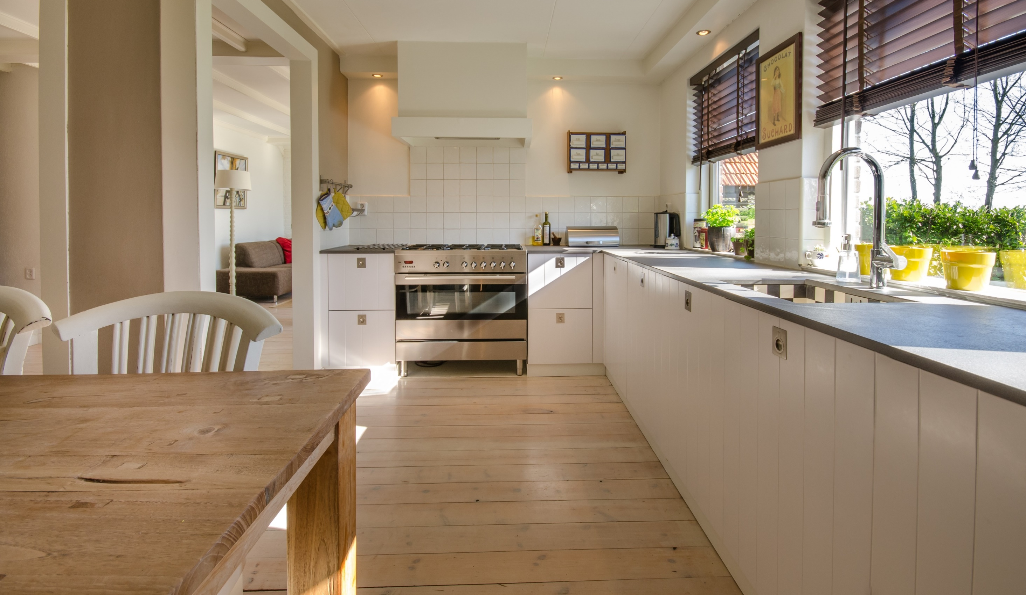
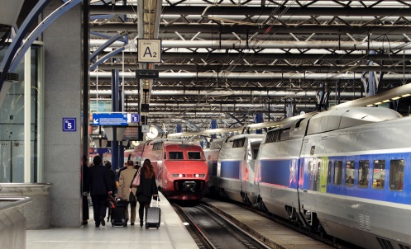
PLANET E
PENTHOUSE
314, PLANET E, DREAM SUBDV.
SB-1965
SCHOOL & NEIGHBORHOOD
FOR SALE
Railway Station 0.9 Miles
$45,450,00
Car Park
Bar
Bathroom
BBQ
Bedroom
Big Space
The Planet E PENTHOUSE will be a condominium-inspired residential
development that will rise beside schools & neighborhood.

Slide 5
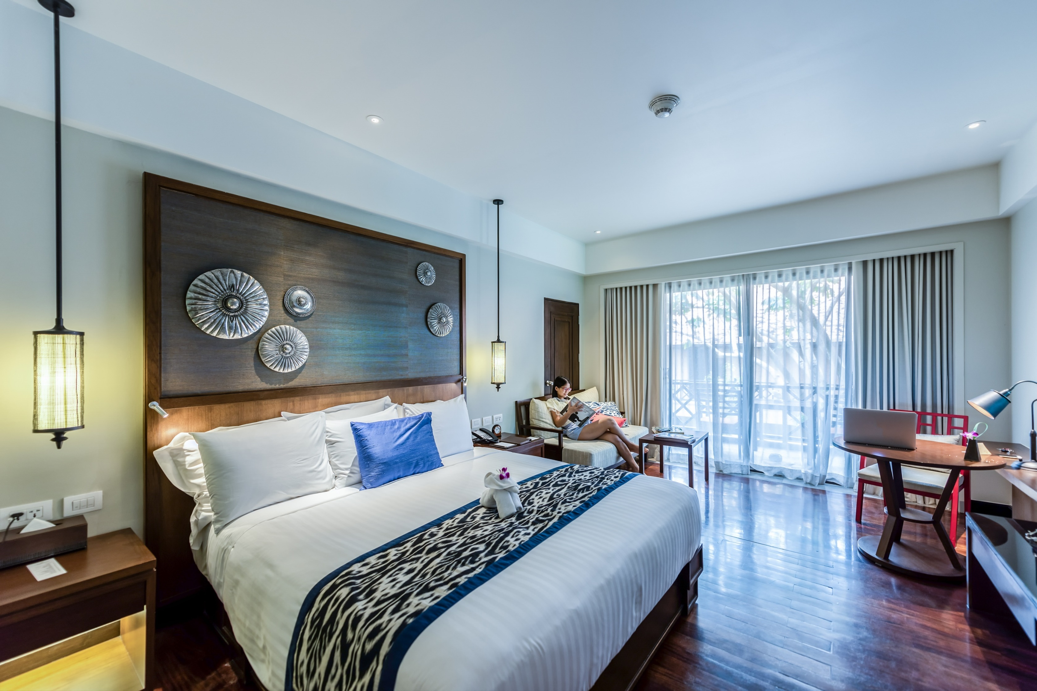
PLANET E MODERN A
PENTHOUSE
314, PLANET E, DREAM SUBDV.
SB-1965
PROPERTY HIGHLIGHTES
Living Room ~450 sq.ft.
Bedroom
~250,300,350 sq.ft.
Kitchen ~500 sq.ft.
FOR SALE
$,50,000,00
Car Park
Bar
Bathroom
BBQ
Bedroom
Big Space
The Planet E MODERN A PENTHOUSE will be a hotel-inspired residential development.

Slide 6
PLANET E MODERN B
PENTHOUSE
314, PLANET E, DREAM SUBDV.
SB-1965
AGENT ANNA LOPEZ
FOR SALE
1-800-123-4567
planeterealstateanna@gmail.com
$45,000,00
Car Park
Bar
Bathroom
BBQ
Bedroom
Big Space
The Planet E MODERN B PENTHOUSE will be a hotel-inspired residential development.

Slide 7
PLANET E MODERN C
PENTHOUSE
314, PLANET E, DREAM SUBDV.
SB-1965
AGENT ANNA LOPEZ
FOR SALE
1-800-123-4567
planeterealstateanna@gmail.com
$97,450,00
Car Park
Bar
Bathroom
BBQ
Bedroom
Big Space
The Planet E MODERN C PENTHOUSE will be a hotel-inspired residential development.

Slide 8
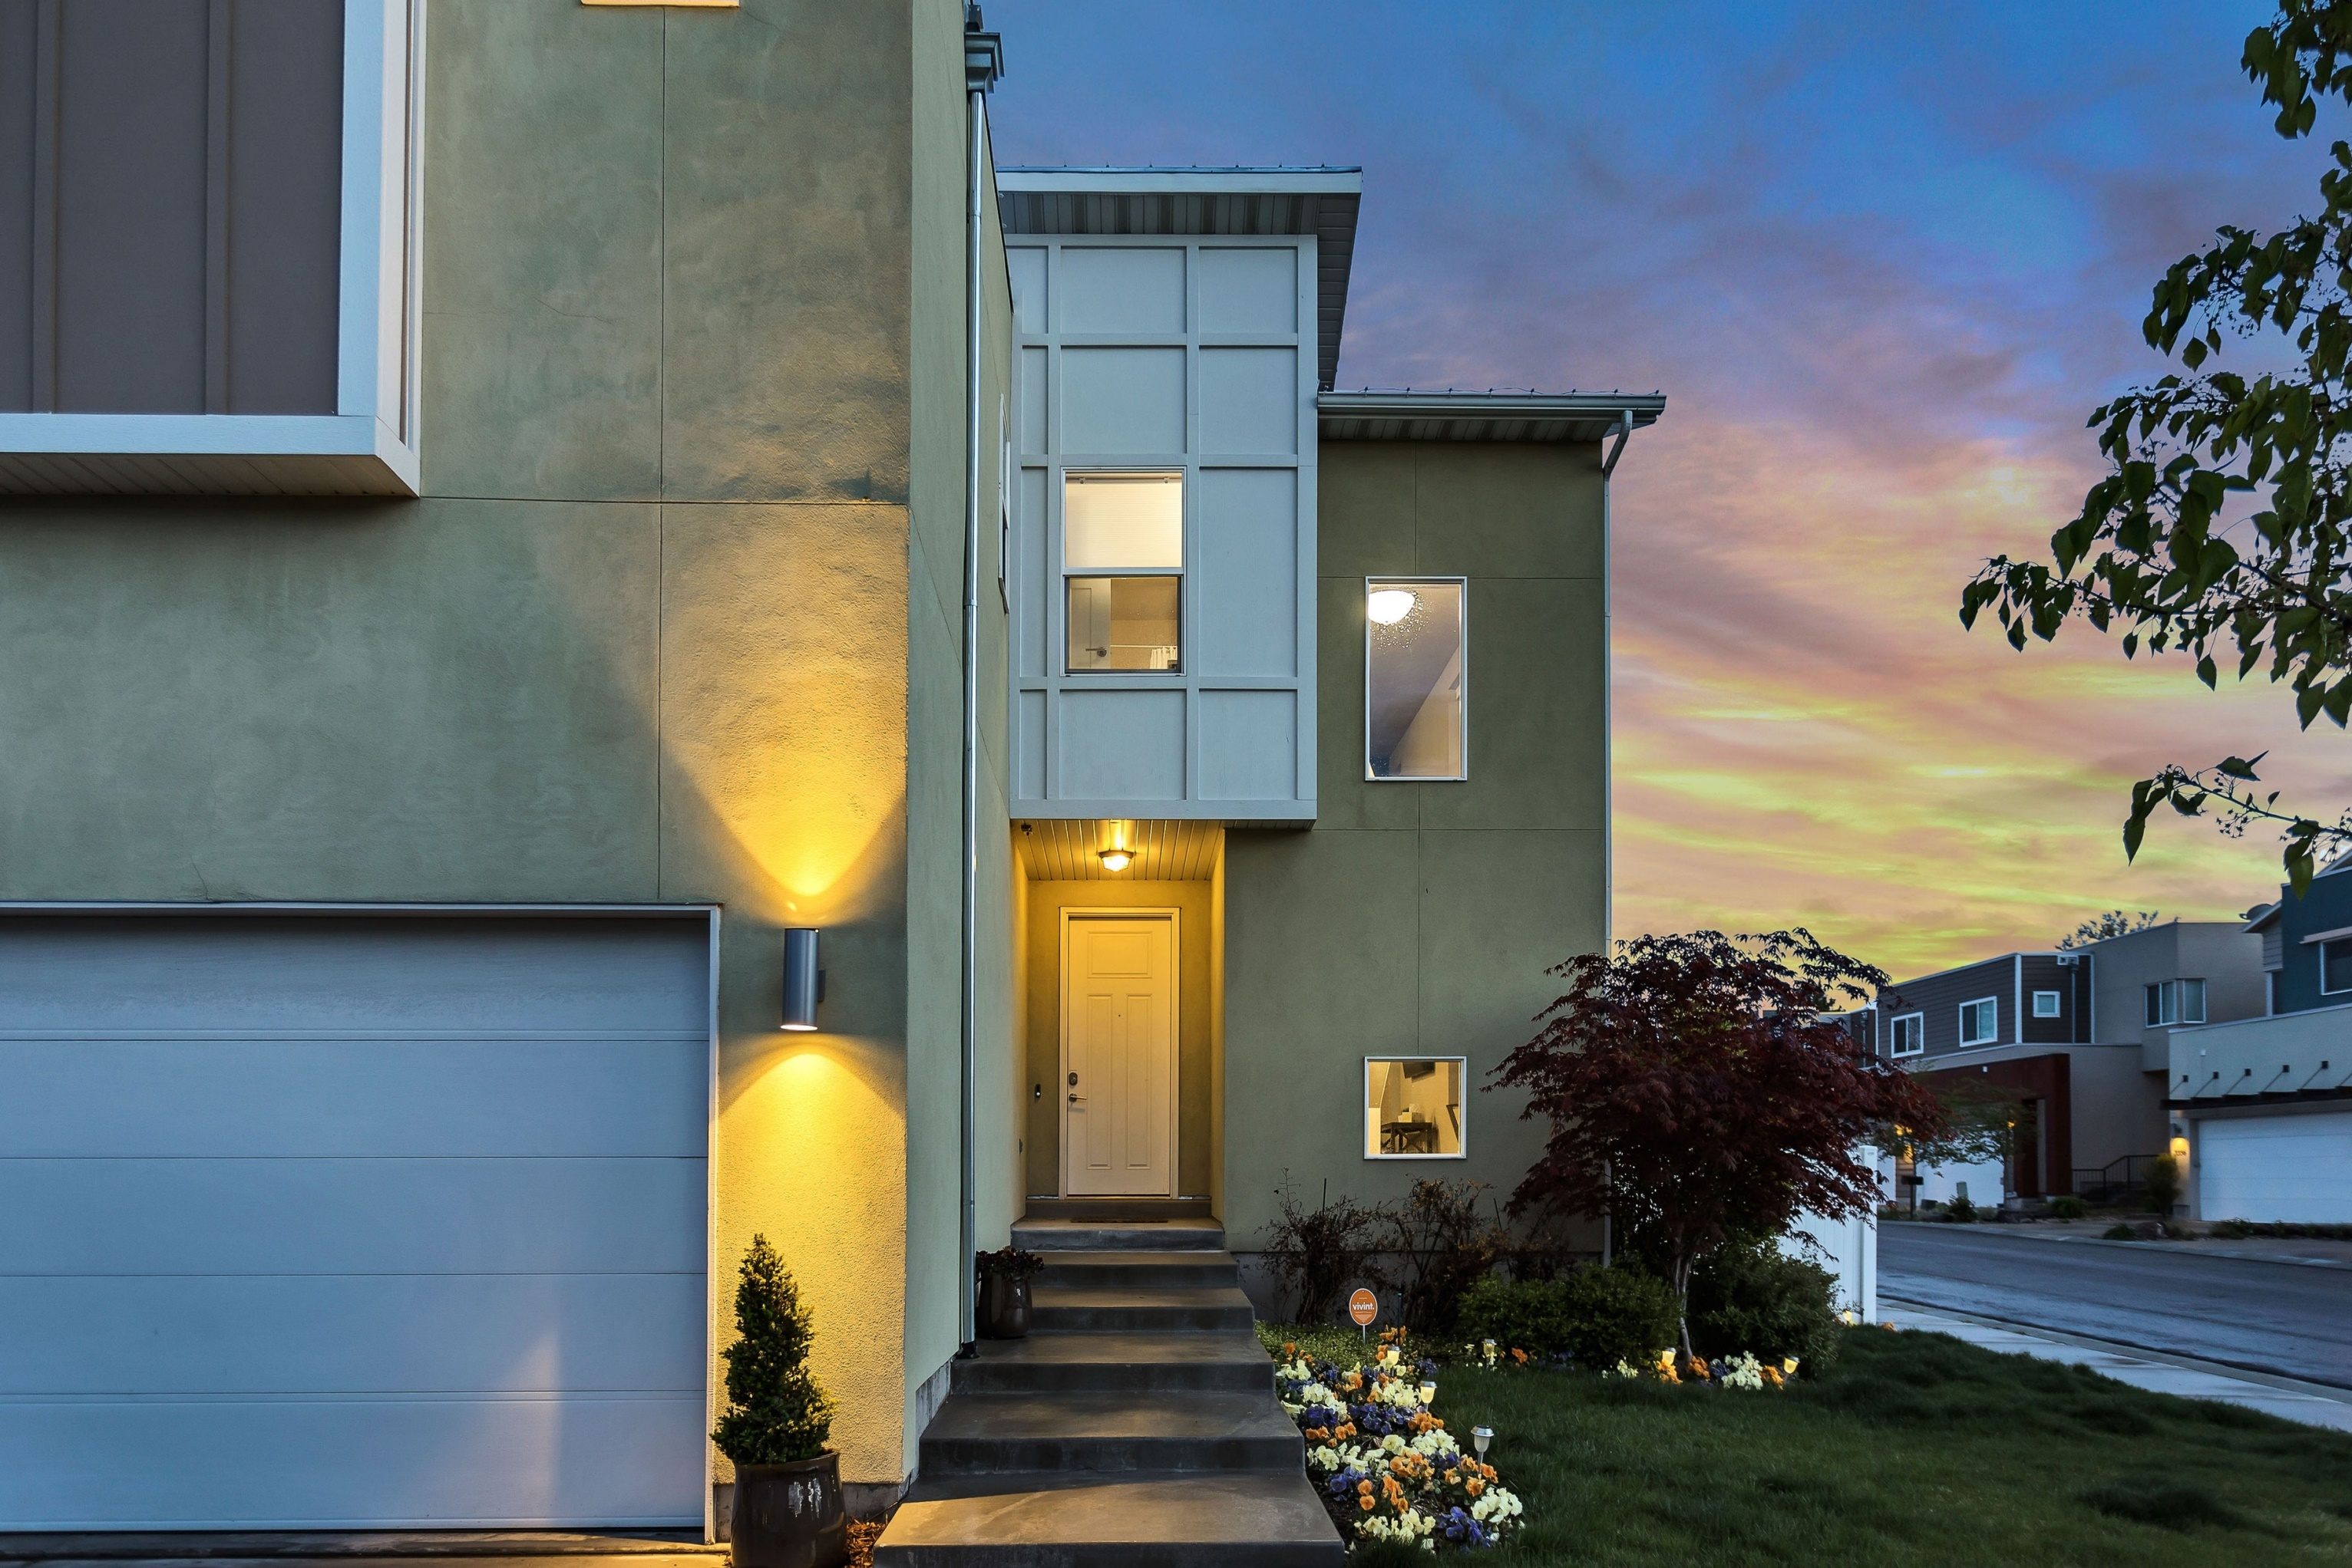
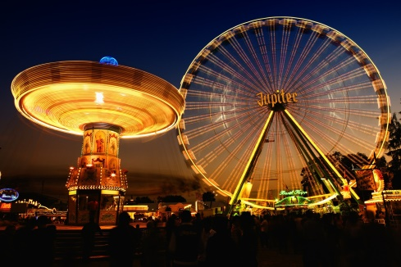
PLANET E
APARTMENT A
BRICK HOUSE
1A, King Halt, Planet E Town, - 001
SCHOOL & NEIGHBORHOOD
High Fun Theme Park 4.3 Miles
FOR SALE
$60,000,00
Terrace
Swimming
Offer
Kitchen
Gym
Garage
The 4-storey Planet E Apartment A will be a Brick-inspired residential development that will rise beside schools & neighborhood.

Slide 9
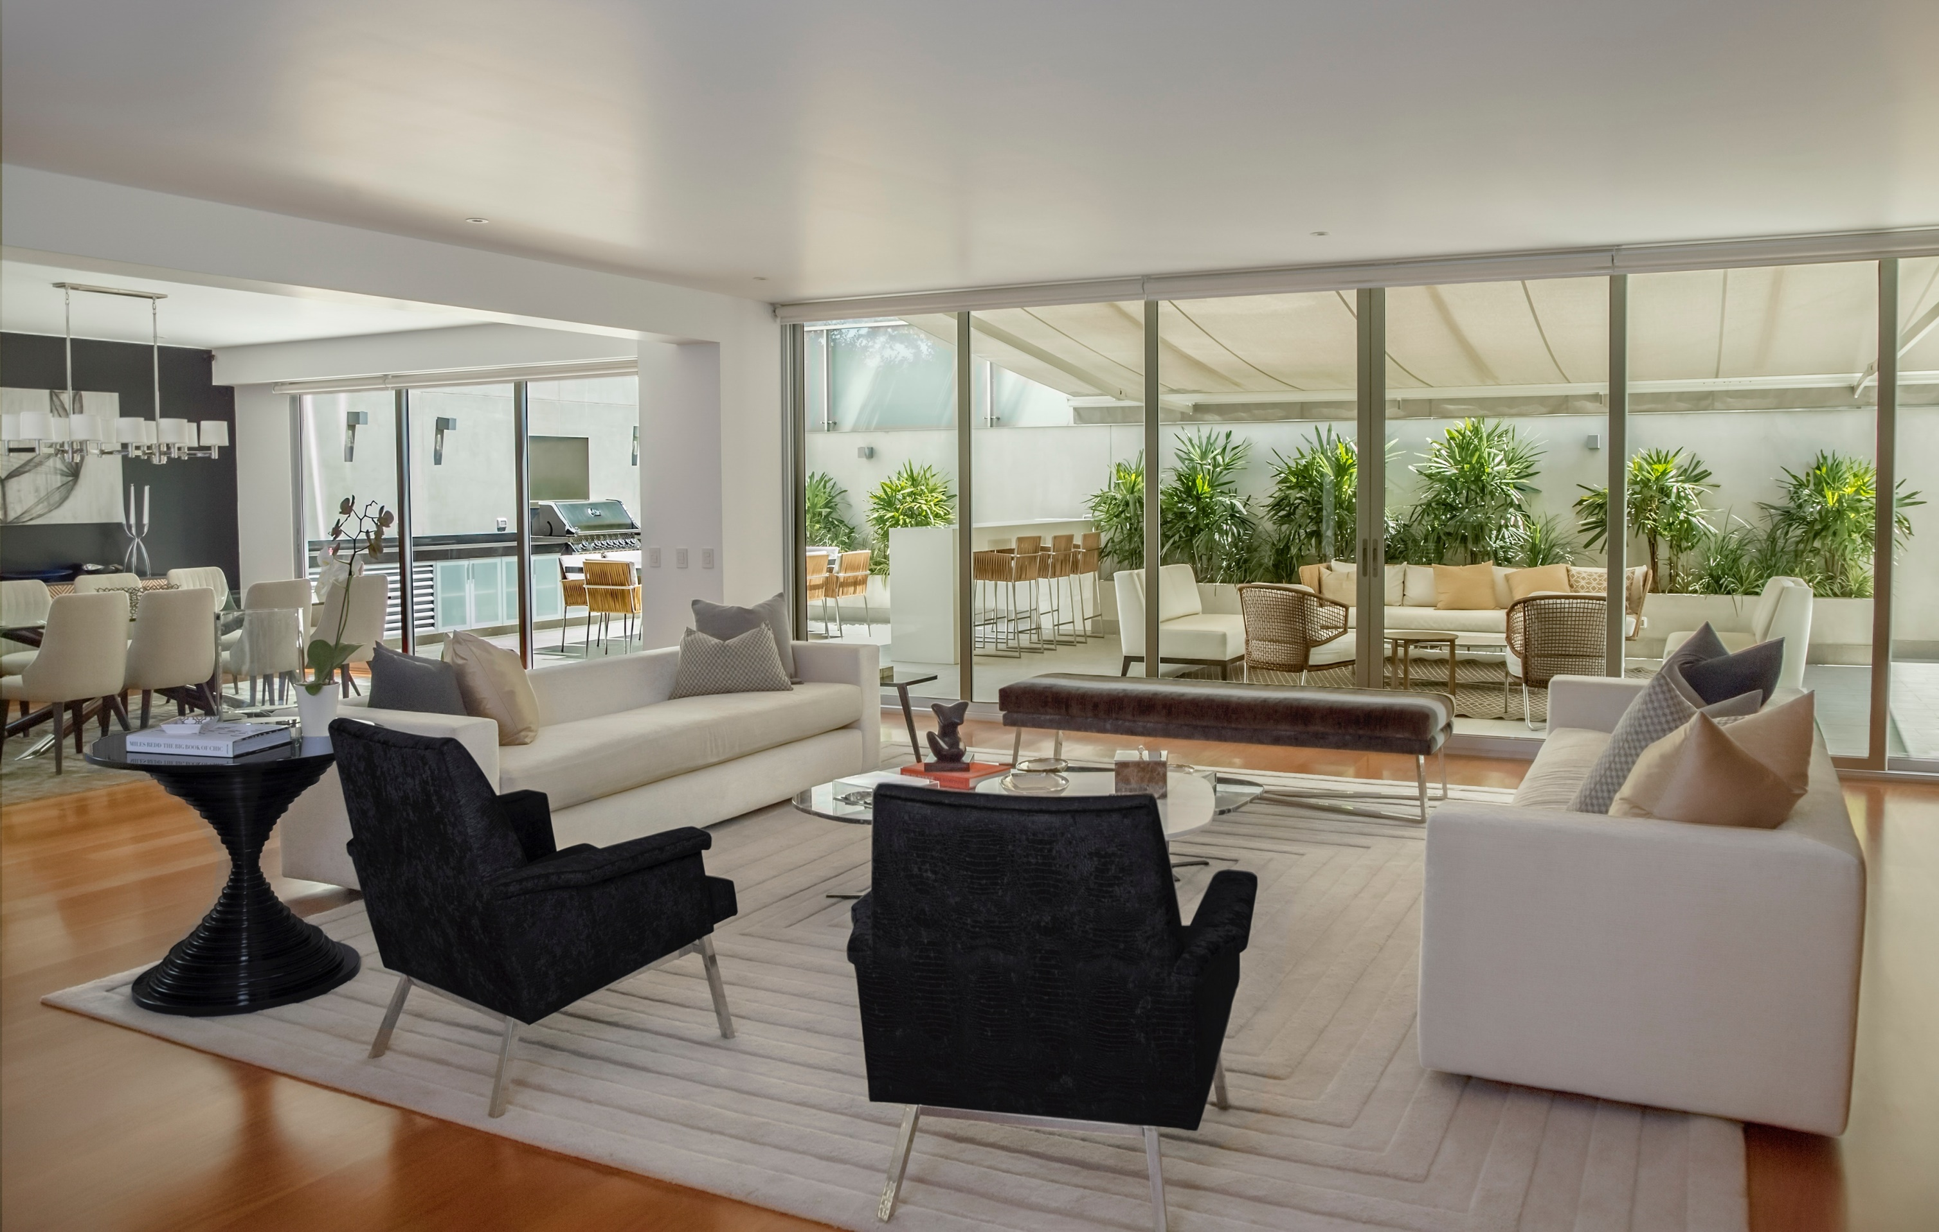
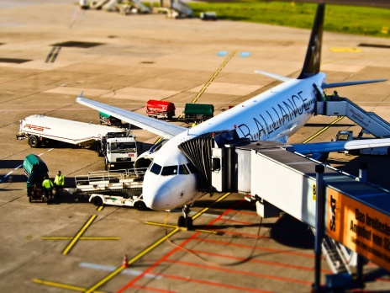
PLANET E
APARTMENT B
BRICK HOUSE
1A, King Halt, Planet E Town, - 002
SCHOOL & NEIGHBORHOOD
Rose Town Airport 5.9 Miles
FOR SALE
$70,000,00
Terrace
Swimming
Offer
Kitchen
Gym
Garage
The 2-storey Planet E Apartment B will be a Brick-inspired residential development that will rise beside schools & neighborhood.

Slide 10
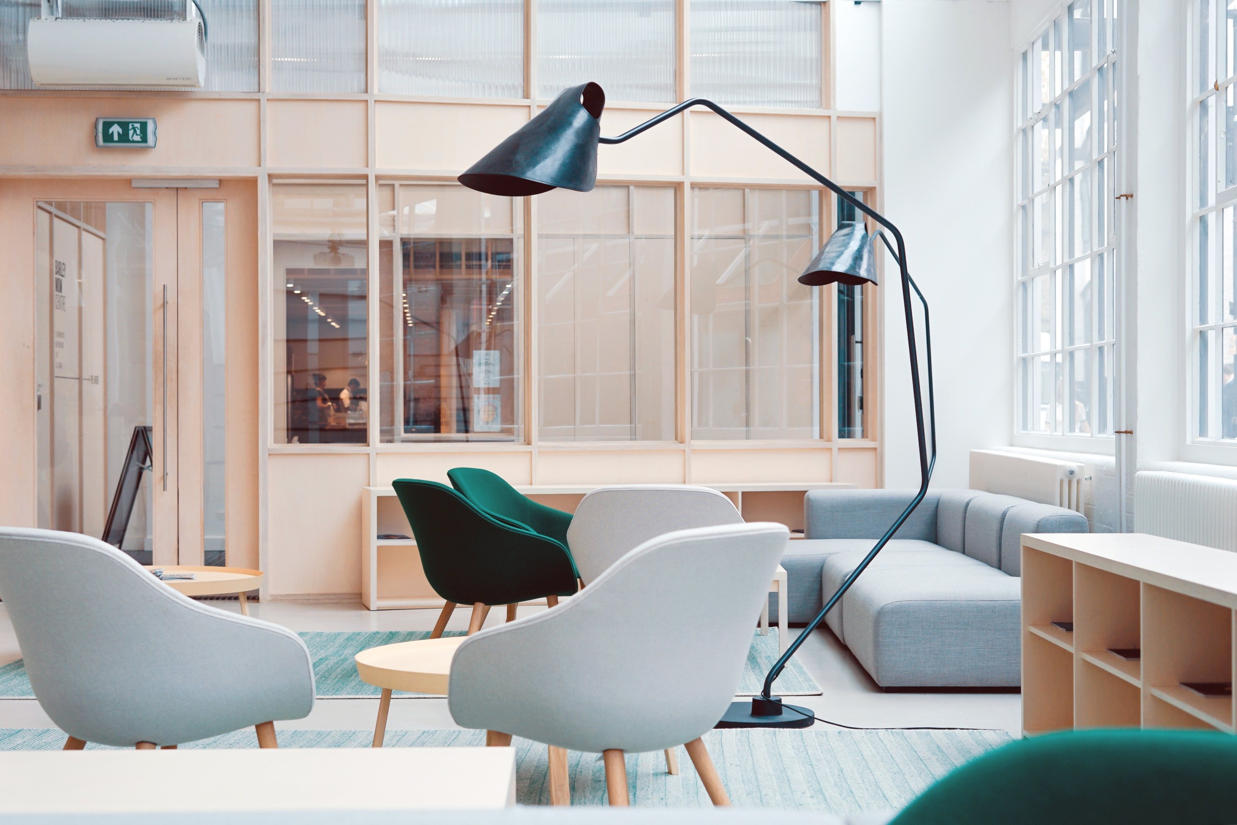
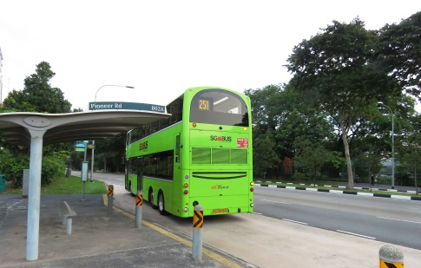
PLANET E
APARTMENT C
BRICK HOUSE
1A, King Halt, Planet E Town, - 003
SCHOOL & NEIGHBORHOOD
Rose Town Airport 5.9 Miles
FOR SALE
$65,000,00
Terrace
Swimming
Offer
Kitchen
Gym
Garage
The 3-storey Planet E Apartment C will be a Brick-inspired residential development that will rise beside schools & neighborhood.

Slide 11
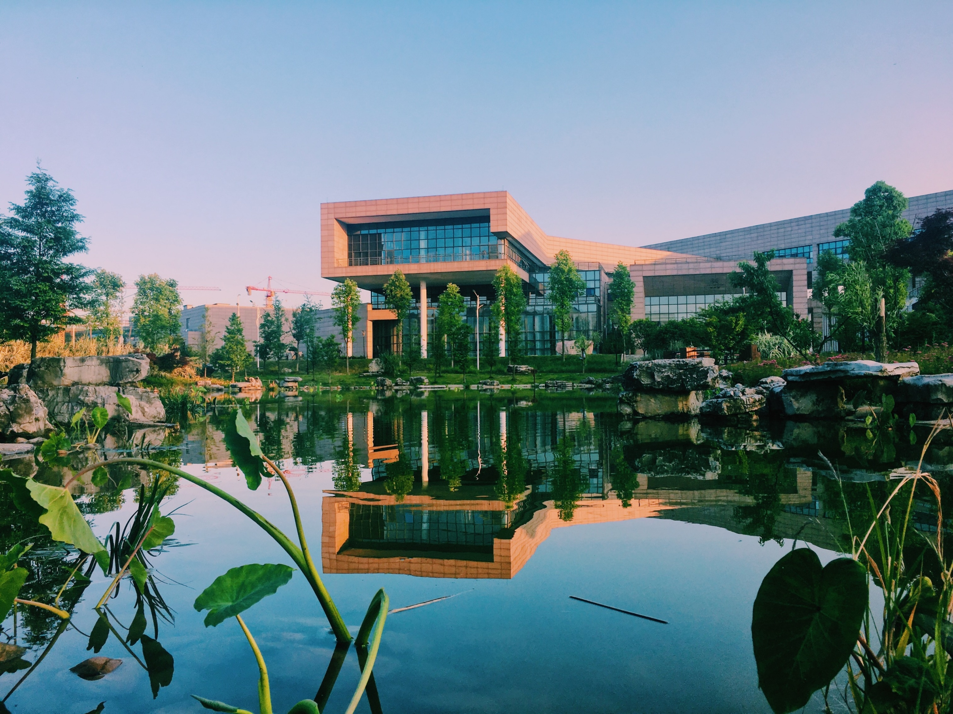
PLANET E
APARTMENT D
BRICK HOUSE
1A, King Halt, Planet E Town, - 004
PROPERTY HIGHLIGHTS
Living Room ~490 sq.ft.
Bedroom
~250,300,390 sq.ft.
Kitchen ~510 sq.ft.
FOR SALE
$50,000,00
Terrace
Swimming
Offer
Kitchen
Gym
Garage
The 5-storey Planet E Apartment D will be a Brick-inspired residential development.

Slide 12
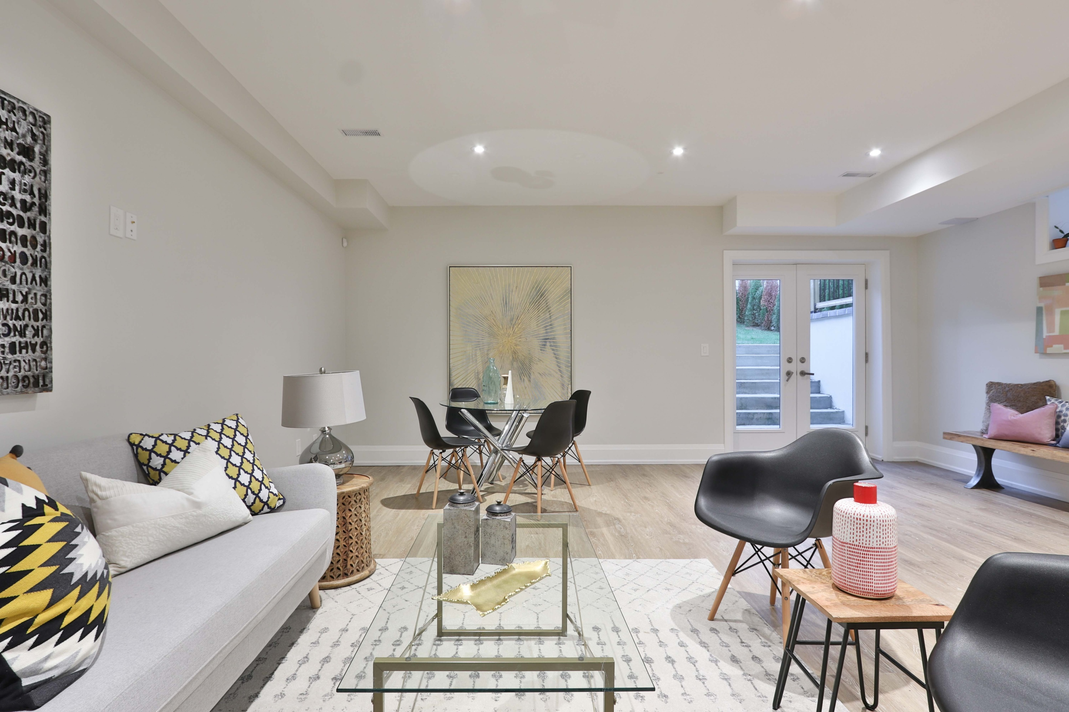
PLANET E
APARTMENT E
BRICK HOUSE
1A, King Halt, Planet E Town, - 005
AGENT
RONI HOWARD
1-800-123-4567
planeterealstateroni@gmail.com
FOR SALE
$78,310,00
Terrace
Swimming
Offer
Kitchen
Gym
Garage
The 4-storey Planet E Apartment E will be a Brick-inspired residential development.

Slide 13
CONTACT US
314 Planet E Real Estate Office, USA
1-800-123-4567
www.facebook.com/planeterealestate www.twitter.com/planeterealestate www.linkedin.com/planeterealestate

Slide 14
CONTACT US
314 Planet E Real Estate Office, USA
1-800-123-4567
www.facebook.com/planeterealestate www.twitter.com/planeterealestate www.linkedin.com/planeterealestate

