Slide 1
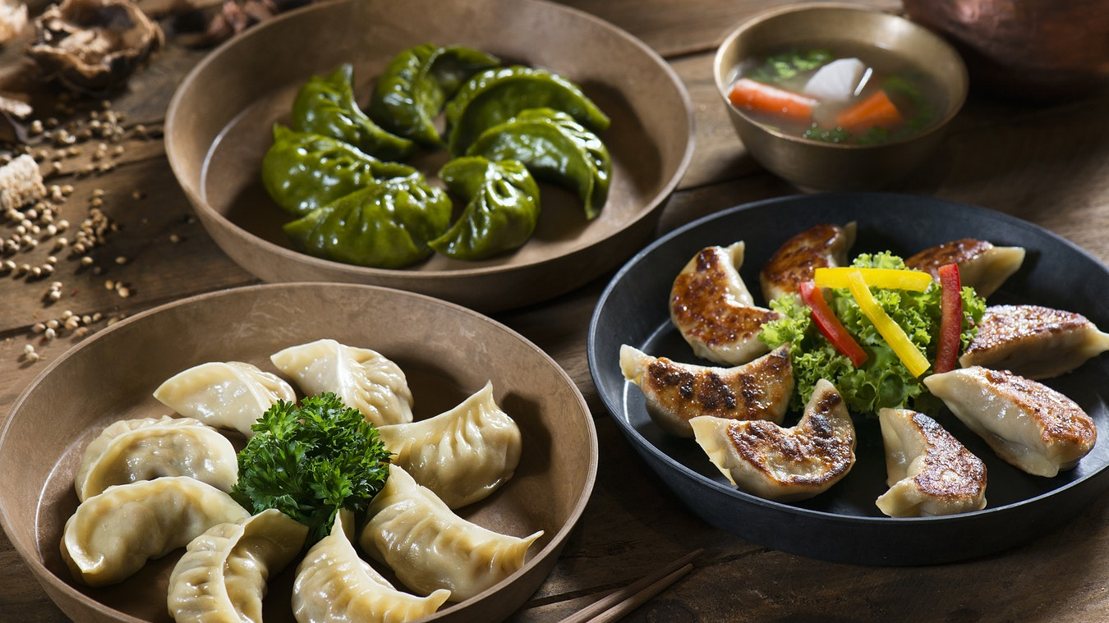
1-800-123-4567
www.bestfoodrestaurant.com
TASTE THAT YOU DESIRE

Slide 2
01
02
03
04
Broccoli Squid
Cheese Cake
Hot Chocolate Milk
Triple Burger
Broccoli with squid with oyster sauce
Very Delicious cheese cake
Hot chocolate with milk
Burger with mayonnaise sauce, tomatoes, lettuce, cheese and onion

Slide 3
FRESH FRUIT SALAD
Recommended
The outstanding taste of fresh fruit salad served with any drinks you want. You’ll also love the creamy very delicious hot cake serve with brewed coffee or any juices that you want.
Special Fruit salad (Bananas mixed with grapes, berries, apple, oranges, dragon fruit, strawberries and mangoes with chocolate
HOT CAKE
Recommended
Very delicious hot cake with sweet creamy sauce and blue berries

Slide 4
Deal 01
Deal 02
Strawberry Cake
Strawberry Cheese Cake
Taste our delicious cake filed with strawberry and raisins.
Taste our delicious cake filed with strawberry, cheese and raisins.
$20
$25
Good for breakfast, you’ll love it.
Good for breakfast, you’ll love it.

Slide 5
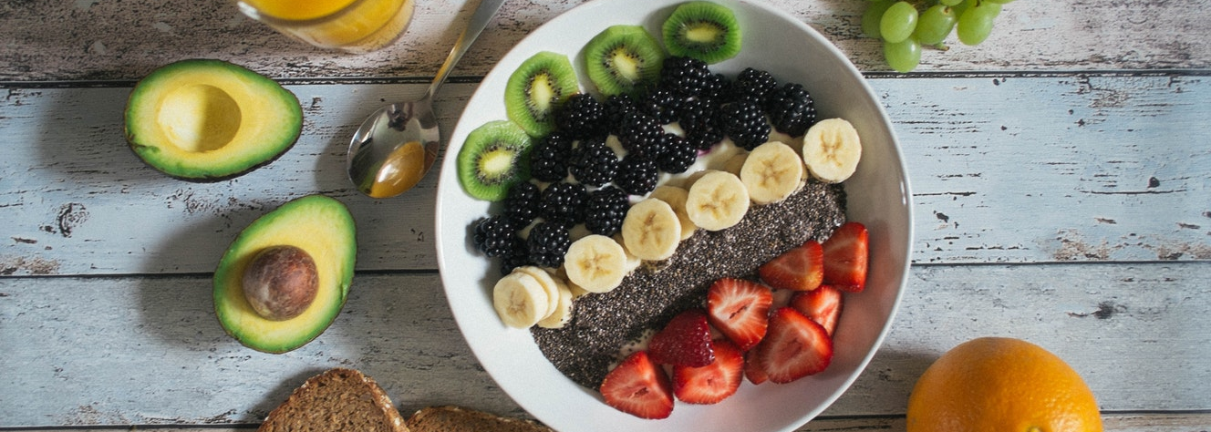
Special Menu
Delicious Food
$15
$20
$5
Good for breakfast, lunch or dinner, you’ll love it. Choose your order from each different sizes.

Slide 6
TASTE THAT YOU DESIRE
Deal 01
Deal 02
Deal 03
$30
$10
$30
Beef Burger with onion and tomato
Chocolate ice cream
Boiled egg served with frapes, fried bacon and lemon

Slide 7
Cheesy Beef Burger
Special Hot Cake
Burger Bun with double cheese with onion and chicken patty
Special hot cake served with sweet creamy sauce and blue berries on top
$20
$10
Dried Coconut Fish
Fresh Fruit Salad
Fish marinated with boiled coconut and broccoli
Hershey chocolate mixed with fresh banana, apple, dragon fruit, oranges and melon
$10
$15
Chicken Balls
Creamy Pork Burger
Delicious fried chicken balls
Burger Bun with tomato, onion and garlic sauce with Pork patty
$20
$15

Slide 8
1-800-123-4567
www.bestfoodrestaurant.com
TASTE THAT YOU DESIRE

