Slide 1
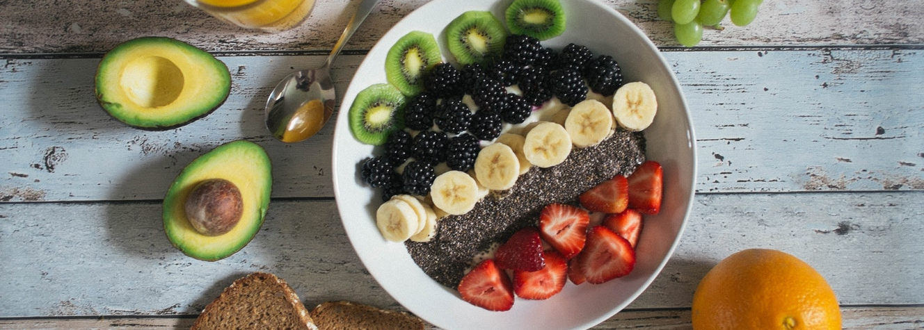
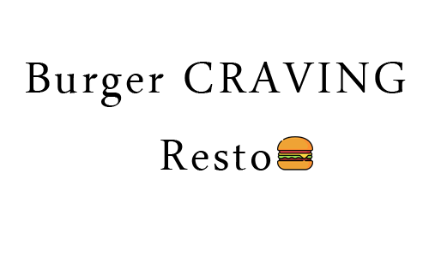
IMAGINE THE BEST
FOOD IN TOWN
A-34, Street# 02, Burger Craving
1-800-123-4567

Slide 2
WE SERVE THE BEST QUALITY FOOD IN TOWN
Burger Craving Resto is operating for almost 10 years in business. We always promise our customers that we will give you the best taste of different kind of burgers in town. We also promise that we are giving you promos and discounts every month.

Slide 3
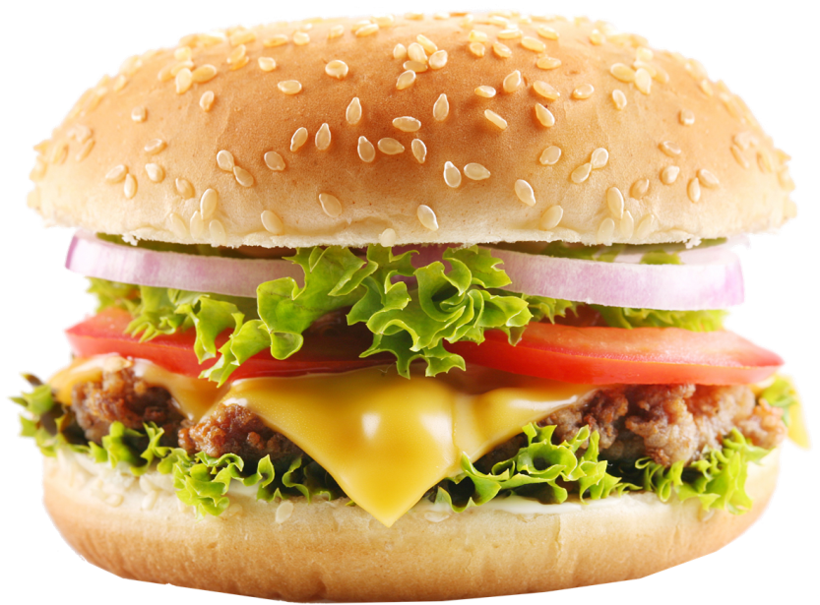
Cheesy Burger Masala
Cheeseburger with fresh lettuce, onion, tomatoes, and pork patty
Double Cheesy Burger Masala
Double Cheeseburger with fresh lettuce, onion, tomatoes, and pork patty

Slide 4
Veg Taco Burger
Cheeseburger with fresh lettuce, onion, tacos, and tomato salsa sauce
Crunchy Fest Burger
Double Cheeseburger with fresh lettuce, onion, tomatoes, and chicken patty with tomato salsa sauce

Slide 5
Mouth Watering
$10 for every Burgers and we still have regular menus too.

Slide 6
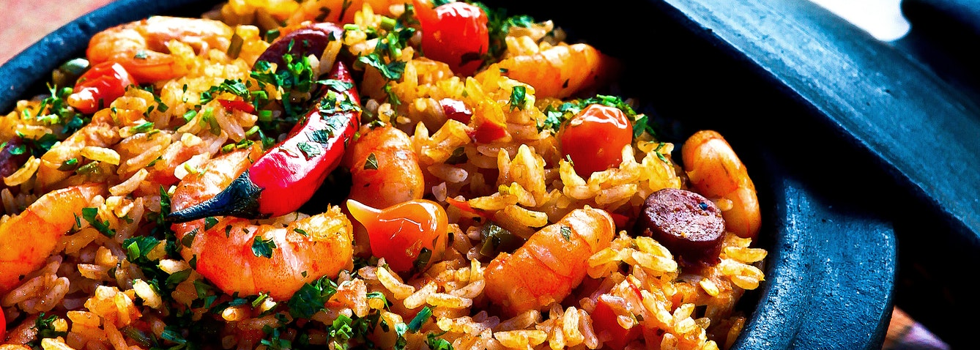
Family Deal
Mouth Watering Food Choice
Sea Food Rice Paella served with fresh sweet and sour shrimp, hot chili sauce, fresh onions, onion leaves and bacon

Slide 7
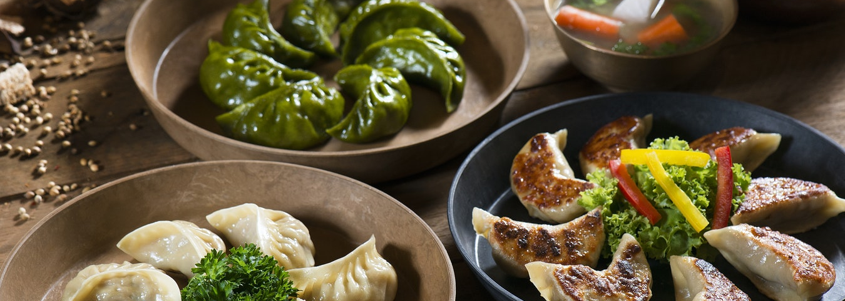
3 Dishes Deal
Mouth Watering Food Choice
Shark’s Fin served with different flavors (sweet and sour, barbecue and original)

Slide 8
BREAK FAST
LUNCH
DINNER
Cheeseburger Masala
$ 6
Bacon Cheeseburger
$ 8
Cheeseburger Masala
$ 12
Double Cheesy Burger Masala
$ 6
Chicken Cheeseburger
$ 8
Chicken Cheeseburger
$ 12
Shark’s Fin
$ 6
Eden Cheeseburger
$ 8
Shark’s Fin
$ 12
Bacon Burger
$ 6
Craft Cheeseburger
$ 8
Craft Cheeseburger
$ 15
Cheeseburger Only
$ 6
Cheese Loaded Burger
$ 8
Cheeseburger Only
$ 15
Double Cheeseburger
$ 7
Mozzarella Burger
$ 10
Mozzarella Burger
$ 18
Triple Cheeseburger
$ 7
Mexican Taco Burger
$ 10
Triple Cheeseburger
$ 18
Garlic Cheeseburger
$ 7
Taco Delight Burger
$ 10
Taco Delight Burger
$ 19

Slide 9
CheeseBurger
Double CheeseBurger
Triple CheeseBurger
Garlic CheeseBurger
Bacon CheeseBurger
Chicken CheeseBurger

Slide 10
Eden CheeseBurger
Craft CheeseBurger
Cheese Loaded Burger
Mozarella Burger
Mexican Taco Burger
Taco Delight Burger

Slide 11
IMAGINE THE BEST
FOOD IN TOWN
A-34, Street# 02, Burger Craving
1-800-123-4567

