Slide 1
Taste the difference
Delicious foods & Drinks

Slide 2
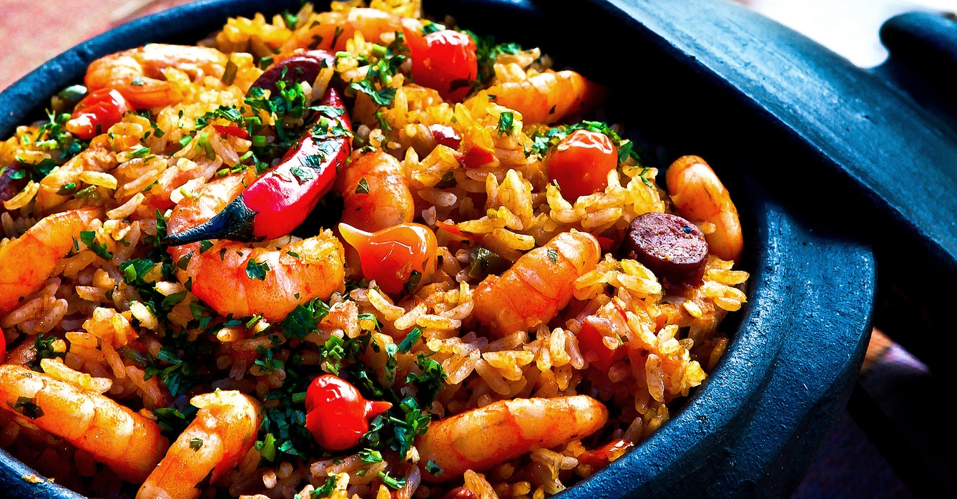
$15
"A very delicious paella using chili, hotdog, onion leaves and shrimp."
Rice Shrimp Paella

Slide 3
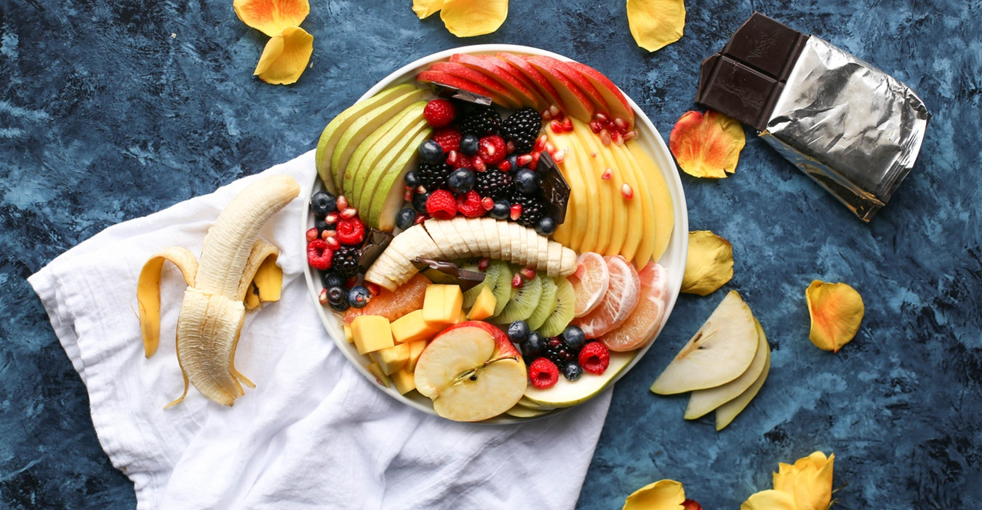
$16
“Fruit salad mixed with fresh mangoes, fresh strawberry, fresh berries, fresh apple, fresh melon, fresh orange and fresh berries.
Fresh Fruit Salad

Slide 4
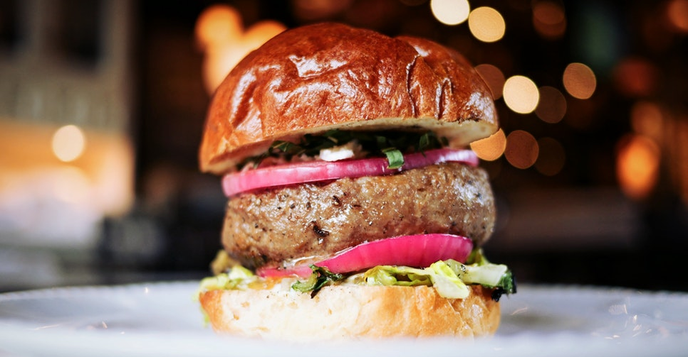
$150
“A very delicious special burger with fresh onion, onion leaves and beef patty.”
Onion Burger

Slide 5
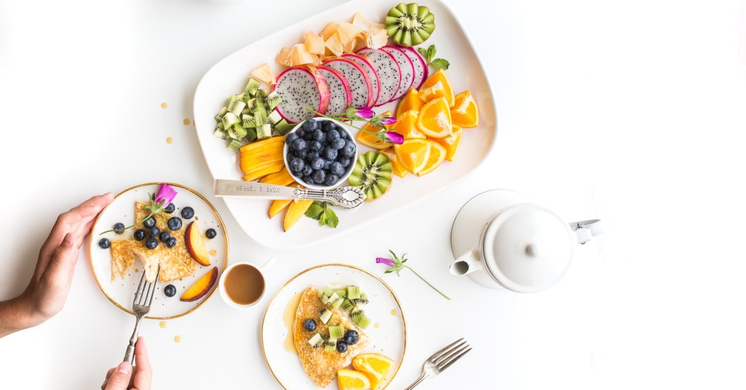
$18
“Enjoy the fantastic fruit dessert full of dragon fruit, oranges, blue berries, jackfruit and mangoes.”
Fantastic Fruit Dessert

Slide 6
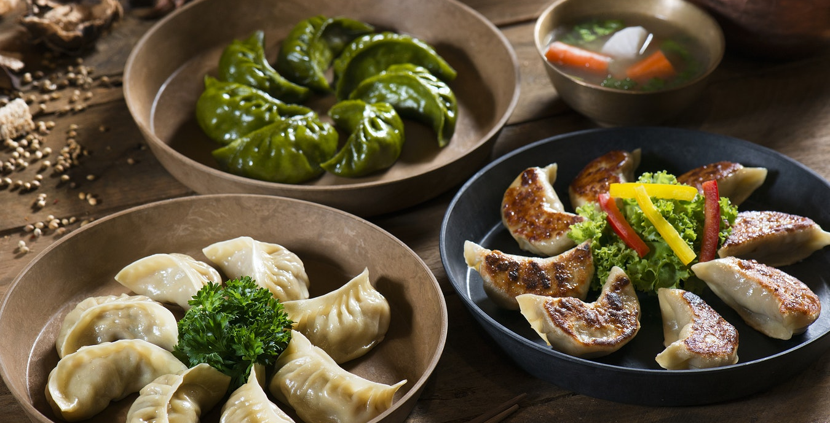
$20
“You will love the taste of special fried shark’s fin for your dinner.”
Special Fried Shark’s Fin Siomai

Slide 7
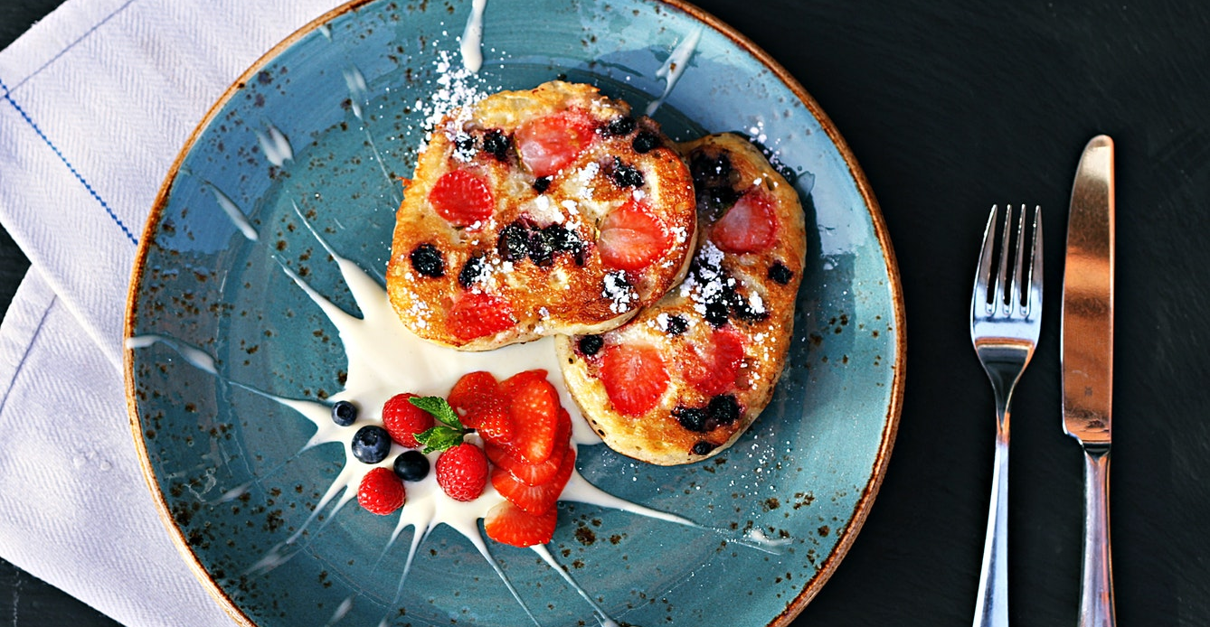
$350
“This very delicious Strawberry with Milk will be fit for your bread for your breakfast or snack.”
Strawberry Bread with Milk

Slide 8
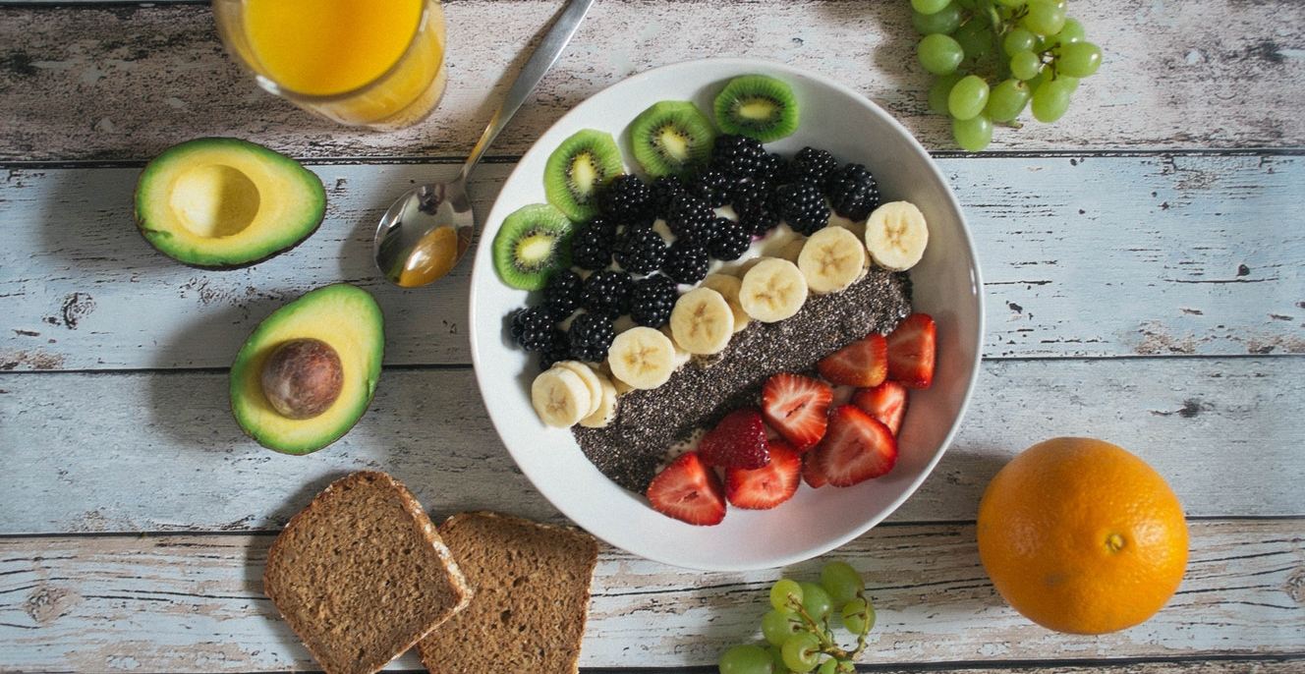
$14
“This is not a typical salad, this is a very special fruit mixed with sliced avocados, sliced dragon fruits, sliced grapes, sliced bananas and sliced strawberries.
Fruit Meal

Slide 9
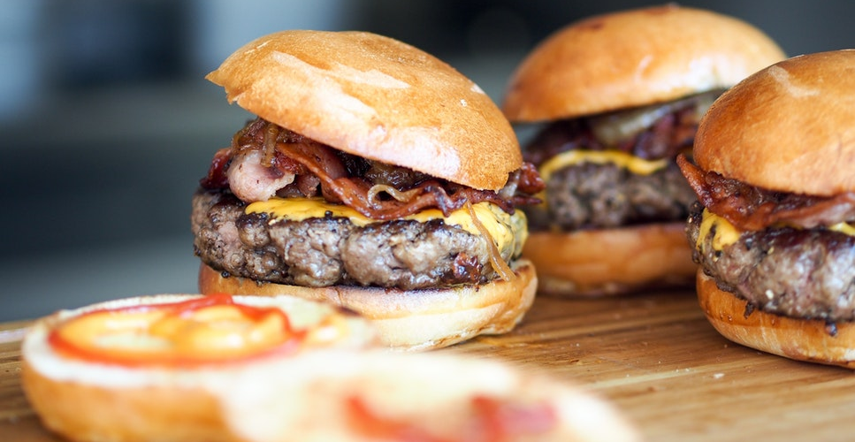
$15
“Taste our burger patty with bacon and cheese.”
Bacon Cheeseburger

Slide 10
Taste the difference
Delicious foods & Drinks

