Slide 1
You’ll Love it!
A-315, 567, Pizzichicklicious, USA
09123456789

Slide 2
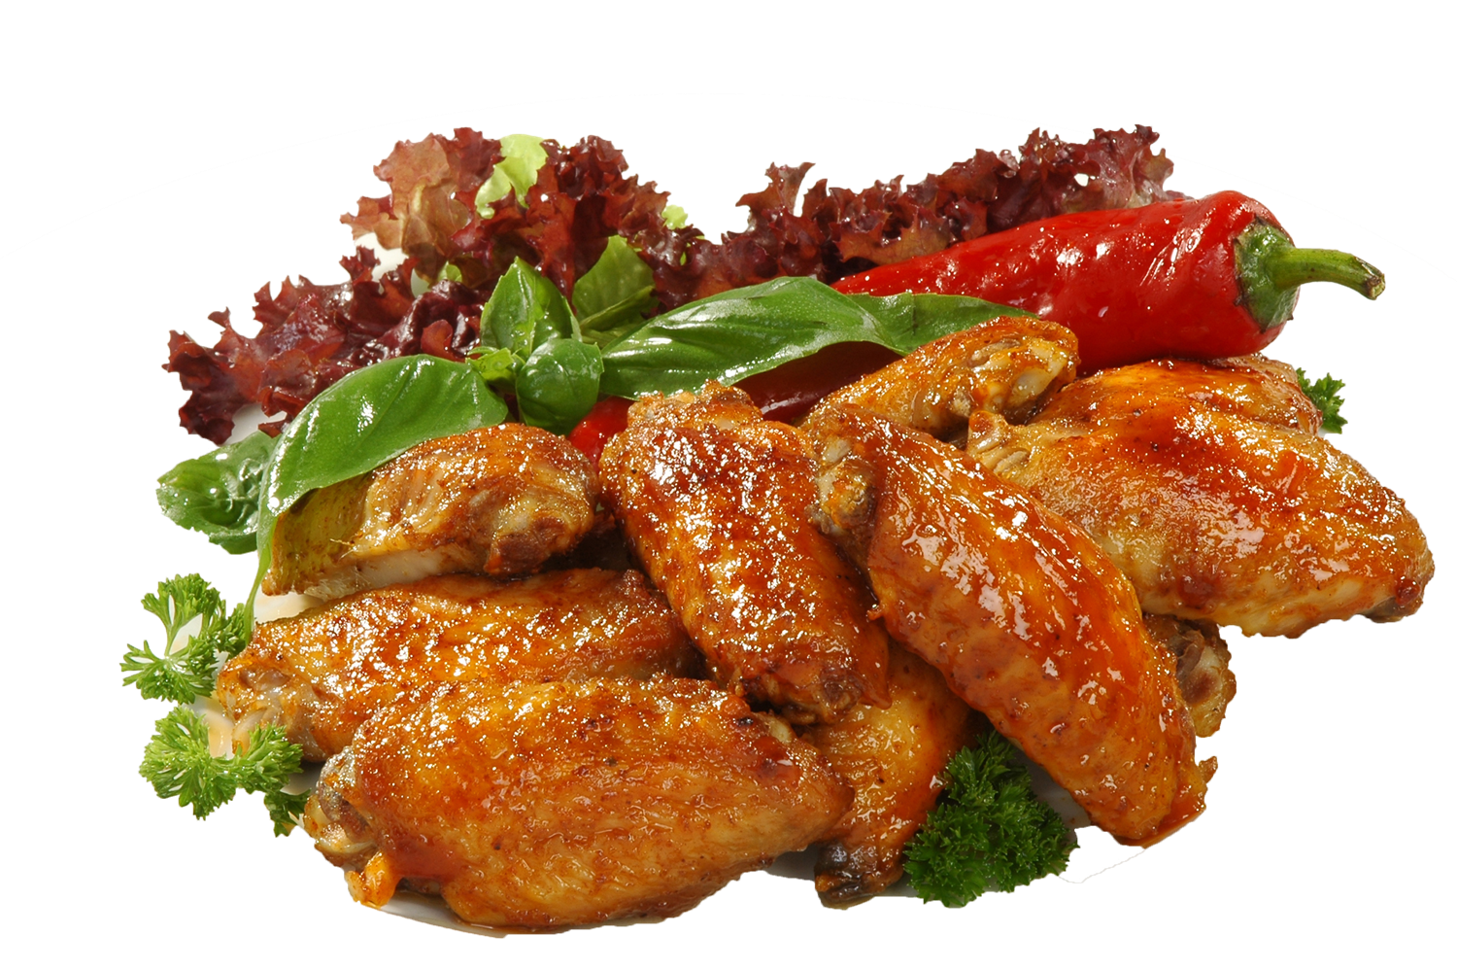
1KG
This Sweet and Spicy Chicken is the perfect combination of a sweet and spicy chicken meal.
This chicken is a perfect dinner for your family.
$15
Sweet & Spicy Chicken Meal!

Slide 3
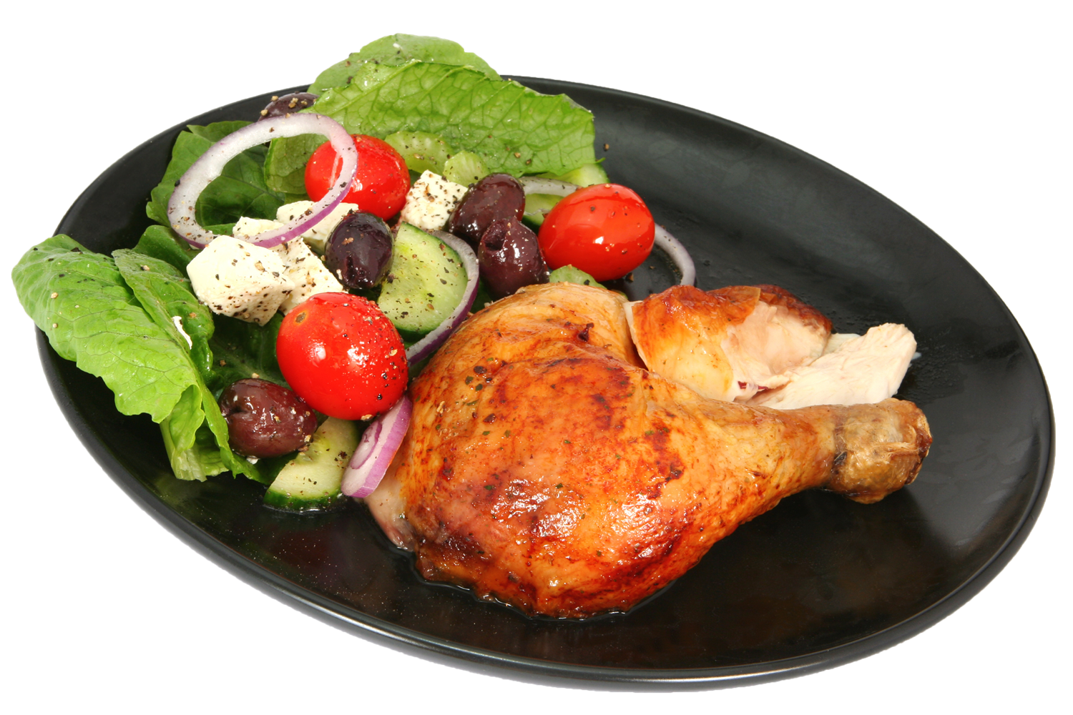
500 Gm
$10
What can be better than a grilled chicken with big fresh salad? This is a simple meal that can be reinvented numerous ways.
Grilled Leg
Piece

Slide 4
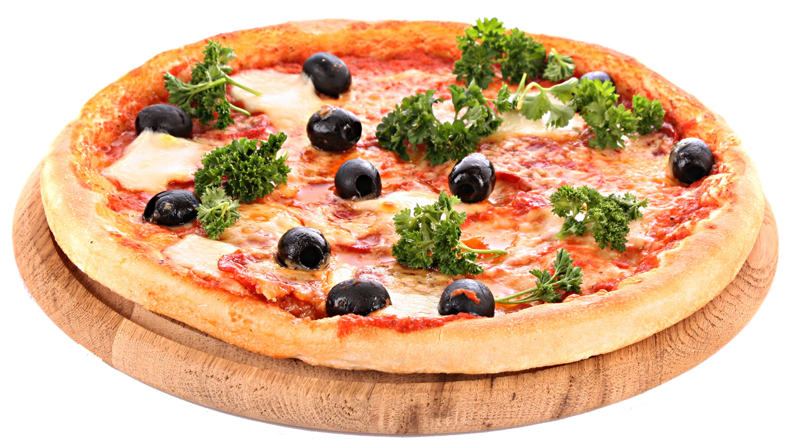
Large
The fabulous special cheesy pizza that your family will love.
$12
Special Cheesy
Pizza

Slide 5
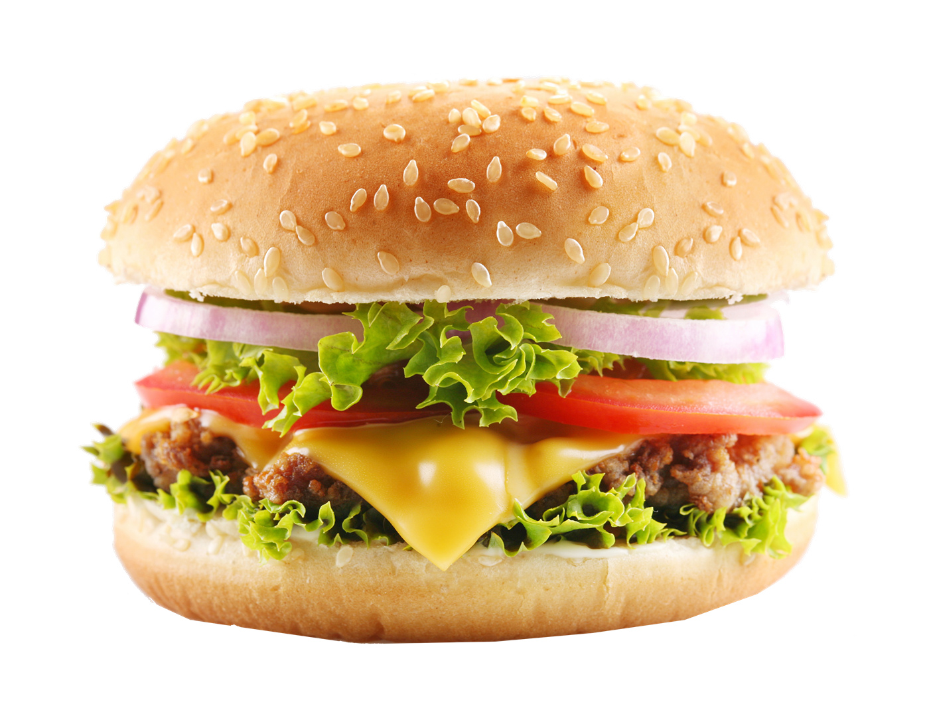
Cheese
$8
Satisfy your cravings with the big cheesy burger with lettuce, tomato and onion.
Big Cheesy Burger

Slide 6
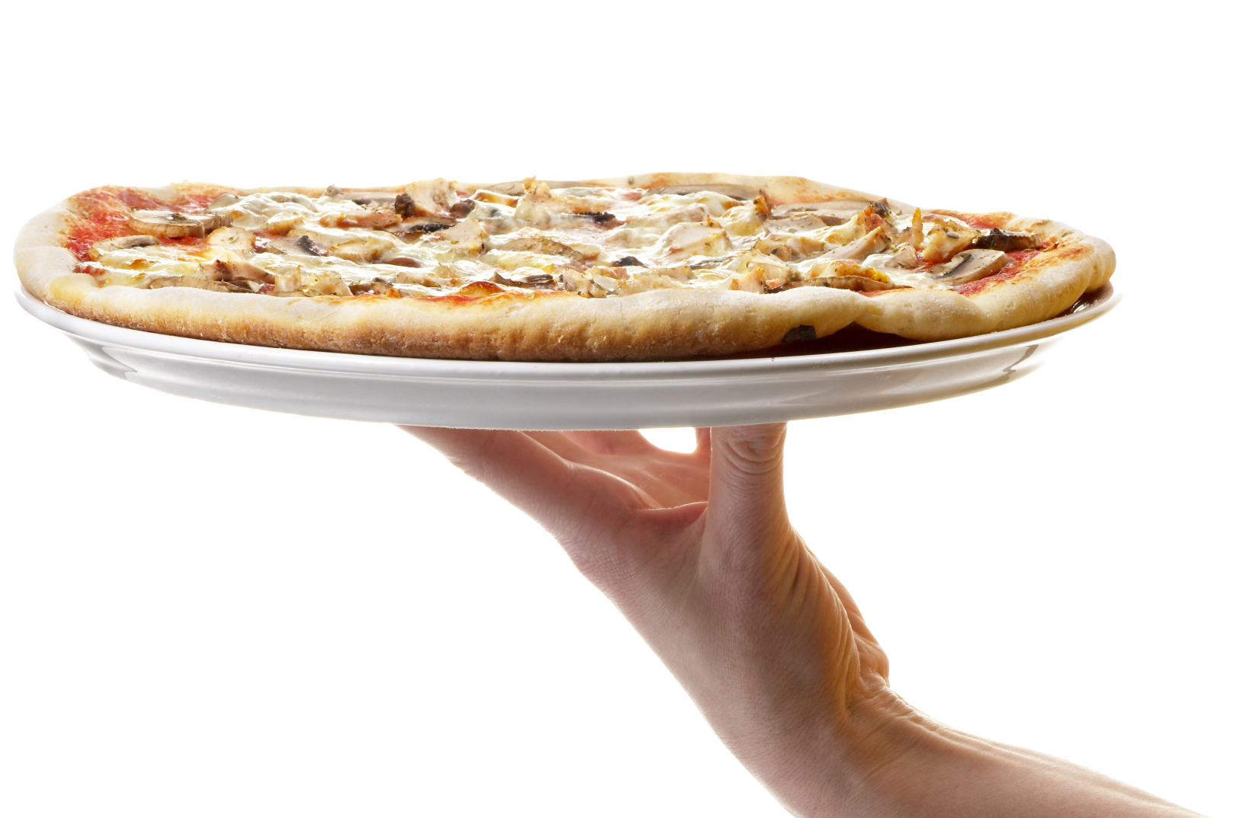
Large
A delicious pizza made using our fresh dough topped with pizza sauce, with garlic dip and mozzarella cheese.
$9
Special Garlic
Pizza

Slide 7
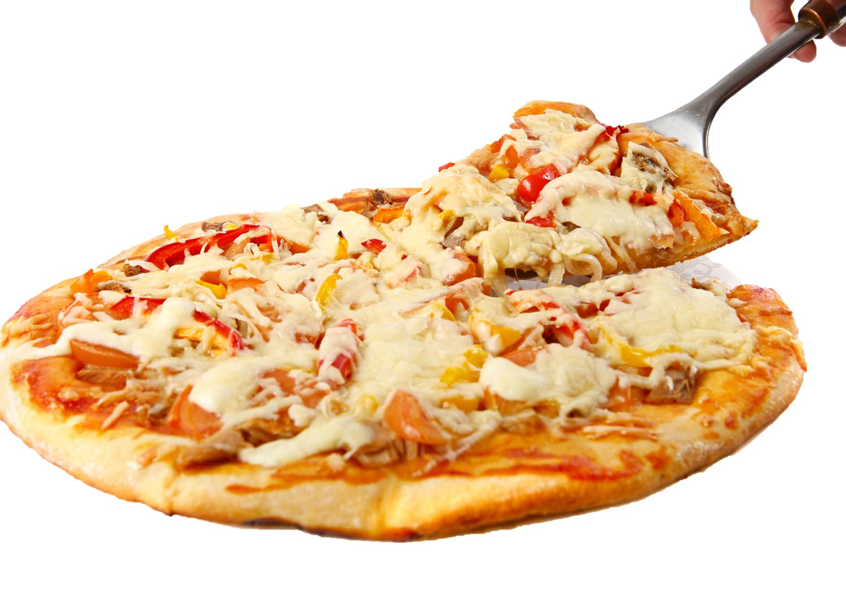
Cheese
$10
Our best seller pizza dough topped with beef, tomato salsa, bell pepper and delicious taco toppings
Mexican Taco Pizza

Slide 8
DEAL
Sweet and Spicy garlic, chicken with lemon juice, parsley and oil—that's all it takes to make the best dressing. You'll be surprised with the taste. Served with bottomless iced tea.
$12
Special Deal Dinner

Slide 9
Cheese
$12
Your lunch will be special if you taste this special cheeseburger with beef patties with cheese, onions, tomatoes, lettuce and tomato ketchup in a bun.
Special Lite Lunch

Slide 10
You’ll Love it!
A-315, 567, Pizzichicklicious, USA
09123456789

